Slide 2
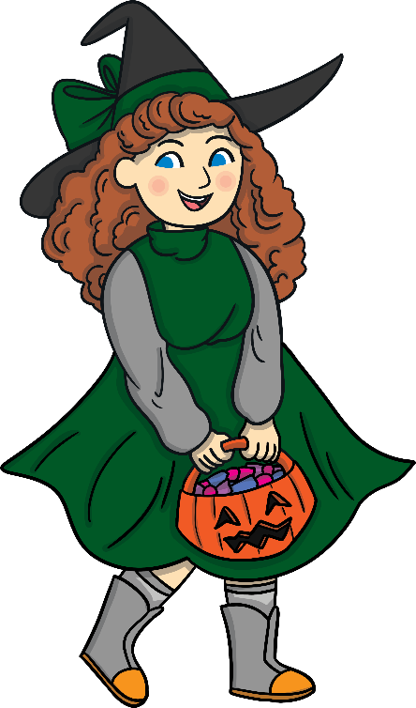
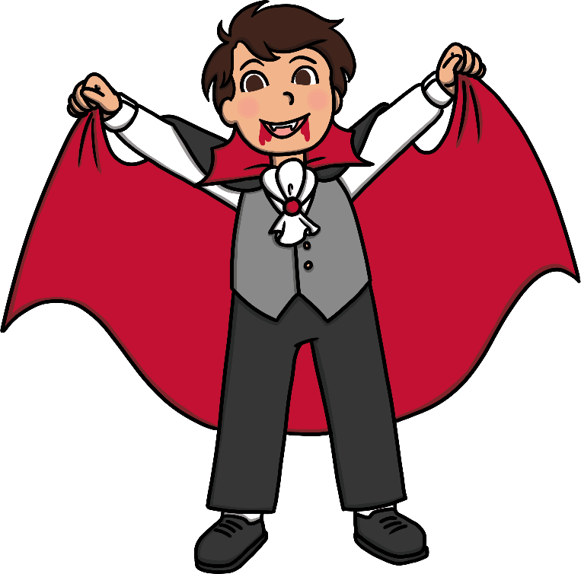
Where are we?
You were trick-or-treating with your friends on Halloween and you decided to visit the spooky haunted house on the hill. You slowly walked up the long path and rang the doorbell. The creaky door swung open. Without thinking, you crept inside in search of treats. Just then, the door slammed shut behind you with a bang! You tried to open it but found it was locked. You could be locked in the haunted house all night!
The only way to escape is with the correct door code. Solve the puzzles in the house to find the clues and reveal the keypad code needed to open the door.

Slide 3
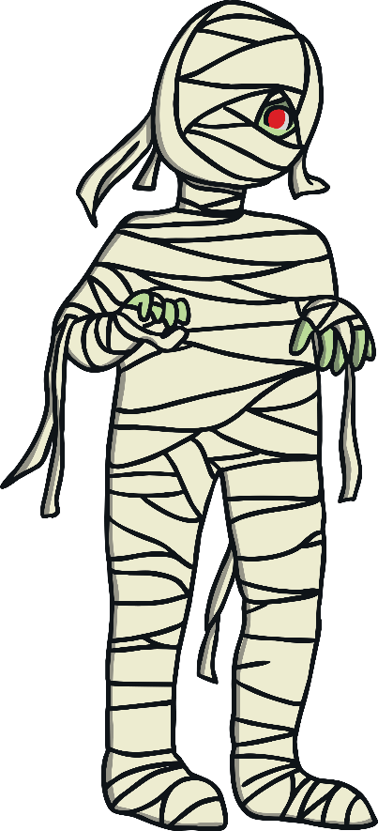
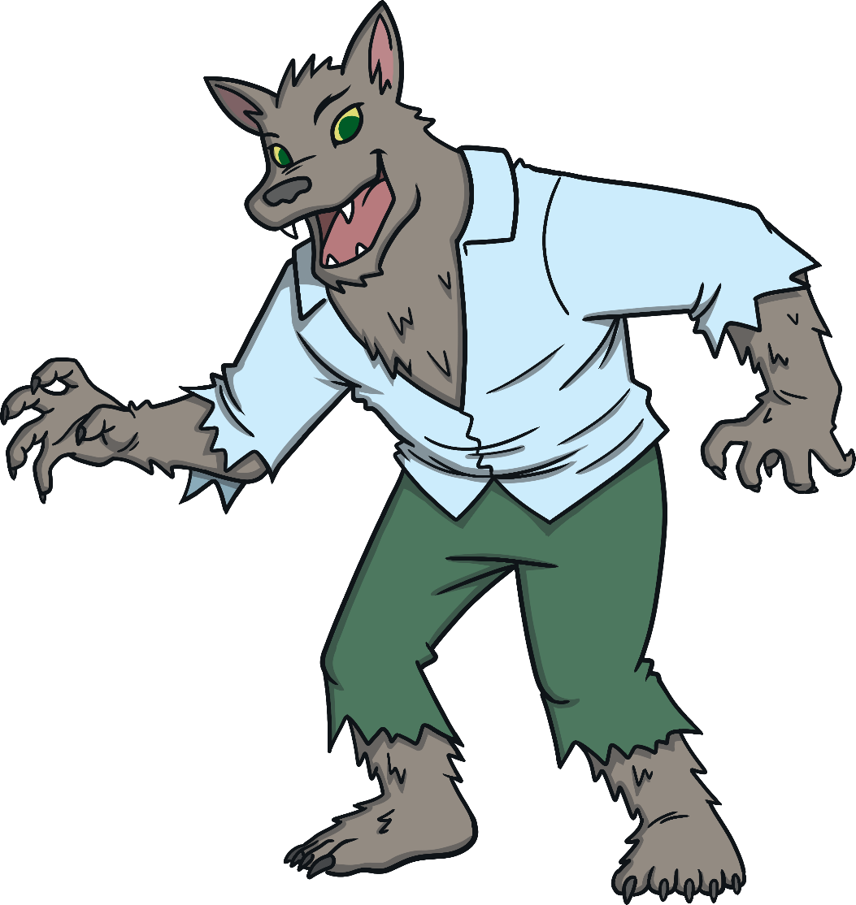
Rules
You can work in small groups.
Work together to solve the clues as you find them.
Record your answers on a piece of paper.
Solve all eight clues to reveal the keypad code.
Check your answer with your teacher and find out if you can escape the haunted house!

Slide 4
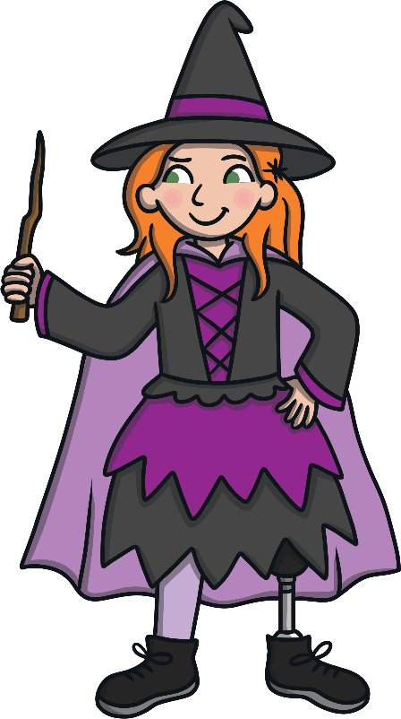
Creepy Clue 1
Follow the arrows and answer the questions about the picture to get the first number in the code to escape the haunted house
What costume is she wearing?
Witch costume
Zombie costume
What color is her dress?
What color are her eyes
Black and Orange
Black and purple
Green
Blue
What is she holding?
Is she wearing a cape?
Does she have a cat?
Is she wearing a hat?
Spider
Wand
Yes
No
Yes
No
Yes
No
1
2
3
4
5
6
7
8

Slide 5
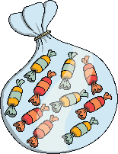
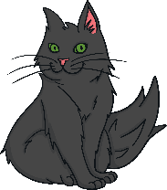
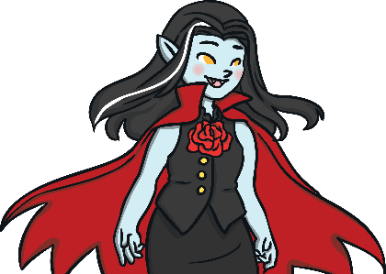
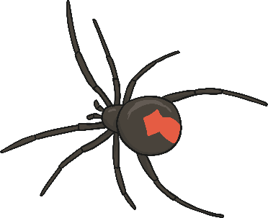
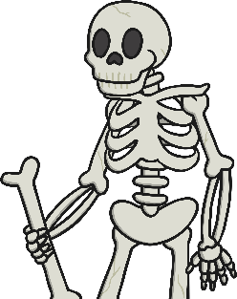
Creepy Clue 2
Spell out each word then use the purple letter to spell the hidden word and find the second clue
1
3
Practice
Surprise
5
Practise
2
4
Practice
Solstice

Slide 6
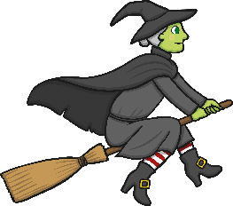
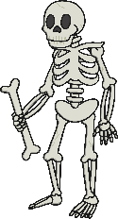
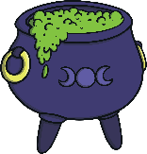
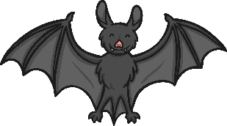
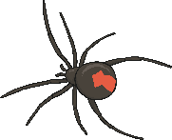
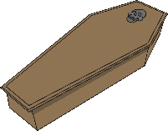
Creepy Clue 3
Count the objects. Whichever picture is the most common is the answer.
1
2
3
4
5
Spiders
Witches
Bats
Ghosts
Skeletons

Slide 7
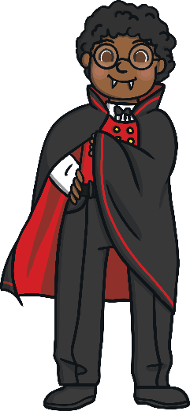
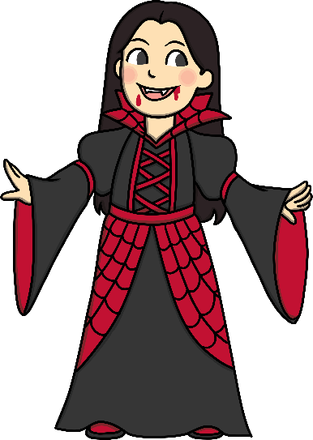
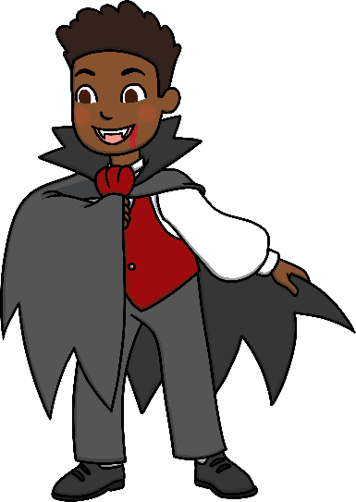
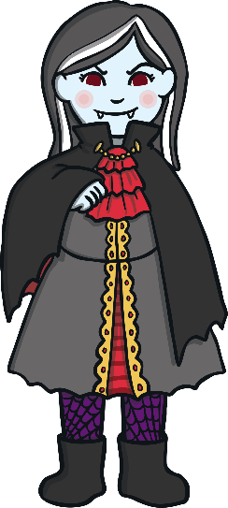
Creepy Clue 4
Read the description and guess who Ben is.
Ben is a 10 year old boy. He is really excited to wear his vampire costume for Halloween. His costume is black and red with a white shirt underneath. He has short curly black hair and he wears glasses. Who is Ben?
1
2
3
4
5

Slide 8
Creepy Clue 5
Unscramble the letters to make a Halloween word or phrase. Which word is not in the puzzle?
1
potions
Yummm
2
black cat
Olfwerew
Labck tac
3
Trick or treat
Ckitr ro taert
4
werewolf
5
mummy

Slide 9
Creepy Clue 6
What is being described?
Clue 1: I fly at night.
Clue 2: I love dark places.
Clue 3: People think I drink blood.
Clue 4: But I mostly eat insects and fruit!
1
3
vampire
zombie
5
ghost
2
4
bat
witch

Slide 10
Creepy Clue 7
What is this?
Y
24
Z
25
A
0
B
1
X
23
C
2
W
22
D
3
V
21
E
4
U
20
F
5
T
19
G
6
S
18
H
7
R
17
I
8
Use the 4th letter to find the number you need
Q
16
J
9
P
15
K
10
O
14
L
11
N
13
M
12

Slide 11
Creepy Clue 8
What colours are associated at Halloween?
Red, green and blue
Green, orange and purple
What is celebrated in Mexico instead of Halloween?
Where does Halloween come from?
Ireland, the UK and France
The USA
Dia de los muertos
Dia de los gatos
Do people sing Christmas carols on Halloween?
Is Halloween in November?
Do kids eat more vegetables on Halloween?
Do kids wear costumes on Halloween?
Yes
No
Yes
No
Yes
No
Yes
No
1
2
3
4
5
6
7
8

Slide 12
Keypad Code
3
5
3
2
1
4
3
6
Click on the rectangles to reveal the digit

