Slide 2
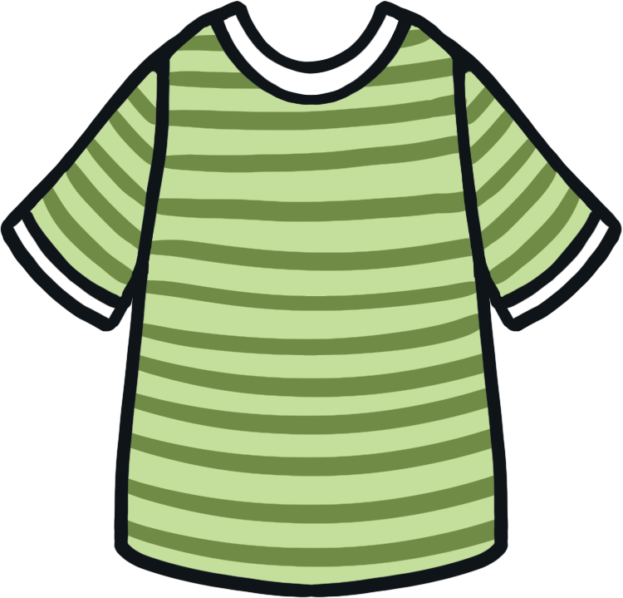
How can we say this in English?
Answer
?
?
Answer
?
?
?
?
T-shirt

Slide 3
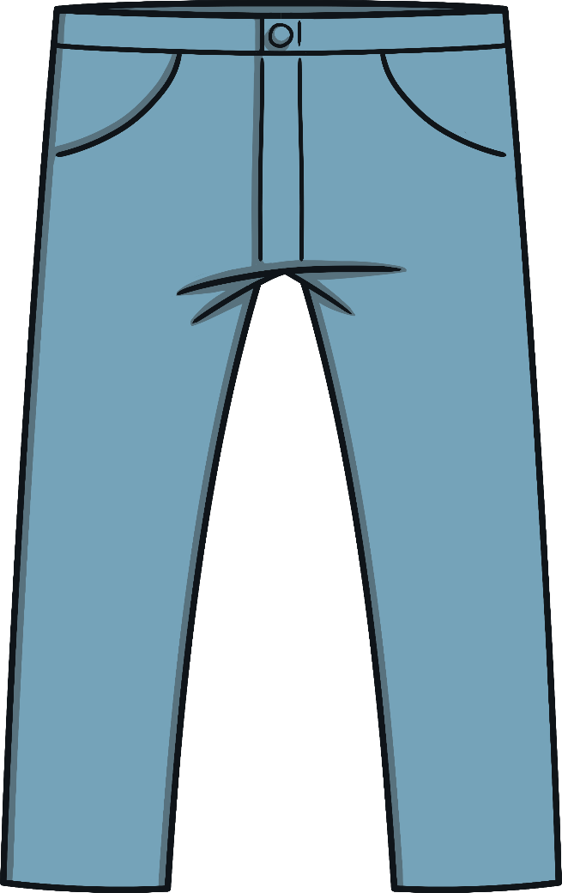
How can we say this in English?
Answer
?
?
Answer
?
?
?
?
Trousers

Slide 4
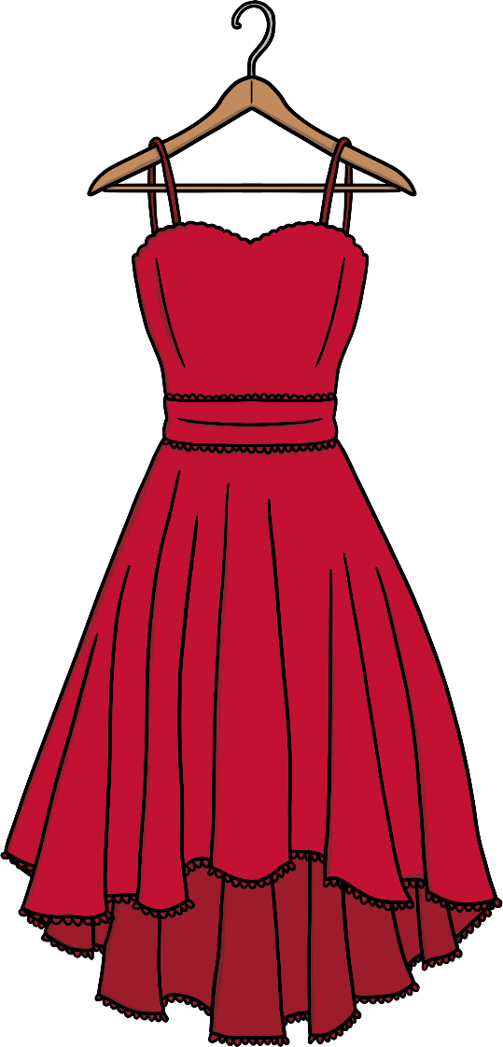
How can we say this in English?
Answer
?
?
Answer
?
?
?
?
Dress

Slide 5
How can we say this in English?
Answer
?
?
Answer
?
?
?
?
Hat

Slide 6
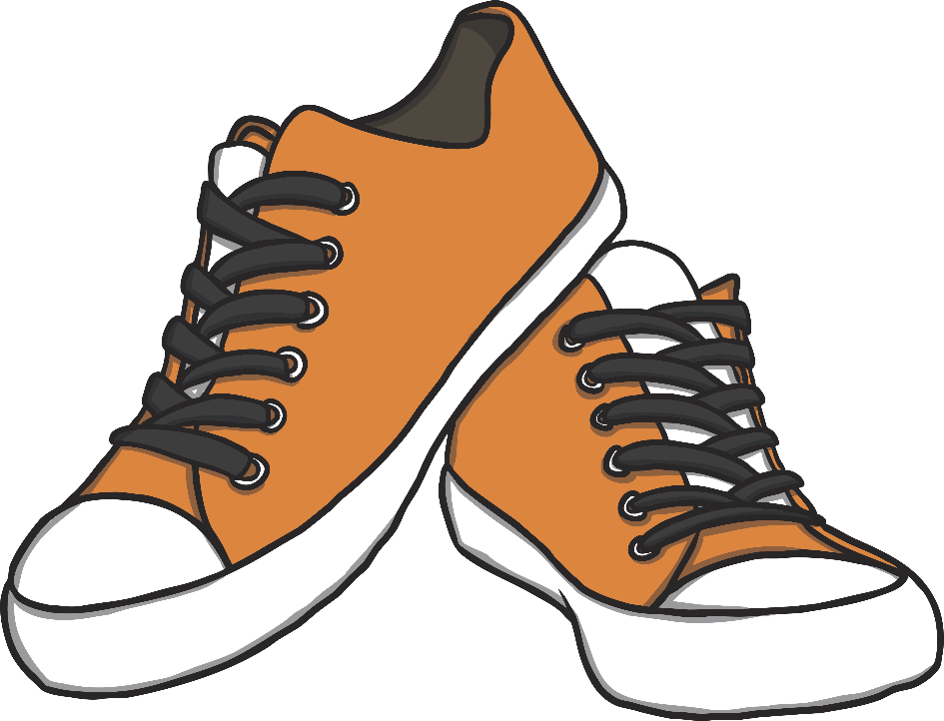
How can we say this in English?
Answer
?
?
Answer
?
?
?
?
Shoes

Slide 7
How can we say this in English?
Answer
?
?
Answer
?
?
?
?
Skirt

Slide 8
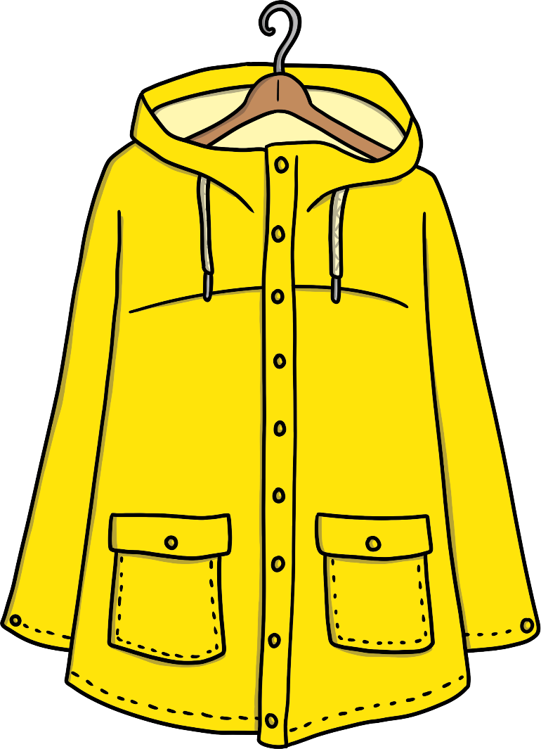
How can we say this in English?
Answer
?
?
Answer
?
?
?
?
Jacket

Slide 9
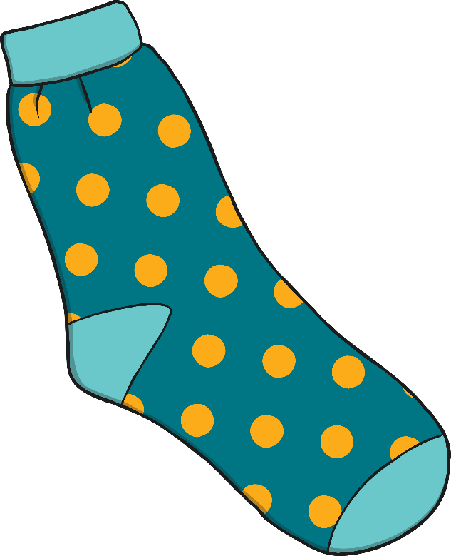
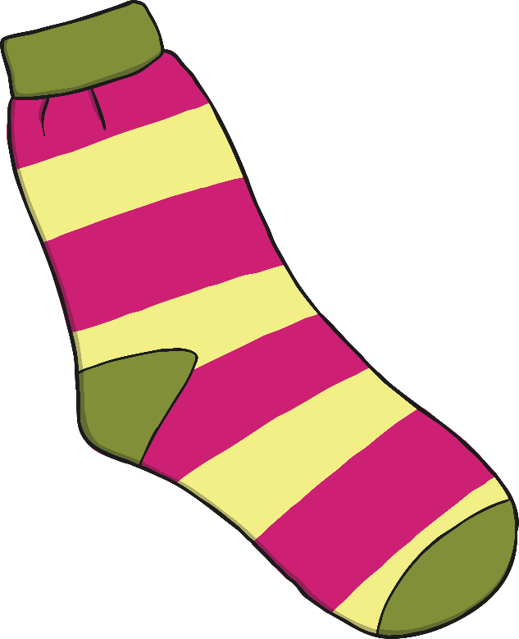
How can we say this in English?
Answer
?
?
Answer
?
?
?
?
Socks

Slide 10
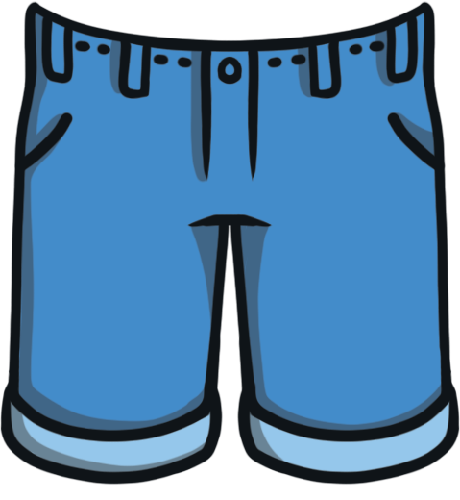
How can we say this in English?
Answer
?
?
Answer
?
?
?
?
Shorts

Slide 11
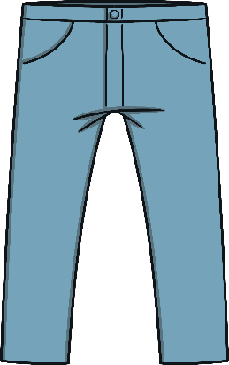
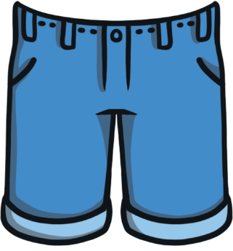
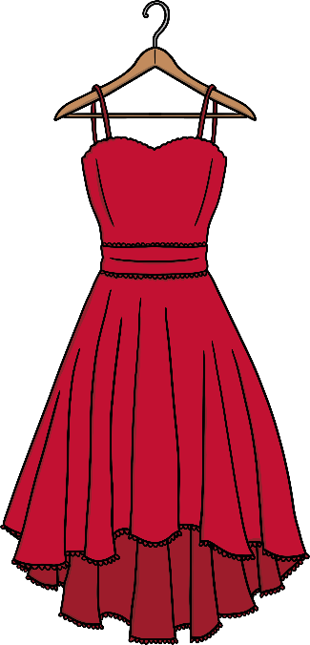
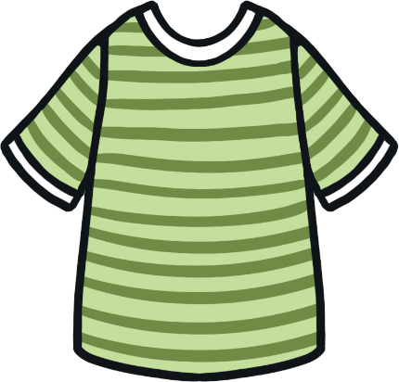
Let’s Practice

Slide 12
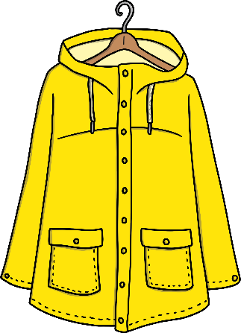
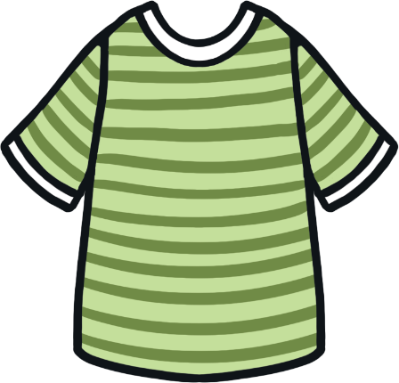
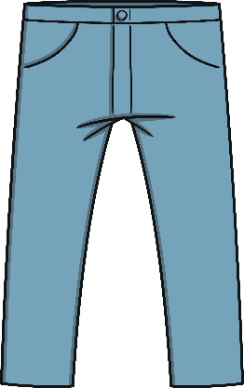
What are they wearing?

Slide 13
What is he wearing?
?
T-shirt

Slide 14
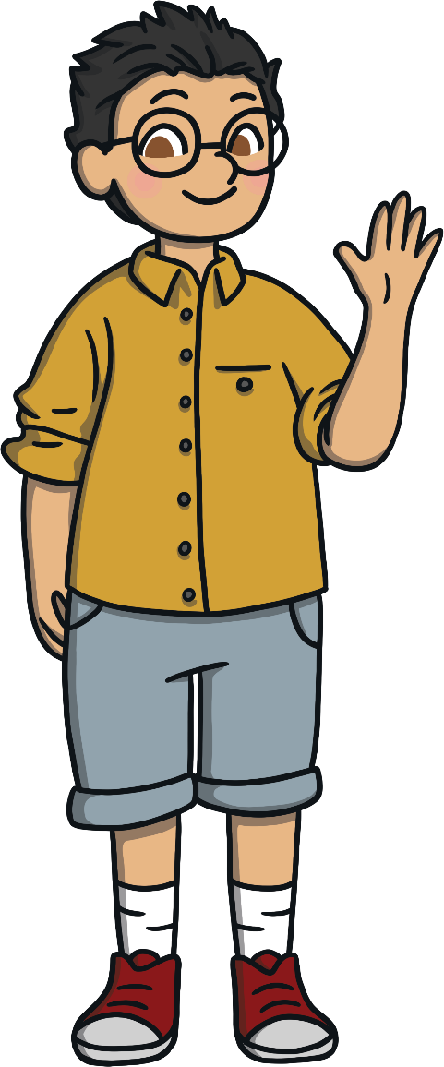
What is he wearing?
?
Shorts

Slide 15
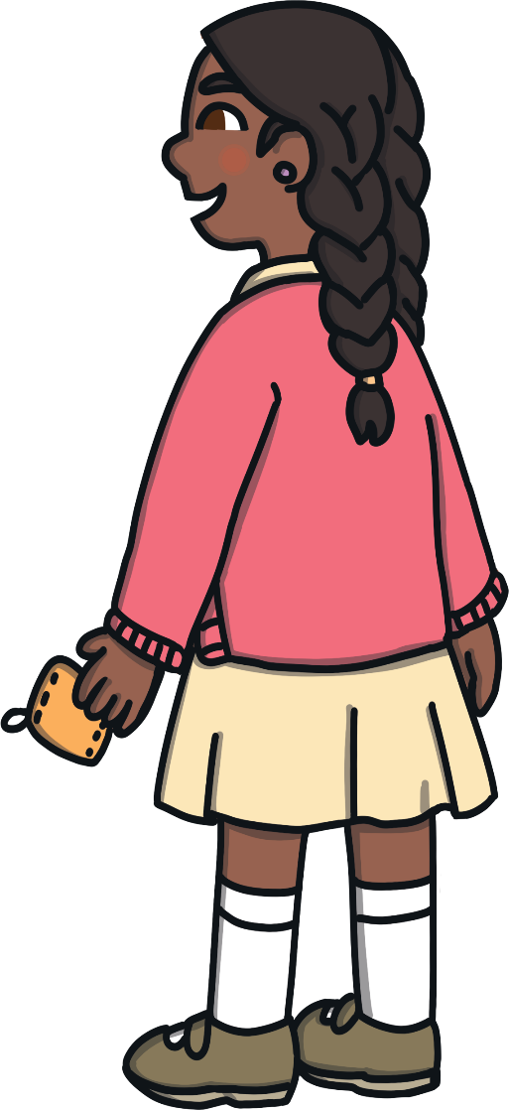
What is she wearing?
?
Skirt

Slide 16
What is she wearing?
?
Dress

Slide 17
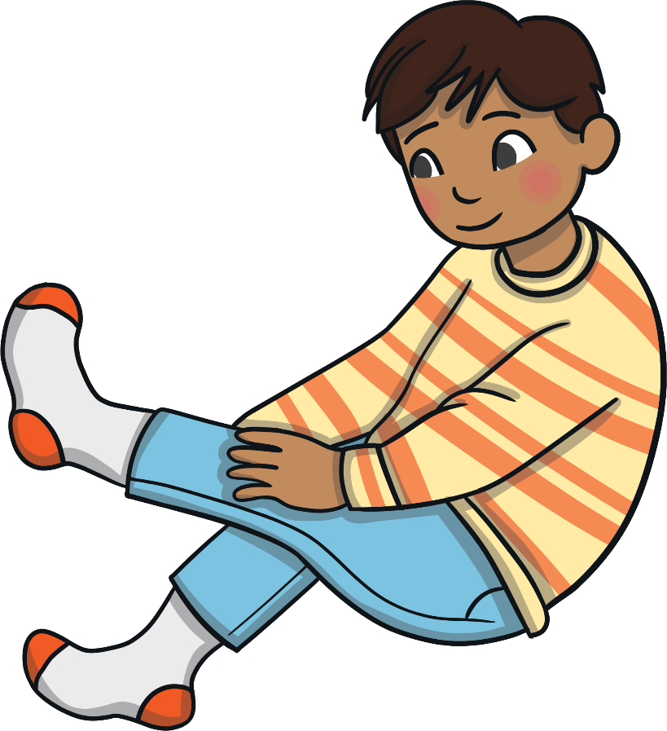
What is he wearing?
?
Socks

Slide 18
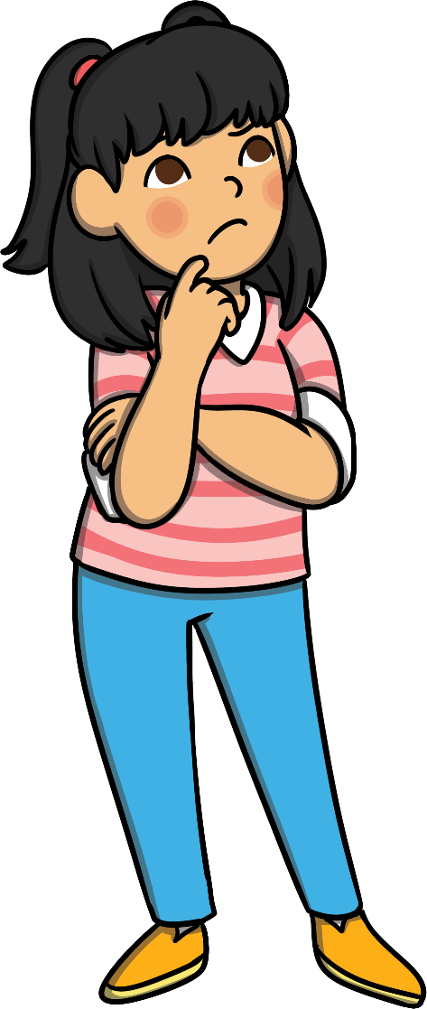
What is she wearing?
?
Trousers

Slide 19
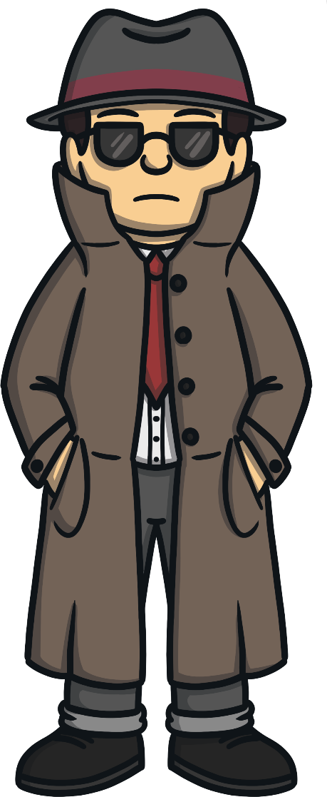
What is he wearing?
?
Hat

Slide 20
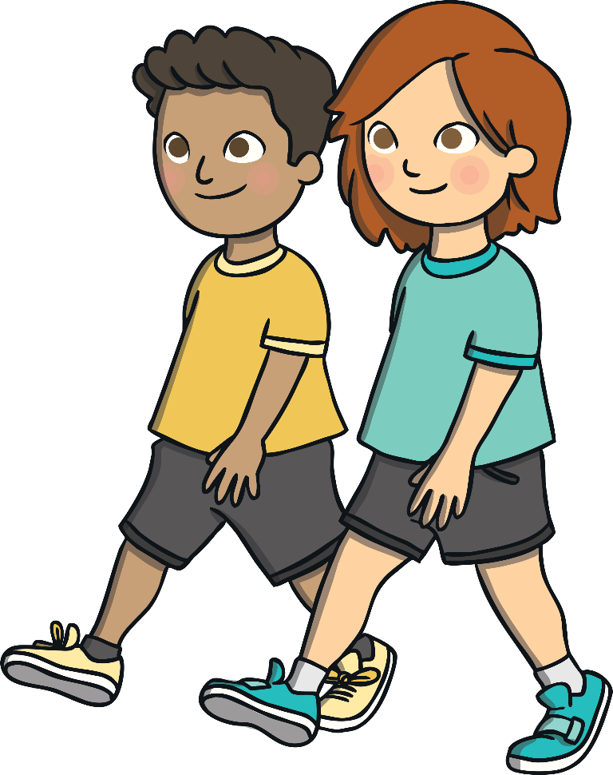
What are they wearing?
?
Shoes

