Slide 1
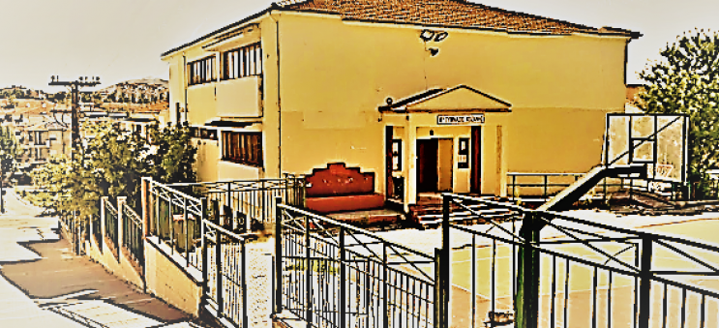
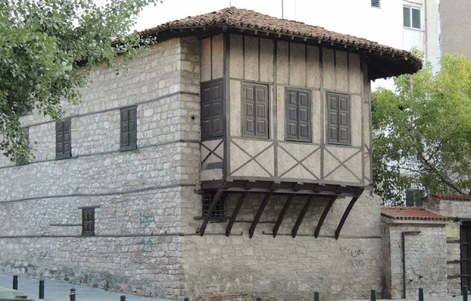
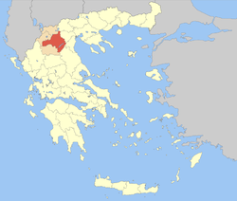
8th Junior High School
Kozani, Greece
Welcome to Kozani
Welcome to our school
Welcome to our lives

Slide 2
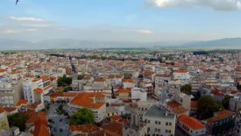
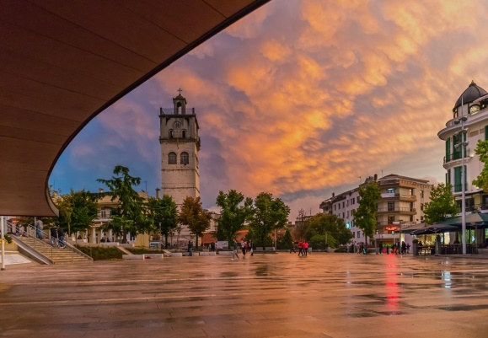
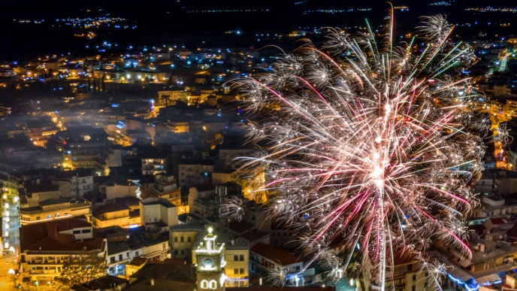
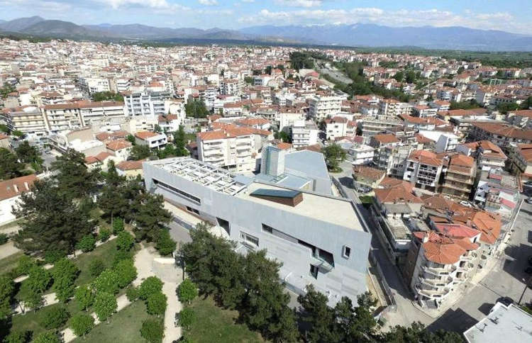
The city of Kozani
Kozani (Greek: Κοζάνη, pronounced [koˈzani]) is a city in northern Greece. It is located in the western part of Macedonia, in the northern part of the Aliakmonas River valley. The city lies 710 metres above sea level in a plateau surrounded by mountains.
Kozani was founded by Christian settlers who, after the Ottoman conquest, withdrew from the plains of Macedonia into the mountains, during the 14th and 15th centuries. The population of the city of Kozani is over 70,000 people. The climate of the area is continental with cold and dry winters, and hot summers.
Kozani is the home of the University of Western Macedonia, with about 15,000 students from all over Greece and other places.

Slide 3
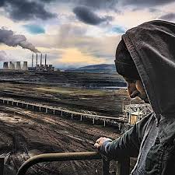
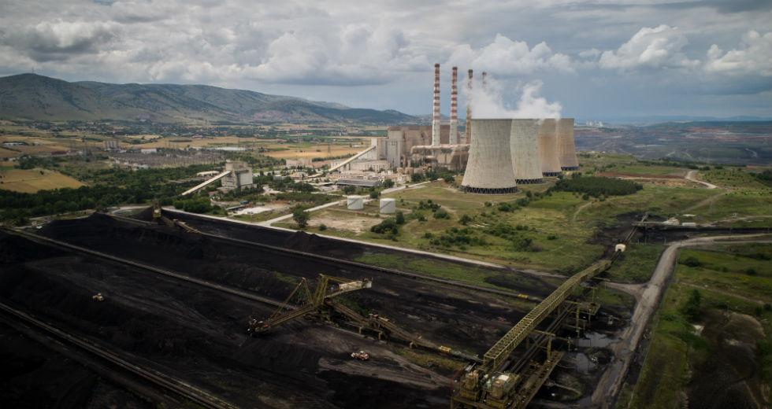
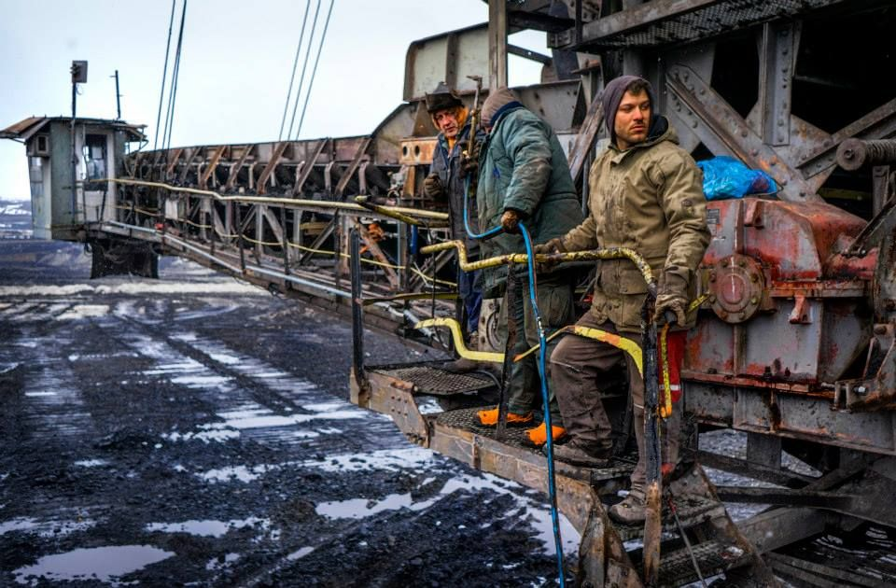
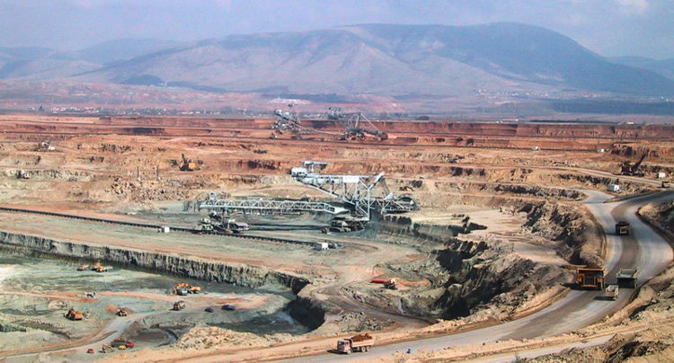
The region of Kozani is highly industrial and is mostly known for its important contribution to the Greek electricity supply.
A large part of the population works in the Public Power Corporation. The area is rich in lignite and it hosts the Western Macedonia Lignite Center, which is accountable for the production of 40% of the electric energy of the country.

Slide 4
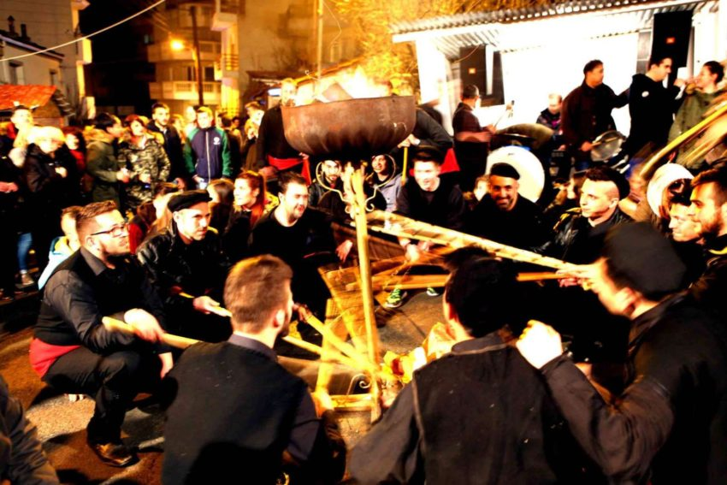
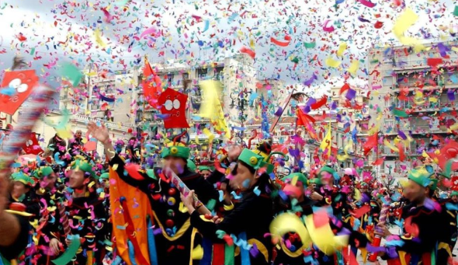
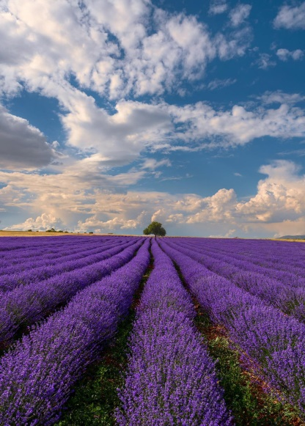
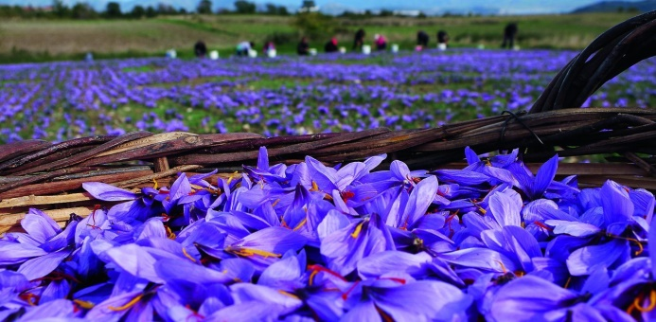
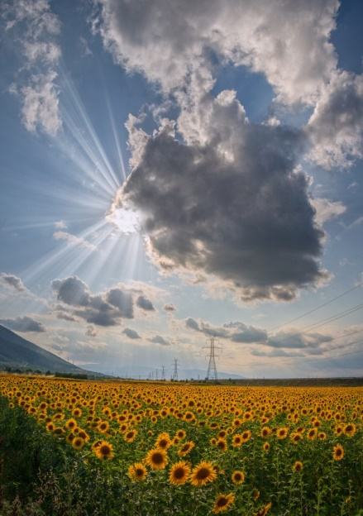
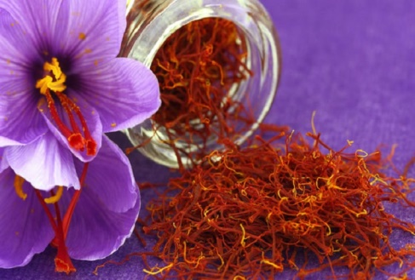
One of the most important aspects of local folklore is Kozani's carnival at the end of the winter, which retains much of the profanity of the ancient Dionysiac cult. Kozani is renowned in Greece and abroad for the production of saffron (Krokos Kozanis), in the nearby town of Krokos, but also lavender and sunflowers.

Slide 5
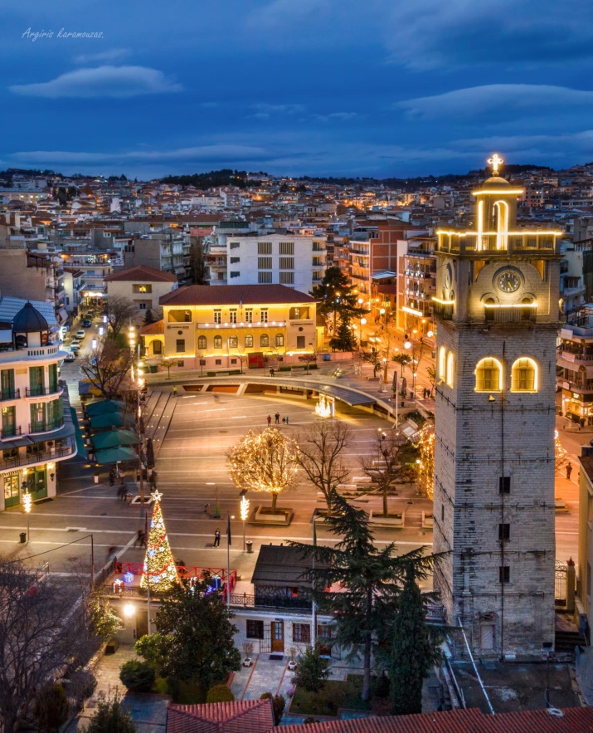
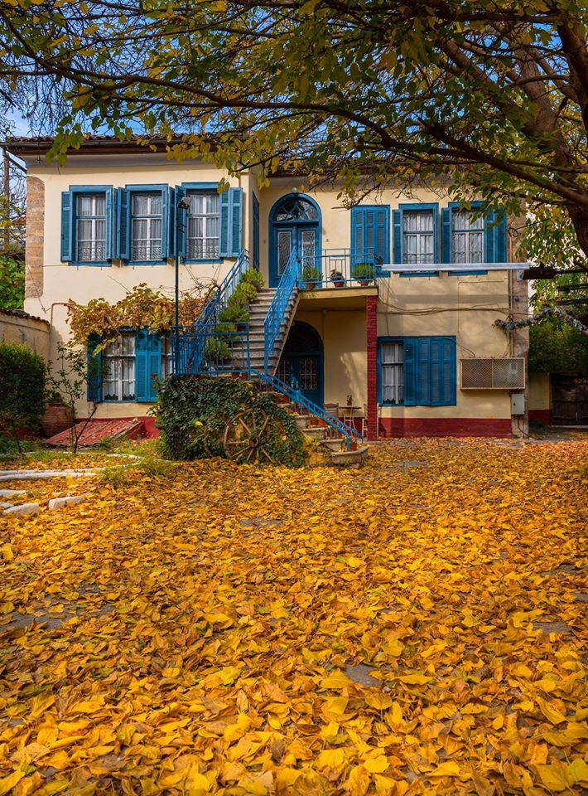
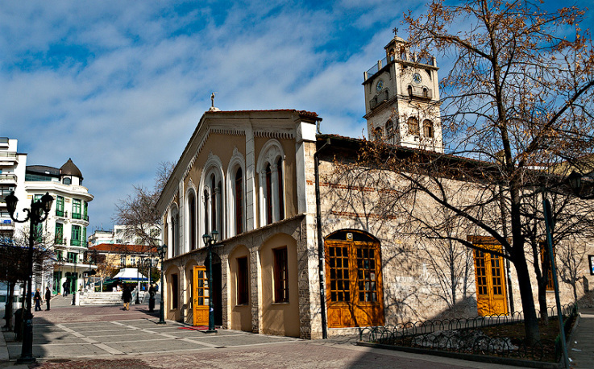
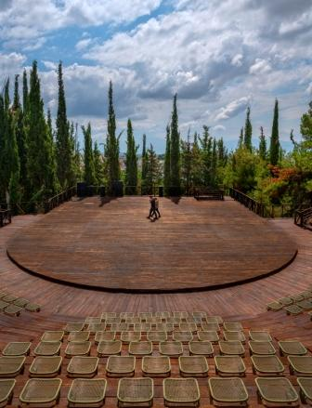
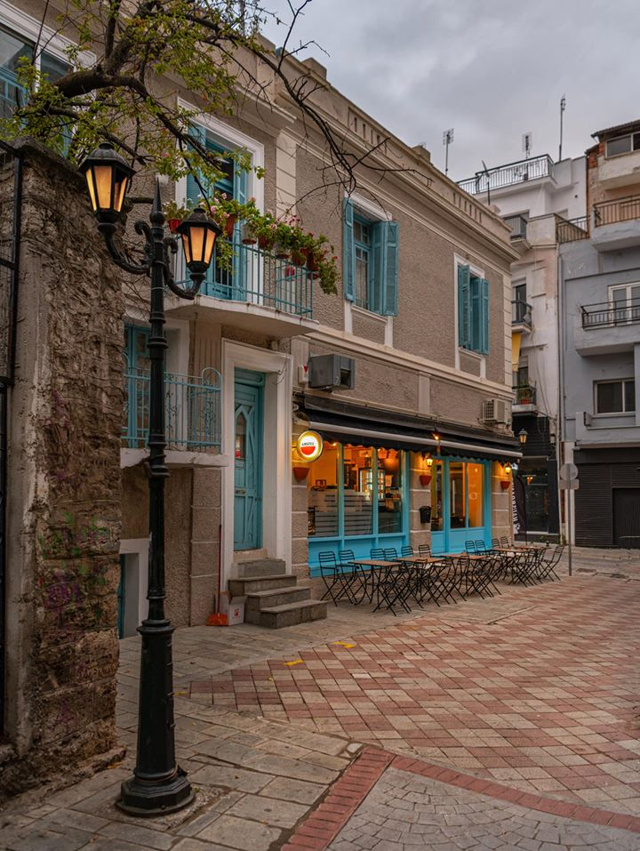
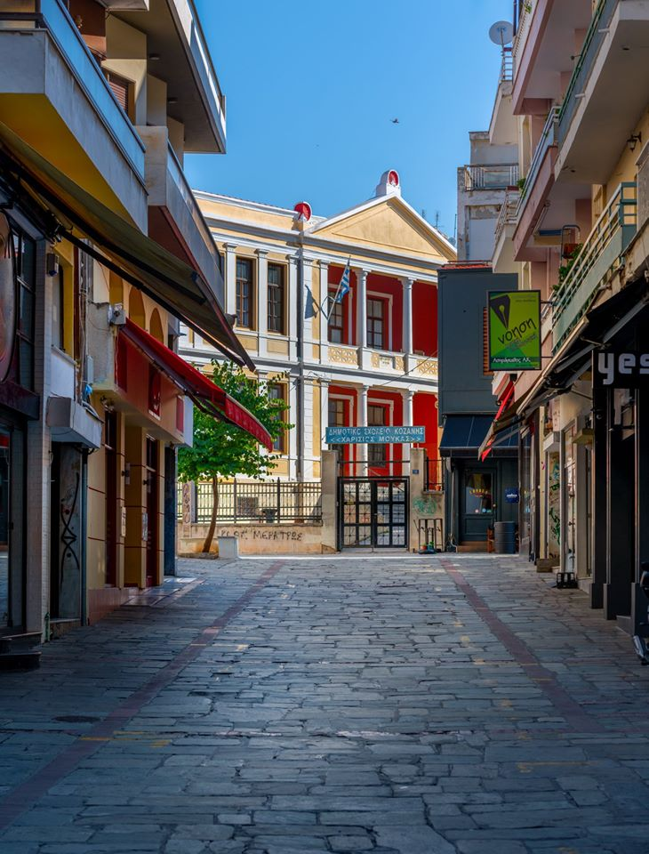
Some pictures of our town! And now a few things about us!

Slide 6
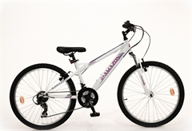
Hi, my name is Katerina Tsiara and I am 13 years old. My hobbies are drawing and cycling.
My favorite color is blue and I am a fan of Panathinaikos football team.
Two subjects I like are mathematics and biology.

Slide 7
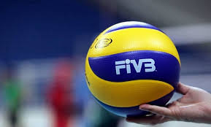
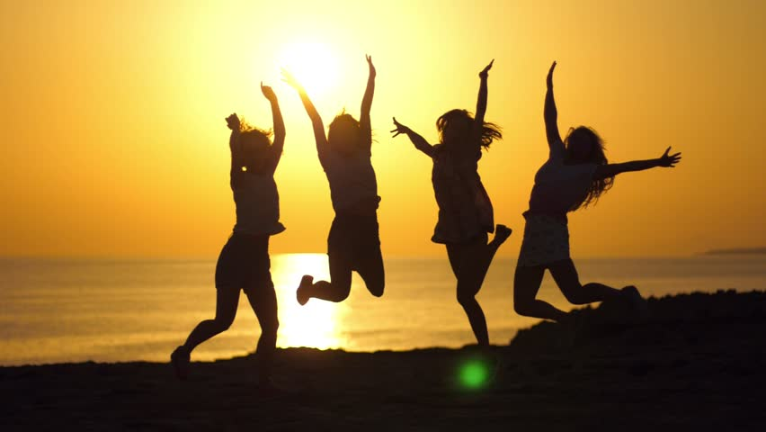
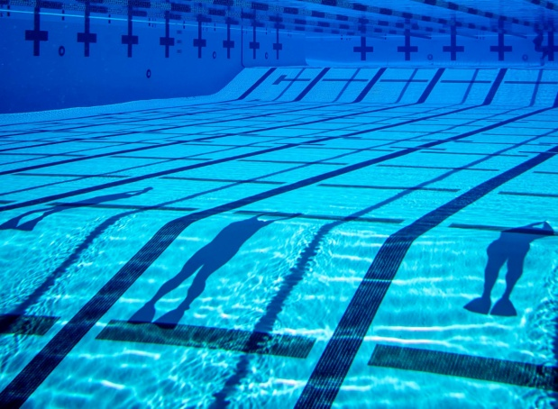
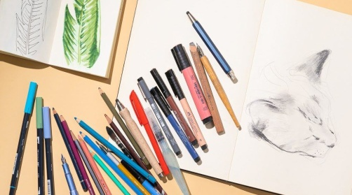
Hello!!My name is Irene Ziganitidou and I am 13 years old. I am a high school student and I go to 8th Junior High School. I live in Greece, in a small town in the north, called Kozani . My favorite subject is biology . In my leisure time I take walks with my best friends and we have fun. Also in my free time I like to draw and I listen to music. I play volleyball and I like swimming.

Slide 8
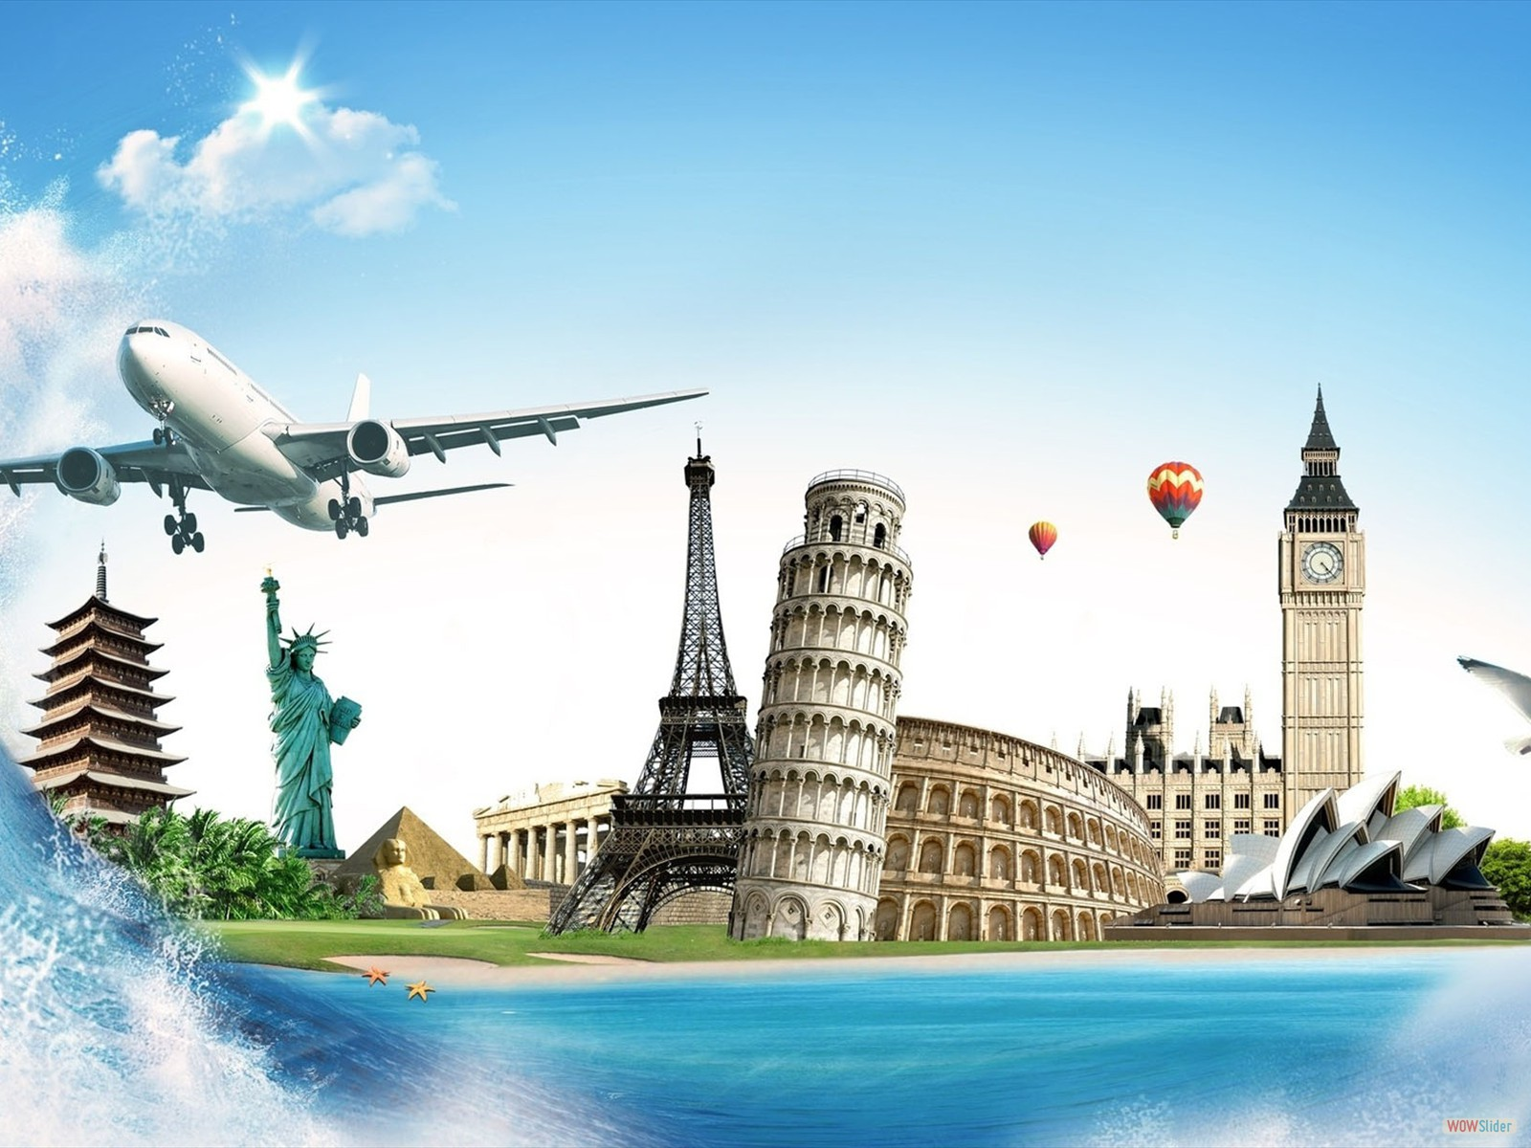
Hello everybody,
I’m Sophia Papazisi and I am 13 years old.
I am a student of the second grade in the 8th Junior High School of Kozani and some of my favorite subjects are maths and biology.
I love playing basketball, so I have joined a basketball team.
I also like running and cooking.
I am fun of Olympiakos football team and enjoy watching games when Olympiakos plays.
When I grow up I want to be a doctor.
In the future I want to travel to many countries.

Slide 9
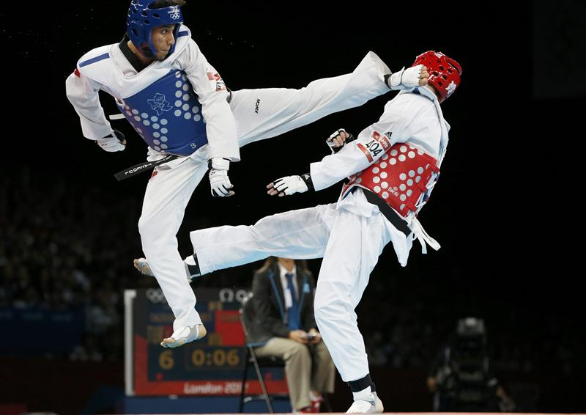
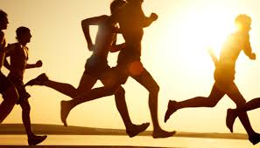
I am Nikos Rousis.
I am a student in the second grade of 8th Junior High School.
My hobby is TaeKwonDo.
My favorite subject is physical education.
My favorite football team is PAOK.

Slide 10
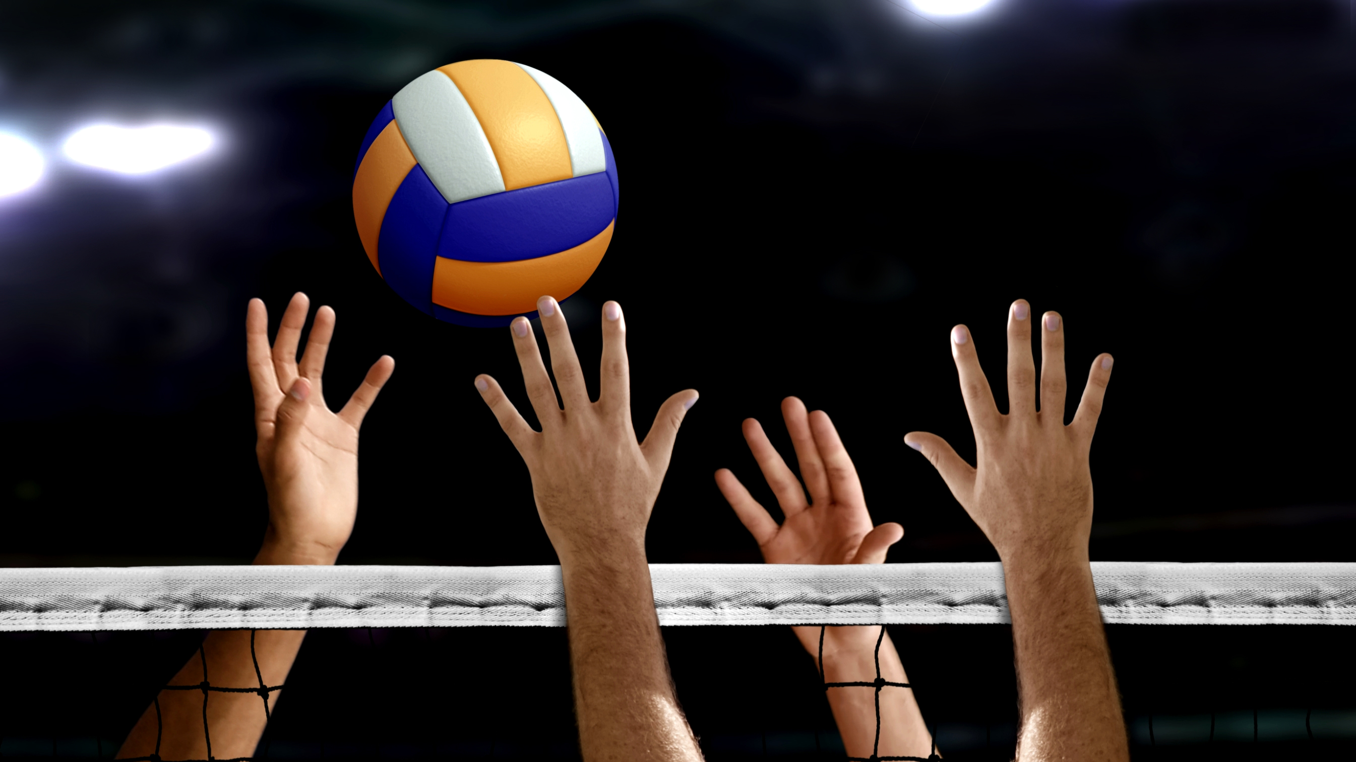
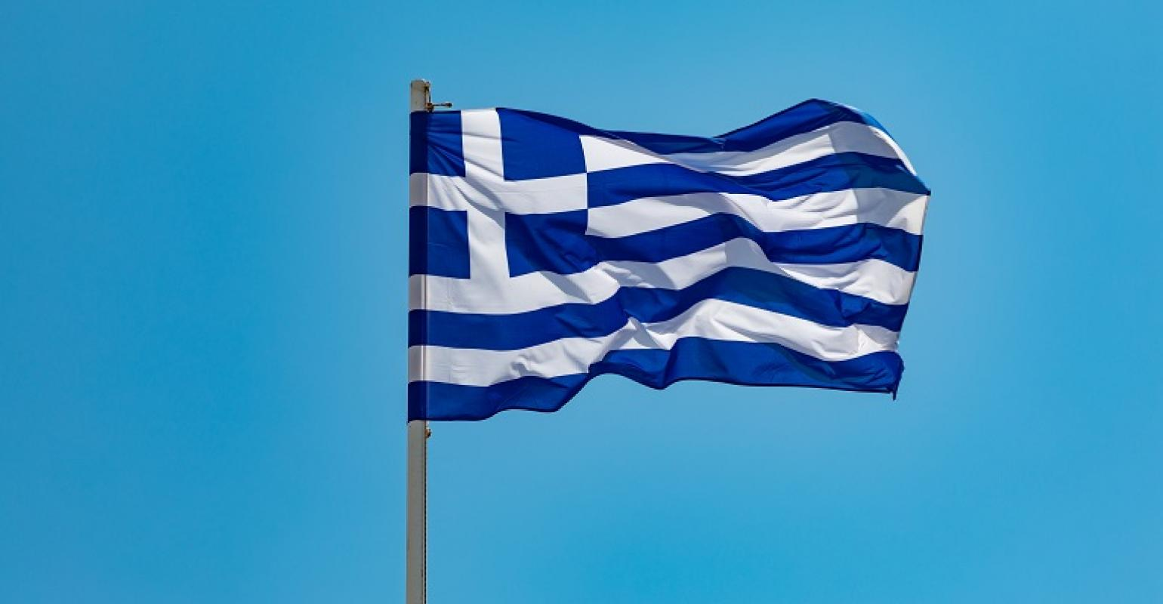
Hello! My name is Sophia Salakidou and I am 13 years old. I'm a high school student. I go to the 8th high school of Kozani - Greece. My favorite subject is literature. I play volleyball and I like learning foreign languages.

Slide 11
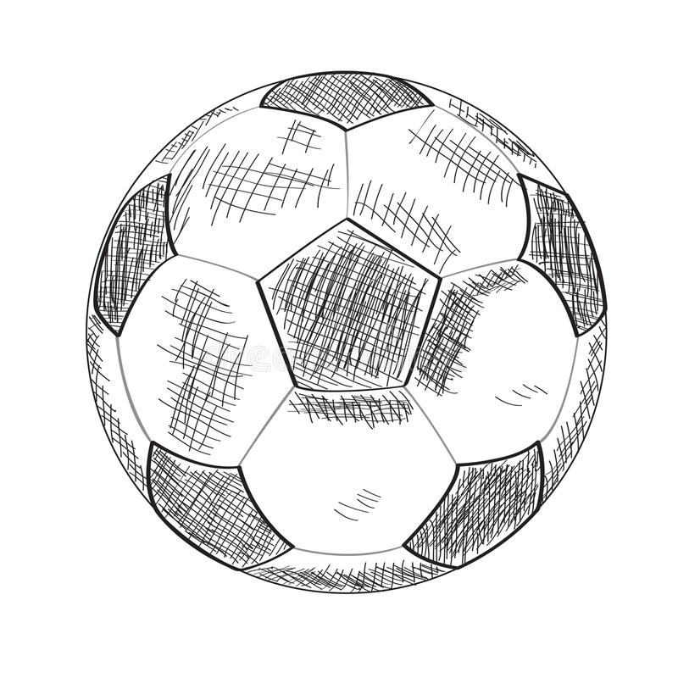
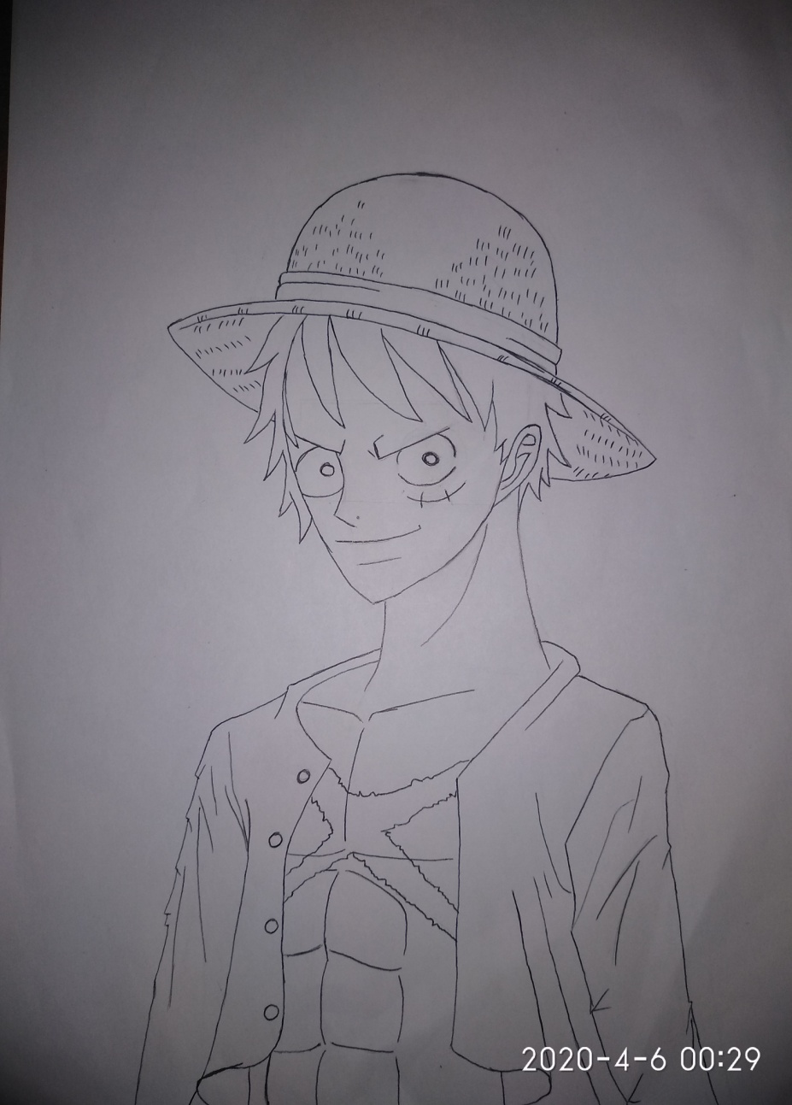
I am Marinos-Argyris Farmakis. I go to the 2nd class of high school. My hobbies are football and working-out. I also like playing videogames and listening to boom bap music. I adore watching anime and action movies, like Avengers… My favorite movie is ”Guardians of the Galaxy“, while my favorite anime is ”One piece“ and my favorite band is ”Logos Timis“. What is more in my free time I draw or I take care of my pets.

Slide 12
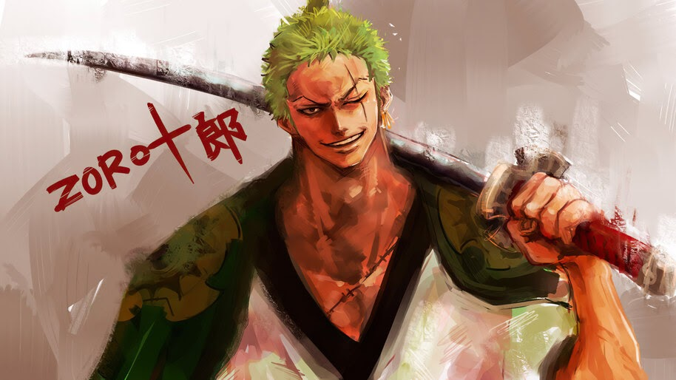
My name is Thomas- Marios Farmakis I go to the second grade of high school My favorite sport is football In my spare time I like reading books I love watching anime and playing video games What I like the most at school is physical education My favorite football teams are PAOK and Bayern Munich

Slide 13
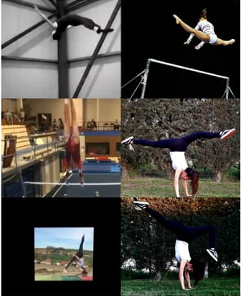
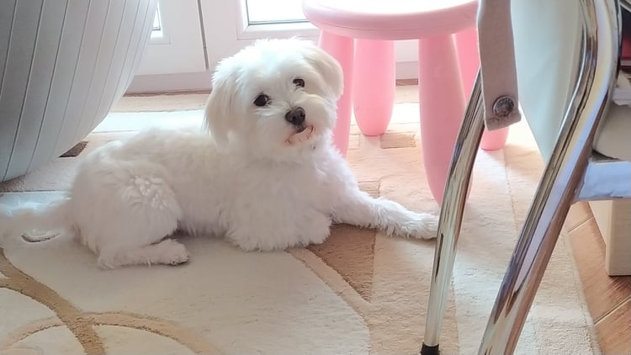
Hello everyone,
My name is Evi, I am 13 years old and I ‘m in the second grade of the 8th Junior High School of Kozani.
My favorite subject is maths.
My hobby is gymnastics and I’ve been doing this since I was 5 years old.
I am an only child, but I have a dog, named is Timos.
I do not often watch football but if you ask me I will say Olympiakos is my favorite team.
I like rollers and I also like cycling and listening to music.

Slide 14
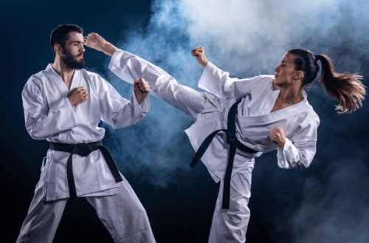
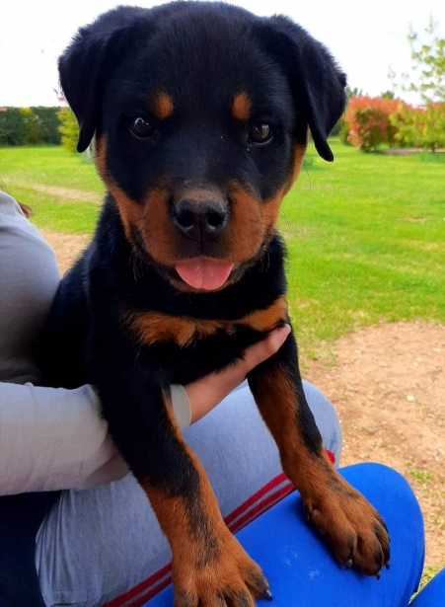
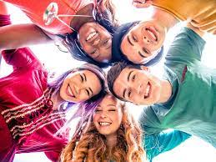
Hello, my name is Argyro.
I am in the second year of Junior High School.
My favorite subjects are biology, maths, literature and of course Physical Education.
I prefer spending my free time listening to music, hanging out with my friends and playing with my dog.
I do karate and the team i like most is Olympiakos.

Slide 15
My name is Manolis Maloutas.
My favourite game is League of Legends
My favourite subject is history
and I like watching movies.

Slide 16
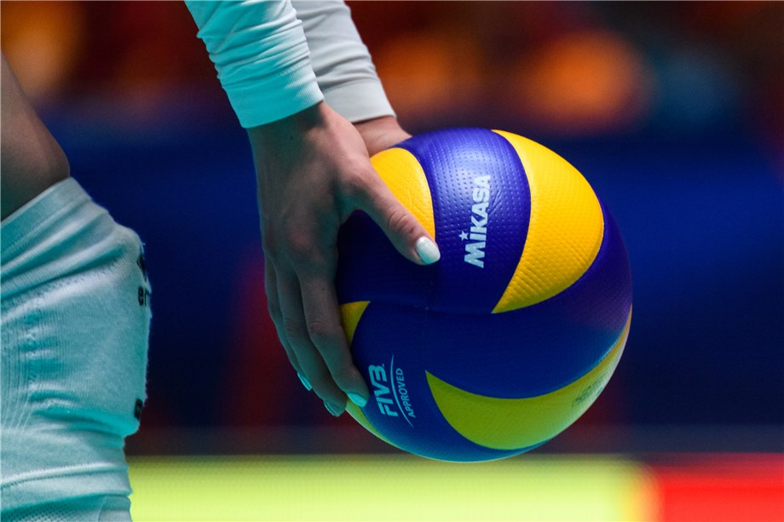
Hello! My name is Maria Koiou! I am 13 years old. I’m a high school student and I live in Kozani, Greece. My favorite subject is the history. In my free time I like to play volleyball and hung out with my friends.

Slide 17
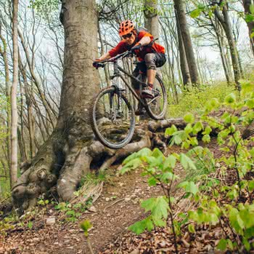
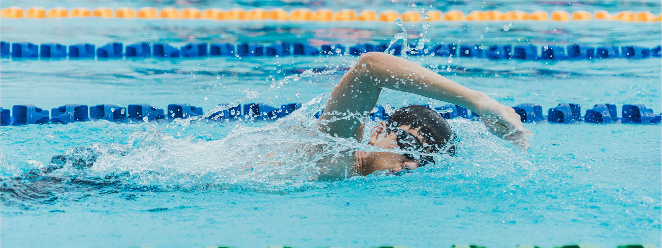
My name is Vangelis Ntinas. I am in the second grade of high school.
My favorite school subject is the mathematics.
My hobby is cycling and swimming

Slide 18
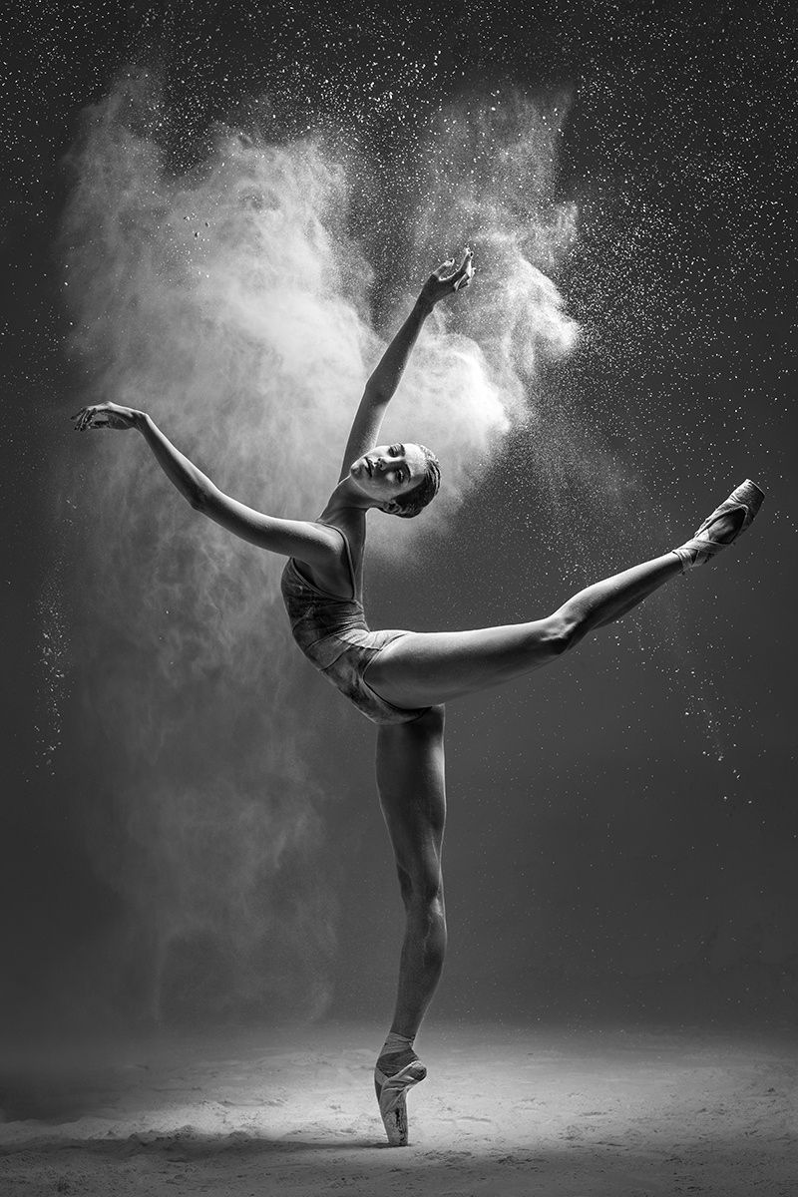
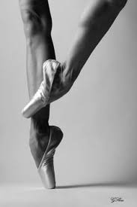
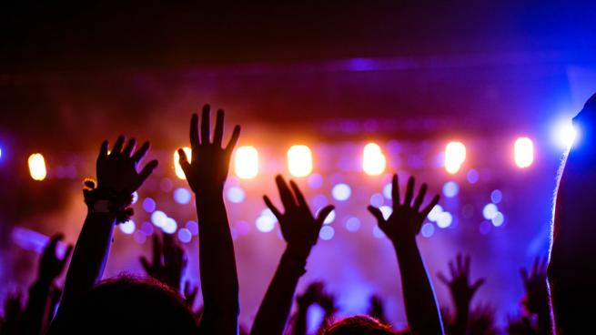
Hello! I am Stella Tsiami.
I am a student of the second grade and my hobby is dancing.
My favourite subject is mathematics.
I love listening to music.

Slide 19
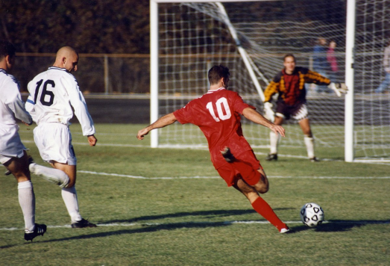
My name is Vaggelis Trompoukis I am from class B1.
My hobby is football.
My favourite subject is chemistry.
My favourite football team is Paok

Slide 20
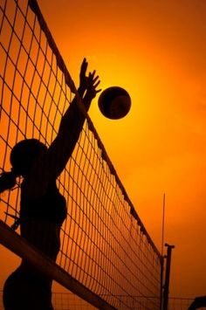
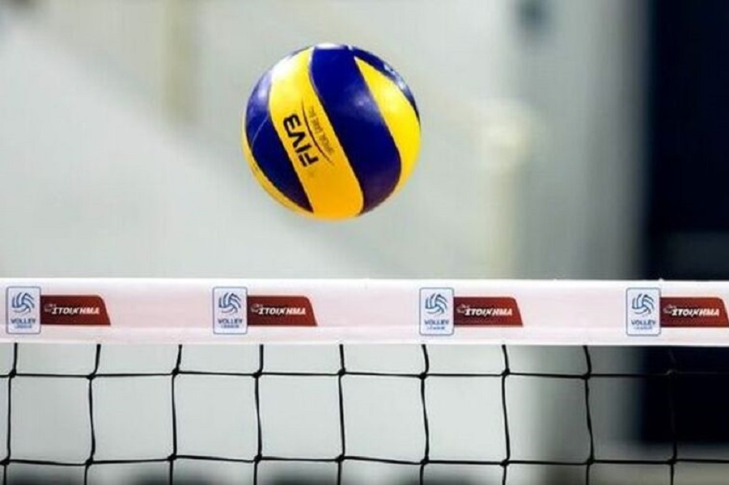
My name is Vagia Antoniadi. I am high school student. I love volleyball and I play very often. In my free time I like to go for walks with my friends.

