Slide 1
Past Continuous

Slide 2
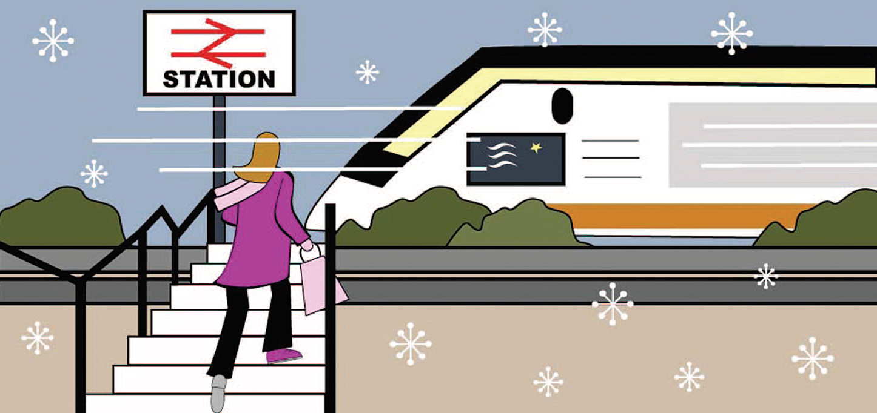
It was winter. I was staying with my grandparents at the time. One day I needed to go to London. My grandparents offered to drive me to the station. It was snowing and the traffic was moving really slowly so I decided to get out and walk. As I arrived at the station the last passengers were getting on the train. I ran to the platform, but it was too late. The train was leaving the station.

Slide 3
USE
Use the past continuous to talk about actions and situations in progress at a particular moment in the past:
It was snowing and the traffic was moving really slowly.

Slide 4
USE
You also often use the past continuous to describe the background to a story:
It was winter. I was staying with my grandparents at the time.
Do not use the past continuous with stative verbs: I needed … (not I was needing.)

Slide 5
Key time words
When/as to introduce a momentary Past Simple action
When she arrived at the platform, the train was leaving the station.
While/as to introduce a long lasting action in progress/ a Past Continuous action
While I was driving to work I crashed into another car.

Slide 6
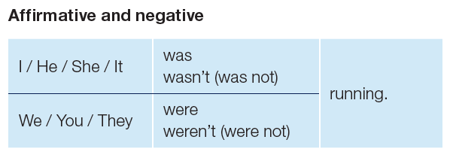
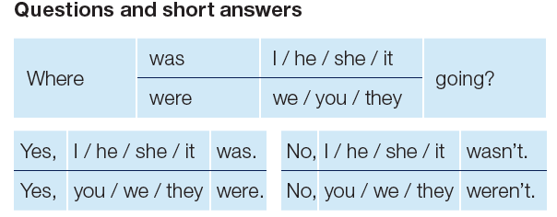
FORM

Slide 7
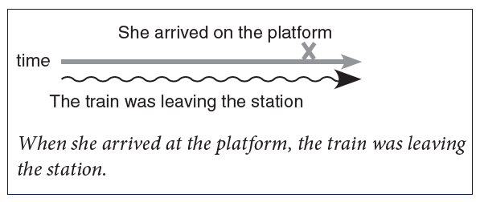
Past continuous and past simple
Use the past continuous to talk about the action which was already in progress.
Use the past simple to talk about a second, shorter action:
You can use the past continuous with the past simple to talk about two actions that happened at the same time.

Slide 8
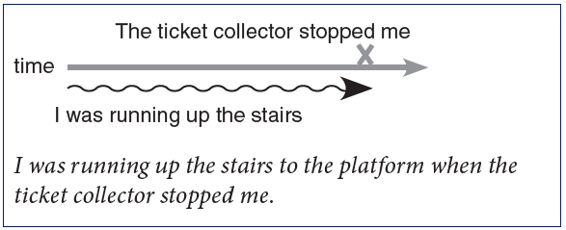
Past continuous and past simple
The second, shorter action sometimes interrupts the action already in progress:

