Slide 1
ADJECTIVES - ADVERBS
Degrees of comparison

Slide 2
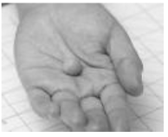
When we compare two nouns: comparative. When we compare three or more nouns: superlative.
A small ball.
A big ball.

Slide 3
FORMATION

Slide 4
SPELLING

Slide 5
EXCEPTIONS

Slide 6
Structure.

