Slide 1
Easter IslandS
Quiz, who do you believe built this temple;
Spanish
Αztecs
Maya
Incas

Slide 2
Information and history
Easter Island covers roughly 64 square miles in the South Pacific Ocean, and is located some 2,300 miles from Chile’s west coast and 2,500 miles east of Tahiti. Known as Rapa Nui to its earliest inhabitants, the island was christened Paaseiland, or Easter Island, by Dutch explorers in honor of the day of their arrival in 1722. It was annexed by Chile in the late 19th century and now maintains an economy based largely on tourism. Easter Island’s most dramatic claim to fame is an array of almost 900 giant stone figures that date back many centuries. The statues reveal their creators to be master craftsmen and engineers, and are distinctive among other stone sculptures found in Polynesian cultures. There has been much speculation about the exact purpose of the statues, the role they played in the ancient civilization of Easter Island and the way they may have been constructed and transported.

Slide 3
Moai statues
Moai are monolithic human figures carved by the Rapa Nui people on Easter Island in eastern Polynesia between the years 1250 and 1500.^{[1][2]} Nearly half are still at Rano Raraku, the main moai quarry, but hundreds were transported from there and set on stone platforms called ahu around the island's perimeter. Almost all moai have overly large heads three-eighths the size of the whole statue. The moai are chiefly the living faces (aringa ora) of deified ancestors (aringa ora ata tepuna).^{[3]} The statues still gazed inland across their clan lands when Europeans first visited the island in 1722, but all of them had fallen by the latter part of the 19th century.

Slide 4
Early Settlement
The first human inhabitants of Rapa Nui (the Polynesian name for Easter Island; its Spanish name is Isla de Pascua) are believed to have arrived in an organized party of emigrants. Archaeology dates their arrival at between 700-800 A.D., while linguists estimate it was around the year 400. Tradition holds that the first king of Rapa Nui was Hoto-Matua, a ruler from a Polynesian subgroup (possibly from the Marquesa Islands) whose ship traveled thousands of miles before landing at Anakena, one of the few sandy beaches on the island’s rocky coast

Slide 5
Easter island today
An isolated triangle measuring 14 miles long by seven miles wide, Easter Island was formed by a series of volcanic eruptions. In addition to its hilly terrain, the island contains many subterranean caves with corridors that extend deep into mountains of volcanic rock. The island’s largest volcano is known as Rano Kao, and its highest point is Mount Terevaka, which reaches 1,665 feet (507.5m) above sea level. It has a subtropical climate (sunny and dry) and temperate weather.
Easter Island boasts no natural harbor, but ships can anchor off Hanga Roa on the west coast; it is the island’s largest village, with a population of roughly 3,300. In 1995, UNESCO named Easter Island a World Heritage site. It is now home to a mixed population, mostly of Polynesian ancestry and made up of the descendants of the Long-Ears and Short-Ears. Spanish is generally spoken, and the island has developed an economy largely based on tourism.

Slide 6
The secrets of the island
Some archaeologists point to a layer of subsoil with many obsidian spear points as a sign of sudden warfare. Islanders say there was probably cannibalism, as well as carnage, and seem to think no less of their ancestors because of it. Smithsonian forensic anthropologist Douglas Owsley, who has studied the bones of some 600 individuals from the island, has found numerous signs of trauma, such as blows to the face and head. But only occasionally, he says, did these injuries result in death. In any case, a population that grew to as many as 20,000 was reduced to only a few thousand at most when the captains of the first European ships counted them in the early 18th century.

Slide 7
end
MICHAEL PROTOPAPPAS
JOHN MANOLIS
Thanks for your attention!

Slide 8
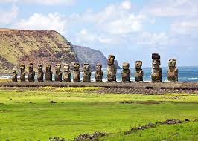
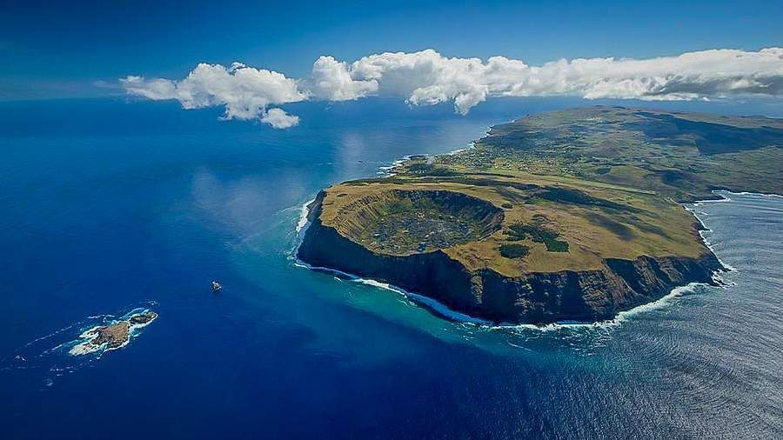
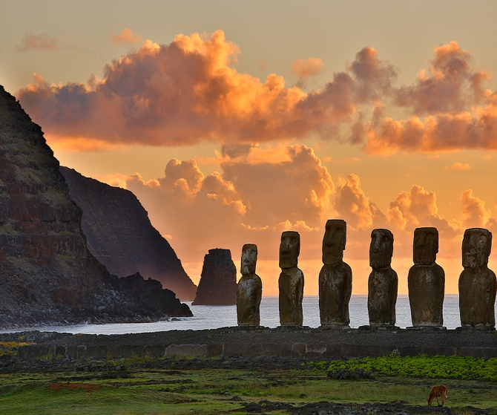
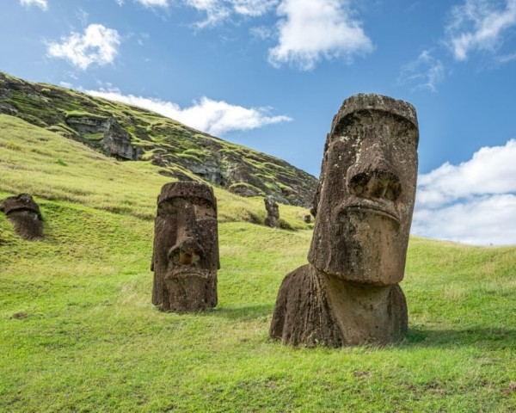
Some Photos

