Slide 1
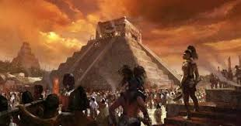
PROJECT
ENGLISH LANGUAGE
MAYA CIVILIZATION BY NAFSIKA STAMOU
A! GYMNASIUM OF VOLOS
CLASS: B! 4

Slide 2
CONTENTS
Locating the Maya
Early Maya, 1800 B.C. to A.D. 250
Cities of Stone: The Classic Maya, A.D. 250-900
Maya Arts and Culture
Life in the Rainforest
Mysterious Decline of the Maya
Do The Maya Still Exist?
Source

Slide 3
INTRODUCTION
The Maya Empire, centered in the tropical lowlands of what is now Guatemala, reached the peak of its power and influence around the sixth century A.D. The Maya excelled at agriculture, pottery, hieroglyph writing, calendar-making and mathematics, and left behind an astonishing amount of impressive architecture and symbolic artwork. Most of the great stone cities of the Maya were abandoned by A.D. 900, however, and since the 19th century scholars have debated what might have caused this dramatic decline.

Slide 4
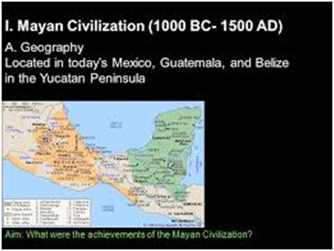
LOCATING THE MAYA
The Maya civilization was one of the most dominant societies of Mesoamerica (a term used to describe Mexico and Central America before the 16th century Spanish conquest). Unlike other scattered Indigenous populations of Mesoamerica, the Maya were centered in one geographical block covering all of the Yucatan Peninsula and modern-day Guatemala, Belize and parts of the Mexican states of Tabasco and Chiapas and the western part of Honduras and El Salvador. This concentration showed that the Maya remained relatively secure from invasion by other Mesoamerican peoples. Within that expanse, the Maya lived in three separate sub-areas with distinct environmental and cultural differences: the northern Maya lowlands on the Yucatan Peninsula, the southern lowlands in the Peten district of northern Guatemala and adjacent portions of Mexico, Belize and western Honduras, and the southern Maya highlands, in the mountainous region of southern Guatemala. Most famously, the Maya of the southern lowland region reached their peak during the Classic Period of Maya civilization (A.D. 250 to 900), and built the great stone cities and monuments that have fascinated explorers and scholars of t he region.
QUESTION: At which part of America Maya were centered?
A. North America
B. South America
C. Central America
QUESTION: Which one region that Maya lived was highly developed during the classic period of Maya Civilization?
A. The northern lowlands region
B. The southern Maya highlands
C. The southern lowland region

Slide 5
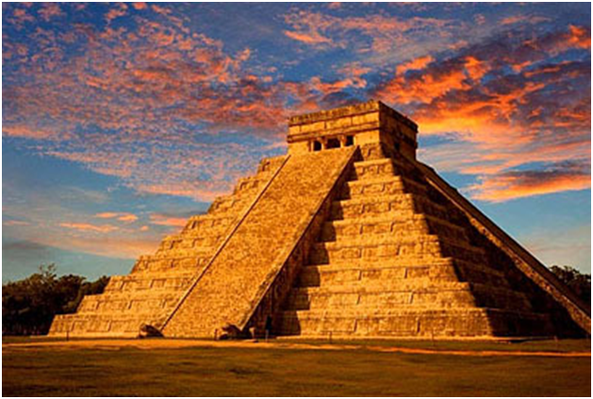
EARLY MAYA (1800 B.C. TO 250 A.D.)
The earliest Maya settlements date to around 1800 B.C. The earliest Maya were agricultural, growing crops such as corn (maize), beans, squash and cassava (manioc). During the Middle Preclassic Period, which lasted until about 300 B.C., Maya farmers began to expand their presence both in the highland and lowland regions. The Middle Preclassic Period also saw the rise of the first major Mesoamerican civilization, the Olmecs. Like other Mesoamerican peoples, such as the Zapotec, Totonac, Teotihuacán and Aztec, the Maya derived a number of religious and cultural traits–as well as their number system and their famous calendar–from the Olmec. In addition to agriculture, the Preclassic Maya also displayed more advanced cultural traits like pyramid-building, city construction and the inscribing of stone monuments.
QUESTION: What did Maya derive from the Olmecs?
A. They learned how to grow crops
B. Olmecs' number system
C. Olmecs' number system together with their famous calendar

Slide 6
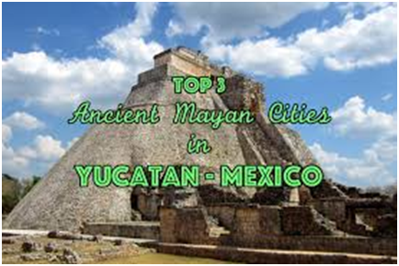
CITIES OF STONE: THE CLASSIC MAYA (250-900 A.D.)
The Classic Period, which began around A.D. 250, was the golden age of the Maya Empire. Classic Maya civilization grew to some 40 cities, including Tikal, Uaxactún, Copán, Bonampak, Dos Pilas, Calakmul, Palenque and Río Bec, each city held a population of between 5,000 and 50,000 people. At its peak, the Maya population may have reached 2,000,000 or as many as 10,000,000. Excavations of Maya sites have unearthed plazas, palaces, temples and pyramids, as well as courts for playing the famous Maya ball game ulama, all ritually and politically significant to Maya culture. Maya cities were surrounded and supported by a large population of farmers. Though the Maya practiced a primitive type of “slash-and-burn” agriculture, they also displayed evidence of more advanced farming methods, such as irrigation and terracing. The Maya were deeply religious, and worshiped various gods related to nature, including the gods of the sun, the moon, rain and corn. At the top of Maya society were the kings, or “kuhul ajaw” (holy lords), who claimed to be related to gods and followed a hereditary succession. They were thought to serve as mediators between the gods and people on earth, and performed the elaborate religious ceremonies and rituals so important to the Maya culture.
QUESTION: What was the Maya population during classic period?
A. From 5.000 to 50.000 people
B. From 2.000.000 to 10.000.000 people
C. Between 50.000 to 2.000.000 people

Slide 7
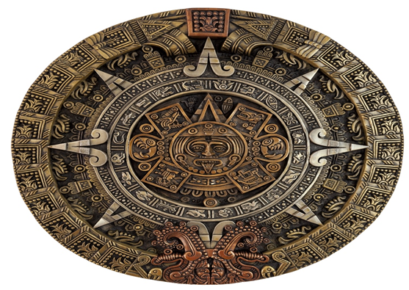
MAYA ARTS AND CULTURE
The Classic Maya built many of their temples and palaces in a stepped pyramid shape, decorating them with elaborate reliefs and inscriptions. These structures have earned the Maya their reputation as the great artists of Mesoamerica. Guided by their religious ritual, the Maya also made significant advances in mathematics and astronomy, including the use of the zero and the development of complex calendar systems like the Calendar Round, based on 365 days, and later, the Long Count Calendar, designed to last over 5,000 years. Serious exploration of Classic Maya sites began in the 1830s. By the early to mid-20th century, a small portion of their system of hieroglyph writing had been deciphered, and more about their history and culture became known. Most of what historians know about the Maya comes from what remains of their architecture and art, including stone carvings and inscriptions on their buildings and monuments. The Maya also made paper from tree bark and wrote in books made from this paper, known as codices , four of these codices are known to have survived. They are also credited with some of the earliest uses of chocolate and of rubber.
QUESTION: How many books made from Maya have survived?
A. Four
B. Five
C. Three
The Maya complex calendar

Slide 8
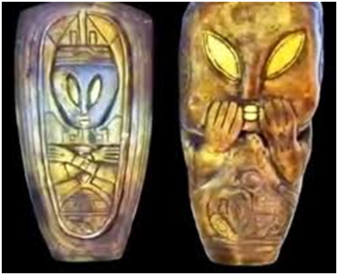
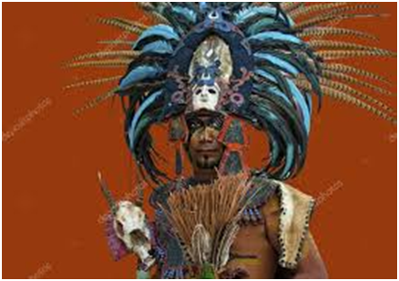
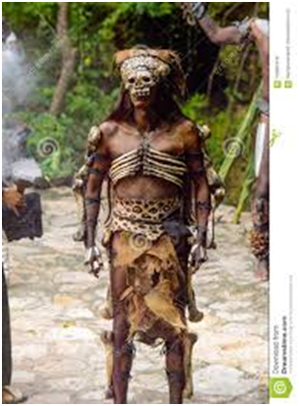
LIFE IN THE FOREST
One of the many intriguing things about the Maya was their ability to build a great civilization in a tropical rainforest climate. In the southern Maya lowlands, however, there were few navigable rivers for trade and transport, as well as no obvious need for an irrigation system. By the late 20th century, researchers had concluded that the climate of the lowlands was in fact quite environmentally diverse. Though foreign invaders were disappointed by the region’s relative lack of silver and gold, the Maya took advantage of the area’s many natural resources, including limestone (for construction), the volcanic rock (for tools and weapons) and salt. The environment also held other treasures for the Maya, including jade, quetzal feathers (used to decorate the elaborate costumes of Maya nobility) and marine shells, which were used as trumpets in ceremonies and warfare.
QUESTION: Which natural resources did Maya take advantage of?
A. Silver and gold
B. Nothing at all
C. Marine shells, jade and volcanic rock

Slide 9
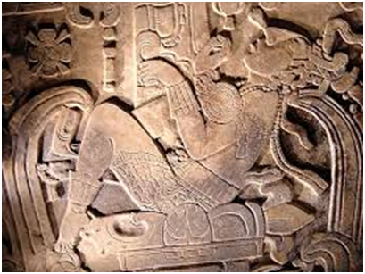
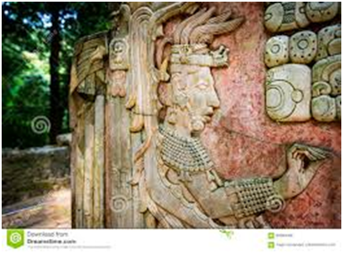
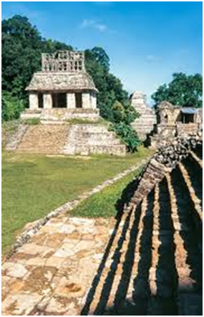
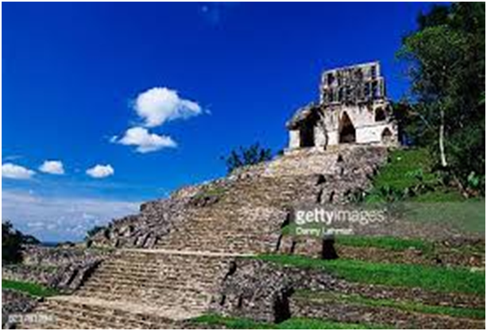
DO THE MAYA STILL EXIST?
Descendants of the Maya still live in Central America in modern-day Belize, Guatemala, Honduras, El Salvador and parts of Mexico. The majority of them live in Guatemala, which is home to Tikal National Park, the site of the ruins of the ancient city of Tikal. Roughly 40 percent of Guatemalans are of Mayan descent.
QUESTION: Where does the majority of Maya live in our days?
A. Guatemala
B. Honduras
C. Mexico

Slide 10
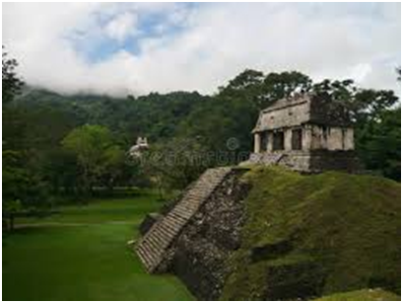
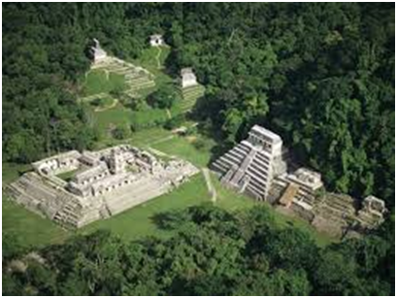
MYSTERIOUS DECLINE OF THE MAYA
From the late eighth through the end of the ninth century, something unknown happened to shake the Maya civilization to its foundations. One by one, the Classic cities in the southern lowlands were abandoned, and by A.D. 900, Maya civilization in that region had collapsed. The reason for this mysterious decline is unknown, though scholars have developed several competing theories. Some believe that by the ninth century the Maya had exhausted the environment around them to the point that it could no longer sustain a very large population. Other Maya scholars argue that constant warfare among competing city-states led them to break down. Finally, some catastrophic environmental change–like an extremely long, intense period of drought–may have wiped out the Classic Maya civilization. Drought would have hit cities like Tikal–where rainwater was necessary for drinking as well as for crop irrigation–especially hard. All three of these factors–overpopulation and overuse of the land, endemic warfare and drought–may have played a part in the downfall of the Maya in the southern lowlands. In the highlands of the Yucatan, a few Maya cities–such as Chichen Itza, Uxmal and Mayapán–continued to flourish in the Post-Classic Period (A.D. 900-1500). By the time the Spanish invaders arrived, however, most Maya were living in agricultural villages, their great cities buried under a layer of rainforest green.
How many factors exist as far as Maya downfall is concerned?
A. Two
B. Four
C. Three

Slide 11
Source
The Mayan Civilization. Stanford.edu.
Article title
Maya
Author
History.com Editors
Website Name
HISTORY
URL
https://www.history.com/topics/ancient-americas/maya
Access Date
14 Μαρτίου 2022
Publisher
A&E Television Networks
Last Updated
April 16, 2021

