Slide 1
Lost Civilizations: The Khmer empire
Ditsas Peter, B1, 1st Junior High School, Volos, Greece
January 25th 2025

Slide 2
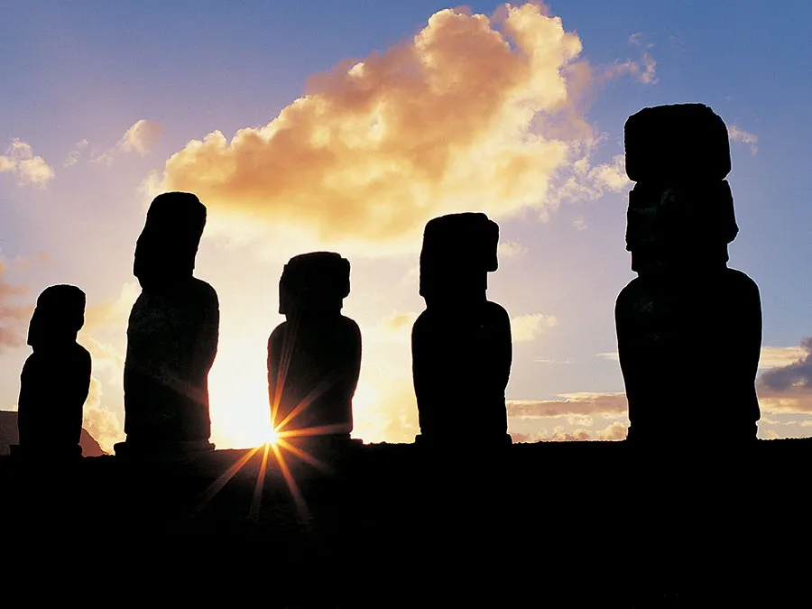
Lost Civilizations
Throughout the course of human history, great civilizations have been built, thrived, and declined.
Many of these have been well documented by historians, and later civilizations have been able to track their rise and fall. But some seem to have suddenly disappeared.
Some civilizations left clues as to what caused their demise, while the loss of others remains a mystery. Here are some of these puzzling lost civilizations.

Slide 3
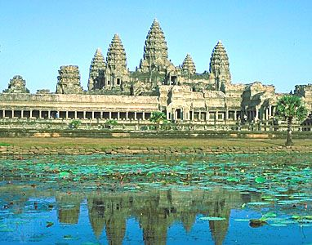
The Khmer empire: Introduction & History
On the other side of the world, the Khmer empire had spread across modern-day Cambodia.
Angkor was one of the civilization’s largest cities, with an extensive system of roads and canals and an estimated population of as many as one million people.
The Khmer empire was at its height between 1000 and 1200 CE, and experts are unsure what caused the civilization to disappear, leaving its cities at the mercy of the relentless jungle. Theories range from war to environmental catastrophe.
Towers of Angkor Wat reflected in a pond, Angkor, Cambodia.

Slide 4
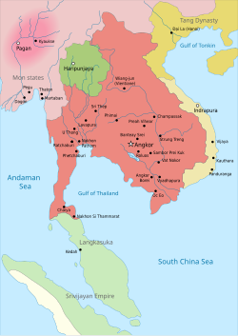
The Khmer empire: Introduction & History
The Khmer Empire ruled Southeast Asia (802-1431 AD).
Covered Cambodia, Thailand, Laos, and Vietnam.
Located in Southeast Asia.
Founded by King Jayavarman II.
Relied on the Mekong River for farming and trade.
Non-existent flag
802–1431
Kambuja
កម្វុជ (Old Khmer)

Slide 5
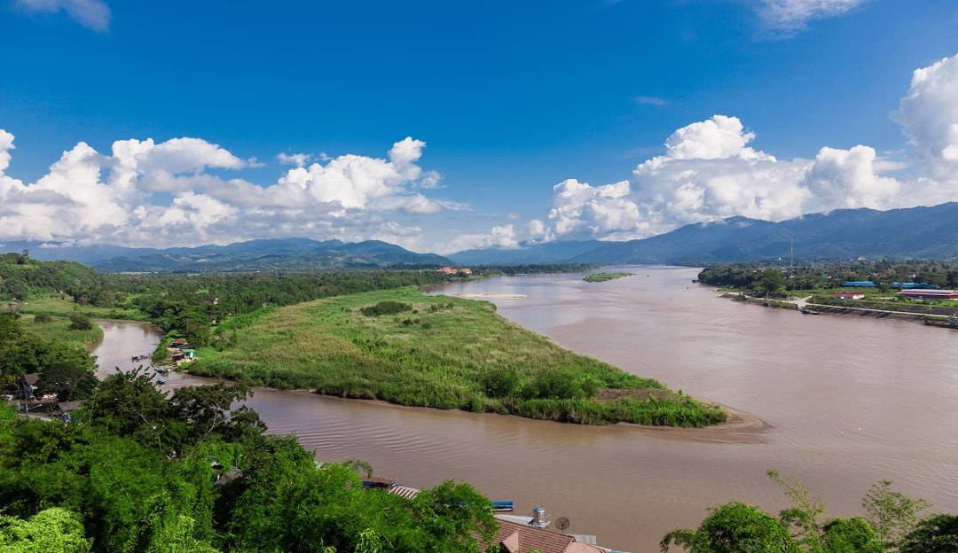
The Khmer empire: Introduction & History
The Khmer Empire, a medieval powerhouse that dominated Southeast Asia, holds a unique place in history with its architectural marvels, cultural richness, and complex socio-political structure.
Nestled in the heart of Southeast Asia, the Khmer homeland boasted lush plains, dense forests, and the majestic Mekong River – elements that played a pivotal role in the empire's agricultural prosperity and trade networks. The emergence of organized communities, influenced by Indian cultural elements, marked the early societal development. The integration of Hinduism, the emergence of a distinctive Khmer identity, and the establishment of a centralized state under Jayavarman II set the stage for the empire's historical narrative.

Slide 6
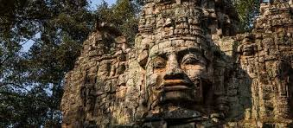
The Khmer empire: History of Ancient Civilization of the Enigmatic World Rise of the Khmer Empire
The visionary leadership of King Jayavarman II in the early 9th century marked the founding of the Khmer Empire. Military campaigns and strategic alliances led to the unification of Khmer territories, culminating in the establishment of a sovereign state.
The intertwining of religion and politics, with Hinduism at the forefront, contributed to a unique cultural identity. We explore the architectural wonders of Angkor, including the iconic Angkor Wat, as tangible symbols of the empire's rise and cultural sophistication.
National History

Slide 7
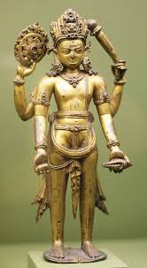
The Khmer empire: Government & Society
Ruled by kings seen as 'devarajas' (god-kings).
Society: nobles, priests, warriors, farmers, and slaves.
Skilled in engineering, art, and religion.

Slide 8
The Khmer empire: Religion & Culture
Influenced by Hinduism & Buddhism.
Temples dedicated to Hindu gods Vishnu and Shiva.
Later, Buddhism became more popular.

Slide 9
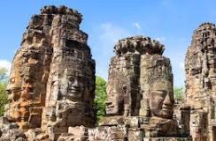
The Khmer empire: Angkor Wat – The Greatest Temple
Built in the 1100s by King Suryavarman II.
Largest religious monument in the world.
Originally Hindu, later used for Buddhism.

Slide 10
The Khmer empire
The Heart of the Empire: Angkor, the capital city, served as the nucleus of Khmer power and administration. The grandeur of Angkor Wat, dedicated to the Hindu god Vishnu, exemplified the empire's artistic and engineering achievements.
Beyond Angkor Wat, we delve into other architectural marvels, such as Angkor Thom and Ta Prohm, showcasing the empire's urban planning expertise and artistic brilliance.
Economic prosperity, facilitated by advanced irrigation systems and strategic trade routes, laid the foundation for the empire's enduring legacy.

Slide 11
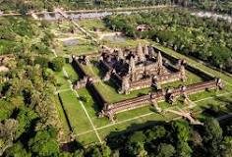
The Khmer empire: Achievements
Advanced irrigation for farming.
Huge stone temples like Angkor Wat.
Strong trade networks with China and India.

Slide 12
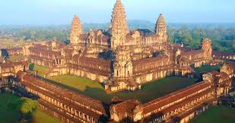
The Khmer empire: Decline of the Khmer Empire
Declined around 1431 AD.
Reasons: wars, droughts, weak rulers.
Thai Ayutthaya Kingdom attacked Angkor.
Angkor Wat is still an important site today.
Khmer language and culture continue in Cambodia.
Influenced Southeast Asian history and architecture.

Slide 13
References
https://www.britannica.com/list/6-lost-civilizations
https://en.wikipedia.org/wiki/Khmer_Empire

