Slide 2
S’ inquieter

Slide 3
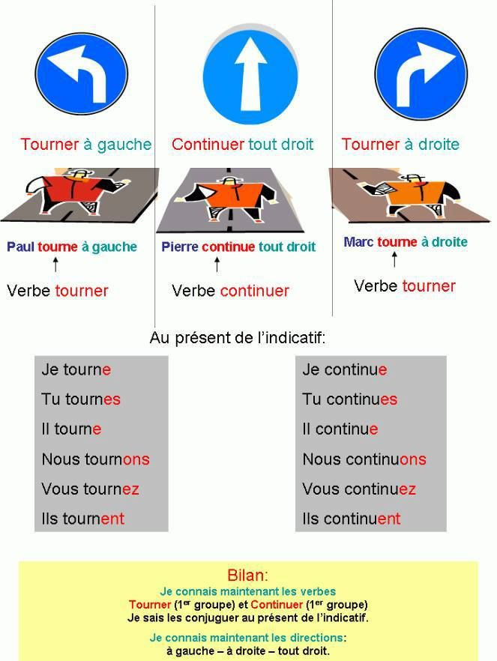

Slide 4
