Slide 1
Module 4 - Life on the Net

Slide 2
AGENDA
Intro (5’)
Topic 1: Knowledge on the web: disinformation, fake news, fact checking and critical thinking (20’)
Activity for Topic 1: Identifying Fake News (15’)
Topic 2: Identifying and countering hate speech online (20’)
Activity for Topic 2: Identifying Online Hate Speech (15’)
BREAK (30’)
Topic 3: Privacy, anonymity and confidentiality online (20’)
Activities for Topic 3 (15’)
Topic 4: AI-related opportunities for participation and engagement (digital citizenship) (20’)
Activities for Topic 4 (15’)

Slide 3
Topic 1 - Knowledge on the web: disinformation, fake news, fact checking and critical thinking
Key Terms →
Fake news
Fact checking
Debunking
Echo chambers
Filter bubbles
Information overload
Infodemic
Information disorder
Source: http://rhetoricmediaciviclife.blogspot.com/2017/04/my-filter-bubble.html
Notes:
https://www.youtube.com/watch?v=KX8-BOc7Z0c

Slide 4
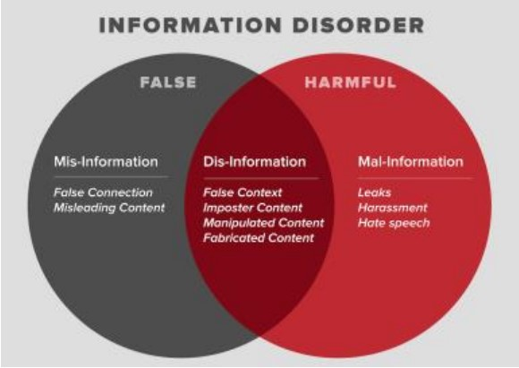
Topic 1 - Knowledge on the web: cont.
Source: Wardle and Derakhshan, 2017
Notes:
https://www.youtube.com/watch?v=KX8-BOc7Z0c

Slide 5
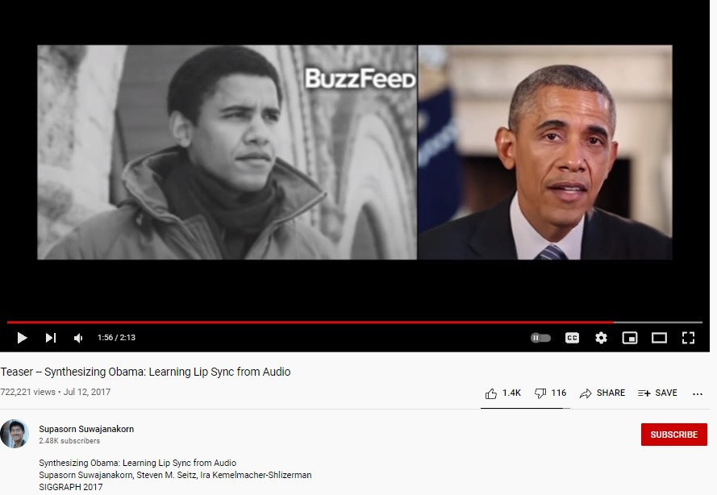
Topic 1 - Knowledge on the web- cont.
Roles of AI in information disorder
Micro-targeting
Computational amplification
Using AI to produce fake news (“deep fake”)
Watch Youtube video of experiment at Washington Uni
Notes:
https://www.youtube.com/watch?v=MVBe6_o4cMI

Slide 6
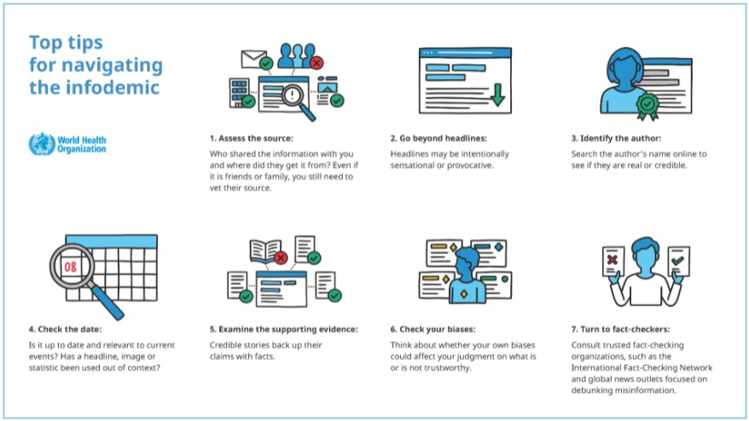
Topic 1 - Knowledge on the web - cont.
What to do? Reactive measures
AI tools to combat fake news and filter bubbles
Fact checking tools
Avoid sharing untrustworthy information
Reporting and tracking fake news
Source: WHO

Slide 7
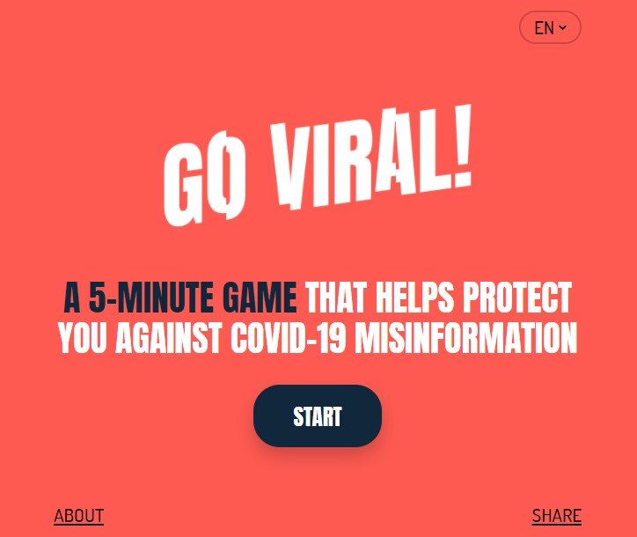
Topic 1 - Knowledge on the web - cont.
What to do?
Preventive measures
Pre-bunking
Critical media literacy in schools to equip youth against “information disorder” (McDougall 2019)
Notes:
https://www.goviralgame.com/en/intro
https://firstdraftnews.org/articles/a-guide-to-prebunking-a-promising-way-to-inoculate-against-misinformation/

Slide 8
Activity for Topic 1: Identifying Fake News
STEP 1: Teacher/educator introduces key terms and examples of fake news (country-specific, if possible)
STEP 2: Homework: Every student identifies one example of fake news they have encountered on social media and prepares a short written description of the example, with a link to an online resource that can be accessed in class during Step 3
STEP 3: In-class presentation of examples + moderated discussion
STEP 4: The discussion is followed by the identification of a shared definition of “fake news” and recommendations to add to the class code of conduct, i.e. how to identify fake news and how to respond to them

Slide 9
Topic 2- Identifying and countering hate speech online
Any kind of communication in speech, writing or behaviour, that attacks or uses pejorative or discriminatory language with reference to a person or a group on the basis of who they are, in other words, based on their religion, ethnicity, nationality, race, colour, descent, gender or other identity factor
(UN Strategy and Plan of Action on Hate Speech).
Links with hate crimes and violence

Slide 10
Topic 2- Identifying and countering hate speech online
Young people and hate speech, some evidences:
Overexposure to media debates and hateful messages
Overlapping of imaginaries and issues
Individual freedom of expression as dominant value;
Lack of awareness of consequences
Rare reporting
Need for digital education and intercultural education
Hate Speeches and Youth Cultures Online
https://youtu.be/totD3od_kPA

Slide 11
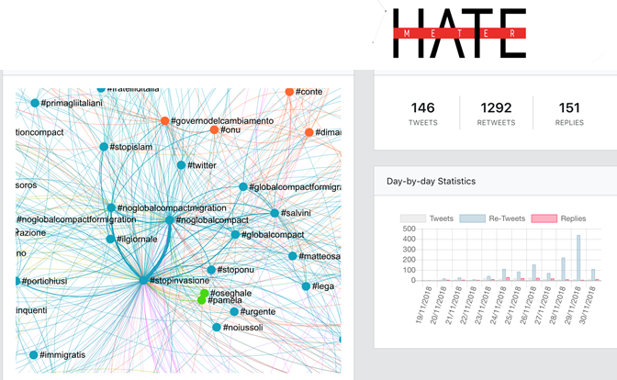
Topic 2- Identifying and countering hate speech online
Countering hate speech online: counternarratives combat hate speech by discrediting and deconstructing the narratives on which they are based
AI-based tools in countering online hate speech
HATEMETER: a platform to support NGOs’ operators in tackling anti-Muslim hate speech online, by automatically monitoring and analysing Internet and social media data on the phenomenon.
http://hatemeter.eu/

Slide 12
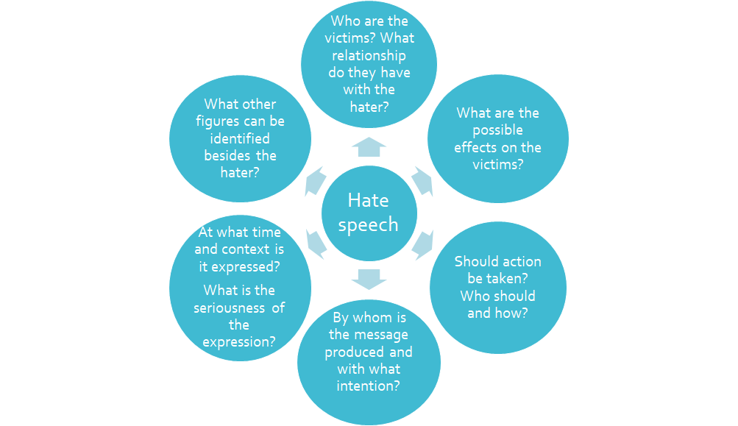
Activity for Topic 2: Identifying and analysing Online Hate Speech

Slide 13
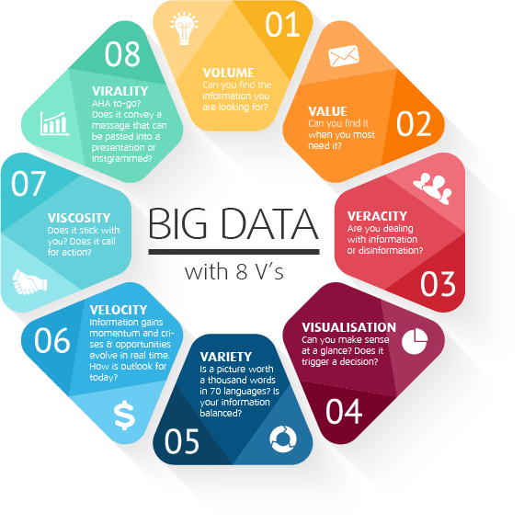
Topic 3 - Privacy, anonymity and confidentiality online
Big Data : Volume, Rapidity and Variety
Velocity
Veracity
Value
Variability
Exhaustive
Relational
Extensional
Scalability
Ex. Covd-19 apps

Slide 14
What about my privacy?

Slide 15
Everyday, millions of people leave their information footprint while using internet services.
This footprint consists of all of the information that people post, the hidden data attached to those posts by the services people use, the record of people’s online activities, and also the inferences that can be drawn from putting that collective information together.

