Slide 1
Module 3

Slide 2
AGENDA
Intro (5’)
AI for good (15’)
Main societal challenges and risks in the use of AI (20’)
In class activities for Topic 1 (40’)
BREAK (15’)
Ethics and AI (30’)
Scenario Discussion (20’)
Other Activities of Topic 2 (20’)

Slide 3
Topic 1 - Real-world Applications of AI
AI for Good
Healthcare
Wildlife
Climate Change
AI-assisted robotic surgery
AI-assisted disease detection
Cancer screening
Track wildlife patterns
Cease poaching
Classify animal species
Models for environmental sustainability
Monitoring ecosystems
Notes:
https://www.crisscrossed.net/2018/12/19/12-inspiring-examples-of-artifical-intelligence-for-good/

Slide 4
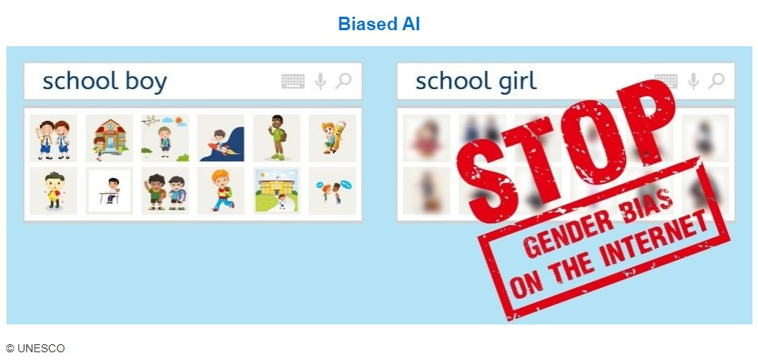
Challenges and risks - Algorithm bias
Gender bias
Racial/ethnic bias
Bias against people with disabilities
….
Notes:
See other examples from https://en.unesco.org/artificial-intelligence/ethics/cases; https://www.businessinsider.com/google-hiring-bias-settlement-2-million-racial-gender-discrimination-dol-2021-2?IR=T

Slide 5
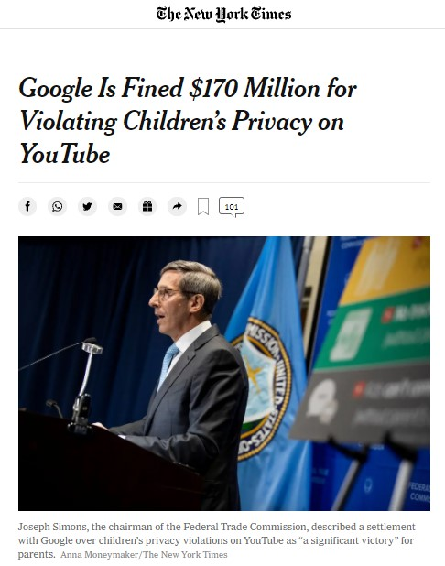
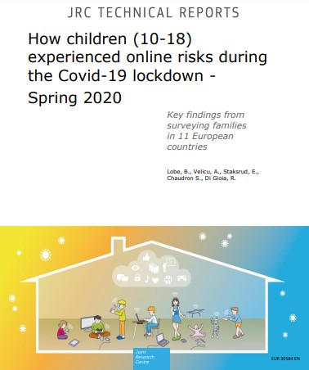
Challenges and risks - Privacy issues
Violation of children’s privacy: manipulation or dissemination of personal information or images without consent
Exposure to online risks (including sexual risks, cyberbullying)
Parental, teacher and peer mediation
Notes:
For more information on risks related to children’s privacy, see https://www.unicef-irc.org/publications/pdf/Investigating-Risks-and-Opportunities-for-Children-in-a-Digital-World.pdf
Mention: European Union’s 2018 General Data Protection Regulation (GDPR), use of students’ personal data in online education and new AIA.
See also: https://cdt.org/area-of-focus/privacy-data/student-privacy/

Slide 6
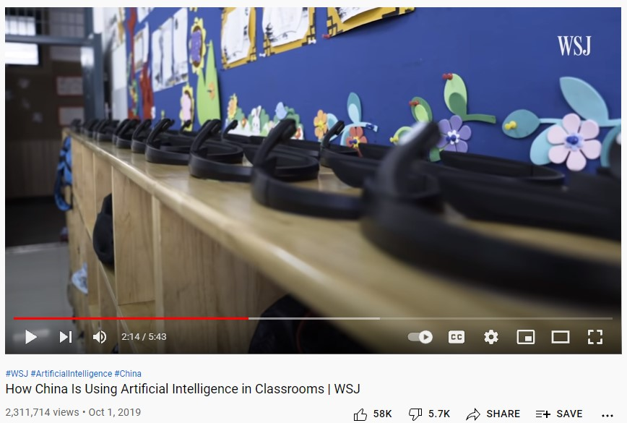
Challenges and risks - Surveillance
Use of face recognition systems
For border control
For law enforcement
Facial recognition and other AI tools in schools
Notes:
WATCH VIDEO ON AI IN SCHOOLS IN CHINA: https://www.youtube.com/watch?v=JMLsHI8aV0g
Border control: https://www.europarl.europa.eu/RegData/etudes/IDAN/2021/690706/EPRS_IDA(2021)690706_EN.pdf (unlawful profiling, bias, privacy)
Recent European moratorium on using facial recognition for law enforcement: https://www.europarl.europa.eu/news/en/press-room/20210930IPR13925/use-of-artificial-intelligence-by-the-police-meps-oppose-mass-surveillance
Attempts to introduce facial recognition in schools, so far condemned by local authorities as violating the GDPR: https://www.politico.eu/article/french-privacy-watchdog-says-facial-recognition-trial-in-high-schools-is-illegal-privacy/
Report on risks in using facial recognition in schools (overview page 28) https://stpp.fordschool.umich.edu/sites/stpp/files/uploads/file-assets/cameras_in_the_classroom_full_report.pdf

Slide 7
Challenges and risks -
Environmental and economic repercussions
AI represents a threat to employment (automation, loss of jobs)
Machine learning tasks for big tech companies are carried out by low-paid workers in poorer countries, including refugees
AI can have a significant negative impact on the environment
Notes:
Jobs at risk: https://medium.com/innovation-machine/artificial-intelligence-3c6d80072416
See also Daniel Susskind’s book “A World Without Work”. https://www.theguardian.com/technology/2020/jan/18/automation-jobs-universal-basic-income-daniel-susskind-interview
On Development: https://restofworld.org/2021/refugees-machine-learning-big-tech/
On environmental impact: https://www.forbes.com/sites/forbestechcouncil/2020/08/17/why-we-should-care-about-the-environmental-impact-of-ai/
https://theconversation.com/it-takes-a-lot-of-energy-for-machines-to-learn-heres-why-ai-is-so-power-hungry-151825

Slide 8
In-class activities for Topic 1
Real-world Applications of AI
Discussing positive impact of AI (in groups) [Activity 3.1.1]
Discussing negative impact of AI (in groups) [Activity 3.1.2]
Raising questions about future scenarios in AI (“what if” activity = co-design fictions, in groups) [Activity 3.1.3]
Jamboard
https://jamboard.google.com/d/1nUXddX5wrDG6mYuE05Y98ZReRtudzIpTSkS-N83sClQ/edit?usp=sharing

Slide 9
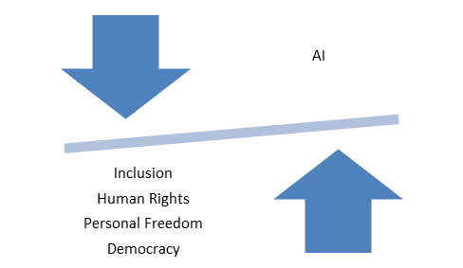
Topic 2 - Ethics of AI (1)
“AI will need to be introduced in ways that build trust and understanding, and respect human and civil rights.” (European Parliament, 2020)
This requires:
Fairness
Transparency
Accountability
Control/Regulation
Notes:
UNESCO’s Recommendations on the ethics of AI: https://en.unesco.org/artificial-intelligence/ethics and EU’s ethics guidelines for trustworthy AI https://digital-strategy.ec.europa.eu/en/library/ethics-guidelines-trustworthy-ai

Slide 10
Topic 2 - Ethics of AI (2)
Education in Ethics
learn what is right and what is wrong (normative ethics)
making ethical decision / adopting ethical behaviors (descriptive ethics)
critical thinking on ethics and values (meta-ethics)
Education on Ethics (and AI)
Identify ethical dilemmas
Learning criteria for ethical decision making / adoption of ethical behaviors
critical thinking on ethics and values (meta-ethics)

Slide 11
Topic 2 - Ethics and AI (3)
Working on ethics and AI through dialogue in classrooms
Dialogue (vs debate) as a means of:
improving teaching and learning,
facilitating intercultural understanding
cultivating thinking and argumentation
advancing democratic values and participation
etc.
Why hasn’t dialogue become a common form of classroom discourse?

Slide 12
Ethics of AI - Guiding in class discussion
Criteria for dialogical contents
purposeful (guided by educational goals)
cumulative (participants respond to and build upon one another’s ideas)
critical: participants identify and investigate open questions and points of contention
meaningful: participants relate the topic of discussion to their own horizons of meaning, and bring those horizons to bear upon one another in developing new understandings
Alexander, R. J. Towards Dialogic Teaching: Rethinking Classroom Talk, 2nd edn, Cambridge: Dialogos
Guidelines and suggestions for facilitating class discussions
Encourage students to come to terms with the uncertainty of their own positions and the need to acquire information
Work on students' awareness of the sources and conditioning "behind" their opinions
Identify and free the field from ways of discussing that can trigger emotional and non-rational reactions
Work on active listening
Promote willingness to abandon persuasive intentions in favor of understanding
Construct and share together the basic rules of dialogue
Difficult Dialogue in the Classroom - Training resource from Tony Blair Institute for Global Change

