Slide 1
Module 2

Slide 2
AGENDA
Intro (5’)
Coding, computational thinking, robotics and AI (10’)
Algorithm, machine learning and deep learning (10’)
Teachable machine + demo (15’)
Hands-on + show & tell (20’)
Discussion on Teachable machine (15’)
BREAK (15’)
Scratch and face sensing (10’)
Scratch demo using the flowchart “Is AI or not?” (15’)
Hands-on + show & tell (20’)
Discussion on Face Sensing (15’)
Other tools for class activities (Google Experiments) (20’)

Slide 3
Coding, computational thinking, robotics and AI
Computational thinking
Coding
Robotics
AI education

Slide 4
Algorithm
An algorithm is a set of instructions that are followed by a computer in order to accomplish a task.
Data
Algorithm (Conventional programming)
Results
Program
Data
Algorithm (AI / Machine learning)
Program
Desired results

Slide 5
Defining AI
Artificial intelligence
Field of computer science, which combines computer science and robust datasets, to enable problem-solving
Machine learning
It is a branch of AI that focuses on the use of computer algorithms that can improve automatically through experience and by the use of data
Deep learning
is a set of techniques that allows a system to automatically discover the representations needed for feature detection or classification from raw data

Slide 6
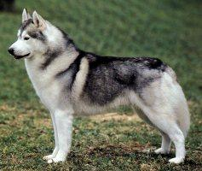
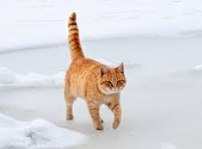
Classification task
Classification problems ask the algorithm to predict a discrete value, identifying the input data as the member of a particular class, or group.
In a training dataset of animal images each photo is pre-labeled as cat or dog.
Dog
Cat

Slide 7
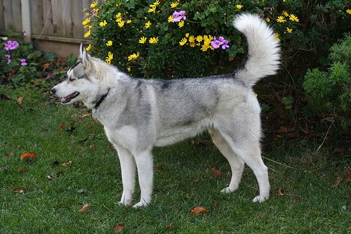
Classification task
Classification problems ask the algorithm to predict a discrete value, identifying the input data as the member of a particular class, or group.
In a training dataset of animal images each photo is pre-labeled as cat or dog.
The algorithm is then evaluated by how accurately it can correctly classify new images of other cats and dogs.
DOG

Slide 8
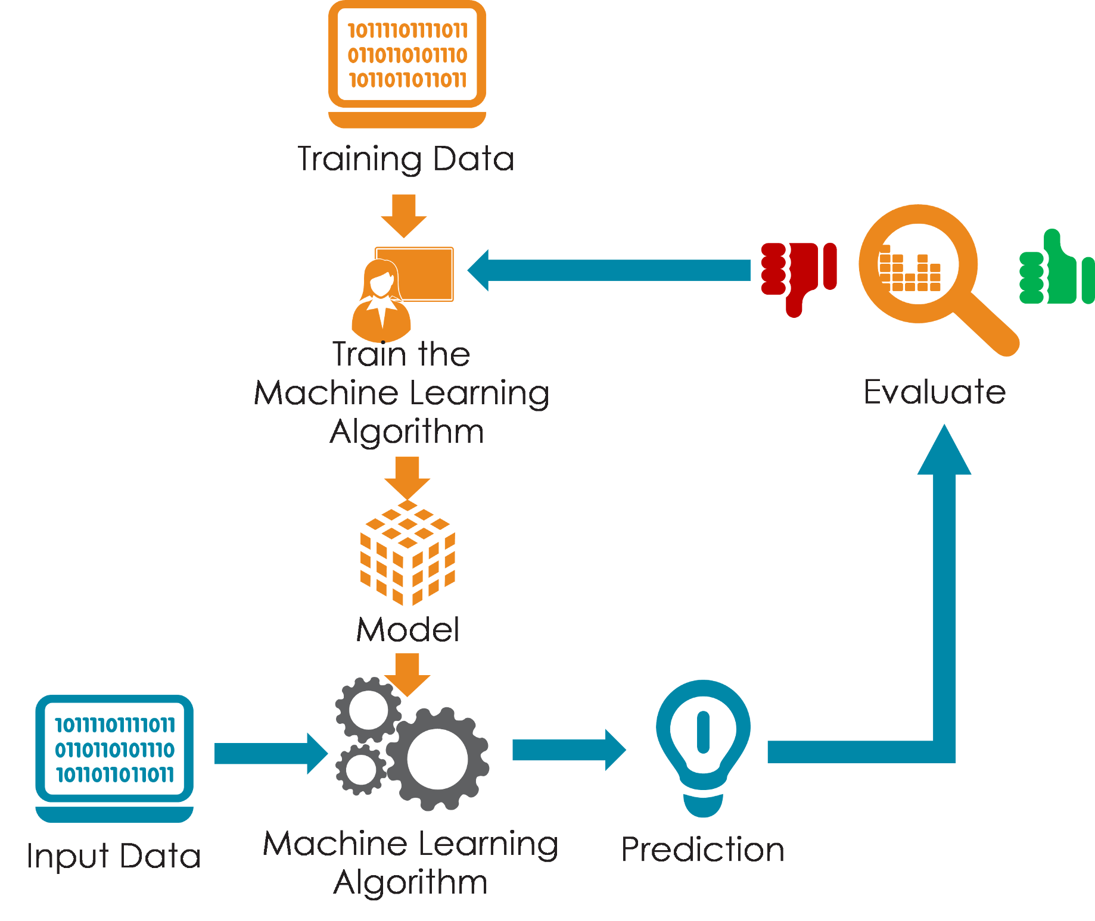
Classification task
Classification problems ask the algorithm to predict a discrete value, identifying the input data as the member of a particular class, or group.
In a training dataset of animal images, that would mean each photo was pre-labeled as cat or dog.
The algorithm is then evaluated by how accurately it can correctly classify new images of other cats and dogs.

Slide 9
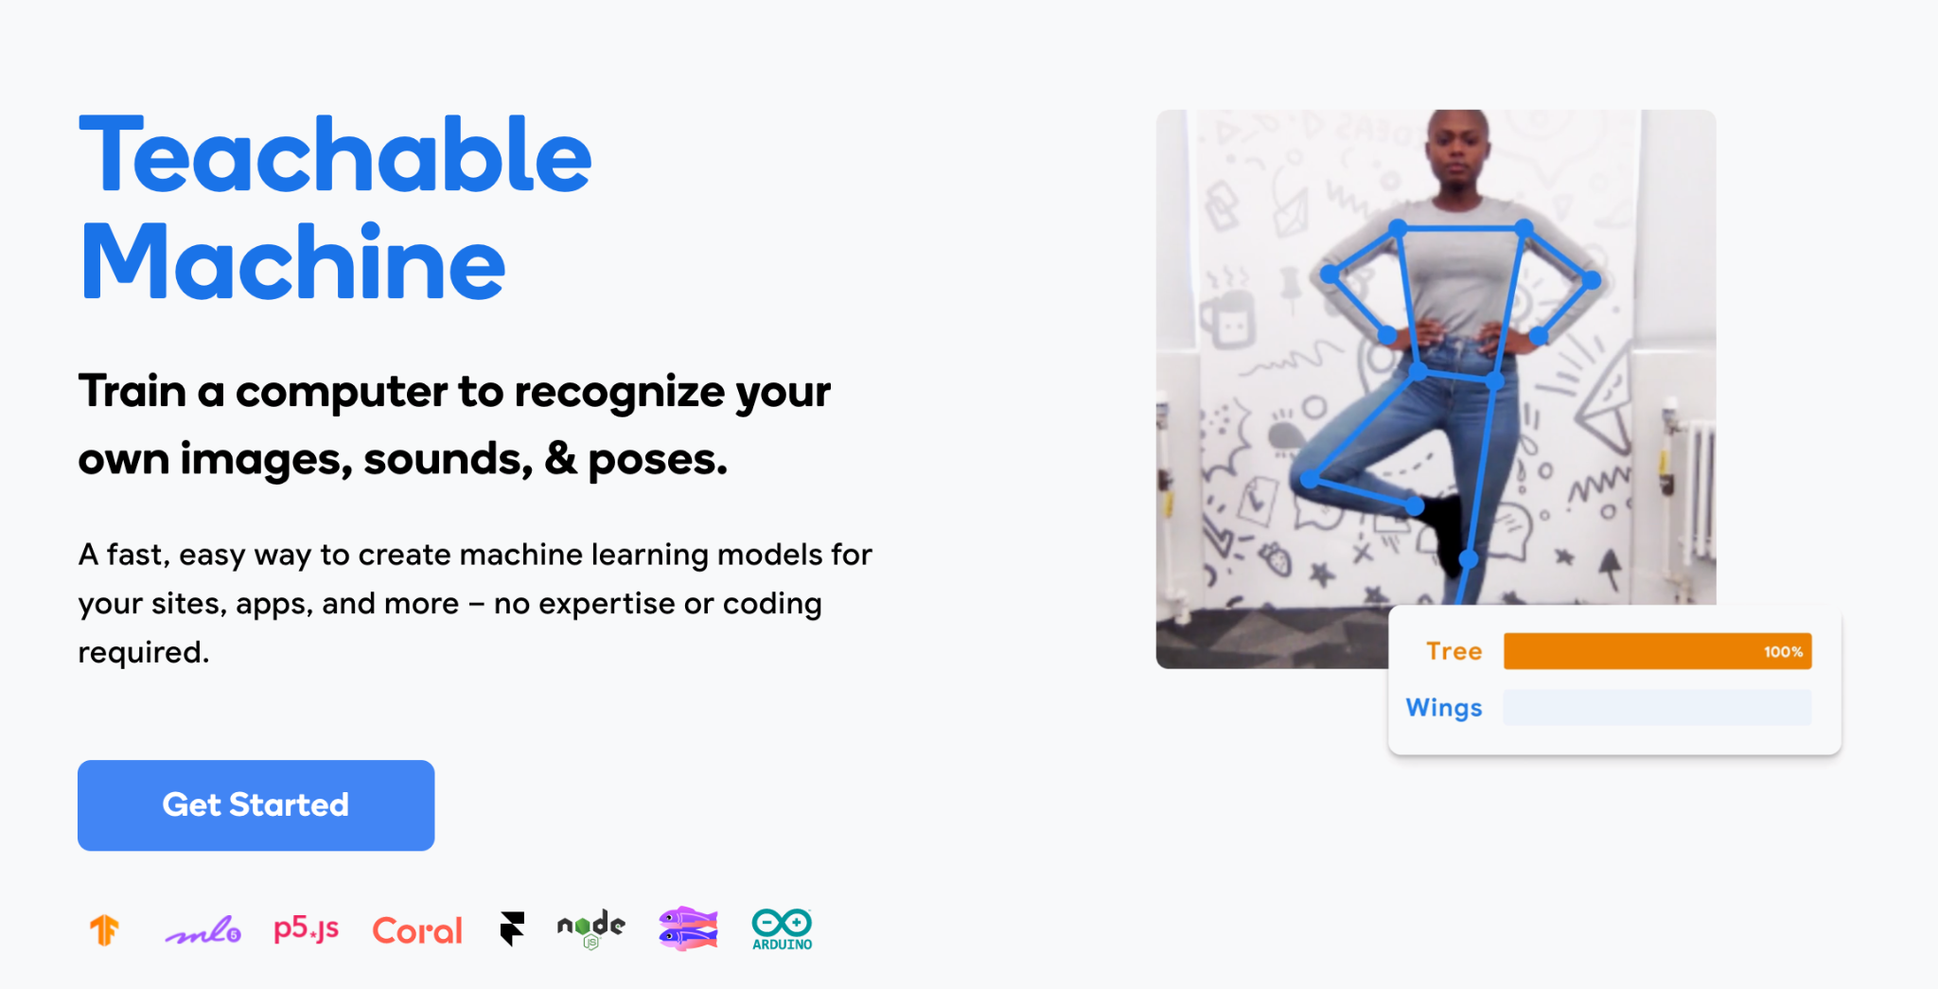
Teachable machine
teachablemachine.withgoogle.com
Dog images for the activity
https://drive.google.com/drive/folders/1tSteP04VOlGvoVaCWWxQ41PyOYkM-nNR

Slide 10
Classical machine learning
Classic Machine learning
DOG
Dataset labelling
Input
Classification
Output
In a task of classification, a classical machine learning algorithm learns on a labeled dataset, providing an answer that the algorithm can use to evaluate its accuracy on training data. This means having a full set of labeled data while training an algorithm. A fully labeled dataset means that each example in the training dataset is tagged with the answer the algorithm should come up with on its own. Dataset labelling is usually a task performed by humans.
When shown a new image, the model compares it to the training examples to predict the correct label.

Slide 11
Deep learning
Deep learning
DOG
Input
Feature extraction + classification
Output
Differently from a classical machine learning technique, a deep learning model is handed a dataset without explicit instructions on what to do with it. The training dataset is a collection of examples without a specific desired outcome or correct answer. The neural network then attempts to automatically find structure in the data by extracting useful features and analyzing its structure.

Slide 12
Two different approaches
Classic Machine learning
DOG
Feature extraction
Input
Classification
Output
Deep learning
DOG
Input
Feature extraction + classification
Output

Slide 13
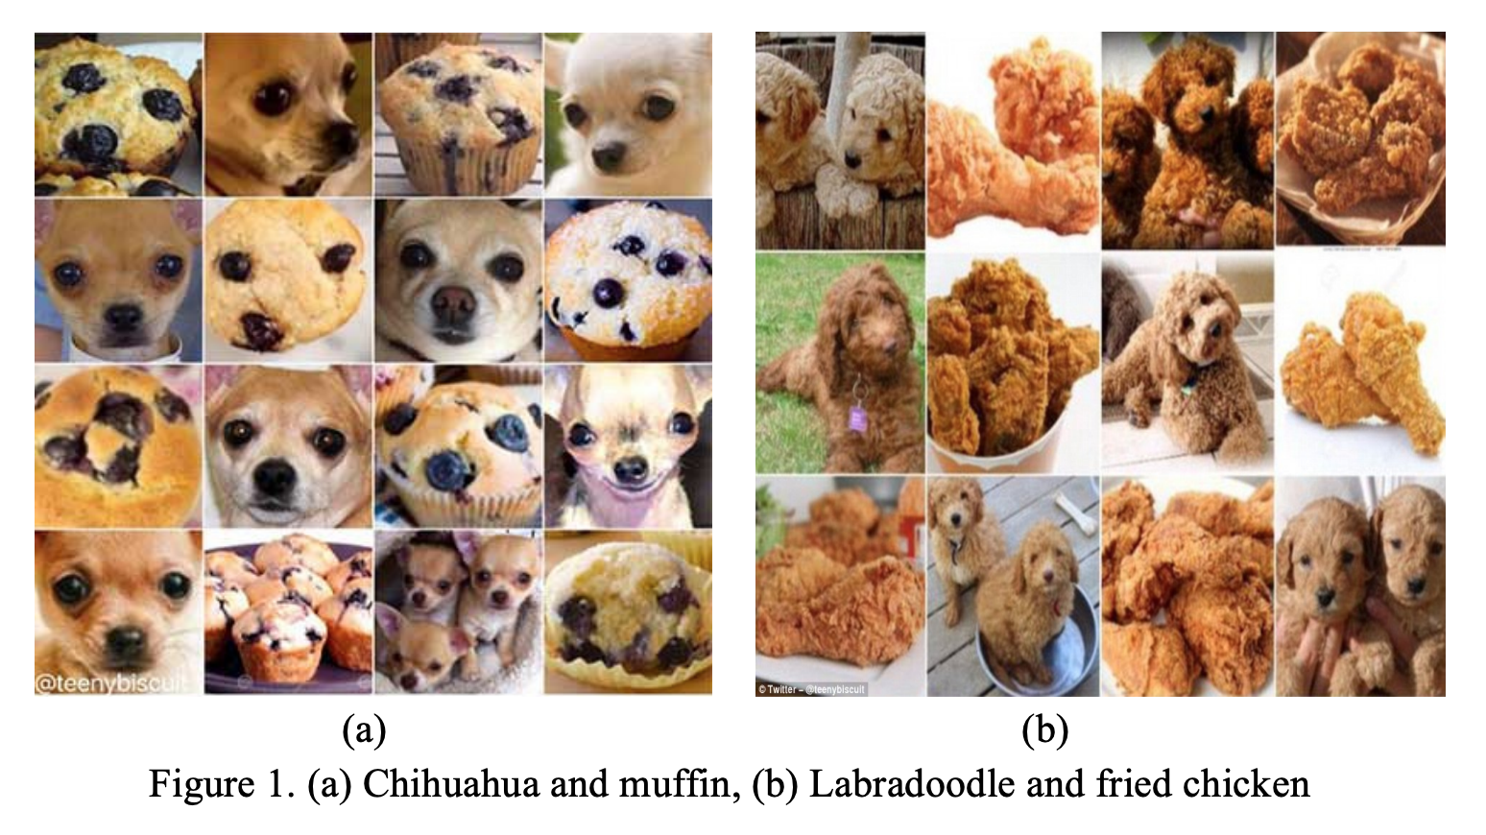
Challenges for AI systems

Slide 14
Teachable machine
Challenge:
Using the dog images provided in the resource, train an algorithm for classifying between two different breeds using 3 images for the training phase. Test the algorithm with a dog image that you find online.
Now train the algorithm with 6 or more images, and test it - how is the performance changed?
Add a third category of dog breed and test the new algorithm
Create a new audio project and use audio recordings for creating a machine learning algorithm that discriminates between two words (yes or no) or between two sounds of your choice

Slide 15
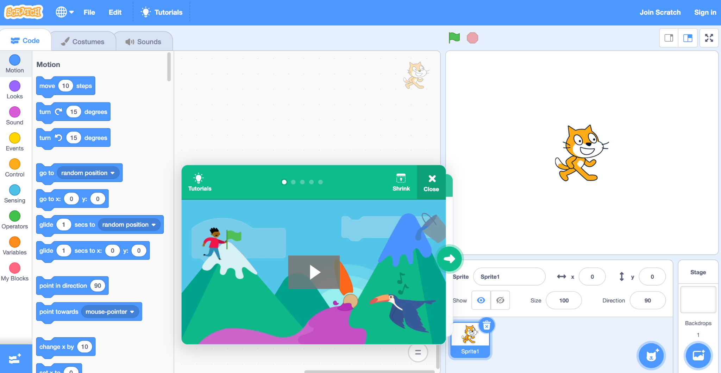
Scratch - Introduction
Scratch is a free programming language that uses code blocks
Free of use
Web based
Large community of educators
Visual language

Slide 16
Scratch Lab - Is AI or not?
Is AI or not - Scratch flowchart - https://scratch.mit.edu/projects/371119352/
Challenge:
Translate the text displayed in the program in your language
Add one more example of AI technology
Add a written text or audio message of the answer provided by the user
Add a message if the user write text that is not “yes” o “no”
Make the system working using “yes” or “no” written in your language
Check if the answer provided by the user is correct (Difficult challenge ;)

Slide 17
Scratch Lab - Face Sensing
https://lab.scratch.mit.edu/face/
Combine Scratch programming language with some basic algorithms for facial recognition (storing information only in the host machine)

Slide 18
Scratch Lab - Face Sensing
Challenge:
Open the project “Flapping bird”
Add a sound if the head touch the border of the camera area
Add a message if no faces are recognised in front of the camera
Introduce a second type of elements (e.g. a “bomb”) that the parrot should not touch

Slide 19
Experiments with Google
Quick Draw - https://quickdraw.withgoogle.com/
Autodraw - https://www.autodraw.com/
Teachable Snake - https://teachable-snake.netlify.app/
Emoji Scavenger Hunt - https://emojiscavengerhunt.withgoogle.com/

