Slide 1
Digital competencies (Ψηφιακές δεξιότητες) & Inclusion (Συμπερίληψη)

Slide 2
AGENDA
Intro & overview (20’)
Activity: Brainstorming (15’)
Slides on the definition of AI and imageries (15’)
Discussion and Q&A (15’)
Activity: Kahoot! (5’)
Discussion on interdisciplinarity on AI (10’)
Activity (Group): Interdisciplinarity (15’)

Slide 3
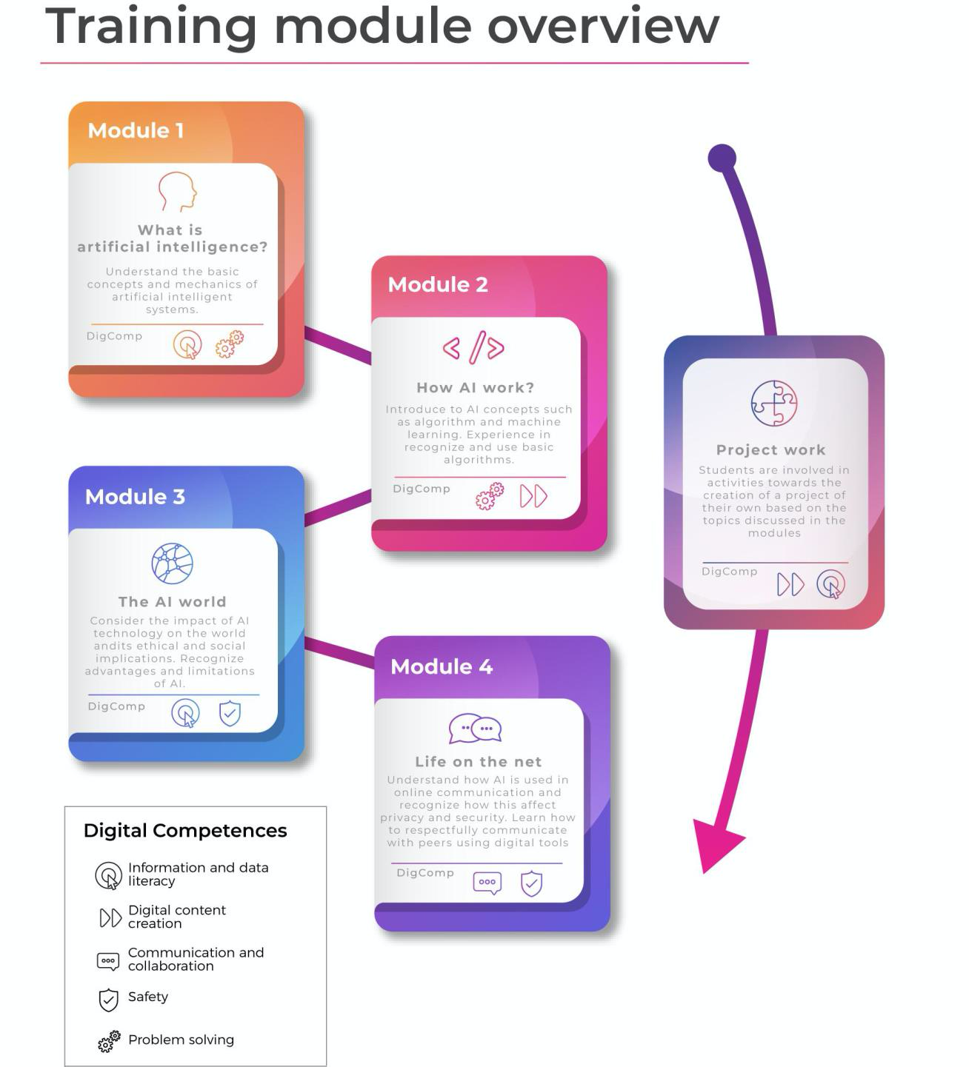
TRAINING MODULES
Module 1 What is AI?
Module 2 How AI work?
Module 3 The AI world
Module 4 Life on the net

Slide 4
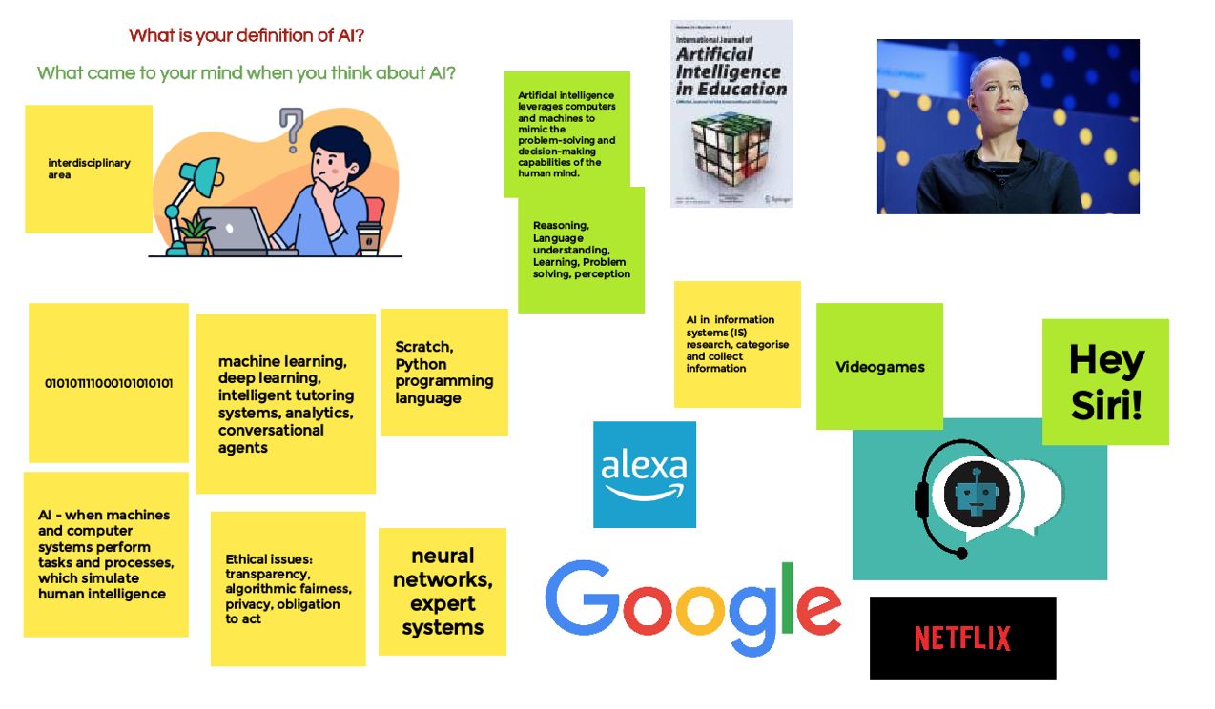
Brainstorming on the concept of AI

Slide 5
Brainstorming AI
Discussing the results of the brainstorming
Questions:
On what points do the group agree?
On what points do the group disagree?
What makes something “AI”?
What are the common imageries around AI?
What source of information we have considered (books, movies, science, etc.)?

Slide 6
Defining AI
Artificial Intelligence
τεχνητή νοημοσύνη
изкуствен интелект
Intelligenza Artificiale
Inteligență artificială
There has been plenty of debate about what human intelligence is, how it is structured, and how it can be best measured…
...and there are similar debates about artificial intelligence.

Slide 7
Defining AI
Artificial intelligence (AI) refers to systems that display intelligent behaviour by analysing their environment and taking actions – with some degree of autonomy – to achieve specific goals
Source: EC High-level expert group on Artificial Intelligence
Artificial Intelligence (AI), the ability of a digital computer or computer-controlled robot to perform tasks commonly associated with intelligent beings. The term is frequently applied to the project of developing systems endowed with the intellectual processes characteristic of humans, such as the ability to reason, discover meaning, generalize, or learn from past experience
Encyclopedia Britannica link

Slide 8
Defining AI
An AI system is a machine-based system that is capable of influencing the environment by producing an output (predictions, recommendations or decisions) for a given set of objectives. It uses machine and/or human-based data and inputs to (i) perceive real and/or virtual environments; (ii) abstract these perceptions into models through analysis in an automated manner (e.g., with machine learning), or manually; and (iii) use model inference to formulate options for outcomes. AI systems are designed to operate with varying levels of autonomy.
OECD Definition from https://www.oecd.ai/ai-principles
Artificial intelligence (AI) is intelligence demonstrated by machines, as opposed to the natural intelligence displayed by humans or animals. Leading AI textbooks define the field as the study of "intelligent agents": any system that perceives its environment and takes actions that maximize its chance of achieving its goals. Some popular accounts use the term "artificial intelligence" to describe machines that mimic "cognitive" functions that humans associate with the human mind, such as "learning" and "problem solving", however this definition is rejected by major AI researchers.
From Wikipedia ENG link

Slide 9
Defining AI
Common aspects:
Systems / digital computer / computer-controlled robots / machine-based system / machines
Display intelligent behaviour / perform tasks commonly associated with intelligent beings / influence the environment / mimic “cognitive” functions (but…)
Perceive the environment and take actions / perform tasks / perceive, abstract concepts and use model inference
AI systems operate with varying levels of autonomy

Slide 10
Defining AI
Artificial intelligence
Field of computer science, which combines computer science and robust datasets, to enable problem-solving
Machine learning
It is a branch of AI that focuses on the use of computer algorithms that can improve automatically through experience and by the use of data
Deep learning
is a set of techniques that allows a system to automatically discover the representations needed for feature detection or classification from raw data

Slide 11
Discussion
Open discussion on the definition of AI

Slide 12
Narrow and General AI
AI
Artificial Narrow Intelligence
Computer's ability to perform a single task extremely well
Artificial General Intelligence
Computer’s ability to understand or learn any intellectual task that a human being can

Slide 13
Narrow and General AI
Tasks for an Artificial Narrow Intelligence
Tasks for an Artificial General Intelligence
Play Chess
Teach students
Drive a car
Walk
Write a romance novel
Recognise a face
Translate a text
Design an AI

Slide 14
Interdisciplinarity of AI
Disciplines directly involved in and affected by the development of AI technologies
Artificial Intelligence
Computer Science
Biology
Engineering
Psychology
Mathematics
Linguistics

Slide 15
Interdisciplinarity of AI
Impact of AI technologies on society and impact of society on AI technologies
Ethics
...
Environment
Healthcare
Artificial Intelligence
Warfare
Transportation and logistics
Security, border control, law enforcement
Finance
Education

Slide 16
Recognizing AI
Cues for recognizing AI
Can it “see”?
Can it “hear”?
Can it “speak”?
Can it “read”?
Can it “reason”?
Can it move?

Slide 17
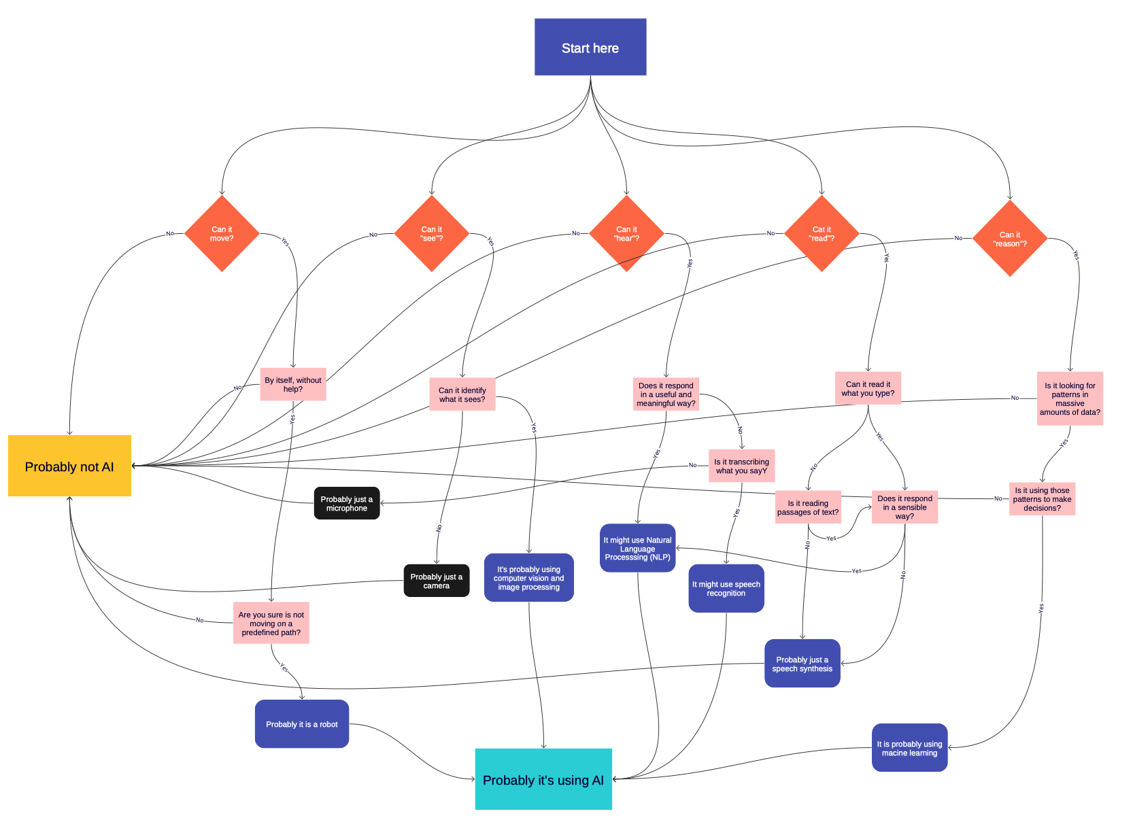
A flowchart for recognizing AI
Link to the flowchart:
https://drive.google.com/file/d/1kULr8kfd0lCDftW7DiJeVHypsQ13T2CU/view?usp=sharing
Scratch version: https://scratch.mit.edu/projects/371119352/

