Slide 1
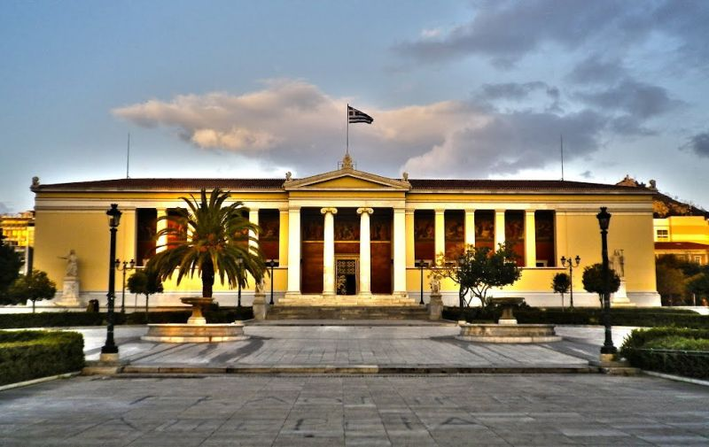
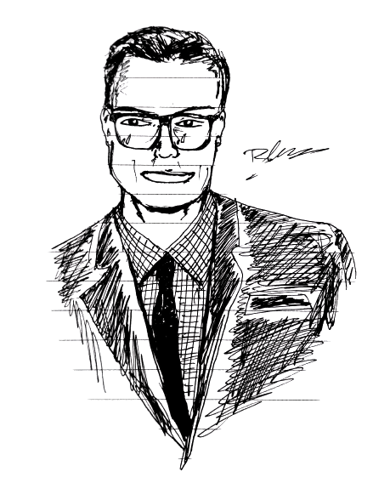

Slide 2
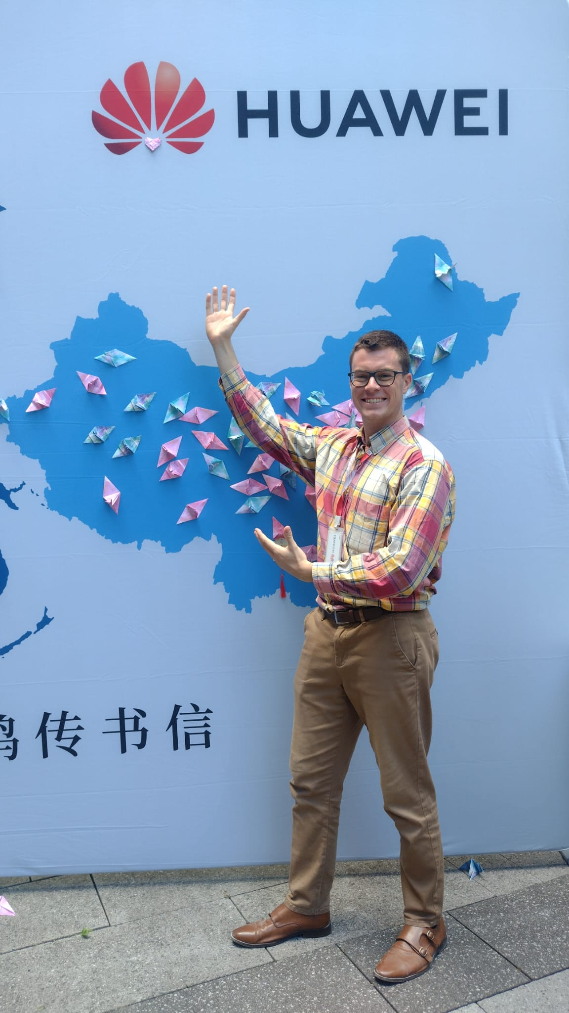
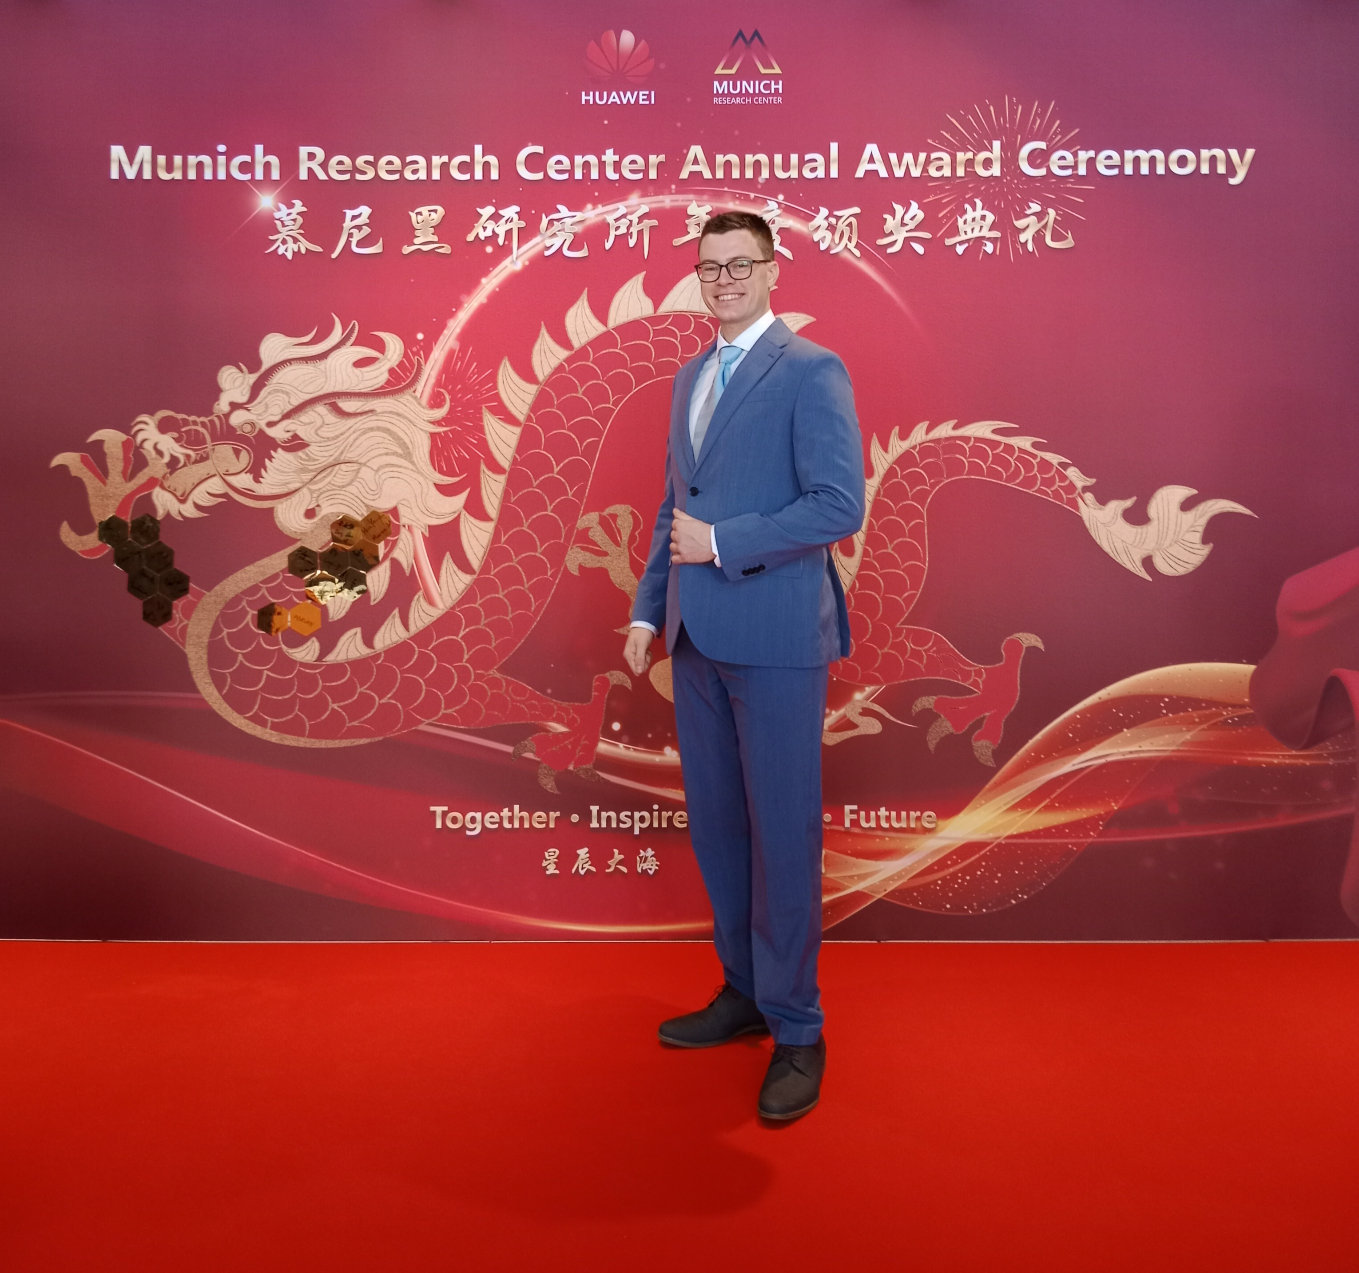
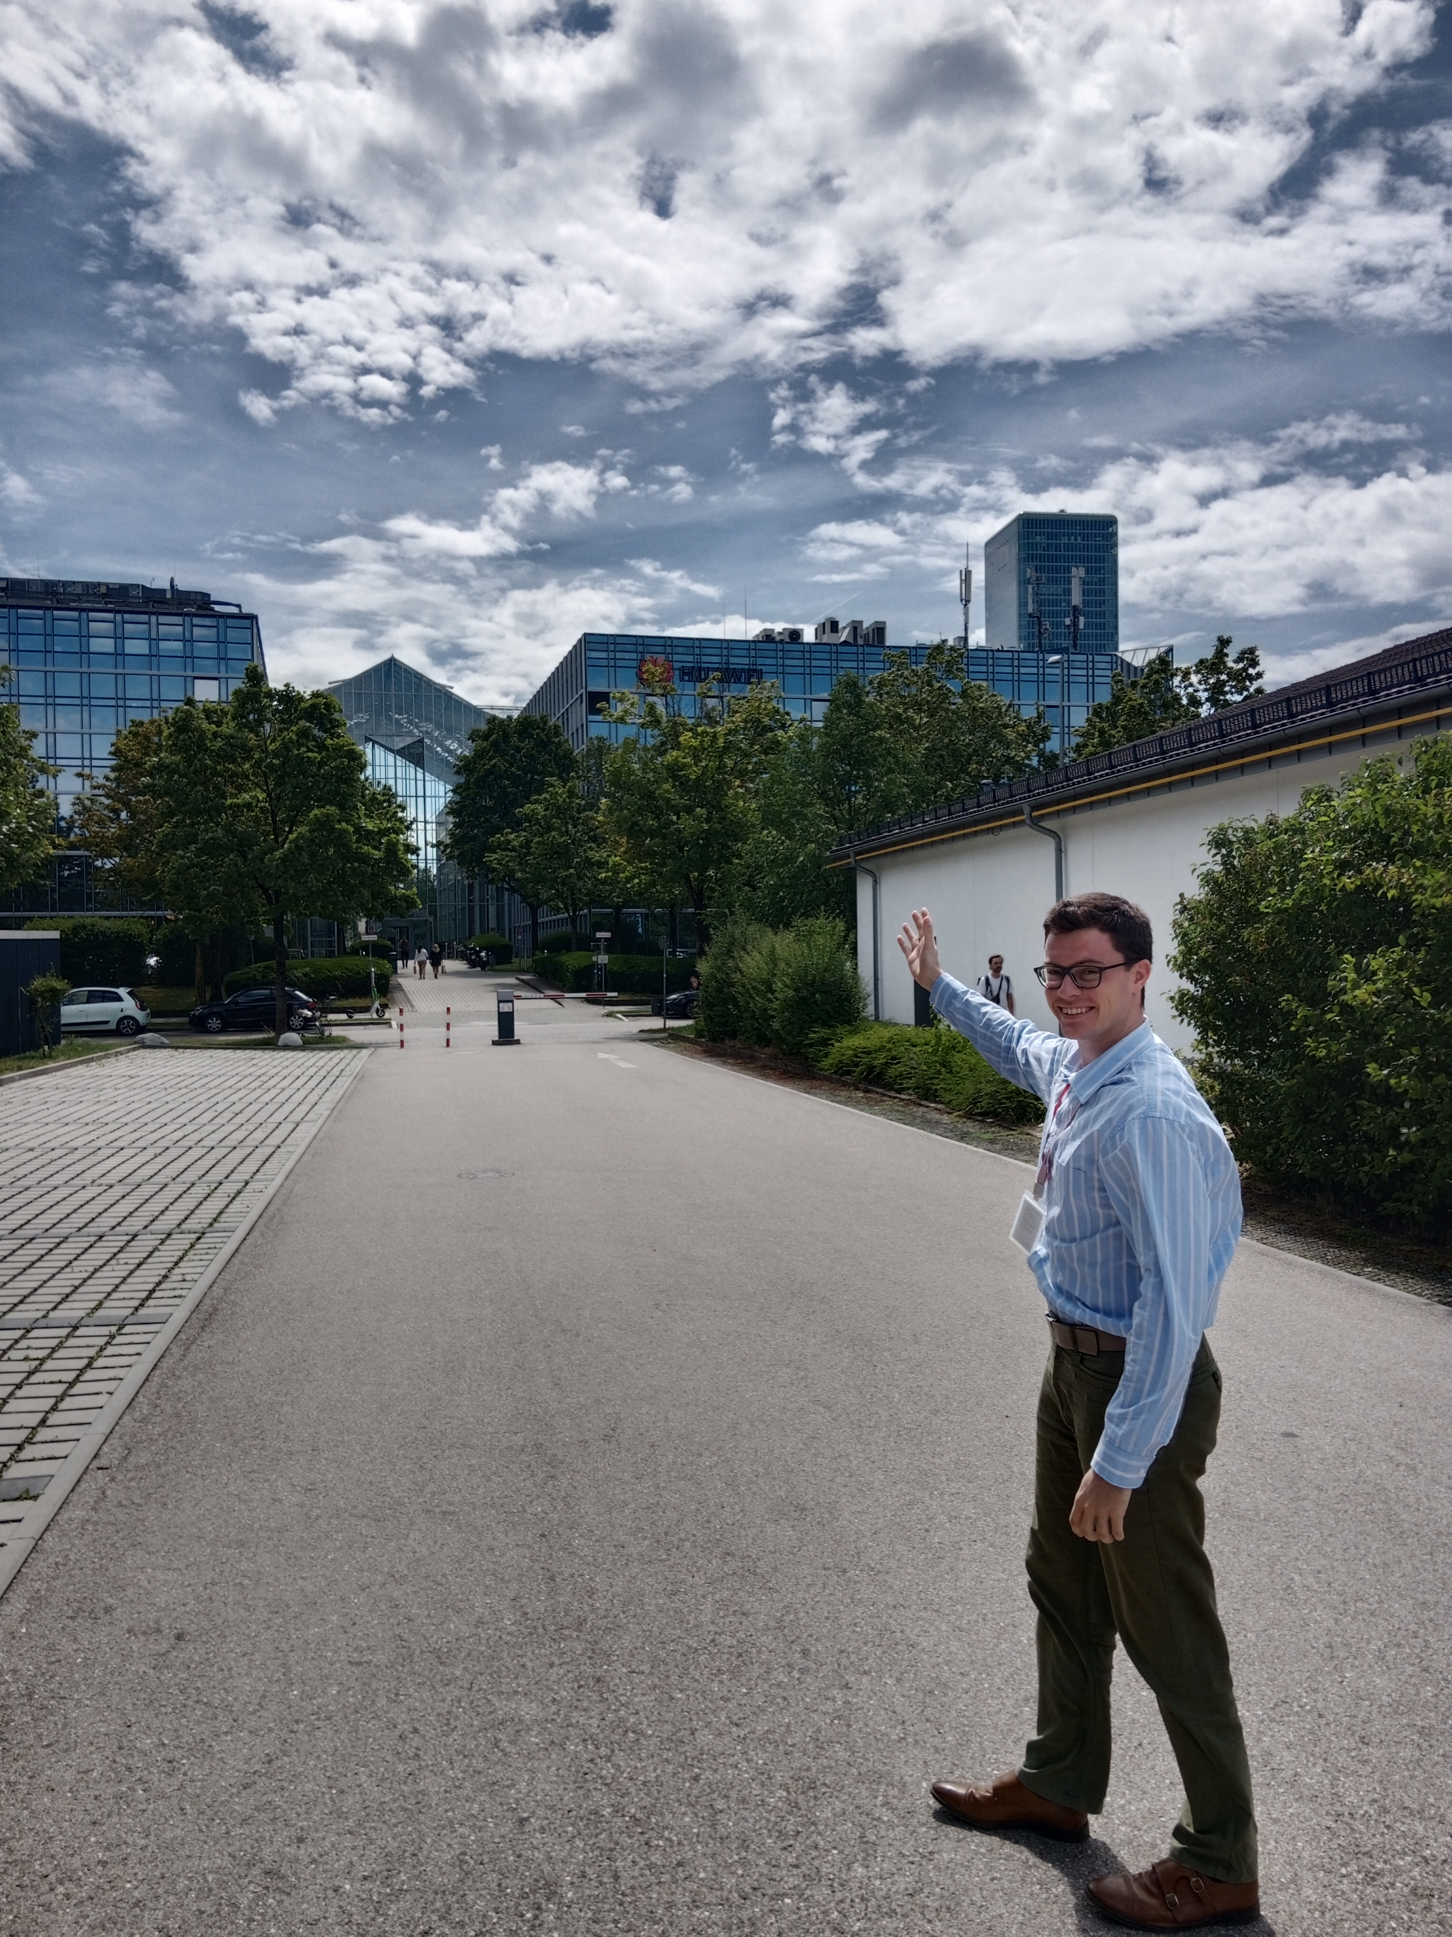
Current Position

Slide 3
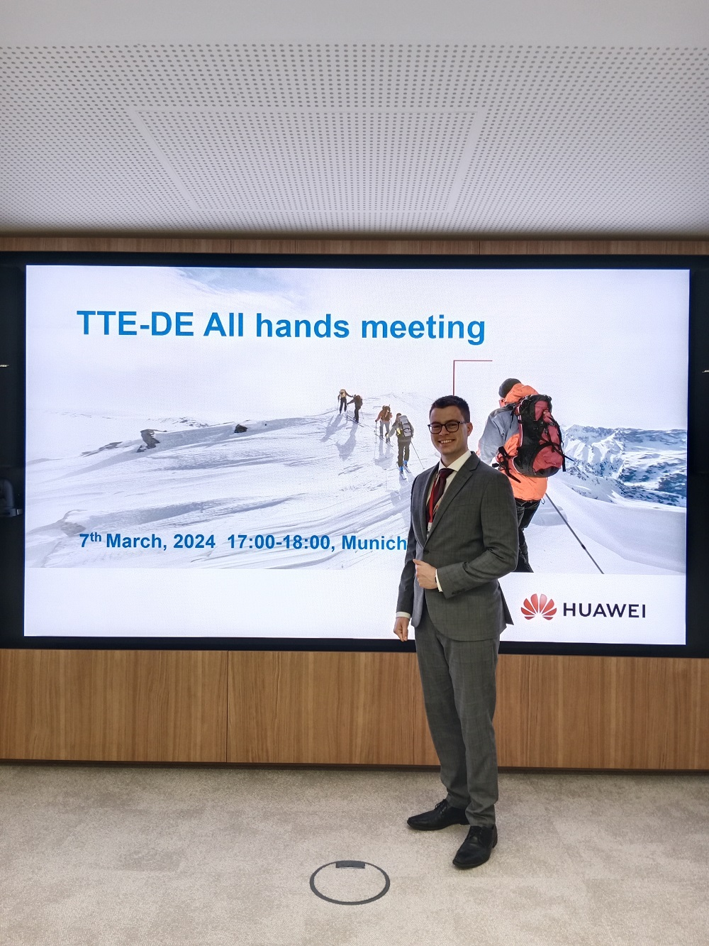
Work and Research Experience
Cooperation with professors and research groups from prestigious European Universities like NTUA, ETH Zurich, TU Munich…
After having proved my research, technical and academic capabilities to my managers, I have been assigned roles that include providing guidance to interns and structuring the course of action for our team’s projects…
These tasks require management skills, time-scheduling capabilities and a holistic view of the company structure…
My ambition is to succeed in such tasks and be trusted to manage and lead larger groups in international research centers.

Slide 4
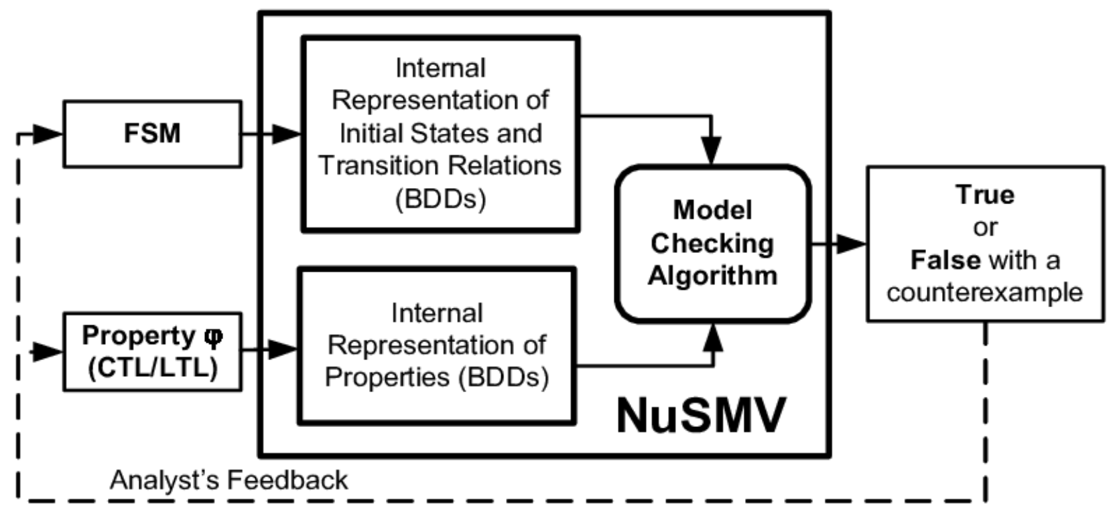
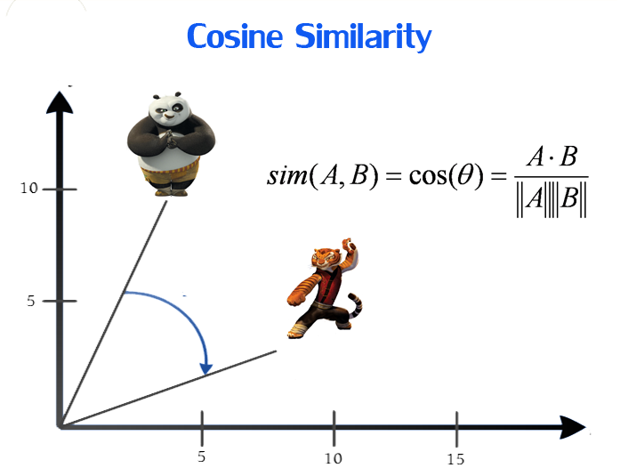
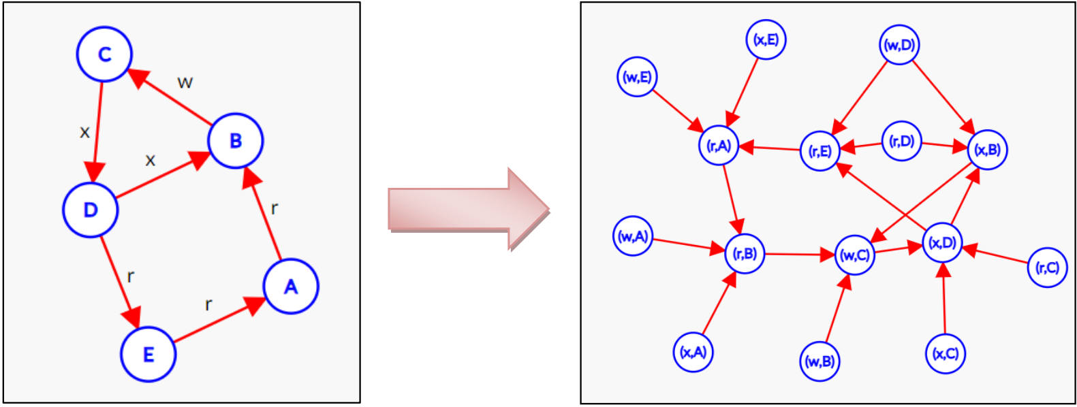
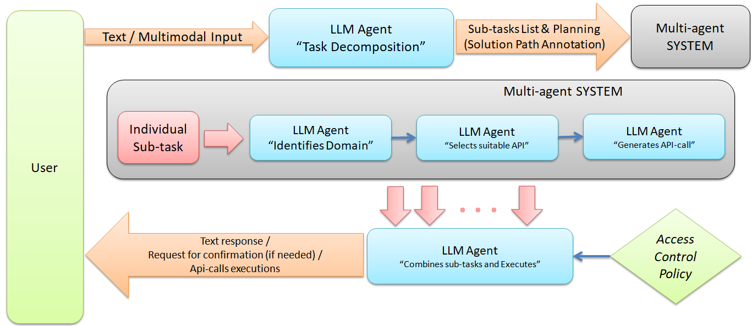
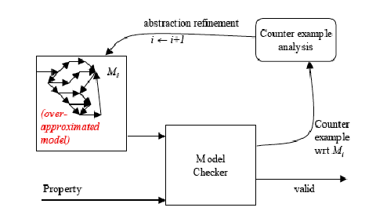
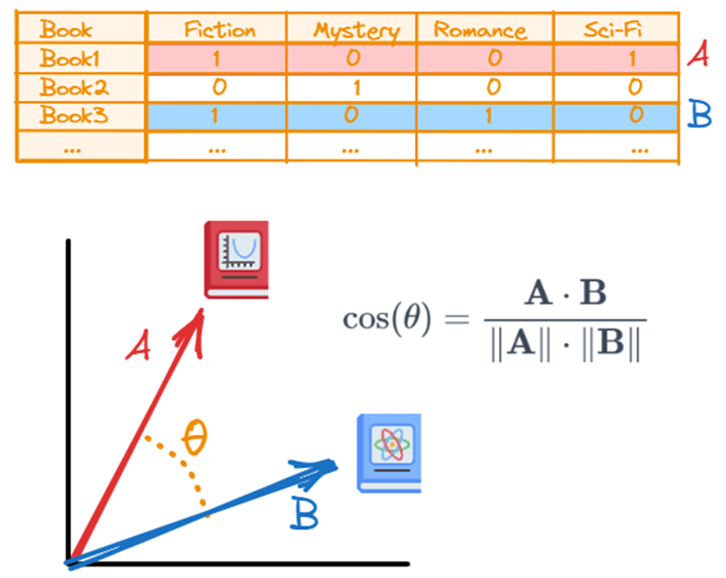
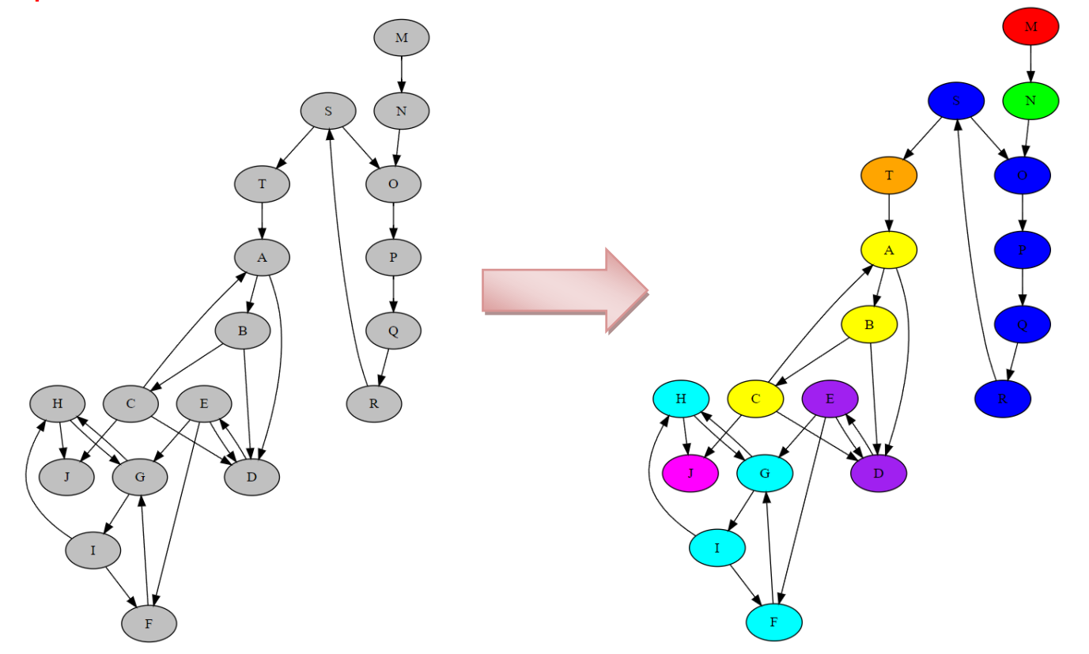
My current research area

Slide 5
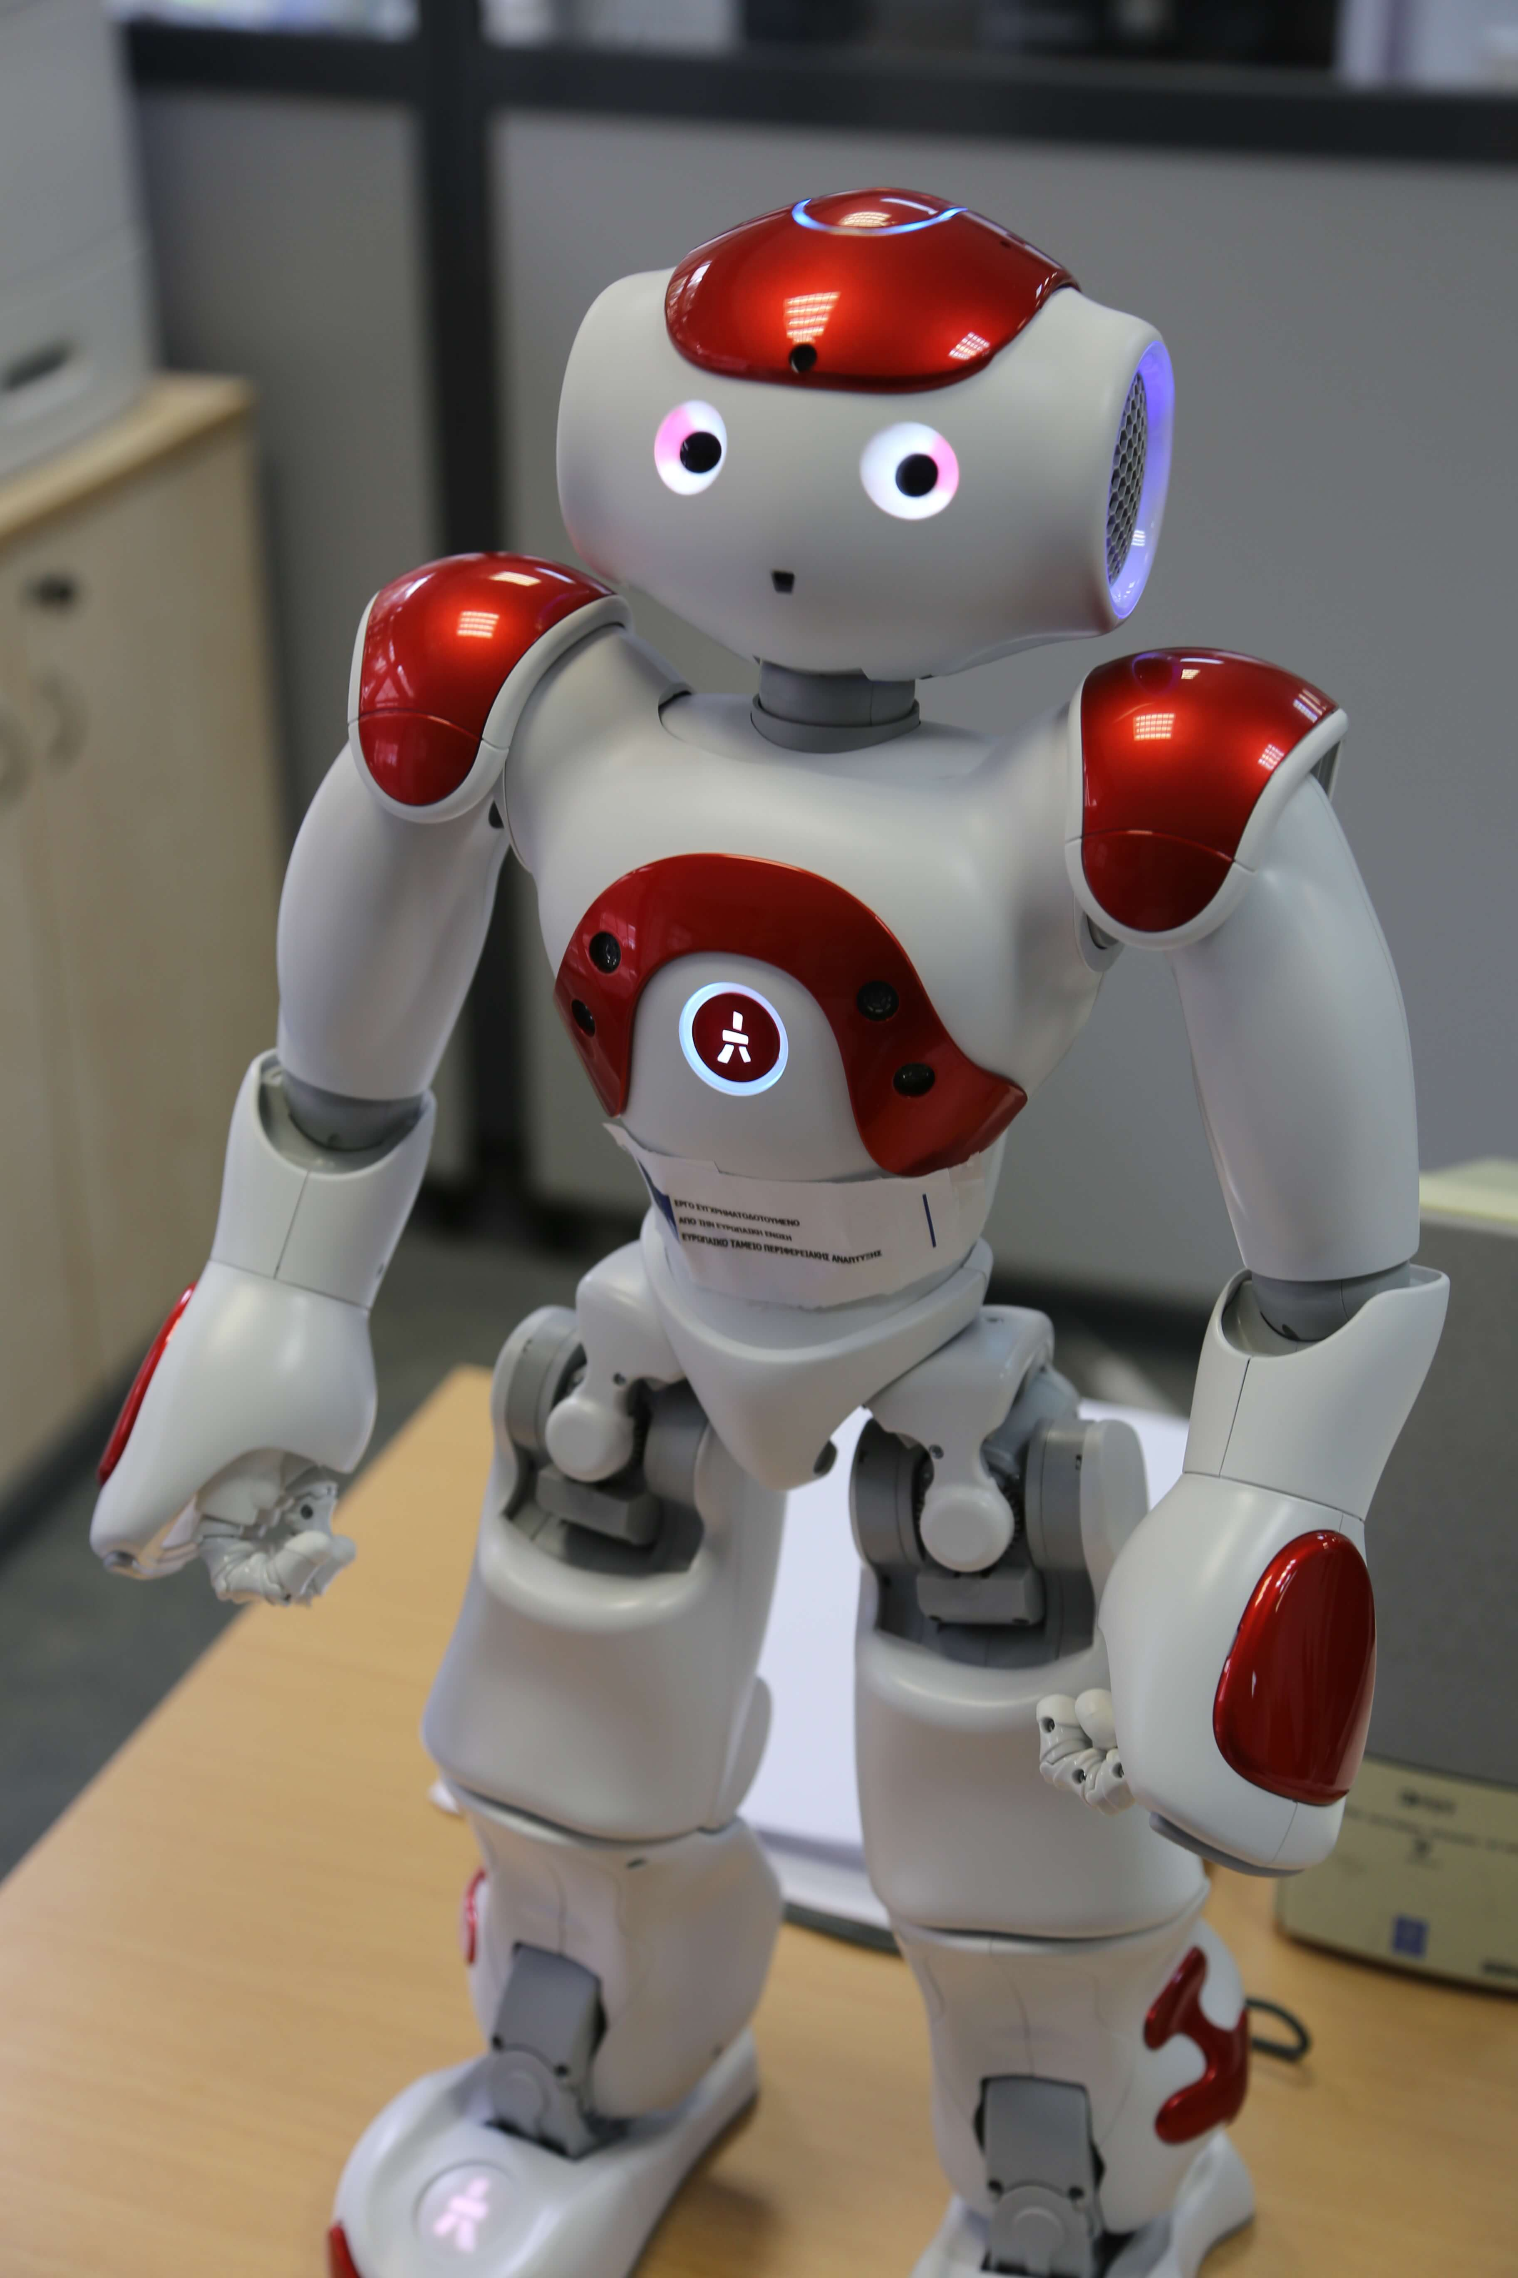
Academic Degrees

Slide 6
Academic Degrees
Master in Electrical and Computer Engineering)
Excellent GPA (9.00/10.00)
Master Thesis topic: “Creating an LLM-based AI-agent: A high-level methodology towards enhancing LLMs with APIs”
Excellent grades at the following subjects related to the MBA:
Organization & Management: Theory & Practice
(Οργάνωση και Διοίκηση)
Business Microeconomics
(Οικονομική Ανάλυση Επιχειρήσεων)
Decision Support Systems
(Συστήματα Αποφάσεων)
Management Game
(Παίγνια Αποφάσεων)

Slide 7
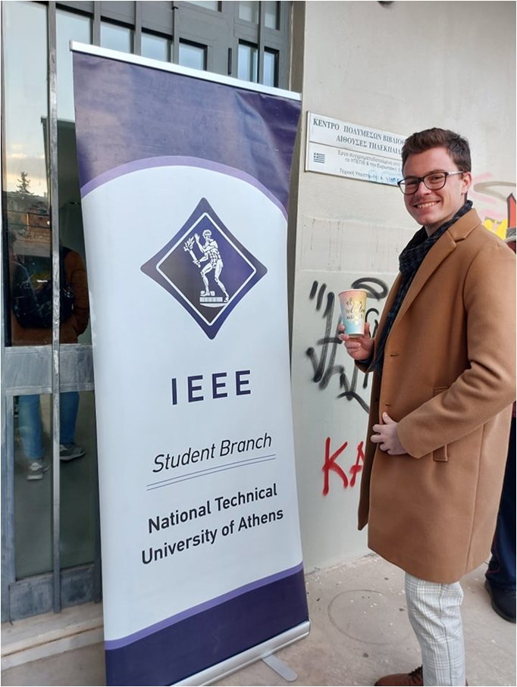
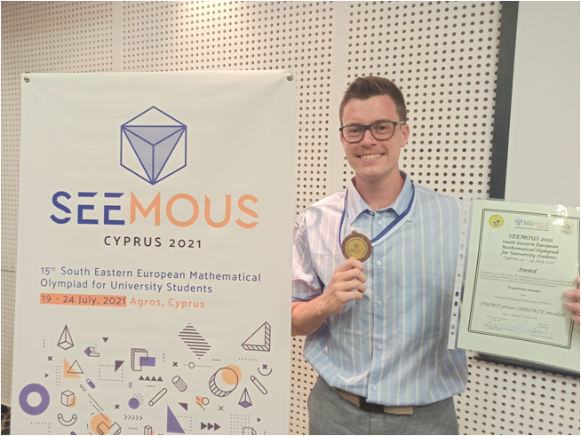
Academic activities

Slide 8
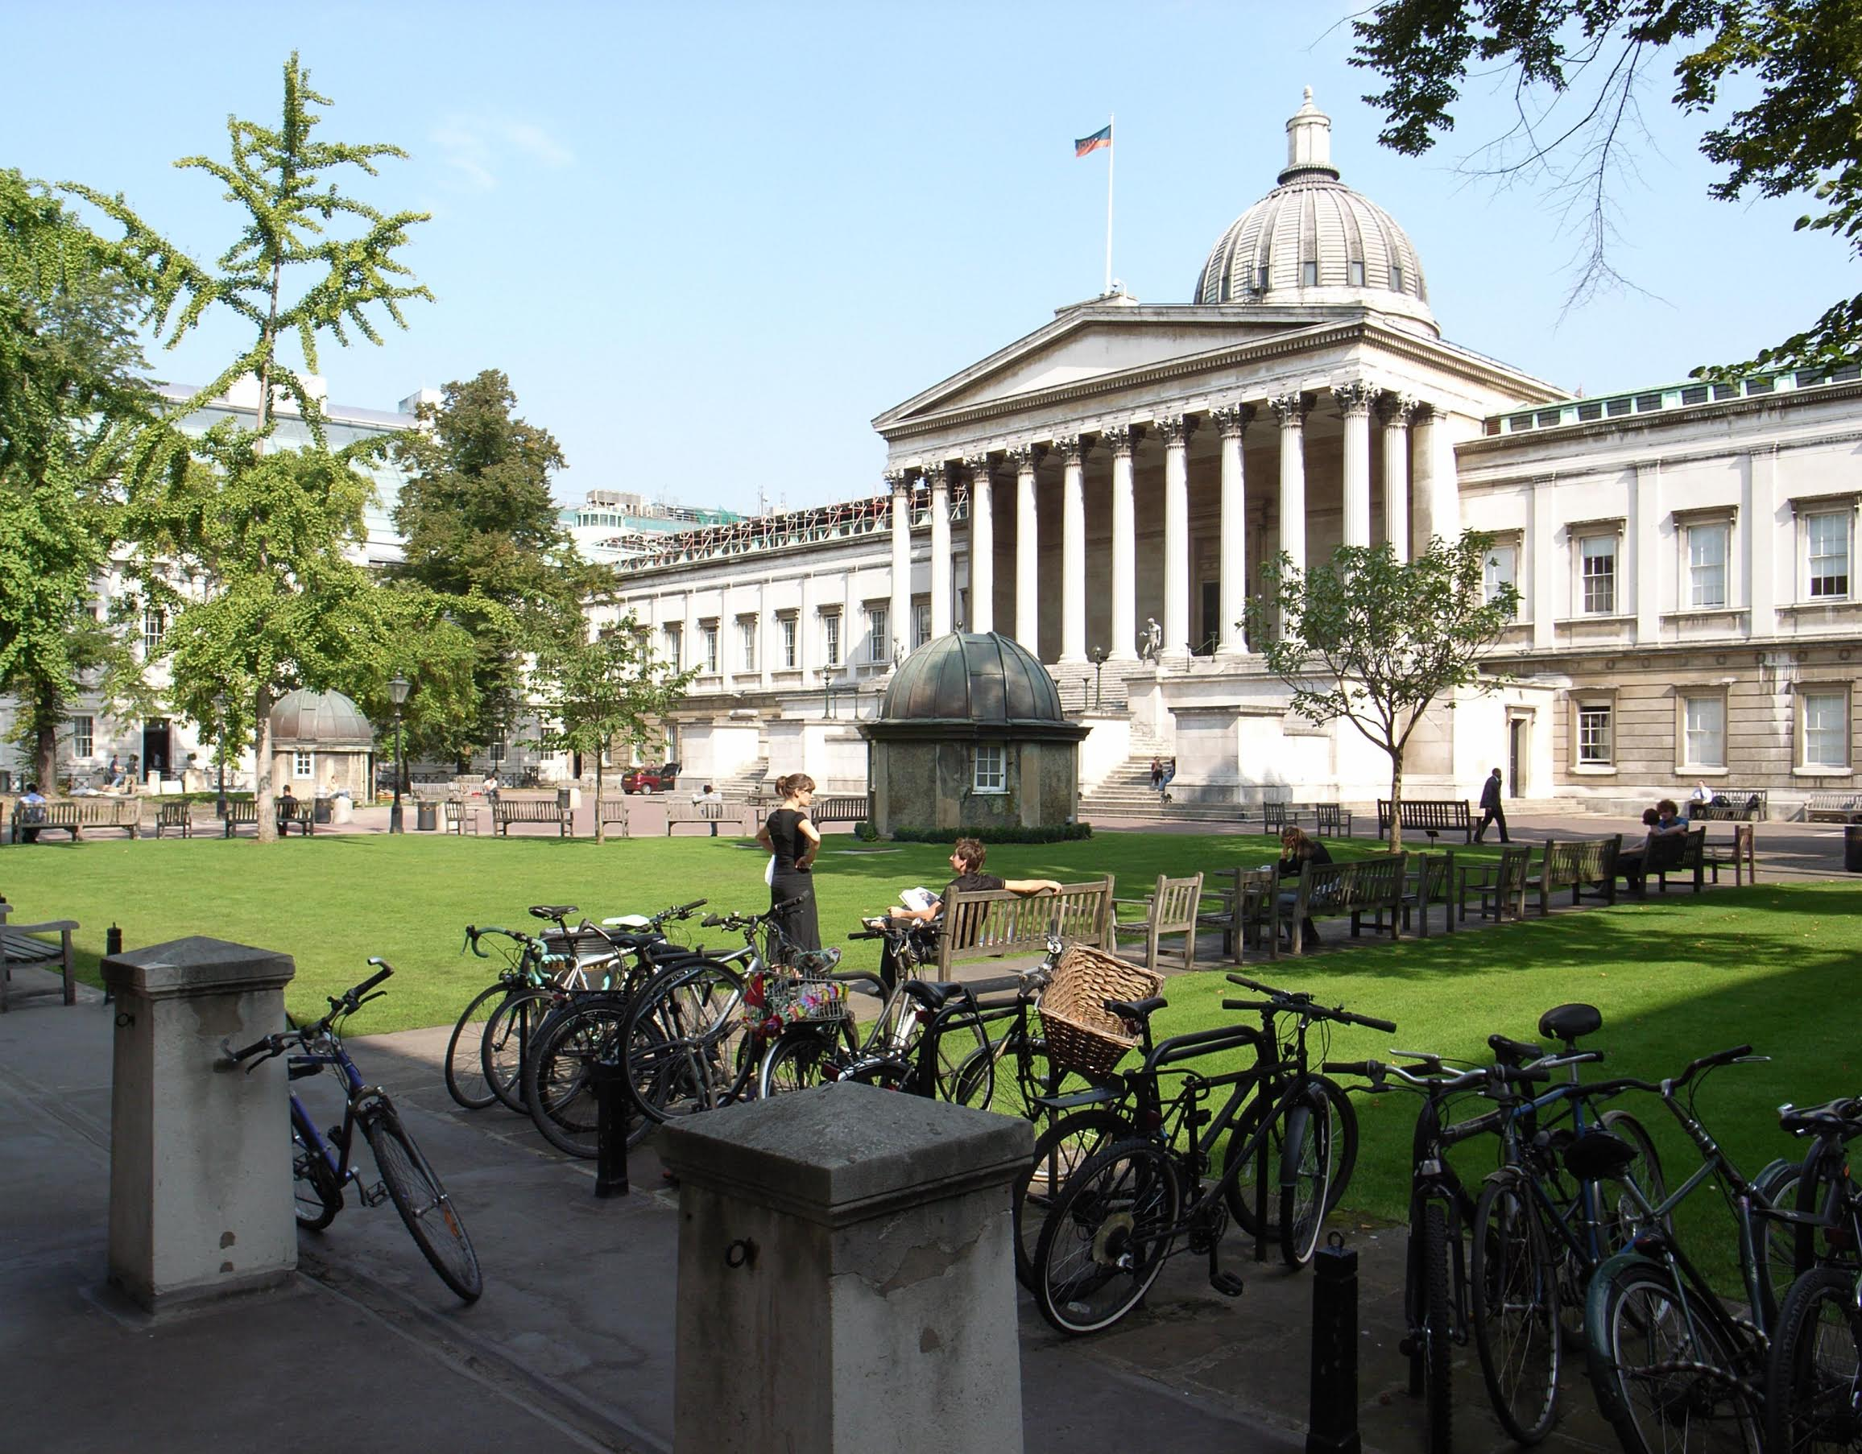
Awards

Slide 9
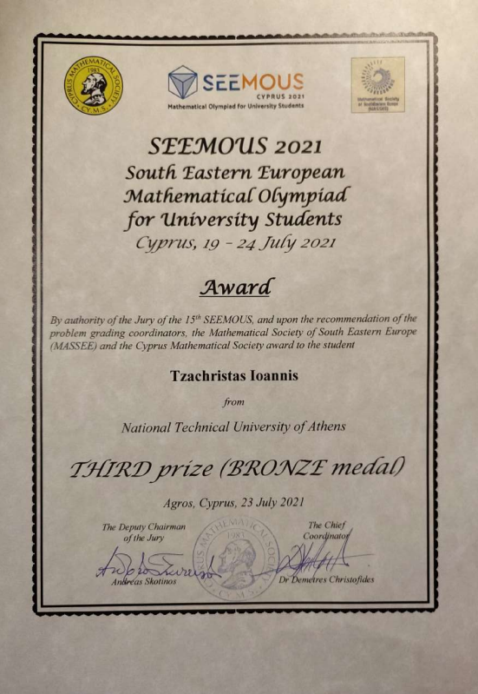
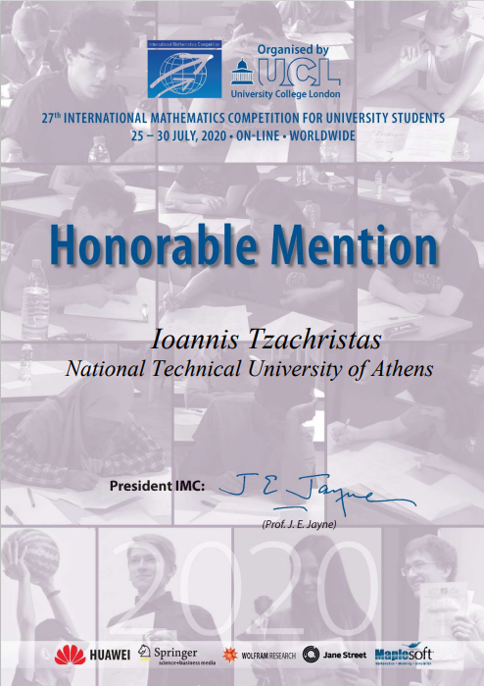
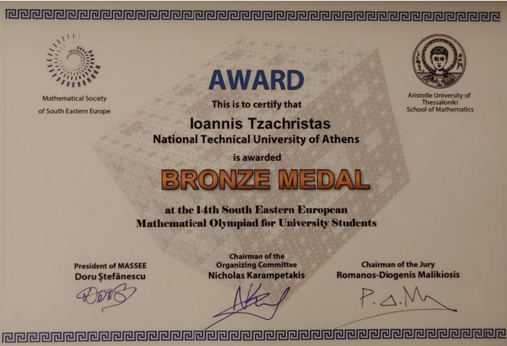
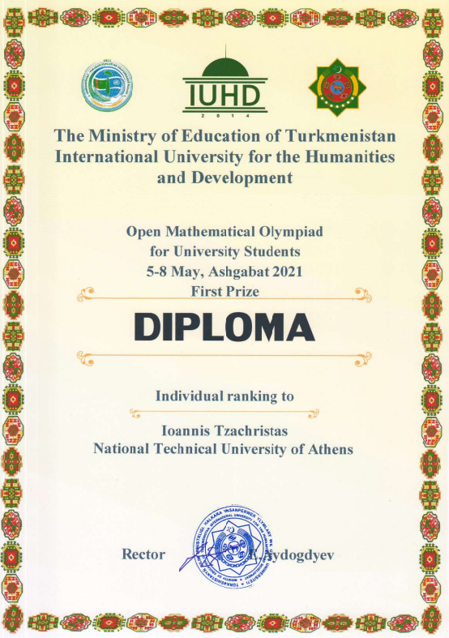
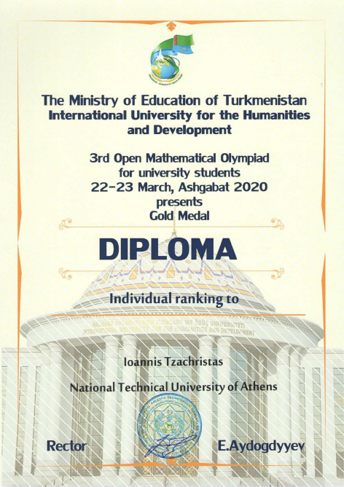
Awards

Slide 10
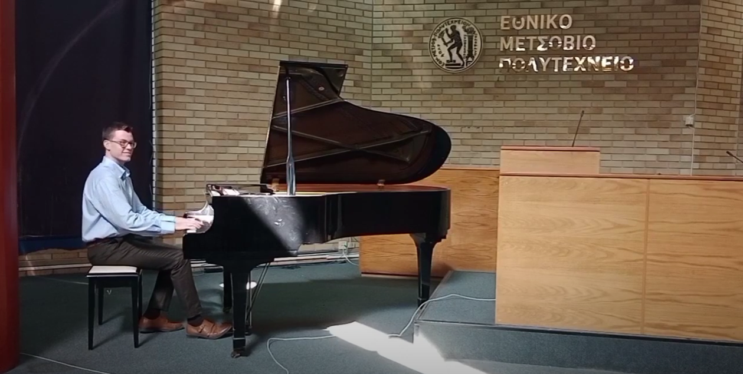
Extras

