Slide 1
DIG 4 FUTURE
Digital competencies, Inclusion and Growth
for Future generations
Module 4 - Life on the Net

Slide 2
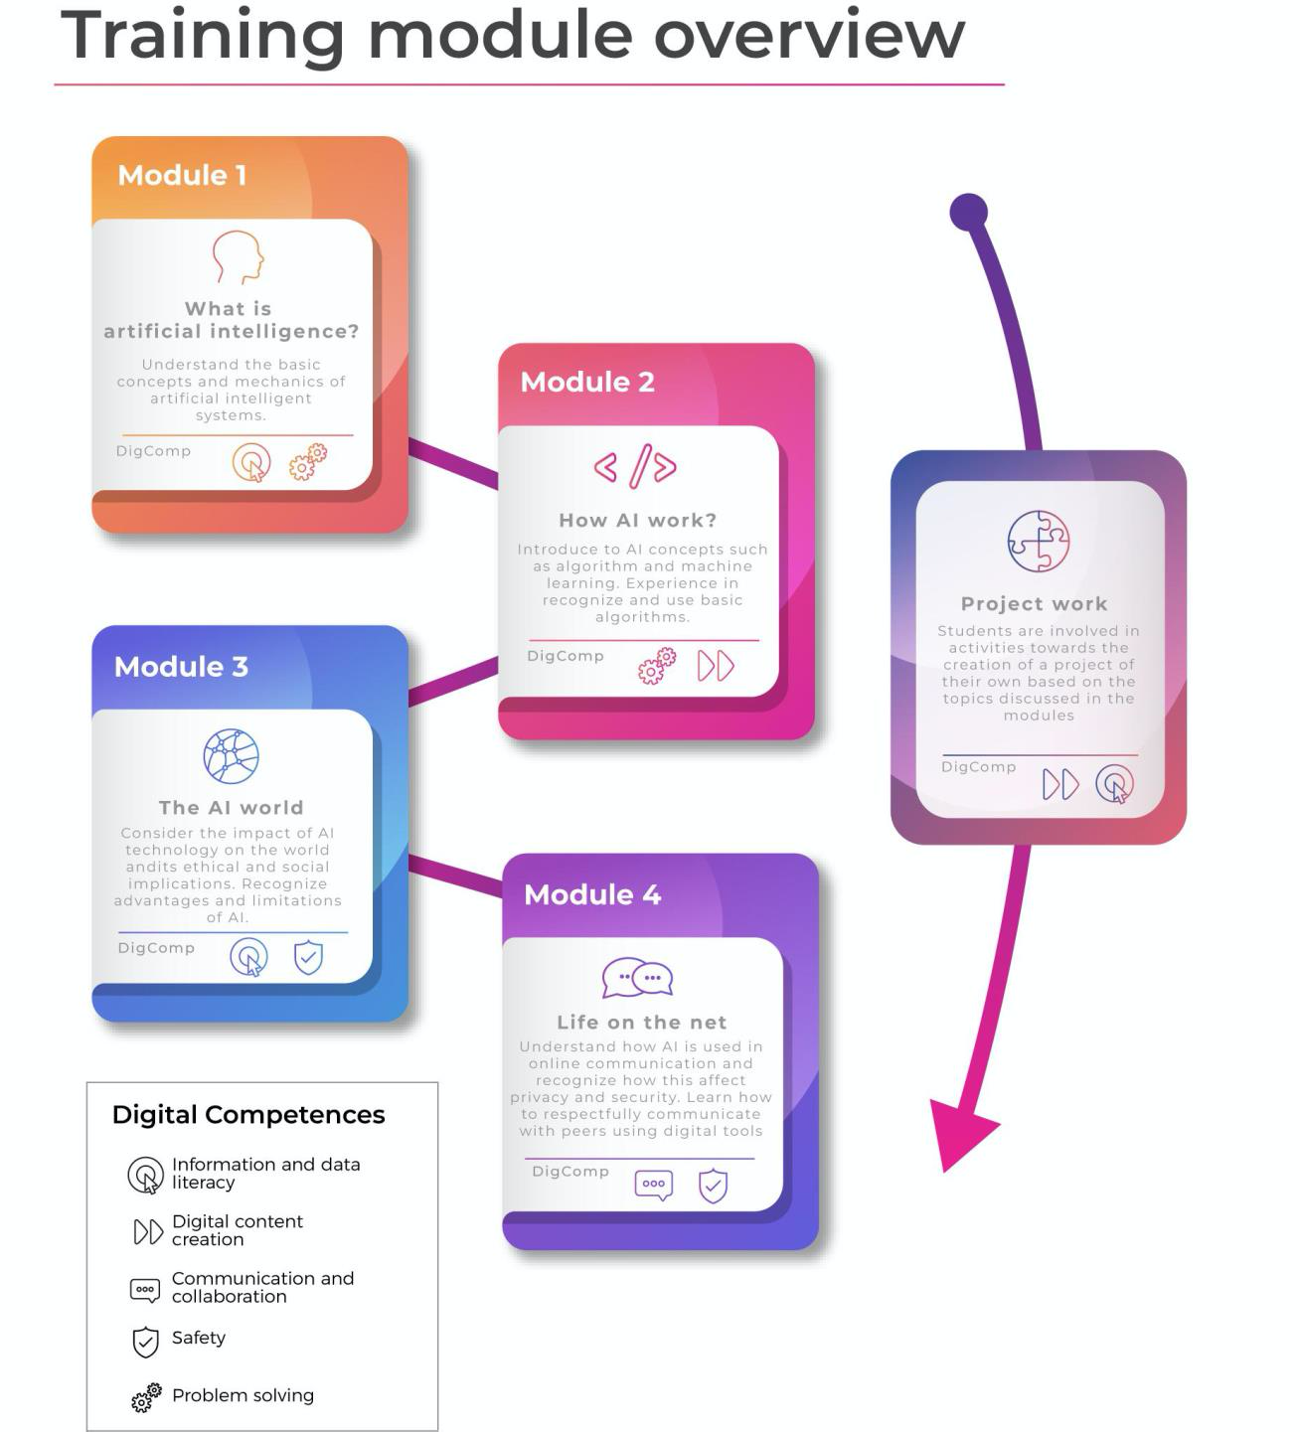
TRAINING MODULES
Module 1 What is AI?
Module 2 How AI work?
Module 3 The AI world
Module 4 Life on the net

Slide 3
AGENDA
Intro (5’)
Topic 1: Knowledge on the web: disinformation, fake news, fact checking and critical thinking (20’)
Activity for Topic 1: Identifying Fake News (15’)
Topic 2: Identifying and countering hate speech online (20’)
Activity for Topic 2: Identifying Online Hate Speech (15’)
BREAK (30’)
Topic 3: Privacy, anonymity and confidentiality online (20’)
Activities for Topic 3 (15’)
Topic 4: AI-related opportunities for participation and engagement (digital citizenship) (20’)
Activities for Topic 4 (15’)

Slide 4
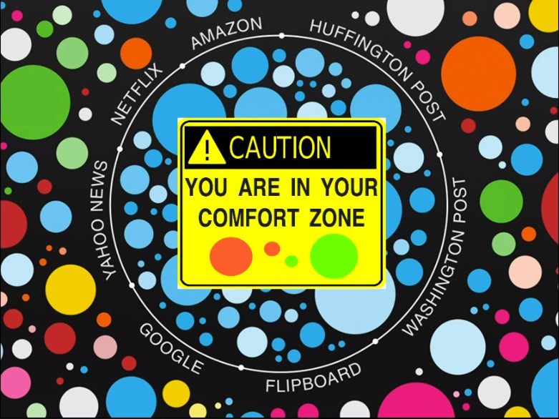
Topic 1 - Knowledge on the web: disinformation, fake news, fact checking and critical thinking
Key Terms →
Fake news
Fact checking
Debunking
Echo chambers
Filter bubbles
Information overload
Infodemic
Information disorder
Source: http://rhetoricmediaciviclife.blogspot.com/2017/04/my-filter-bubble.html
Notes:
https://www.youtube.com/watch?v=KX8-BOc7Z0c

Slide 5
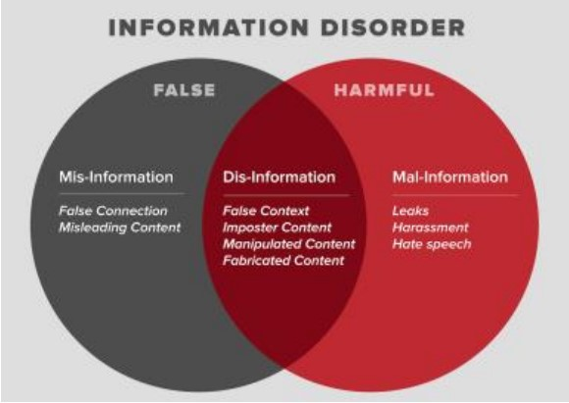
Topic 1 - Knowledge on the web: cont.
Source: Wardle and Derakhshan, 2017
Notes:
https://www.youtube.com/watch?v=KX8-BOc7Z0c

Slide 6
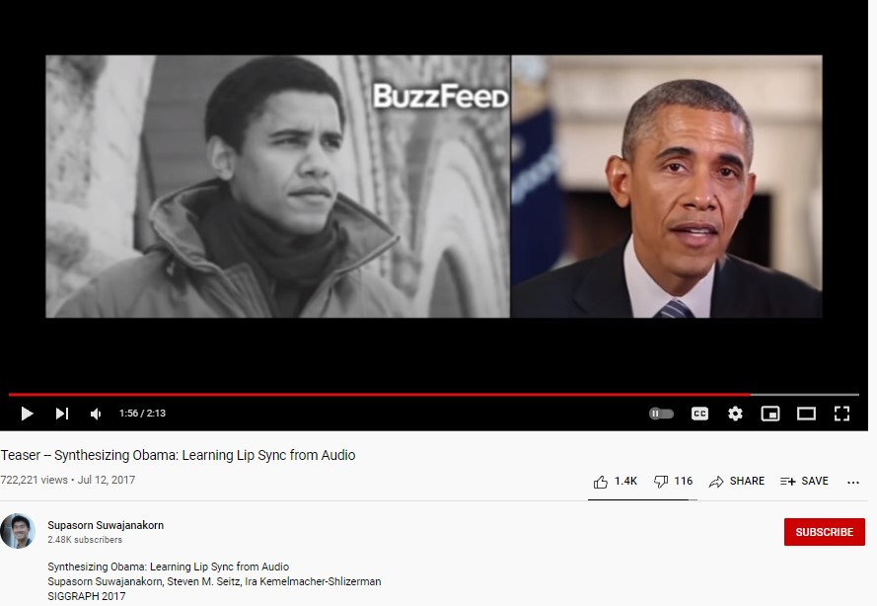
Topic 1 - Knowledge on the web- cont.
Roles of AI in information disorder
Micro-targeting
Computational amplification
Using AI to produce fake news (“deep fake”)
Watch Youtube video of experiment at Washington Uni
Notes:
https://www.youtube.com/watch?v=MVBe6_o4cMI

Slide 7
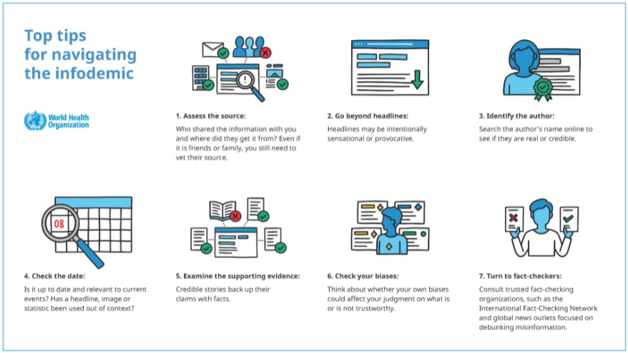
Topic 1 - Knowledge on the web - cont.
What to do? Reactive measures
AI tools to combat fake news and filter bubbles
Fact checking tools
Avoid sharing untrustworthy information
Reporting and tracking fake news
Source: WHO

Slide 8
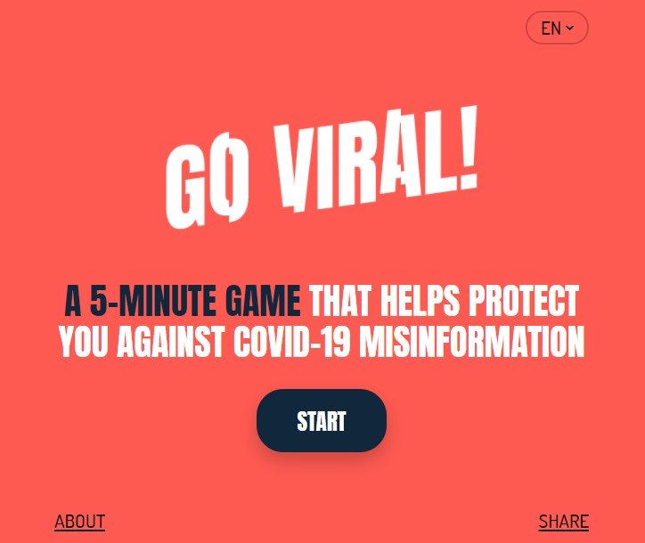
Topic 1 - Knowledge on the web - cont.
What to do?
Preventive measures
Pre-bunking
Critical media literacy in schools to equip youth against “information disorder” (McDougall 2019)
Notes:
https://www.goviralgame.com/en/intro
https://firstdraftnews.org/articles/a-guide-to-prebunking-a-promising-way-to-inoculate-against-misinformation/

Slide 9
Activity for Topic 1: Identifying Fake News
STEP 1: Teacher/educator introduces key terms and examples of fake news (country-specific, if possible)
STEP 2: Homework: Every student identifies one example of fake news they have encountered on social media and prepares a short written description of the example, with a link to an online resource that can be accessed in class during Step 3
STEP 3: In-class presentation of examples + moderated discussion
STEP 4: The discussion is followed by the identification of a shared definition of “fake news” and recommendations to add to the class code of conduct, i.e. how to identify fake news and how to respond to them

Slide 10
Topic 2- Identifying and countering hate speech online
Any kind of communication in speech, writing or behaviour, that attacks or uses pejorative or discriminatory language with reference to a person or a group on the basis of who they are, in other words, based on their religion, ethnicity, nationality, race, colour, descent, gender or other identity factor
(UN Strategy and Plan of Action on Hate Speech).
Links with hate crimes and violence

Slide 11
Topic 2- Identifying and countering hate speech online
Young people and hate speech, some evidences:
Overexposure to media debates and hateful messages
Overlapping of imaginaries and issues
Individual freedom of expression as dominant value;
Lack of awareness of consequences
Rare reporting
Need for digital education and intercultural education
Hate Speeches and Youth Cultures Online
https://youtu.be/totD3od_kPA

Slide 12
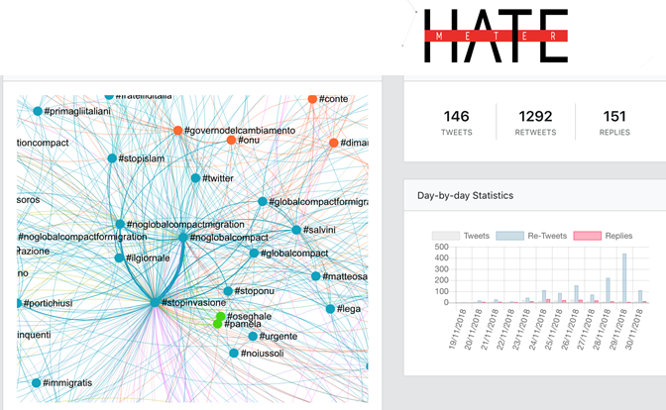
Topic 2- Identifying and countering hate speech online
Countering hate speech online: counternarratives combat hate speech by discrediting and deconstructing the narratives on which they are based
AI-based tools in countering online hate speech
HATEMETER: a platform to support NGOs’ operators in tackling anti-Muslim hate speech online, by automatically monitoring and analysing Internet and social media data on the phenomenon.
http://hatemeter.eu/

Slide 13
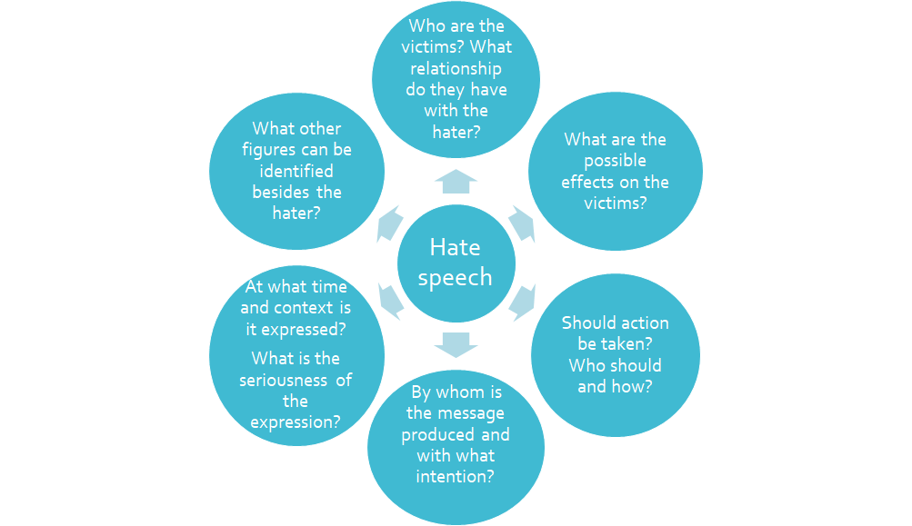
Activity for Topic 2: Identifying and analysing Online Hate Speech

Slide 14
BREAK
30’

Slide 15
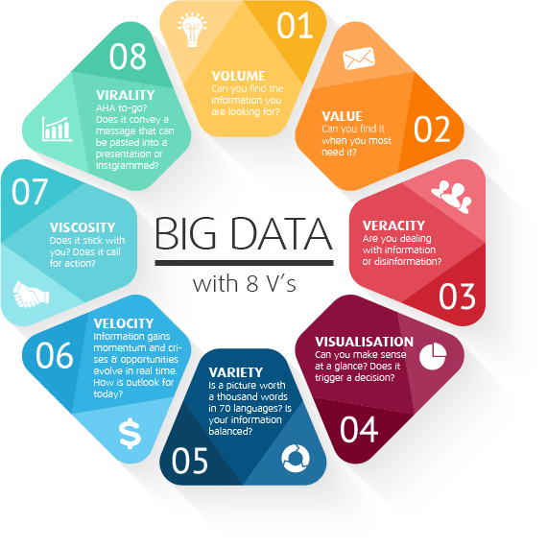
Topic 3 - Privacy, anonymity and confidentiality online
Big Data : Volume, Rapidity and Variety
Velocity
Veracity
Value
Variability
Exhaustive
Relational
Extensional
Scalability
Ex. Covd-19 apps

Slide 16
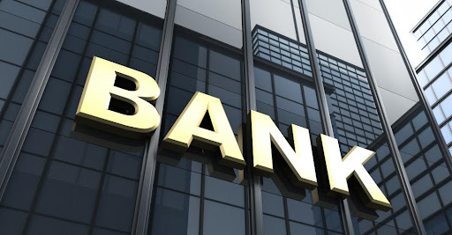
What about my privacy?

Slide 17
Everyday, millions of people leave their information footprint while using internet services.
This footprint consists of all of the information that people post, the hidden data attached to those posts by the services people use, the record of people’s online activities, and also the inferences that can be drawn from putting that collective information together.

Slide 18
Activities for Topic 3
Personal disclosure and data sharing
The teacher leads students into an understanding of concepts such as confidentiality and privacy. The teacher asks questions such as:
Do these terms have any meaning for you?
Do you apply the concepts of Privacy and Confidentiality to your own personal relationships?
Have you already met Privacy and Confidentiality in other areas? Which ones?
These questions should prompt students to reflect on the amount of private and confidential information they share on a daily basis and on the kind of control they have/keep on it.

Slide 19
The classroom as an analogy for the Internet
Game students will use paper copies of a piece of shared information and hide them around the classroom:
Teacher asks one student, the “sharer”, to write something (of their choice) on the board: it could be a word, a phrase, or trivia about themselves, then they leave the room.
Other students, “re-sharers”, will copy the written information and hide the slips within thirty seconds They may make and hide as many copies as they can produce in the given time.
The sharer has then three minutes to find every copy of the information he/she wrote on the board.

Slide 20
Topic 4 - AI-related opportunities for participation and engagement
(digital citizenship)
What is Digital Citizenship?
What is a “good” digital citizen?
Why is it so important?
Source: Electric Platform for Adult Learning in Europe (EPALE)

Slide 21
Topic 4 - Examples of participation and engagement
(digital citizenship)
Examples of Participation and Engagement
Fridays for future
U-Report (UNICEF) https://www.unicef.org/innovation/ureportCOVID19
Citizens Science
Gamification in citizen participation

Slide 22
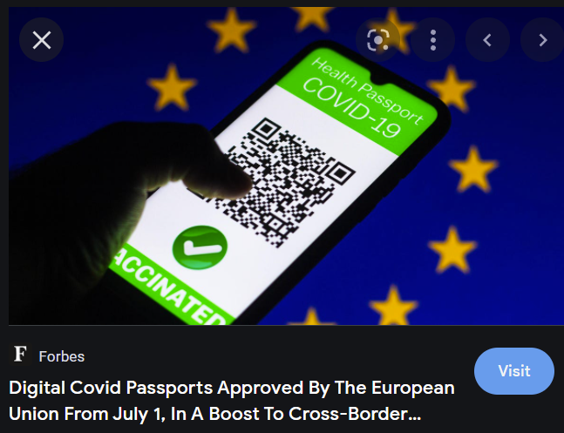
Digital citizens (already)
Each country has its level of digitalization: e.g. in Italy SPID, PEC, etc…
Taken for granted tools:
QR code (EU green passport)
Smartphones
Contactless payments
Source: Forbes

Slide 23
Activity 4.1 - Digital Glossary
Key terms pertaining to the competences and necessary understanding for a digital citizen:
brainstorm the most relevant words in a digital world
creation of a comprehensive glossary
Source: Image by Carpenter Group

Slide 24
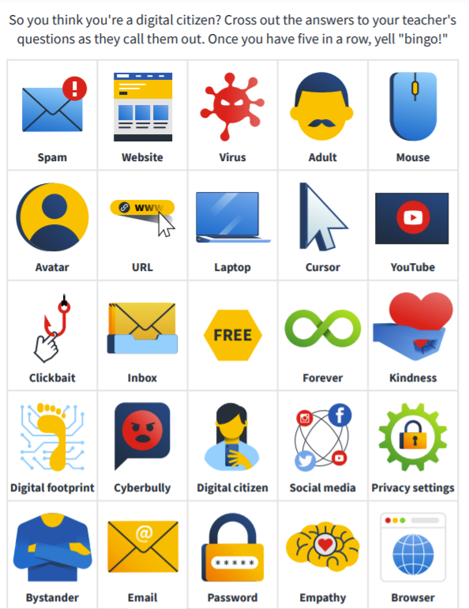
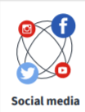
Activity 4.2 - Bingo
Source: Norton

Slide 25
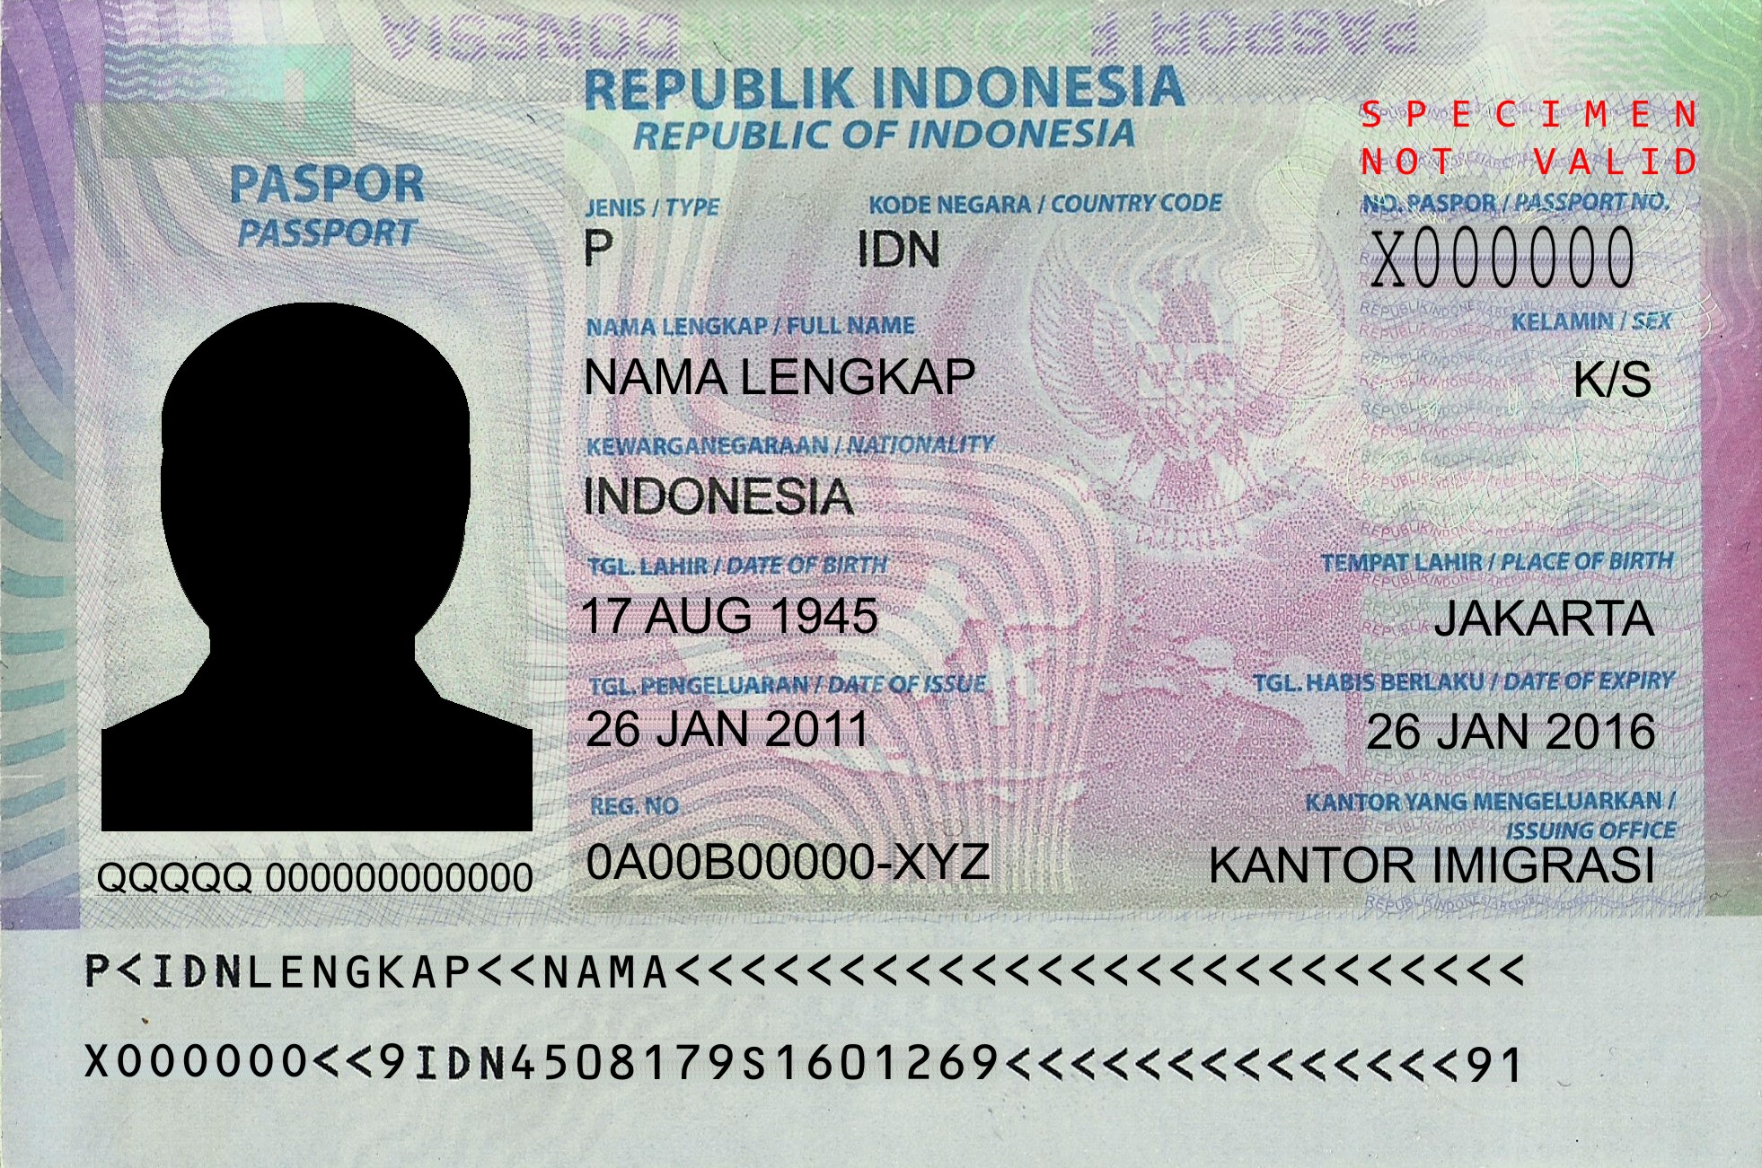
Activity 4.3 - Digital Passport
The passport will resemble in everything a normal passport
The “stamps” applicable to each page will represent the digital ability possessed
The teacher should encourage students to imagine possible skills they would need in a more AI-integrated world

Slide 26
DIG 4 FUTURE
Digital competencies, Inclusion and Growth
for Future generations
Module 4 - Life on the Net

