Slide 1
DIG 4 FUTURE
Digital competencies, Inclusion and Growth
for Future generations
Module 3

Slide 2
AGENDA
Intro (5’)
AI for good (15’)
Main societal challenges and risks in the use of AI (20’)
In class activities for Topic 1 (40’)
BREAK (15’)
Ethics and AI (30’)
Scenario Discussion (20’)
Other Activities of Topic 2 (20’)

Slide 3
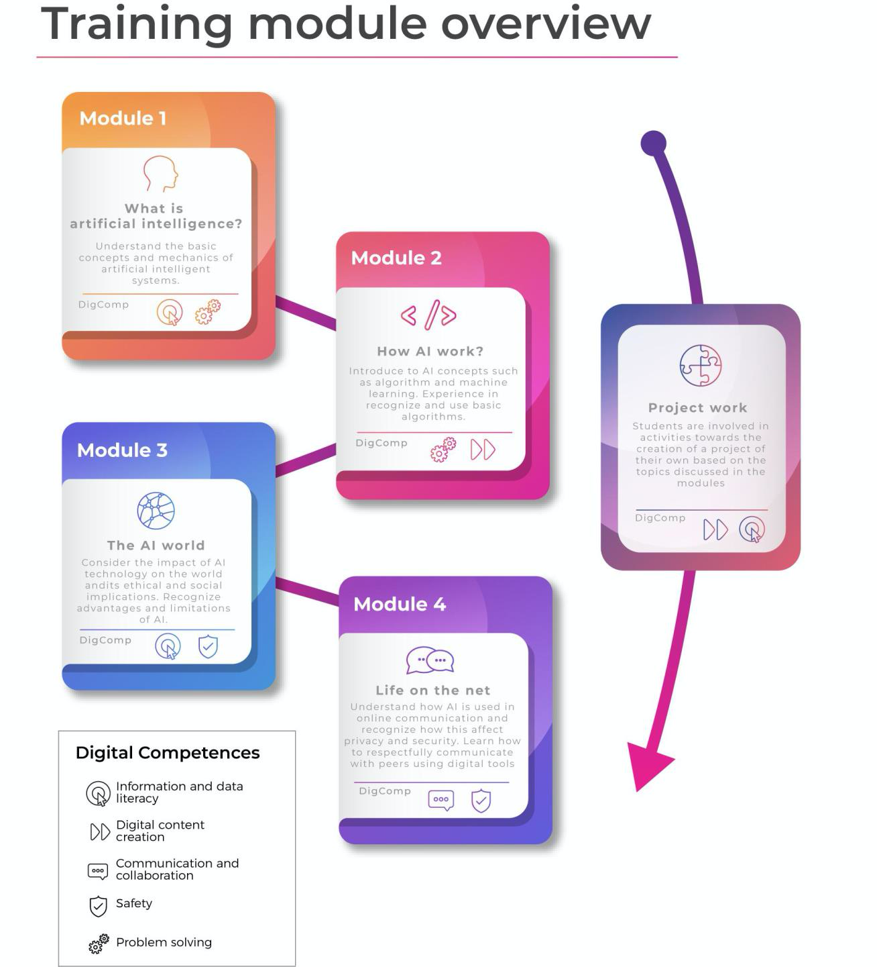
TRAINING MODULES
Module 1 What is AI?
Module 2 How AI work?
Module 3 The AI world
Module 4 Life on the net

Slide 4
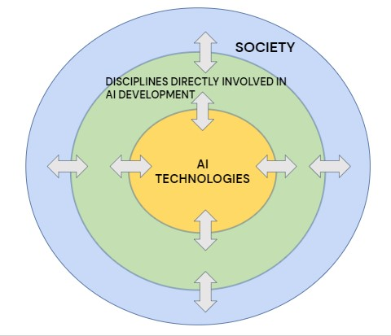
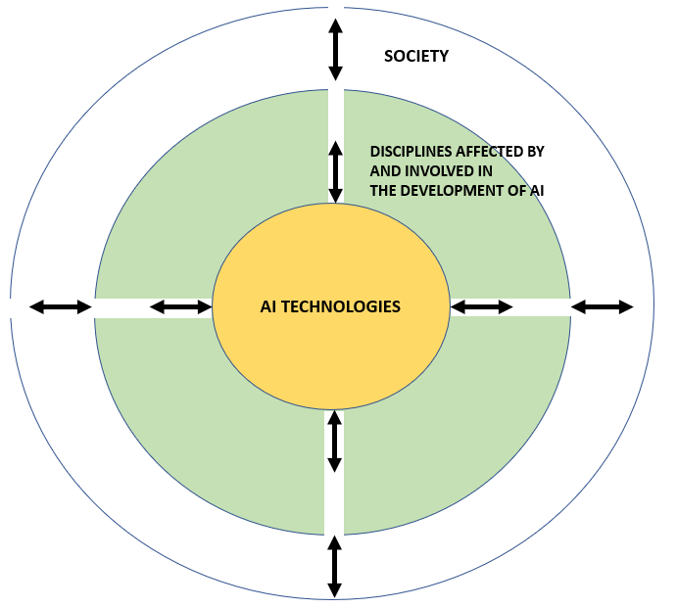
Interdisciplinarity of AI

Slide 5
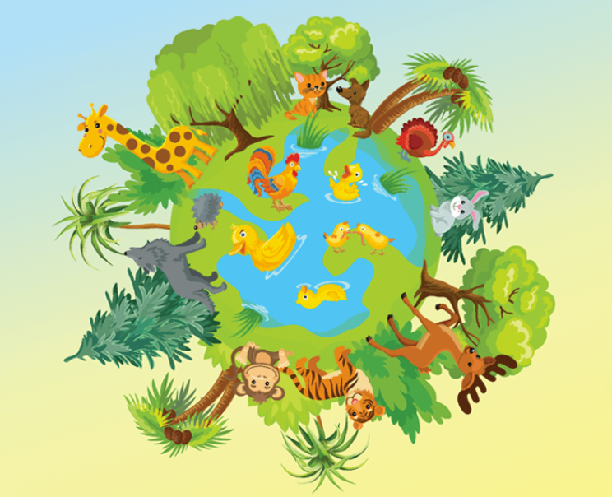
Topic 1 - Real-world Applications of AI
AI for Good
Healthcare
Wildlife
Climate Change
AI-assisted robotic surgery
AI-assisted disease detection
Cancer screening
Track wildlife patterns
Cease poaching
Classify animal species
Models for environmental sustainability
Monitoring ecosystems
Notes:
https://www.crisscrossed.net/2018/12/19/12-inspiring-examples-of-artifical-intelligence-for-good/

Slide 6
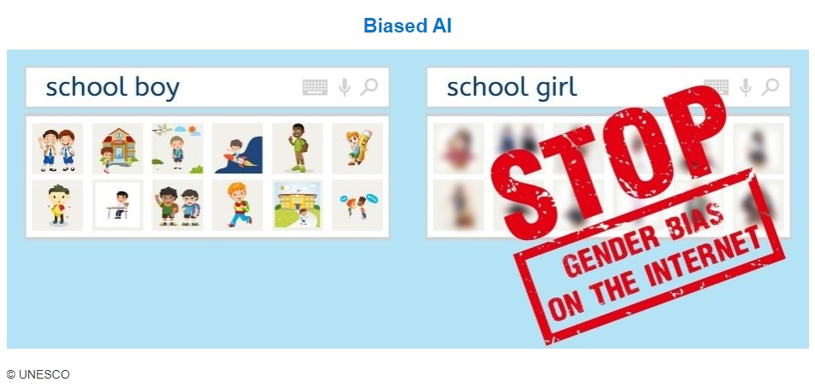
Challenges and risks - Algorithm bias
Gender bias
Racial/ethnic bias
Bias against people with disabilities
….
Notes:
See other examples from https://en.unesco.org/artificial-intelligence/ethics/cases; https://www.businessinsider.com/google-hiring-bias-settlement-2-million-racial-gender-discrimination-dol-2021-2?IR=T

Slide 7
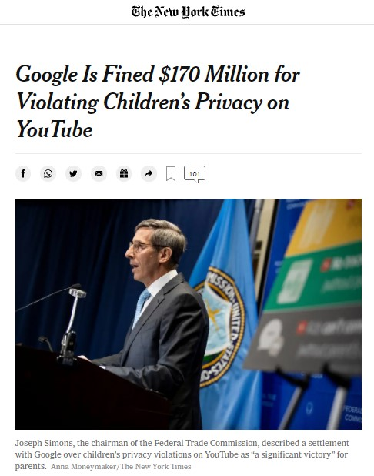
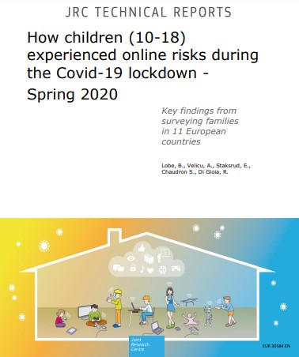
Challenges and risks - Privacy issues
Violation of children’s privacy: manipulation or dissemination of personal information or images without consent
Exposure to online risks (including sexual risks, cyberbullying)
Parental, teacher and peer mediation
Notes:
For more information on risks related to children’s privacy, see https://www.unicef-irc.org/publications/pdf/Investigating-Risks-and-Opportunities-for-Children-in-a-Digital-World.pdf
Mention: European Union’s 2018 General Data Protection Regulation (GDPR), use of students’ personal data in online education and new AIA.
See also: https://cdt.org/area-of-focus/privacy-data/student-privacy/

Slide 8
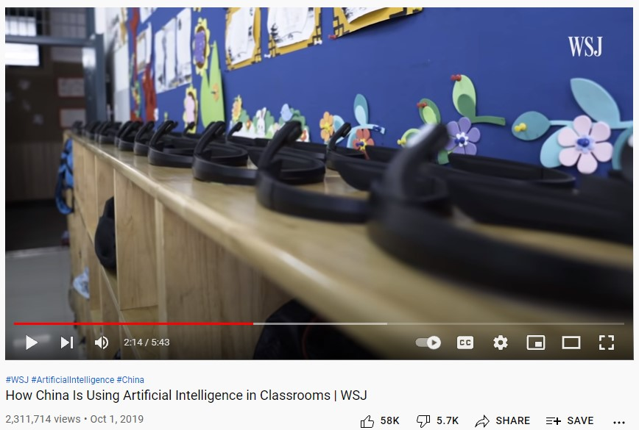
Challenges and risks - Surveillance
Use of face recognition systems
For border control
For law enforcement
Facial recognition and other AI tools in schools
Notes:
WATCH VIDEO ON AI IN SCHOOLS IN CHINA: https://www.youtube.com/watch?v=JMLsHI8aV0g
Border control: https://www.europarl.europa.eu/RegData/etudes/IDAN/2021/690706/EPRS_IDA(2021)690706_EN.pdf (unlawful profiling, bias, privacy)
Recent European moratorium on using facial recognition for law enforcement: https://www.europarl.europa.eu/news/en/press-room/20210930IPR13925/use-of-artificial-intelligence-by-the-police-meps-oppose-mass-surveillance
Attempts to introduce facial recognition in schools, so far condemned by local authorities as violating the GDPR: https://www.politico.eu/article/french-privacy-watchdog-says-facial-recognition-trial-in-high-schools-is-illegal-privacy/
Report on risks in using facial recognition in schools (overview page 28) https://stpp.fordschool.umich.edu/sites/stpp/files/uploads/file-assets/cameras_in_the_classroom_full_report.pdf

Slide 9
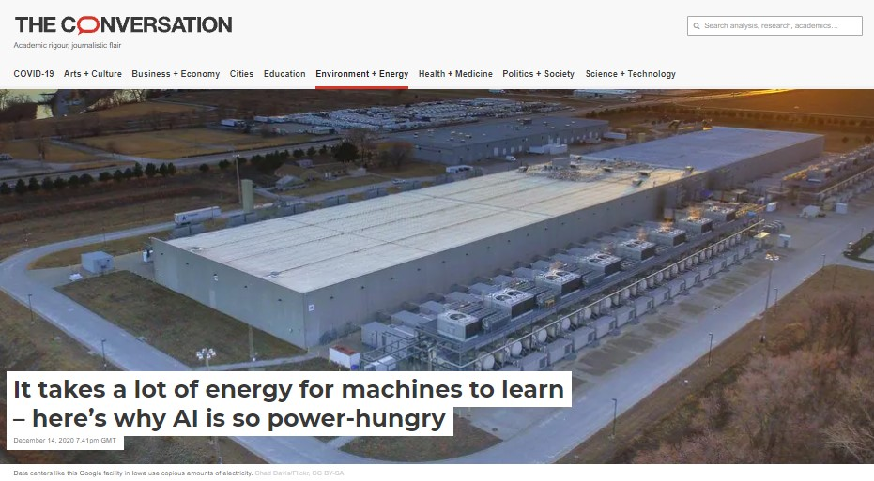
Challenges and risks -
Environmental and economic repercussions
AI represents a threat to employment (automation, loss of jobs)
Machine learning tasks for big tech companies are carried out by low-paid workers in poorer countries, including refugees
AI can have a significant negative impact on the environment
Notes:
Jobs at risk: https://medium.com/innovation-machine/artificial-intelligence-3c6d80072416
See also Daniel Susskind’s book “A World Without Work”. https://www.theguardian.com/technology/2020/jan/18/automation-jobs-universal-basic-income-daniel-susskind-interview
On Development: https://restofworld.org/2021/refugees-machine-learning-big-tech/
On environmental impact: https://www.forbes.com/sites/forbestechcouncil/2020/08/17/why-we-should-care-about-the-environmental-impact-of-ai/
https://theconversation.com/it-takes-a-lot-of-energy-for-machines-to-learn-heres-why-ai-is-so-power-hungry-151825

Slide 10
In-class activities for Topic 1
Real-world Applications of AI
Discussing positive impact of AI (in groups) [Activity 3.1.1]
Discussing negative impact of AI (in groups) [Activity 3.1.2]
Raising questions about future scenarios in AI (“what if” activity = co-design fictions, in groups) [Activity 3.1.3]
Jamboard
https://jamboard.google.com/d/1nUXddX5wrDG6mYuE05Y98ZReRtudzIpTSkS-N83sClQ/edit?usp=sharing

Slide 11
BREAK
11:30

Slide 12
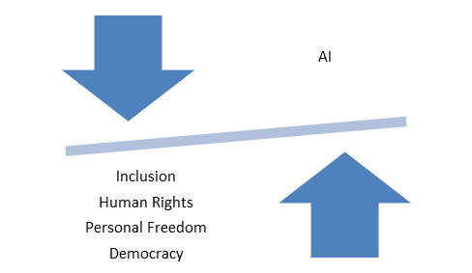
Topic 2 - Ethics of AI (1)
“AI will need to be introduced in ways that build trust and understanding, and respect human and civil rights.” (European Parliament, 2020)
This requires:
Fairness
Transparency
Accountability
Control/Regulation
Notes:
Riprendere alcuni temi ripresi precedentementi (ad es. challenges) e descrivere il tema del dilemma in termini etici e morali e l’effetto contestuale. Menzionare UNESCO’s Recommendations on the ethics of AI: https://en.unesco.org/artificial-intelligence/ethics and EU’s ethics guidelines for trustworthy AI https://digital-strategy.ec.europa.eu/en/library/ethics-guidelines-trustworthy-ai

Slide 13
Topic 2 - Ethics of AI (2)
Education in Ethics
learn what is right and what is wrong (normative ethics)
making ethical decision / adopting ethical behaviors (descriptive ethics)
critical thinking on ethics and values (meta-ethics)
Education on Ethics (and AI)
Identify ethical dilemmas
Learning criteria for ethical decision making / adoption of ethical behaviors
critical thinking on ethics and values (meta-ethics)
Notes:
Riprendere alcuni temi ripresi precedentementi (ad es. challenges) e descrivere il tema del dilemma in termini etici e morali e l’effetto contestuale

Slide 14
Topic 2 - Ethics and AI (3)
Working on ethics and AI through dialogue in classrooms
Dialogue (vs debate) as a means of:
improving teaching and learning,
facilitating intercultural understanding
cultivating thinking and argumentation
advancing democratic values and participation
etc.
Why hasn’t dialogue become a common form of classroom discourse?

Slide 15
Ethics of AI - Guiding in class discussion
Criteria for dialogical contents
purposeful (guided by educational goals)
cumulative (participants respond to and build upon one another’s ideas)
critical: participants identify and investigate open questions and points of contention
meaningful: participants relate the topic of discussion to their own horizons of meaning, and bring those horizons to bear upon one another in developing new understandings
Alexander, R. J. Towards Dialogic Teaching: Rethinking Classroom Talk, 2nd edn, Cambridge: Dialogos
Guidelines and suggestions for facilitating class discussions
Encourage students to come to terms with the uncertainty of their own positions and the need to acquire information
Work on students' awareness of the sources and conditioning "behind" their opinions
Identify and free the field from ways of discussing that can trigger emotional and non-rational reactions
Work on active listening
Promote willingness to abandon persuasive intentions in favor of understanding
Construct and share together the basic rules of dialogue
Difficult Dialogue in the Classroom - Training resource from Tony Blair Institute for Global Change

Slide 16
Ethics of AI - Promoting in class discussion
Ethics evaluation on scenarios presented in the first part of the module

Slide 17
Scenario discussion step by step
Teachers as facilitators
Remind the students about the most common ethical theories as starting point for the discussion development
Divide the pupils in group of 4 or 6
Read a scenario or provides the text if the activity is held on line
Ask the students their intake on the scenario. Which are the ethical problems or issues? (individuation of one problem)
Once a problem is highlighted, the teachers should ask which approaches would solve the issue and the consequences entailed

Slide 18
Scenario discussion step by step
Students as critical thinkers
-Students will critically engage into figuring out ethical dilemmas after the reading of the scenario;
- Each group should propose a list of possible approaches and propose them to the rest of the class and discuss the best solutions outcome.

Slide 19
In-class activities for Topic 2
Ethics of AI
Scenario Discussion - Students intake on ethical considerations
Students should engage into ethical considerations on the potential benefits and risks surrounding AI tools. The discussion should revolve around potential impacts of AI on:
Social inequalities and transformation of labor market
Sustainability and natural resources
Privacy, human relations and human rights

Slide 20
DIG 4 FUTURE
Digital competencies, Inclusion and Growth
for Future generations
Module 3

