Slide 1
Exploring Technology: Creative Construction for the Environment and the Universe
By Vassiliki Tasika and Zoe Liakou

Slide 2
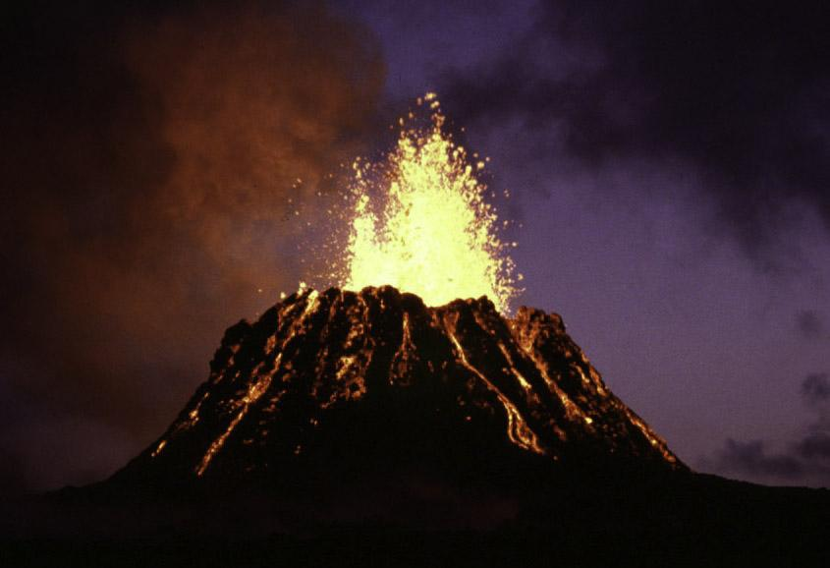
Volcano

Slide 3
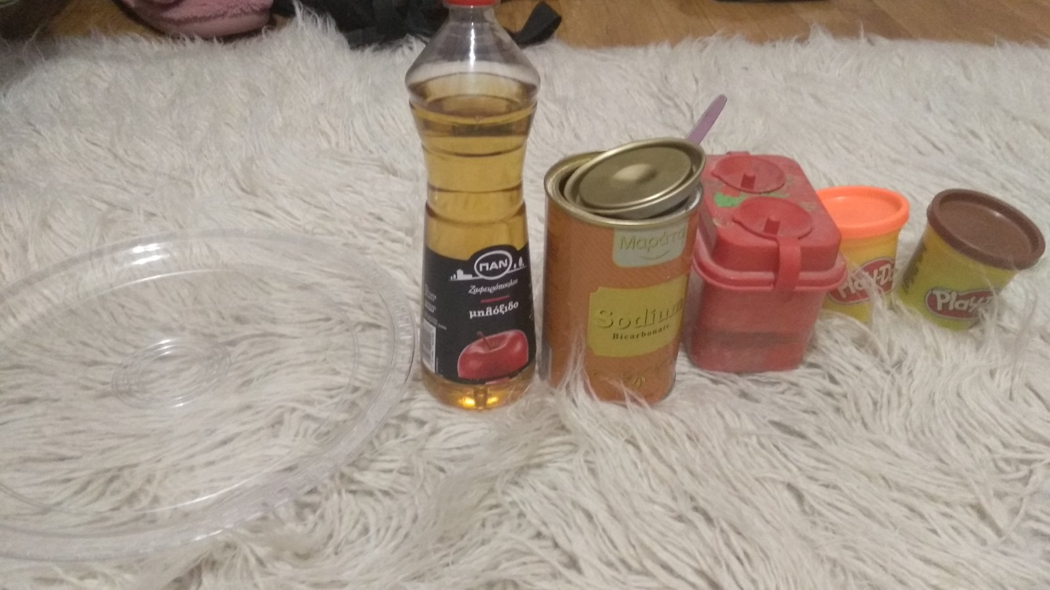
We need
Brown plasticine
White vinegar
Red water coloring
Baking soda
A small glass

Slide 4
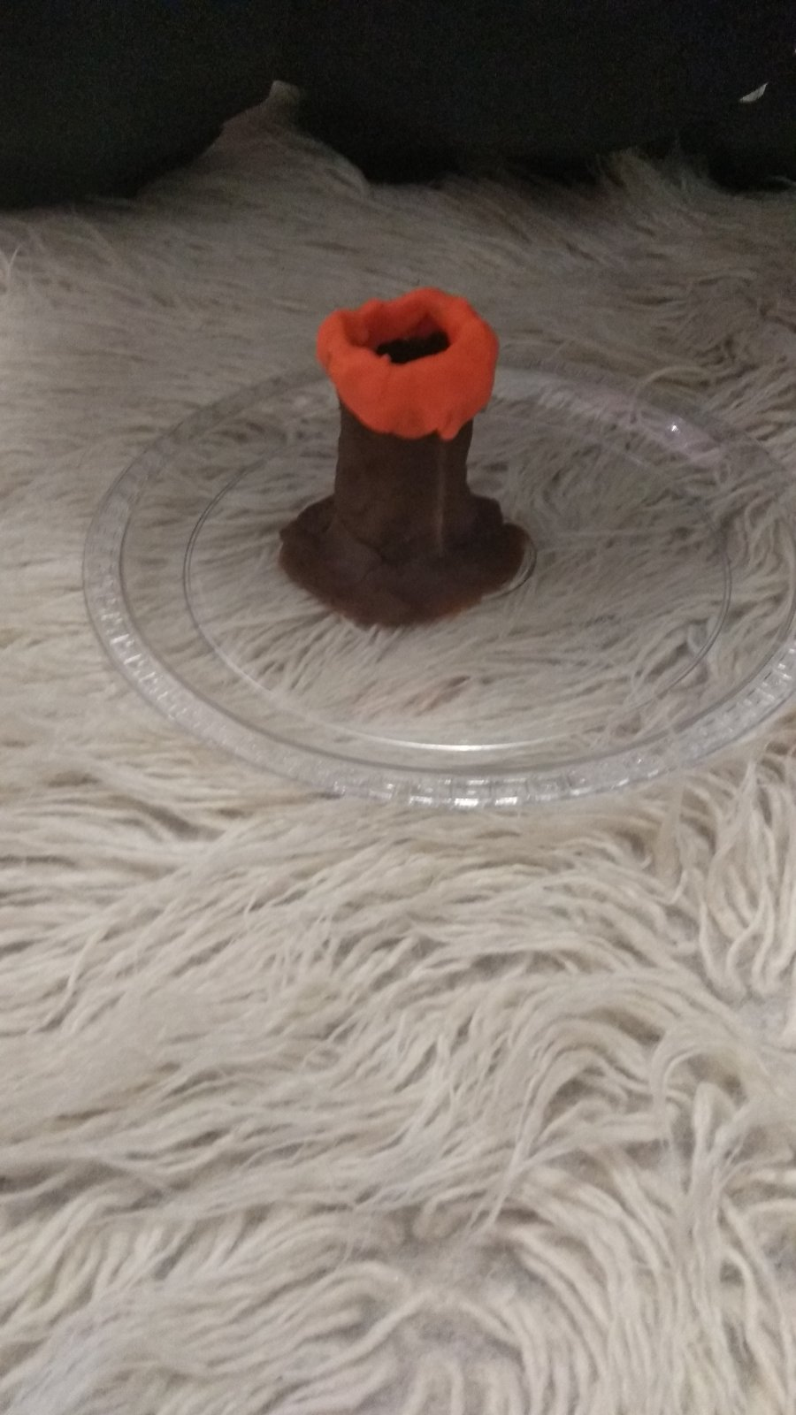
Step1
First we must make a volcano from plasticine.

Slide 5
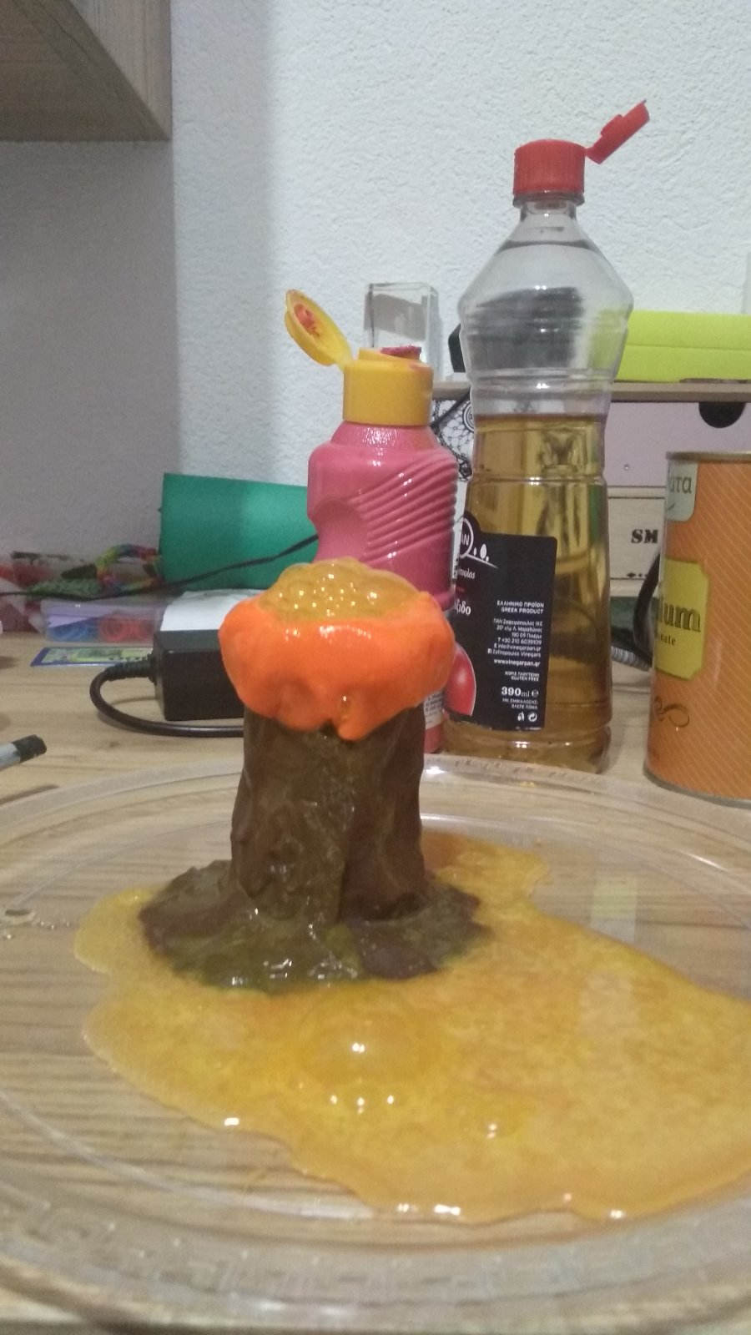
Step 2
Then we put a soda and a red color into the volcano.
At the end we add the vinegar.
Look !!!!

Slide 6
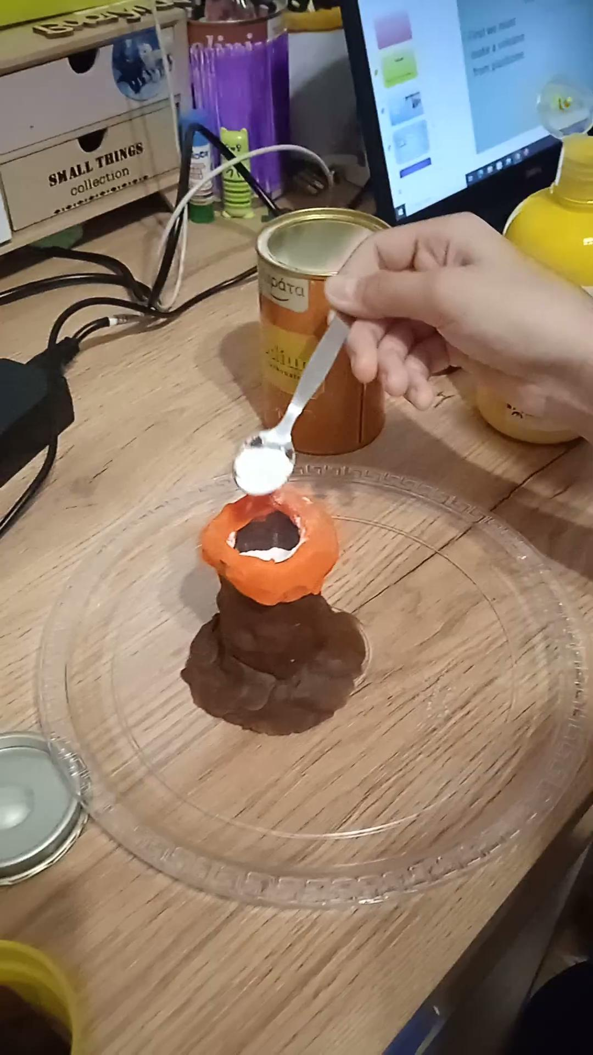
Let’s watch the video!!!!

Slide 7
THANKS FOR WATCHING
!!!!

