Slide 1
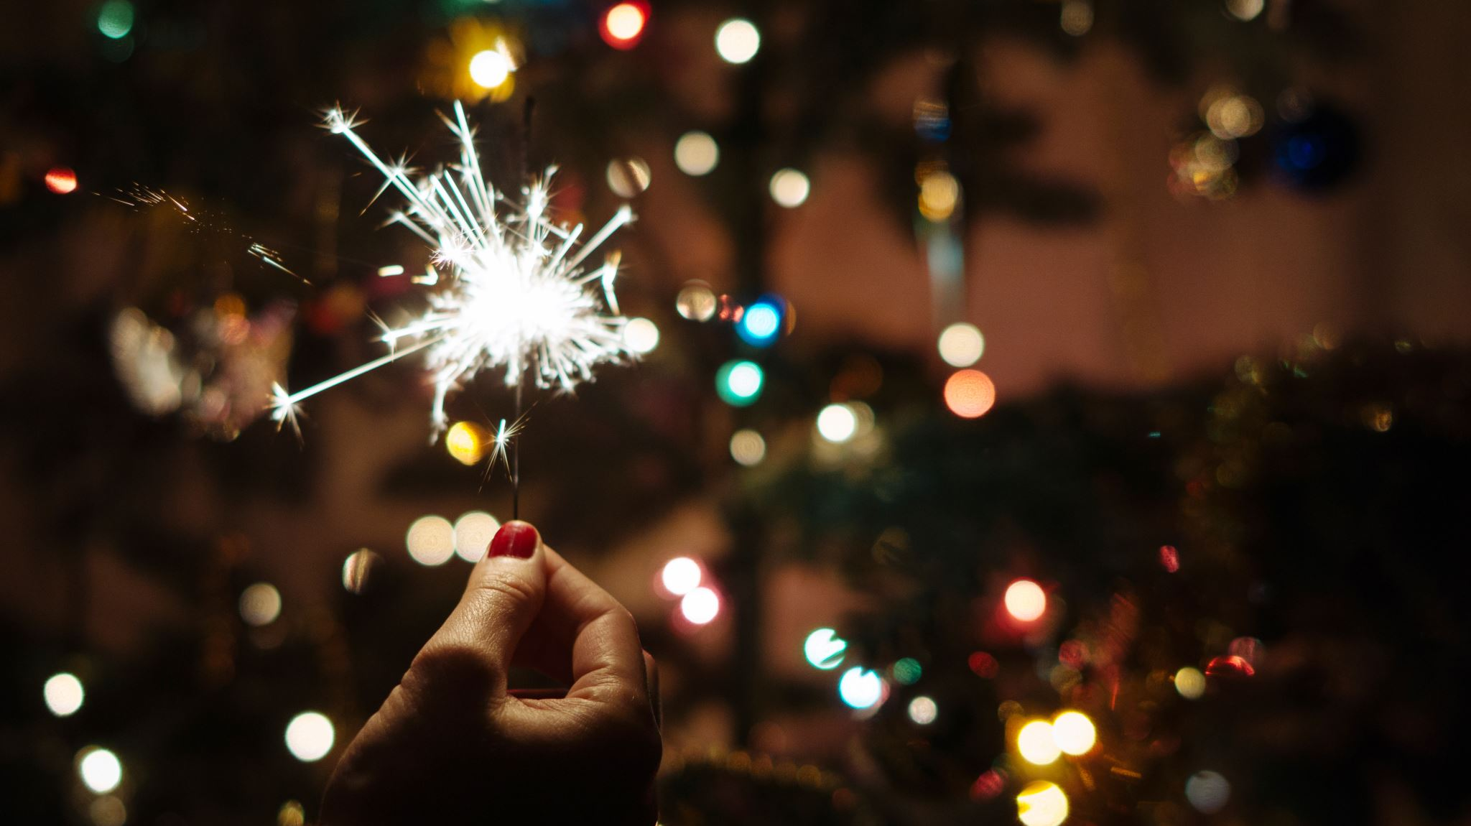
Santa Claus is coming to town
Let's get into the Christmas spirit

Slide 2
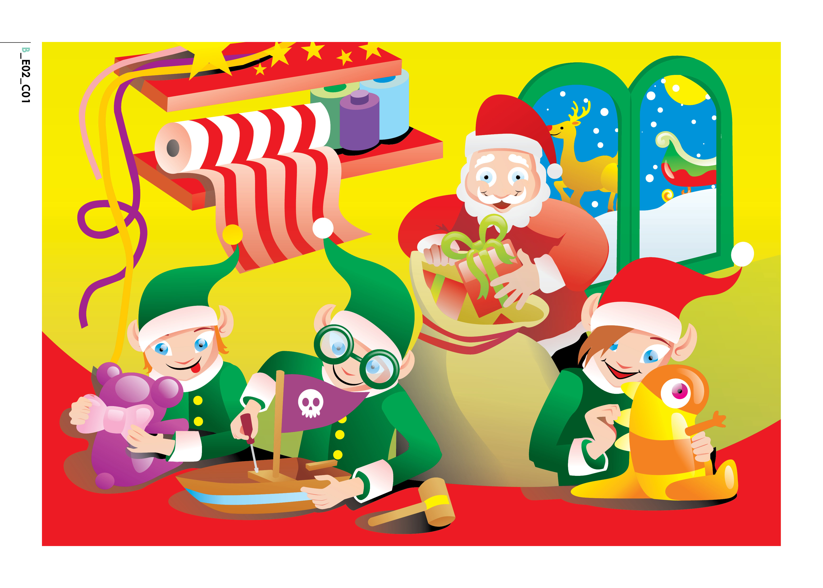

Slide 3
Santa has a problem!!!!
VIDEO

Slide 4
What's your favourite toy?
What do you want for Christmas? ( I want a toy car, a doll, a puzzle, a board game, a video game, a mobile phone)

Slide 5
Let's learn some Christmas Vocabulary!

Slide 6
Flashcards

Slide 7
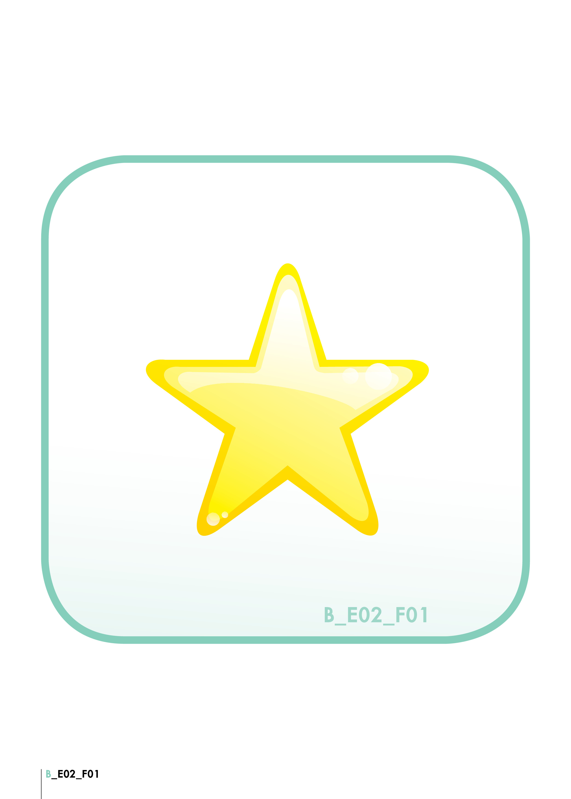
A star

Slide 8
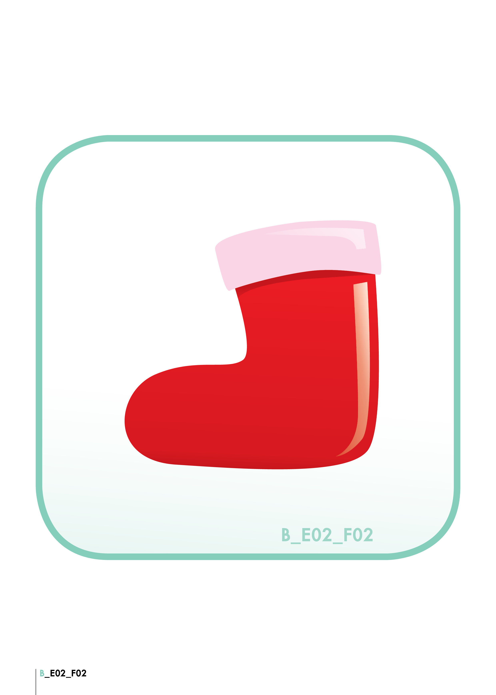
A red stocking

Slide 9
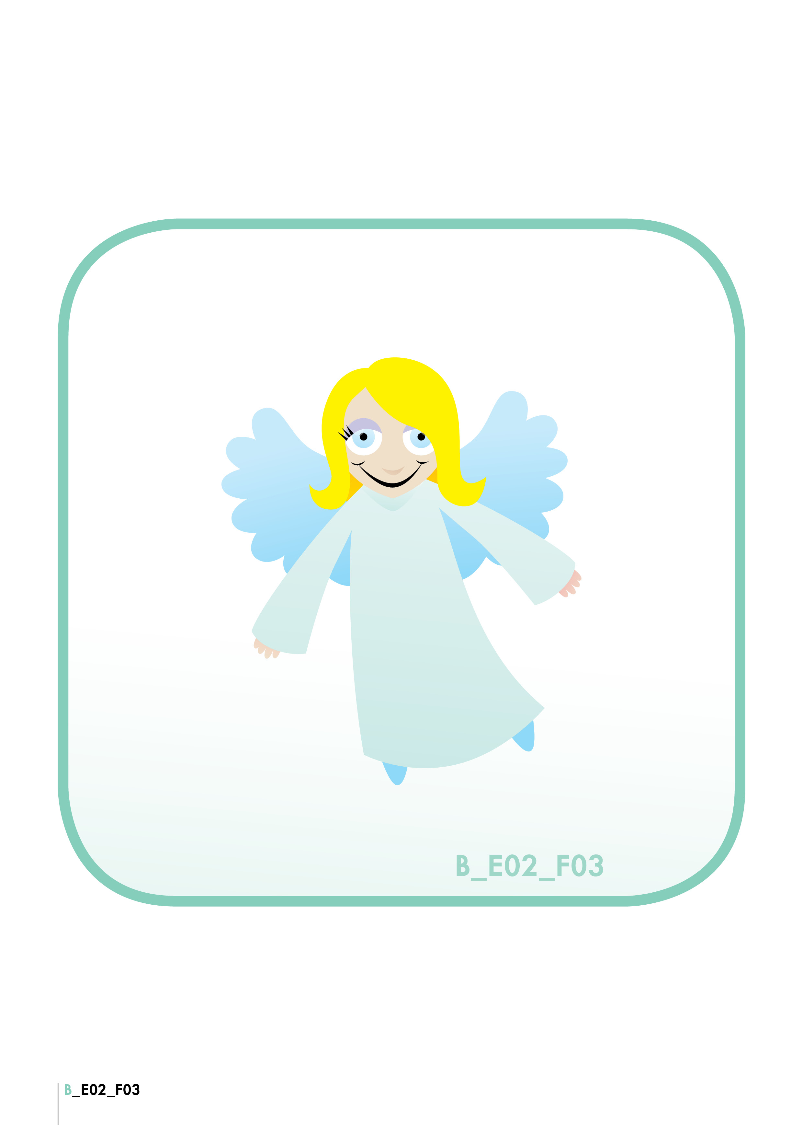
An angel

Slide 10
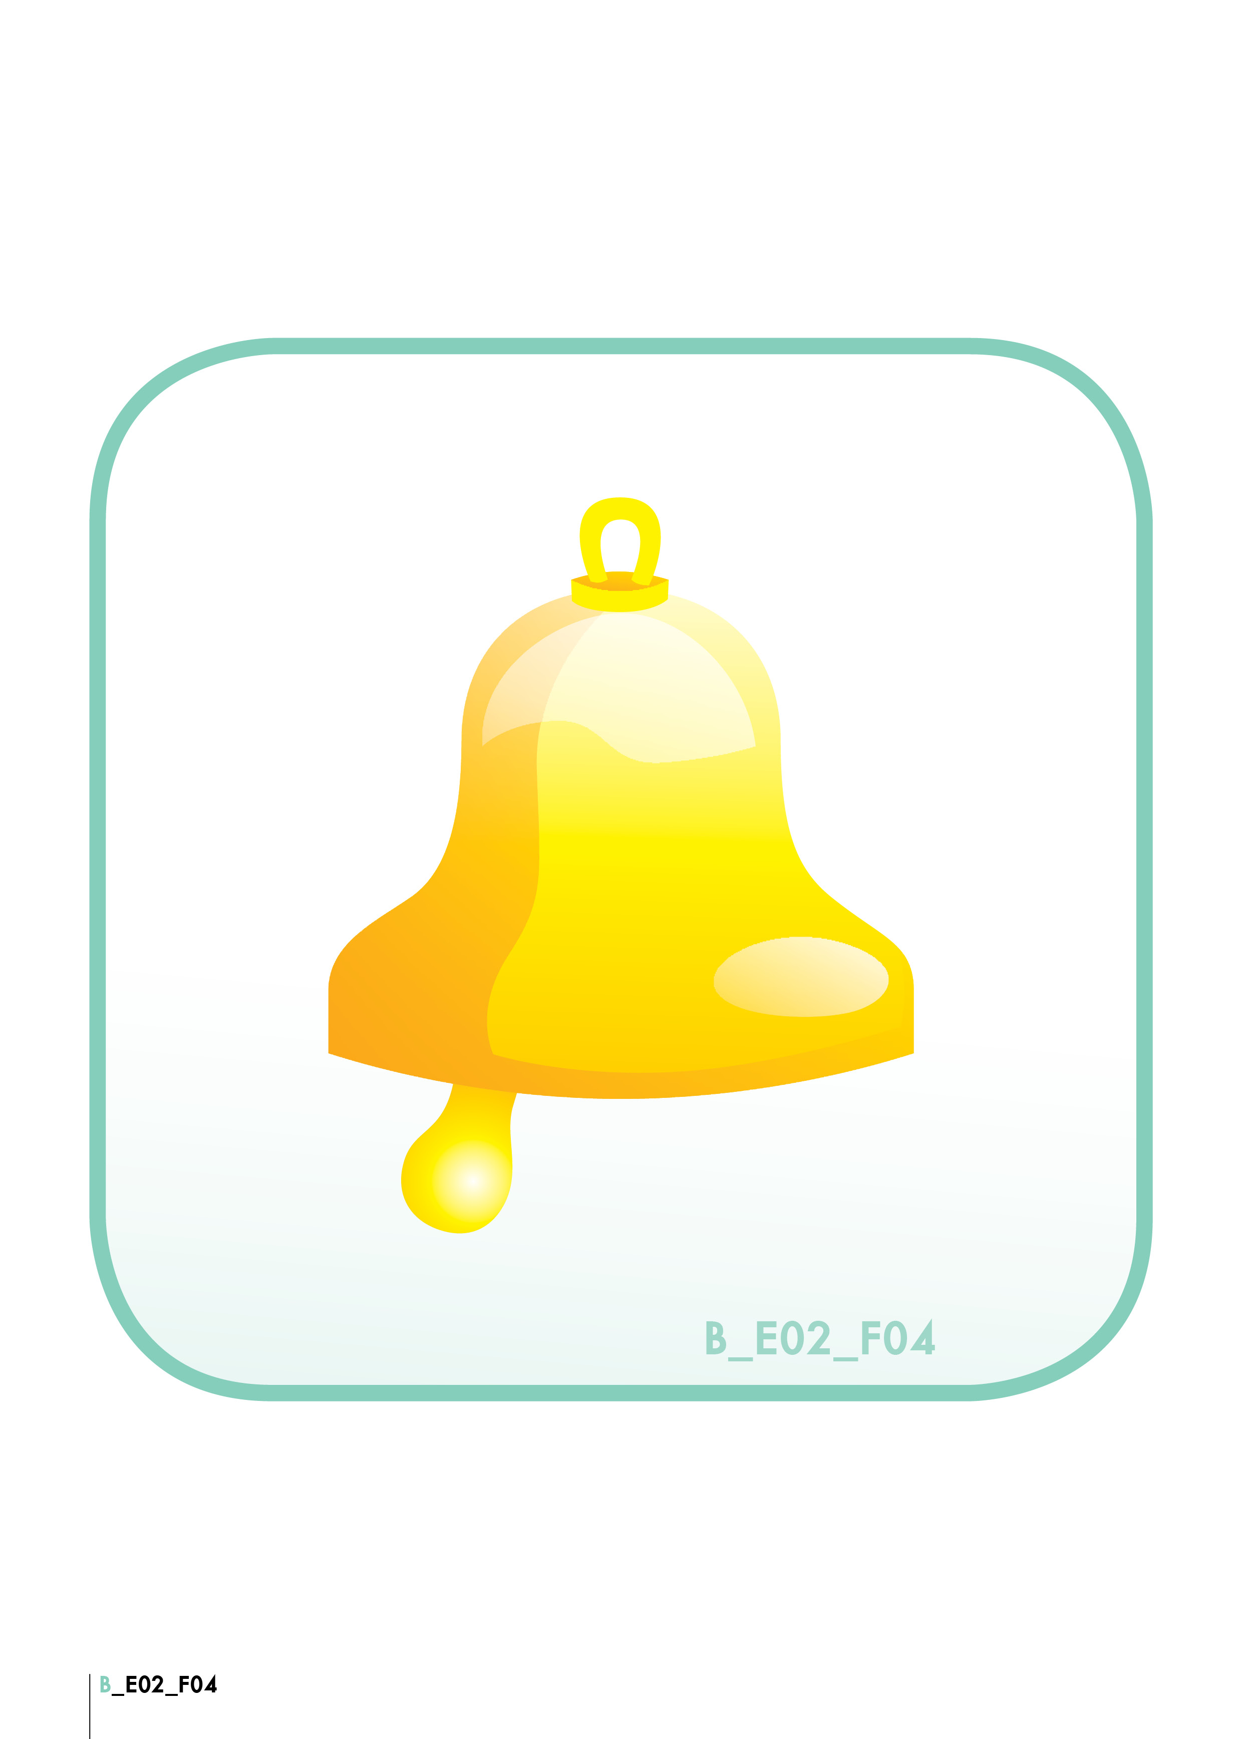
A bell

Slide 11
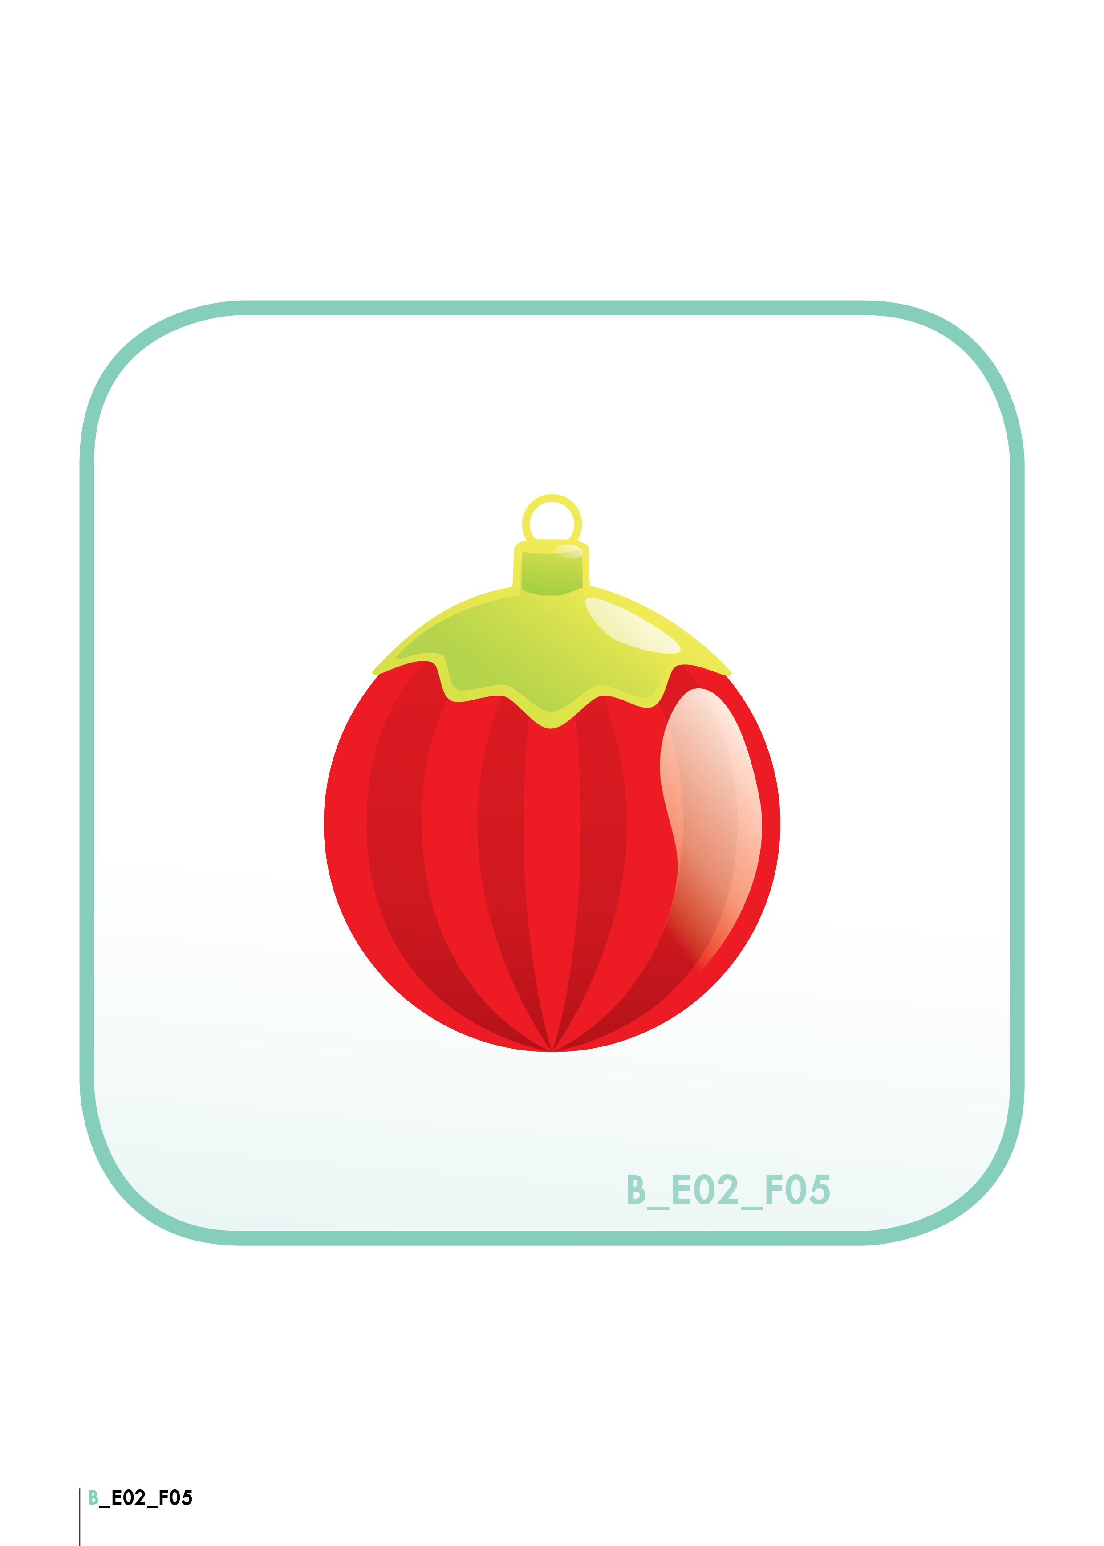
A christmas ball

Slide 12

A present

Slide 13
Song!!!!
THE LIGHTS OF THE TREE
The lights on the tree go blink, blink, blink Blink, blink, blink Blink, blink, blink The lights on the tree go blink, blink, blink All Christmas Day
Other Verses: The presents at the house go rattle, rattle, rattle, etc. The mom at the house goes bake, bake, bake, etc. The dad at the house goes snore, snore, snore, etc. The grandma at the house goes hug, hug, hug, etc. The grandpa at the house goes kiss, kiss, kiss, etc.

Slide 14
Watch the video
‘Little Einsteins’, A Christmas wish
If you had a wish box what would you wish for?

Slide 15
Online colouring
https://www.online-coloring.com/coloring-page/santa-claus-s-reindeer-421.html?fbclid=IwAR2db-t4iIW5ipclvGOhxnCq0X9X0oWwf3wT_4_IJ6XWd2Ad32Ee1Pu1eig

Slide 16
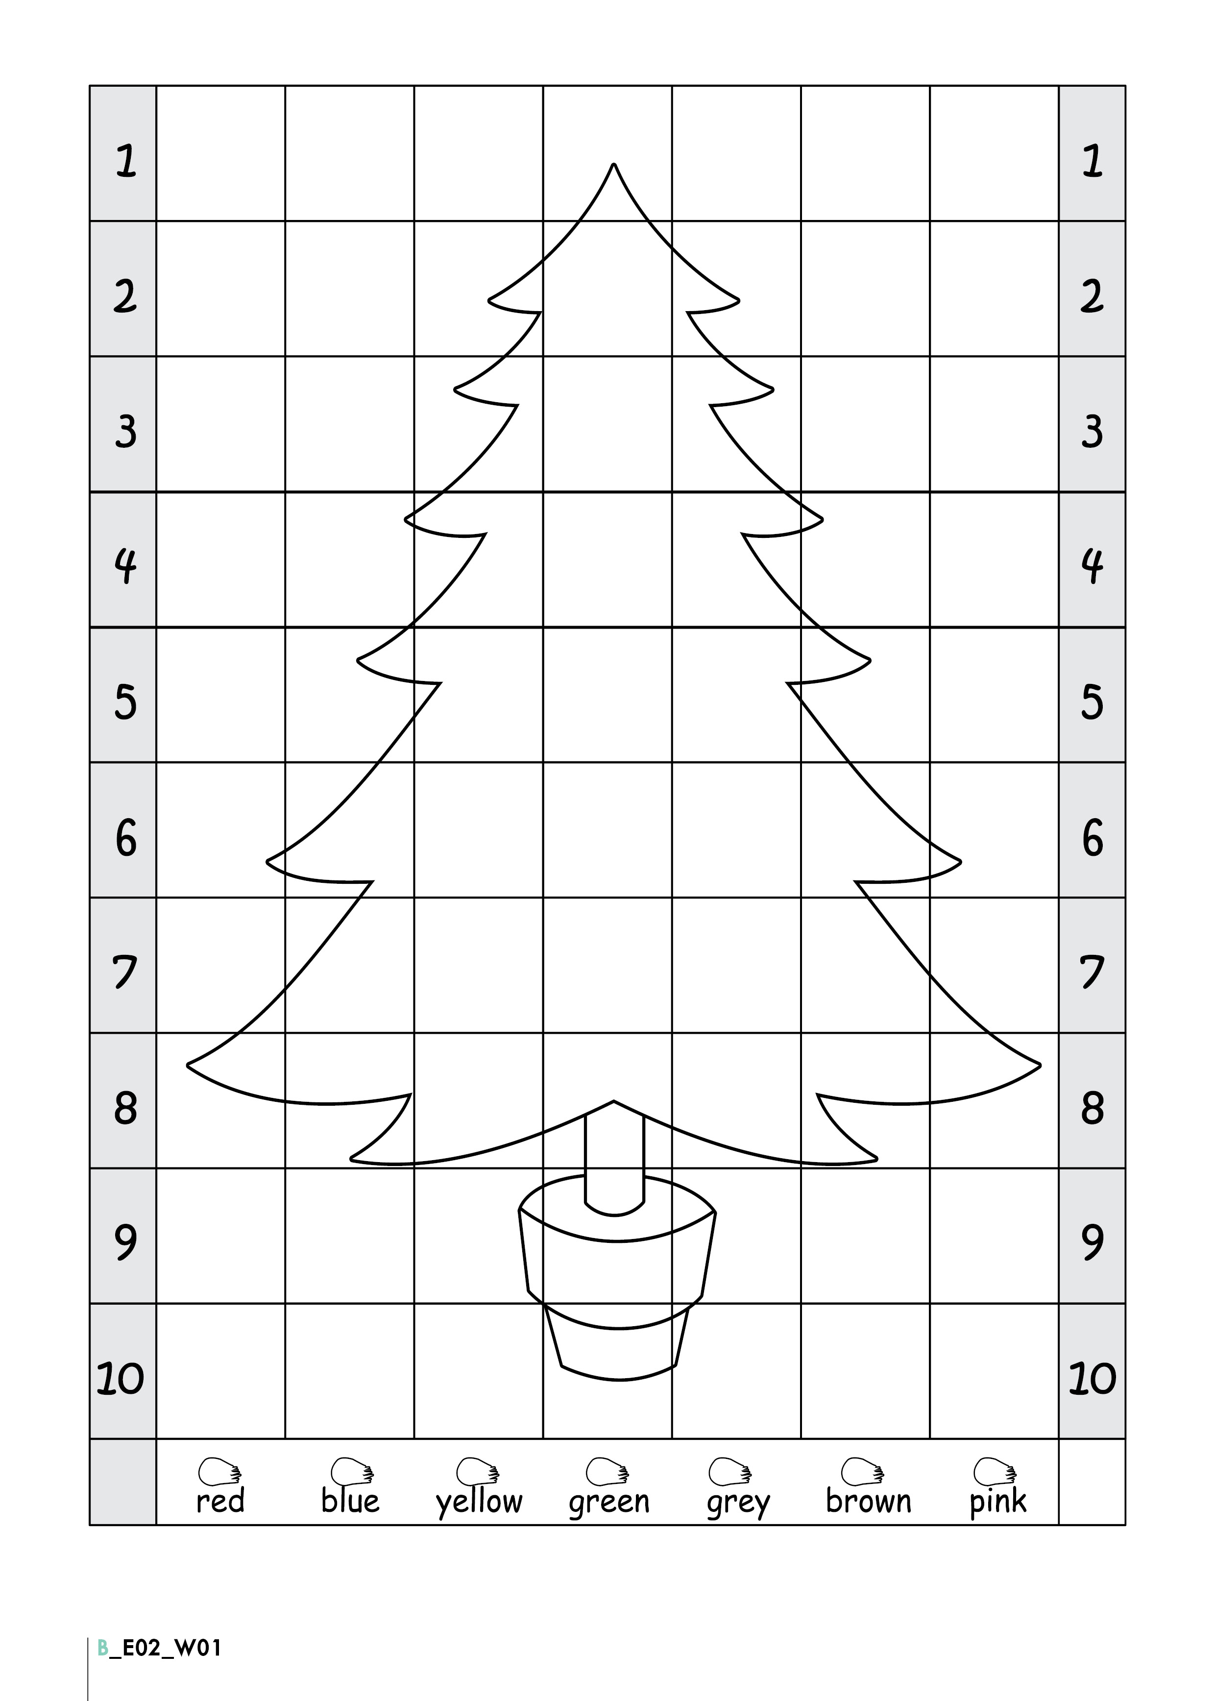

Slide 17
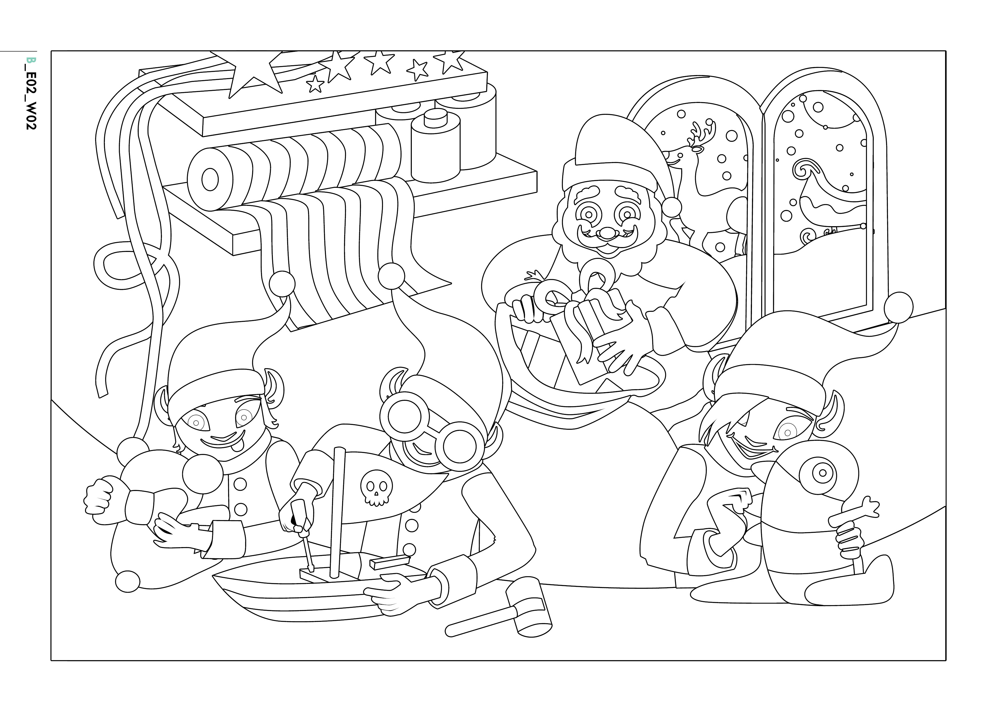

Slide 18
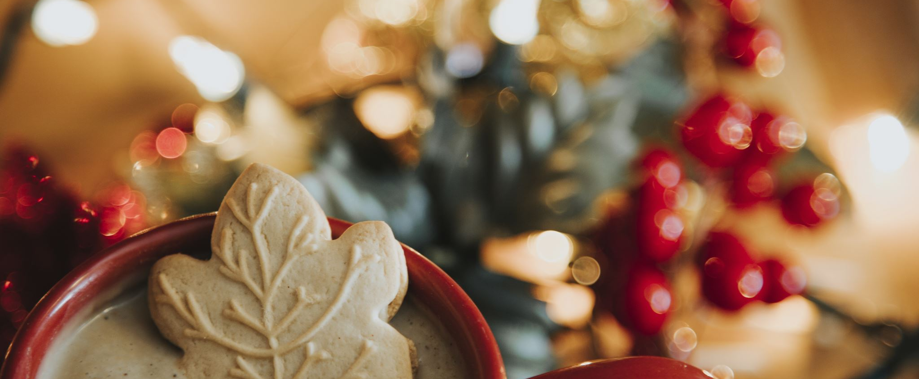
Have a Merry Christmas!!!

