Slide 1


Hola!
European Day of Languages
Hello!
Bonjour!
"If Places Could Speak"
Ciao!
26 September

Slide 2







What is European Day of Languages?
It started in 2001
We celebrate it every year on September 26
SEPTEMBER
26
It's a day to celebrate all languages in Europe
The Council of Europe represents 46 European countries

Slide 3

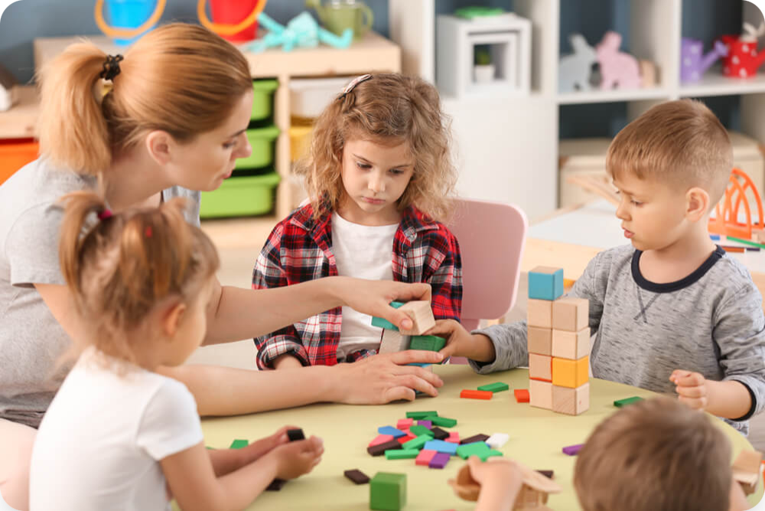





Why We Need Languages
Hello!
Learn New Things
We can learn about other countries
Hola!
Make Friends
We can talk to kids from other countries
Bonjour!
Visit Places
We can travel and talk to local people

Slide 4

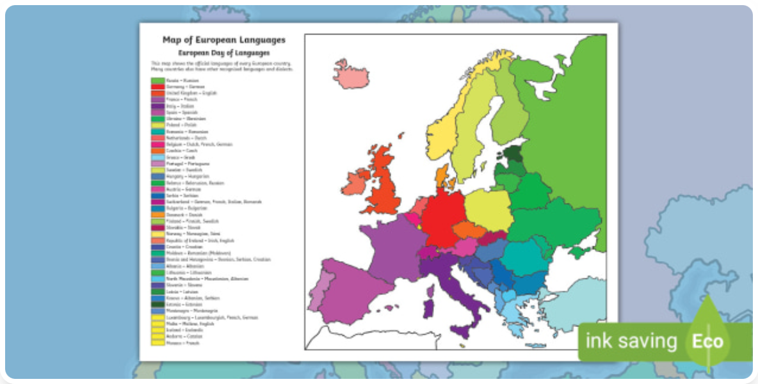
Languages in Europe
Languages
200+
in Europe
24
Official
EU Languages
Big Languages
5
English, French, German, Italian, Russian

Slide 5

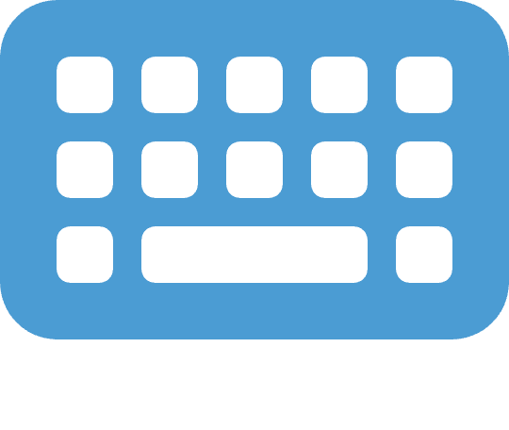


Fun Language Facts
Big German Word
Special Letters
Unique Language
The longest German word has 63 letters! It is very, very long!
Iceland has special letters like:
The Basque language is special!
Þ and Ð
It is not related to any other language in the world!
Can you say it?
These are not in our alphabet!

Slide 6
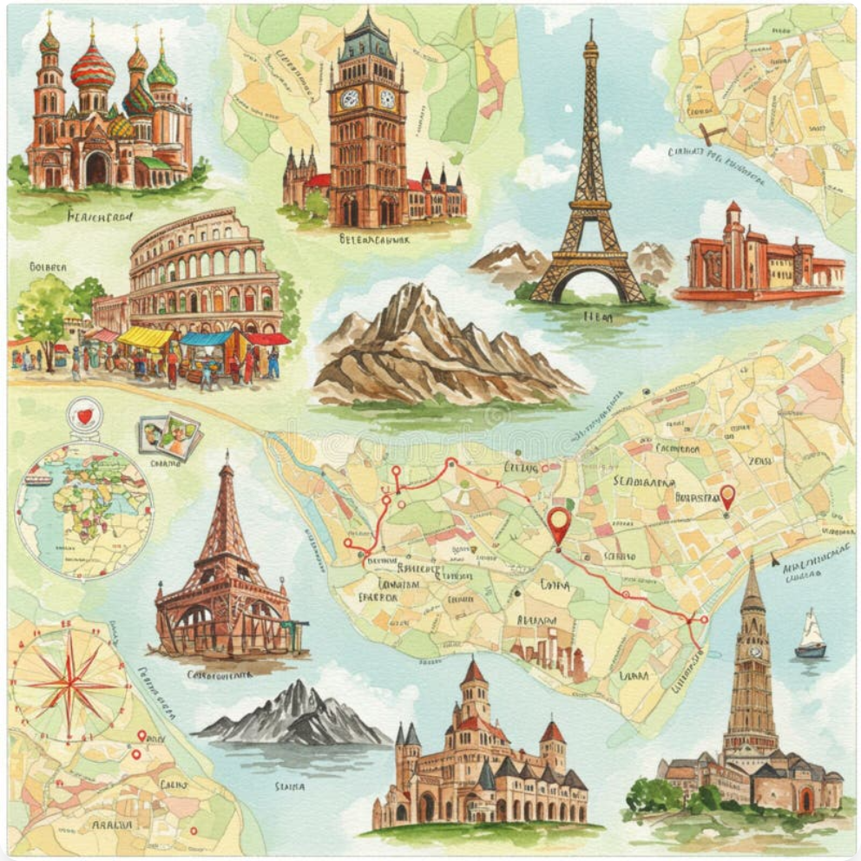
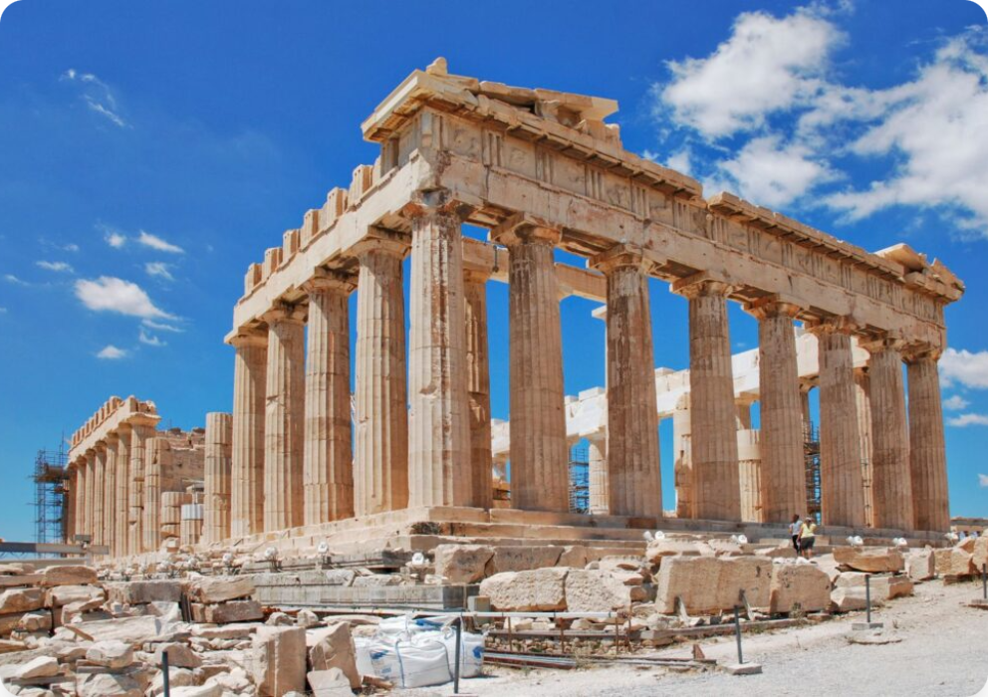
If Places Could Speak – Landmarks
Famous monuments greeting you in their native languages
Bonjour!
French
Γεια σας!
Ciao!
(Yia sas!)
Greek
Italian
Acropolis, Athens

Slide 7
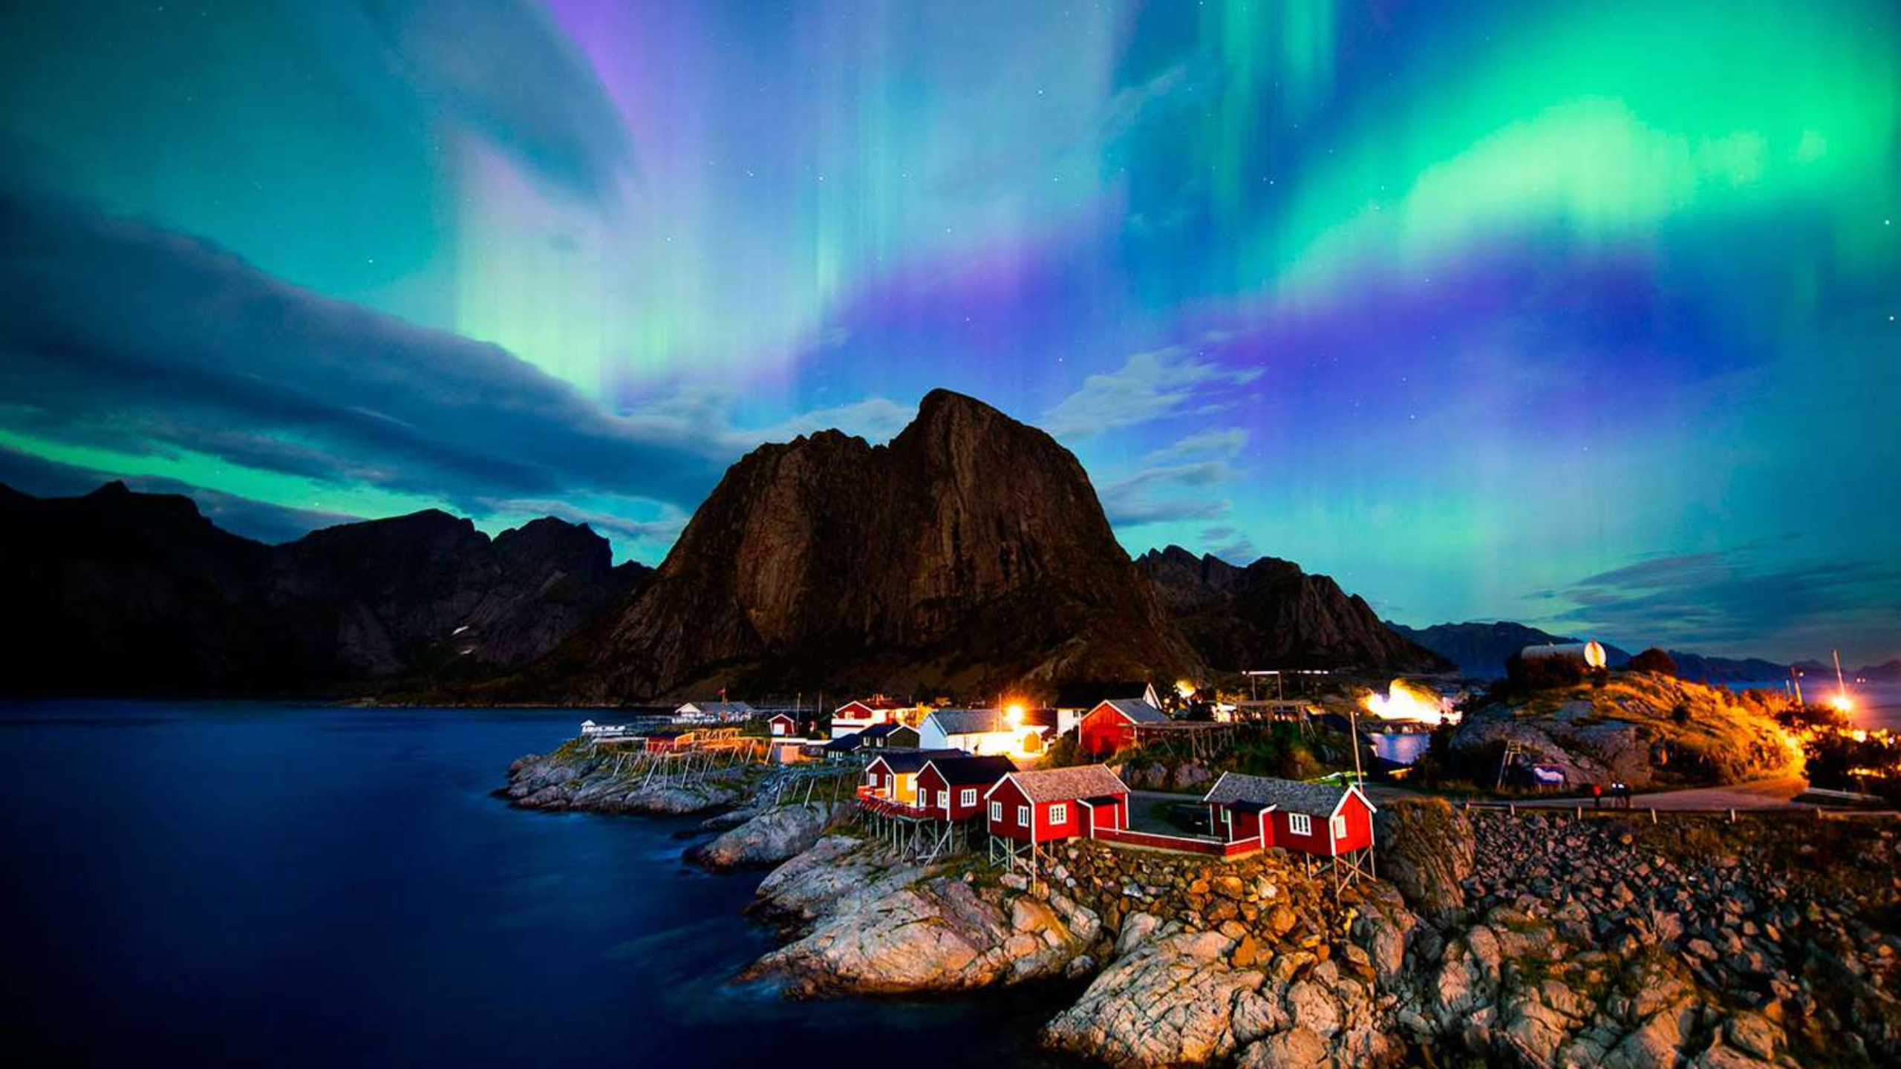






If Places Could Speak – Natural Wonders
Nature speaks in many languages across Europe
Northern Lights
Mediterranean Sea
Swiss Alps
Hei!
Hola! (Spanish)
(Norwegian)
Merhaba! (Turkish)
Grüezi! (German)
The magical aurora borealis of Norway welcomes you
Ciao! (Italian)
Bonjour! (French)
Γεια! (Greek)
Buongiorno! (Italian)
Allegra! (Romansh)

Slide 8

Let's Say Hello!
Bonjour!
Easy greetings in 6 languages
EN
English
FR
French
ES
Spanish
👋
Hello
👋
Bonjour
👋
Hola
👋
Goodbye
👋
Au revoir
👋
Adiós
👋
Thank you
👋
Merci
👋
Gracias
DE
German
PL
Polish
GR
Greek
👋
Guten Tag
👋
Cześć
👋
Γειά σου (Yia sou)
👋
Auf Wiedersehen
👋
Do widzenia
👋
Αντίο (Adío)
Hola!
Dziękuję
Γειά σου!
👋
Danke
👋
👋
Ευχαριστώ (Efcharistó)

Slide 9
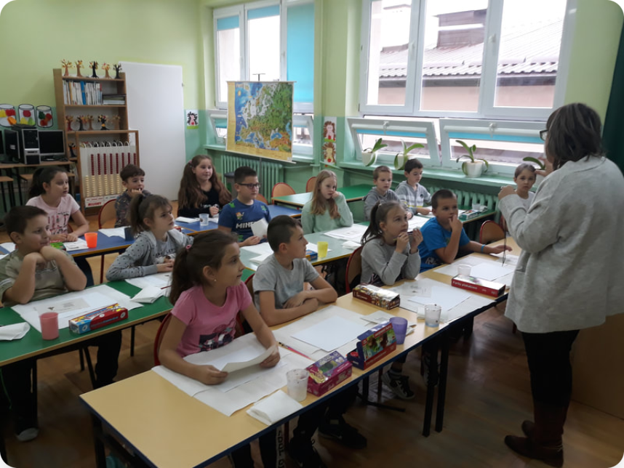






Fun Language Activities
Language Bingo
Duolingo Schools
Culture Corner
Create bingo cards with common words in different languages and play in class!
Try the free classroom version of Duolingo to learn new languages together!
Each student brings one word from a different language and teaches it to the class!
Notes:
.

Slide 10
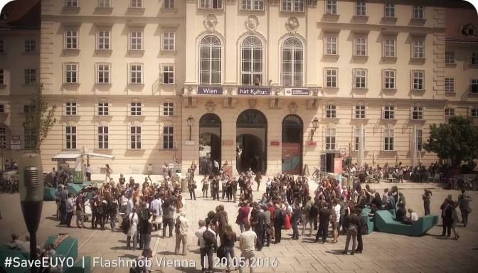
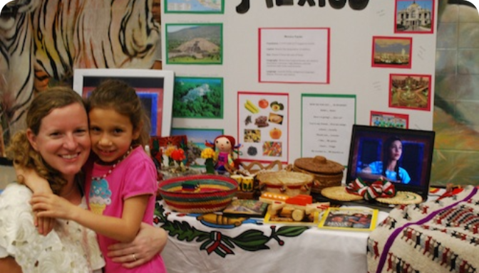
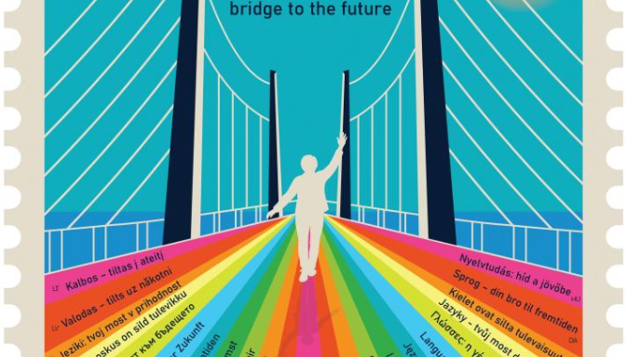

Fun Events in Europe
How people celebrate European Day of Languages
Austria
Spain
Online
Language Flash-mob
Language Fair
Online Quiz Game
Students in Vienna talk in many languages at the same time. Everyone speaks a different language!
In Barcelona, people make small shops to show their language. You can try food and learn easy words.
Schools play a fun quiz game on computers. Students answer questions about languages in Europe.
These are some fun ways to celebrate European Day of Languages!
Notes:
.

Slide 11







How You Can Participate
Organize a Language Café
Scan for more ideas
Set up tables for different languages where students can practice simple conversations.
Create "Teach a Word" Videos
Film short videos teaching one word in different languages to share online.
Join EDL Online Challenge
Participate in the official European Day of Languages social media challenge.
European Day of Languages
Official Website
Learn Songs in Different Languages
Pick simple, catchy songs and learn to sing them in various languages.
Notes:
.

Slide 12










Keep Learning – Resources
Resource
Type
Best For
App / Website
Daily practice, gamified learning
Duolingo
App / Website
Vocabulary building with native speakers
Memrise
Website
Structured courses with cultural context
BBC Languages
Website / Books
Reading same stories in multiple languages
Storybooks Europe
All resources have free versions available for students

Slide 13




If Places Could Speak
Teşekkürler!
Kiitos!
Faleminderit!
Ačiū!
Tack!
Děkuji!
Obrigado!
Merci!
Gracias!
Thank You!
Dank u!
Takk!
Danke!
Mulțumesc!
Köszönöm!
Grazie!
Paldies!
Ευχαριστώ!
Dziękuję!
Hvala!
Gràcies!

