Slide 1
Feelings

Slide 2

happy

Slide 3
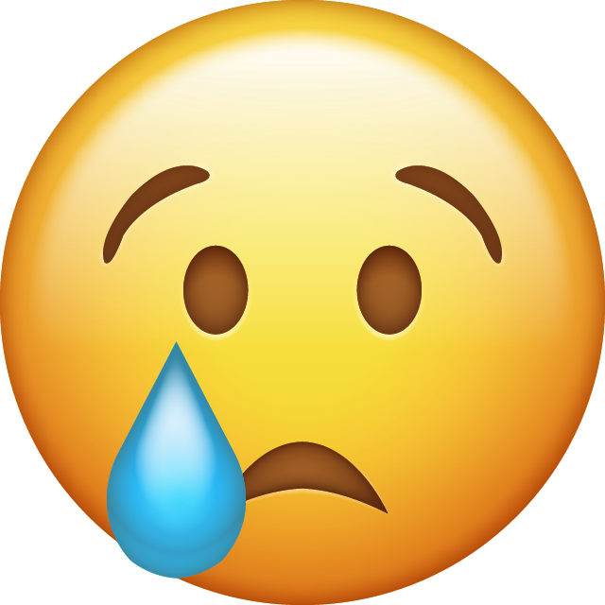
sad

Slide 4

hungry

Slide 5
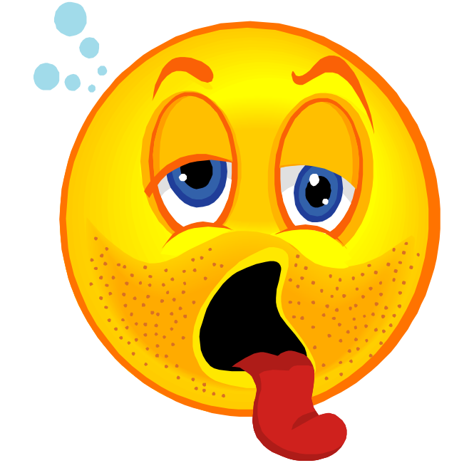
thirsty

Slide 6

angry

Slide 7

scared

Slide 8

bored

Slide 9

tired

Slide 10
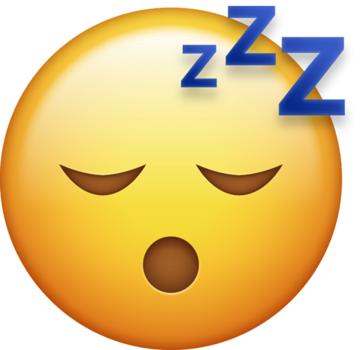
sleepy

