Slide 2
I am happy.

Slide 3
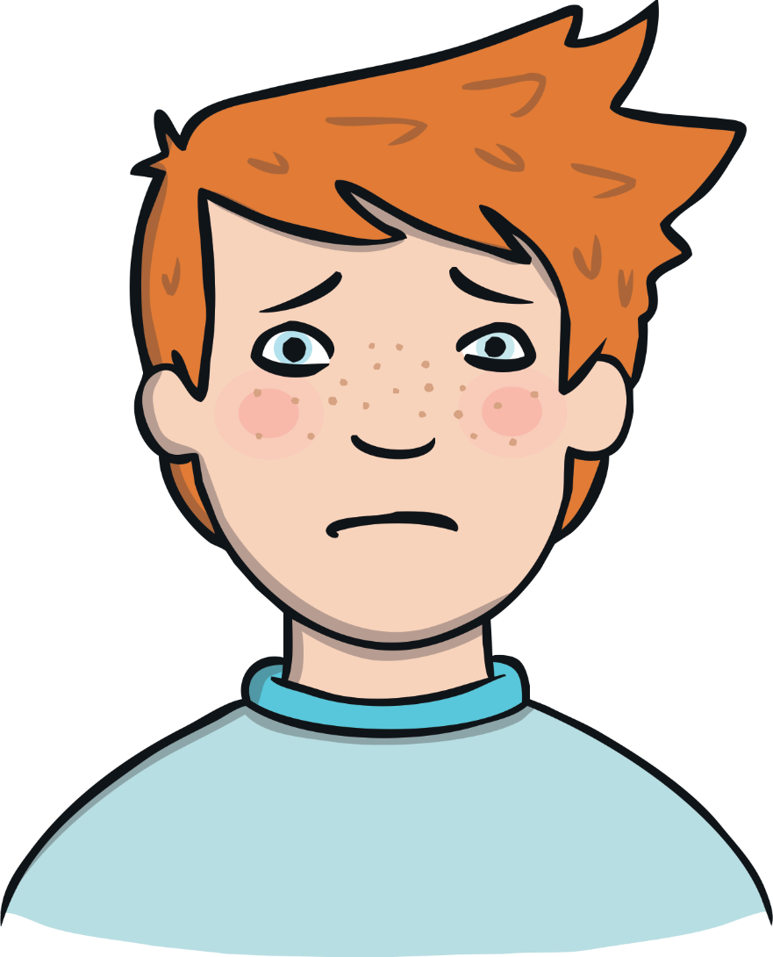
I am sad.

Slide 4
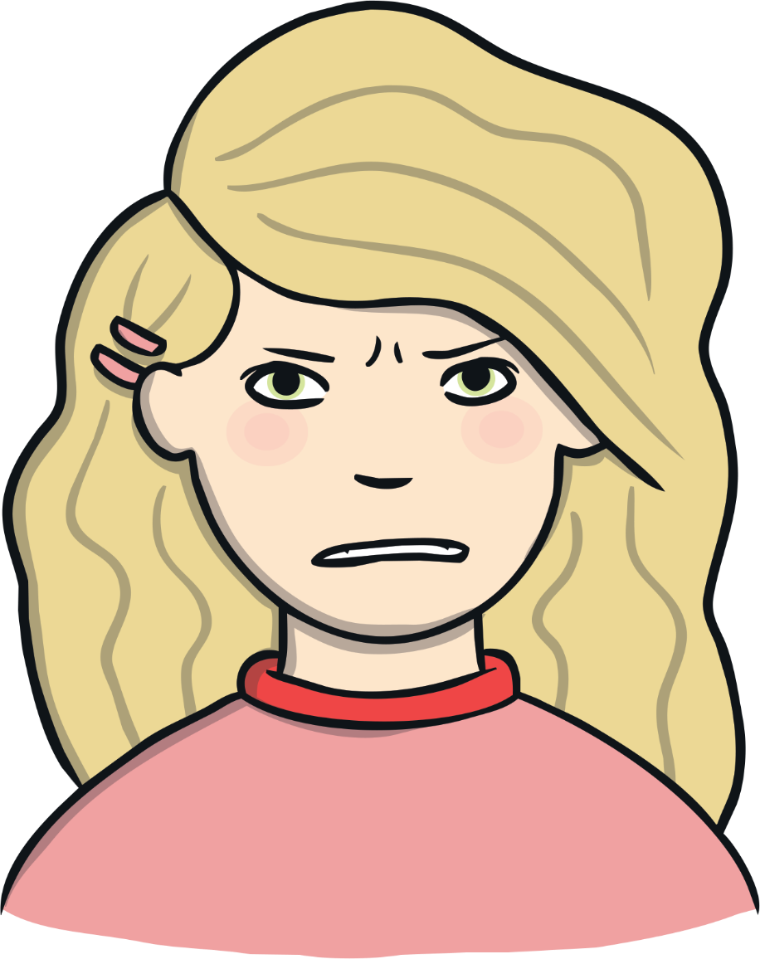
I am angry.

Slide 5
I am excited.

Slide 6
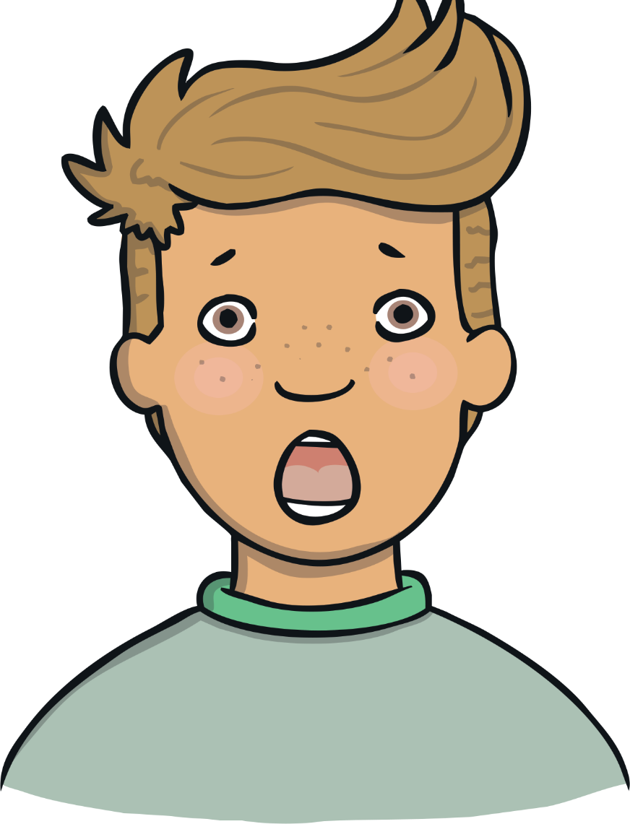
I am surprised.

Slide 7
I am worried.

Slide 8
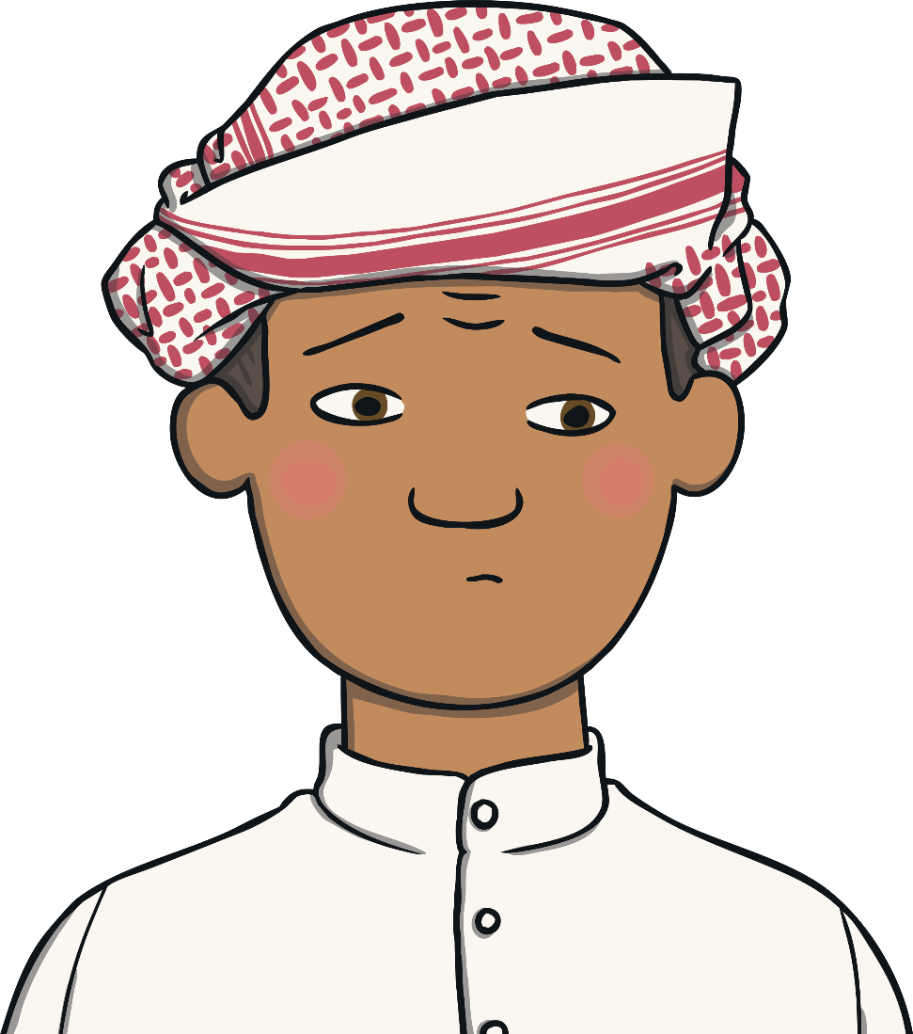
I am confused.

