Slide 1
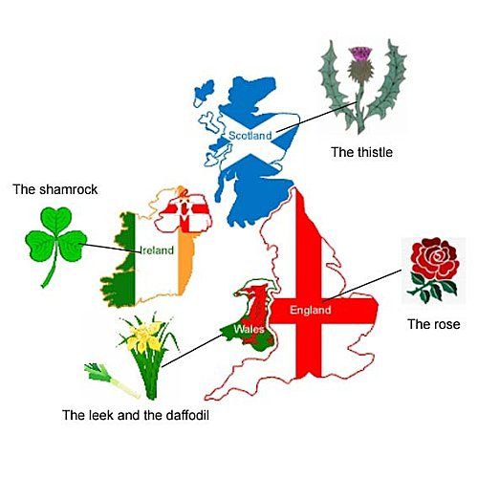
Do you know the difference???
The United Kingdom
Great Britain
The British Isles

Slide 2
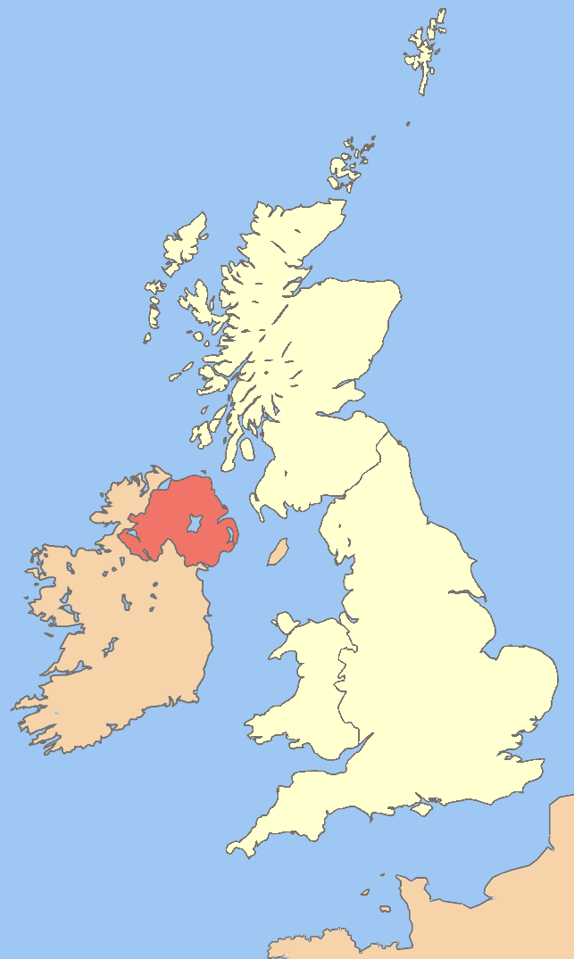
The British Isles
The British Isles are a group of islands in the North Atlantic Ocean. They consist of the islands of Ireland and Great Britain.

Slide 3
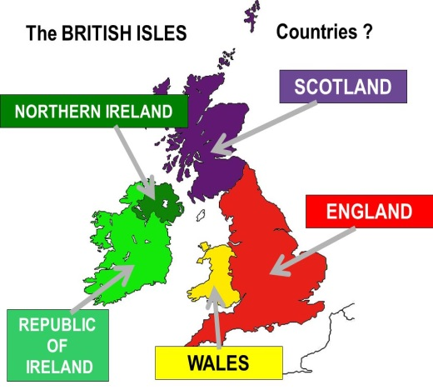
The United Kingdom
The United Kingdom includes Great Britain and only the Northern Ireland.
Great Britain consists of three countries :
England
Scotland
Wales

Slide 4
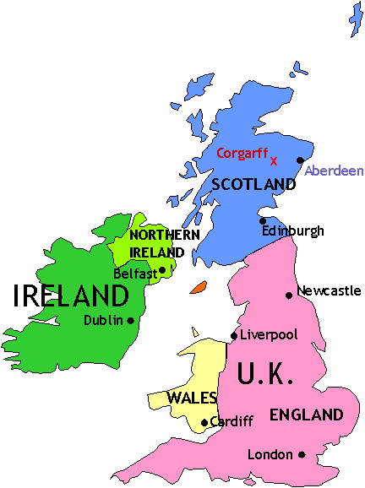
Capitals and cities
England London
Scotland Edinburgh
Wales Cardiff
Northern Ireland Belfast
The United Kingdom London

Slide 5
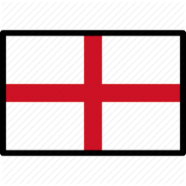
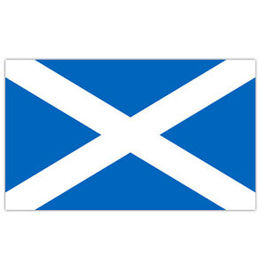
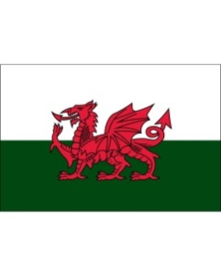
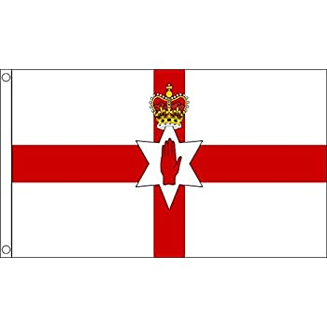
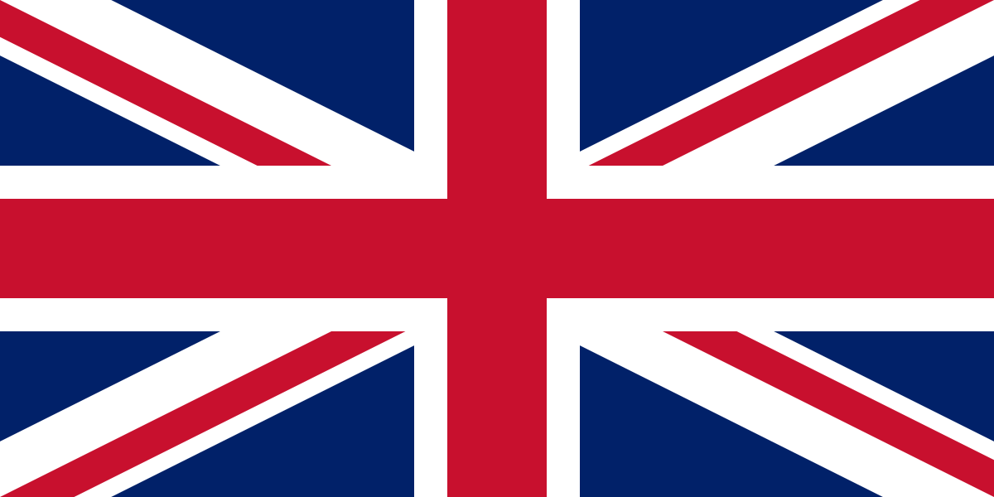
Flags
England
Scotland
Wales
Northern Ireland
The United Kingdom

Slide 6




Emblems
England
Scotland
Wales
Northern Ireland

Slide 7
Nationalities
Country | Nationality
England | English
Scotland | Scottish
Wales | Welsh
Northern Ireland | Northern Irish
The United Kingdom | British

Slide 8
TASK 1
THE BRITISH ISLES
TASK 1: Fill in the gaps:
The British Isles include two big islands: 1)………………………. 2)…………………………………
The United Kingdom is the political union of four countries:
1)…………………………………………………..…
2)……………………….……..……………………..
3)……………………..……………………..……….
.4)……………………………………..................

Slide 9

TASK 2- FLAGS
Do you remember the flags?

Slide 10



TASK 3 - EMBLEMS
Do you remember these emblems???

Slide 11
TASK 4 – CAPITALS
Do you remember the countries of the following capitals???
Cardiff
Belfast
Edinburgh
London

Slide 12
TASK 5-NATIONALITIES
How do we call somebody who is from….
England?
Scotland?
Wales?
Northern Ireland?
The United Kingdom?

