Slide 2
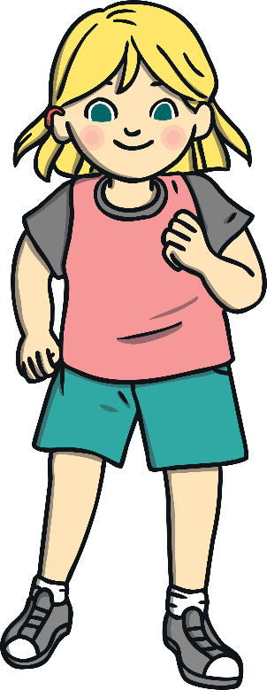
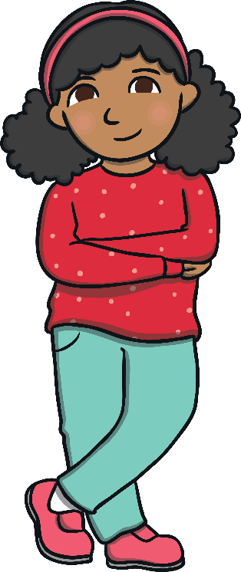
Select the Correct
Personal Pronoun
he
she
they

Slide 3
Select the Correct
Personal Pronoun
he
she
it

Slide 4
Select the Correct
Personal Pronoun
he
it
they

Slide 5
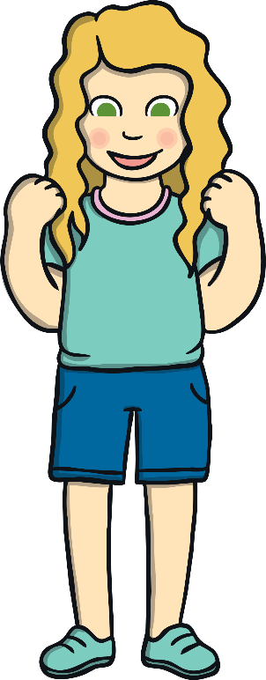
Select the Correct
Personal Pronoun
she
he
they

Slide 6
Select the Correct
Personal Pronoun
he
it
they

Slide 7
Select the Correct
Personal Pronoun
he
it
they

Slide 8
Select the Correct
Personal Pronoun
he
it
they

Slide 9
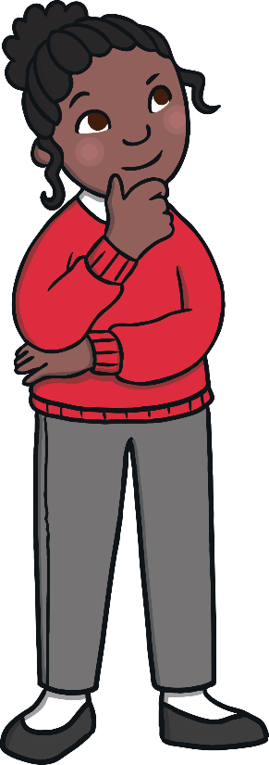
Select the Correct
Personal Pronoun
he
she
it

Slide 10
Select the Correct
Personal Pronoun
he
she
it

Slide 11
Select the Correct
Personal Pronoun
he
she
it

Slide 12
Select the Correct
Personal Pronoun
he
she
it

Slide 13
Select the Correct
Personal Pronoun
he
she
they

Slide 14
Select the Correct
Personal Pronoun
I
they
it

Slide 15
Select the Correct
Personal Pronoun
you
it
I

Slide 16
Select the Correct
Personal Pronoun
we
it
he

