Slide 1
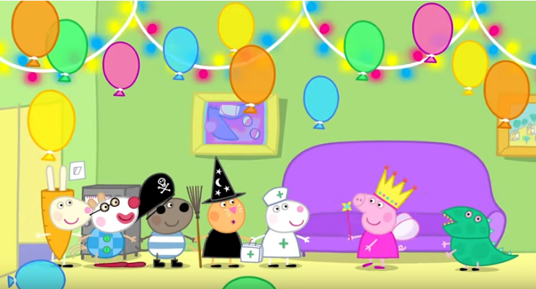
FANCY DRESS PARTY

Slide 2
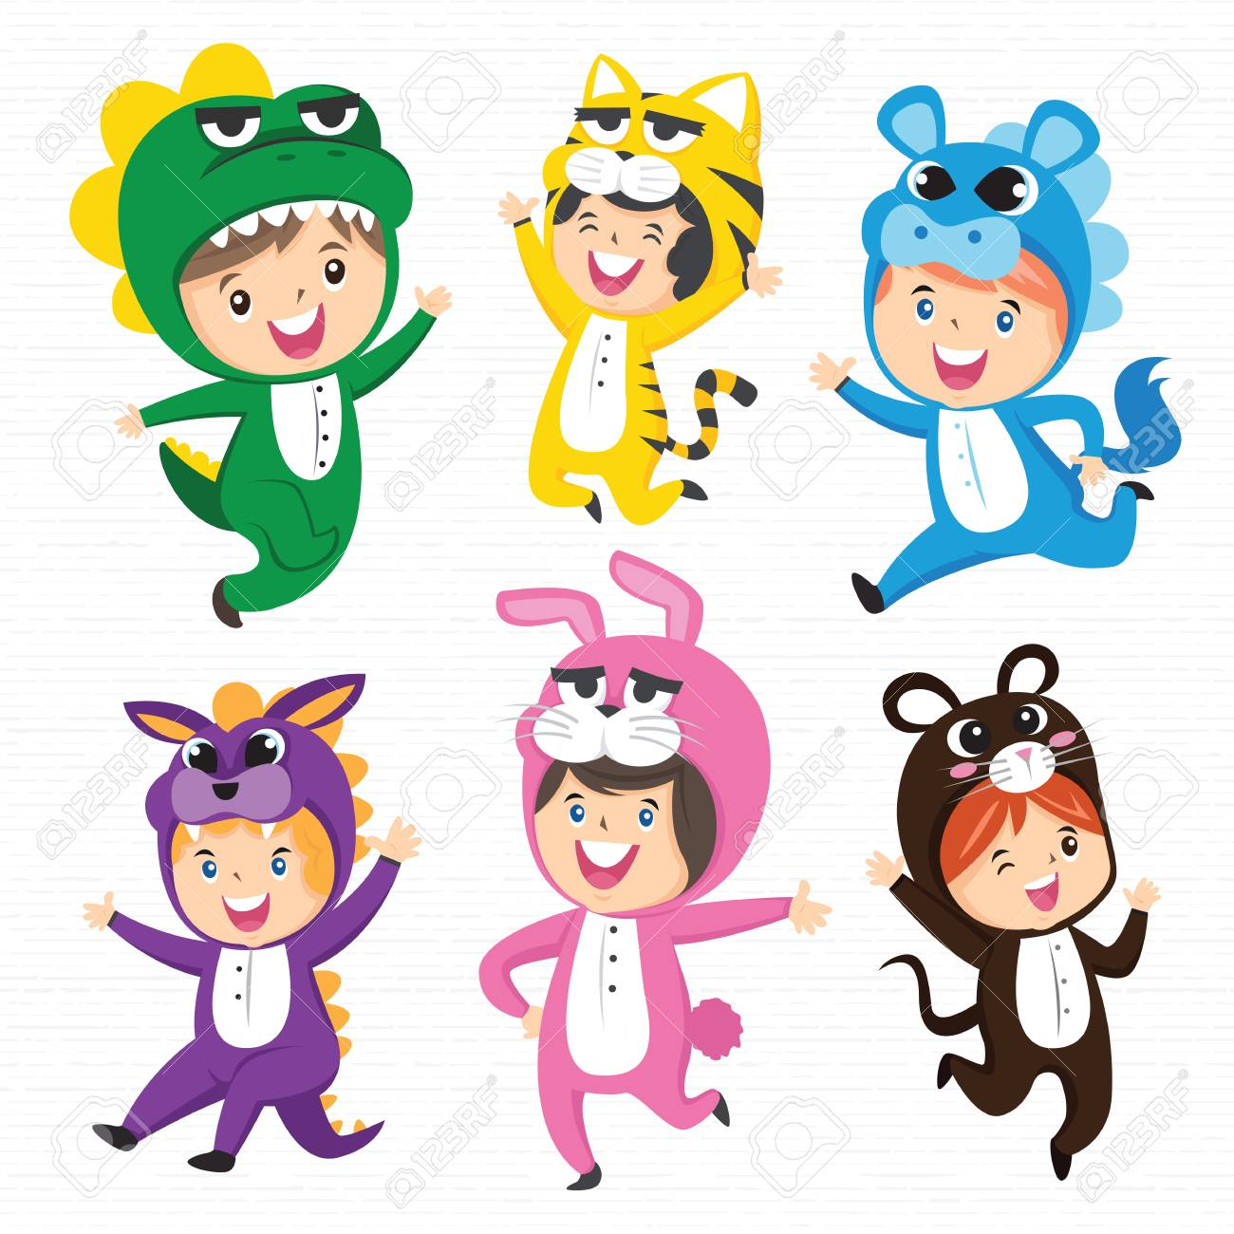
COSTUME

Slide 3
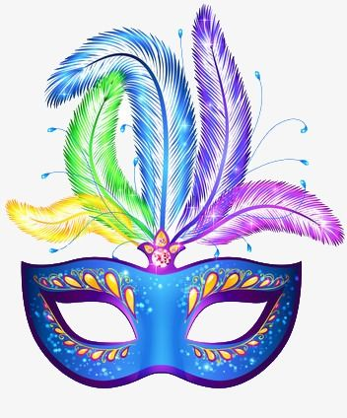
MASK

Slide 4
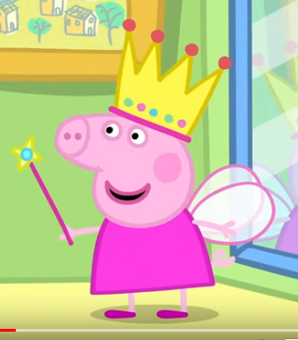
PRINCESS

Slide 5
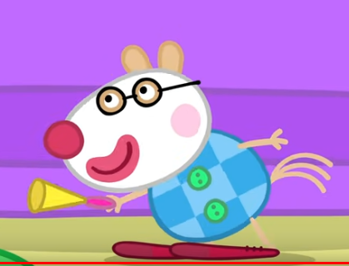
CLOWN

Slide 6
CARROT

Slide 7
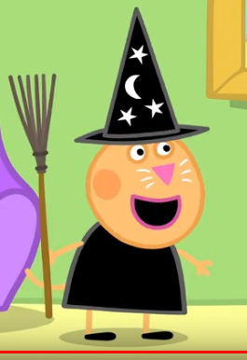
WITCH

Slide 8
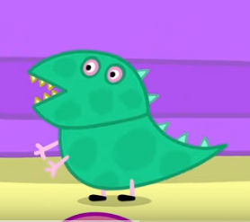
DINOSAUR

Slide 9
NURSE

