Slide 1
Countable /Uncountable nouns
Quantifiers
by Maria Dimitrakopoulou

Slide 2
Countable Nouns |  | Uncountable Nouns
Singular Ενικός | Plural Πληθυντικός | Singular Only= Μόνο ενικός
a banana an apple | some bananas a lot of bananas (a) few bananas | some milk a lot of milk (a) little milk | Κατάφαση
 | any bananas How many bananas | any milk How much milk | Ερώτηση
 | not any bananas not many bananas | not any milk not much milk | Άρνηση

Slide 3
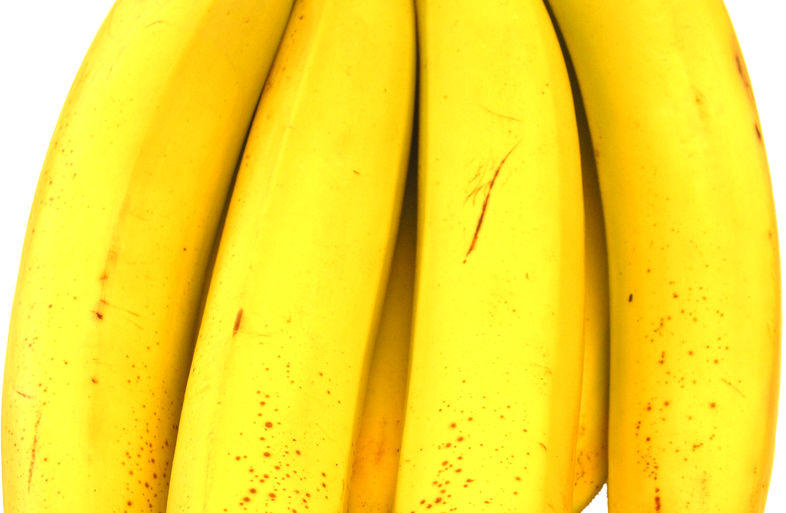
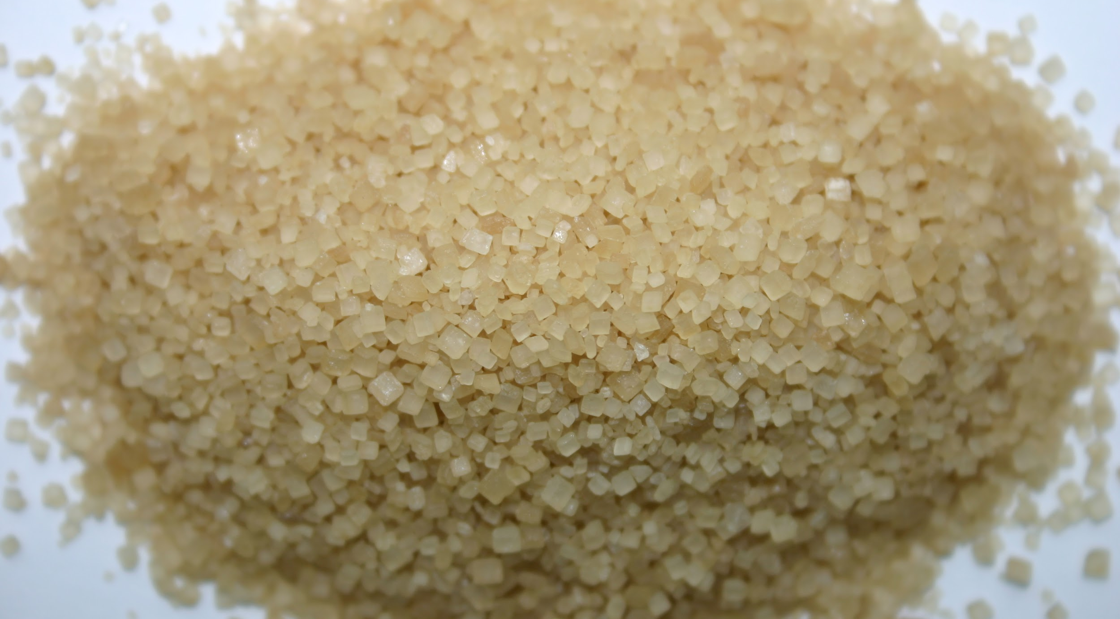
some , a lot of σε καταφατικές προτάσεις και για αριθμήσιμα και για μη αριθμήσιμα.
Countable
There are some(μερικές) bananas in the fridge.
There are a lot of (πολλές) bananas in the fridge
Uncountable
We have got some (λίγη) sugar in the cupboard.
We have got a lot of(πολλή) sugar in the cupboard.

Slide 4
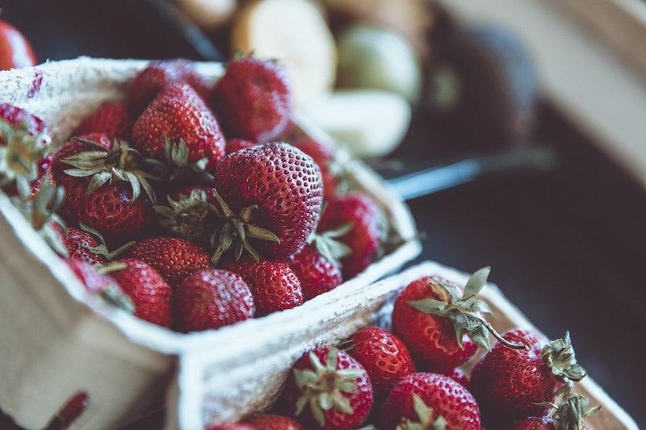
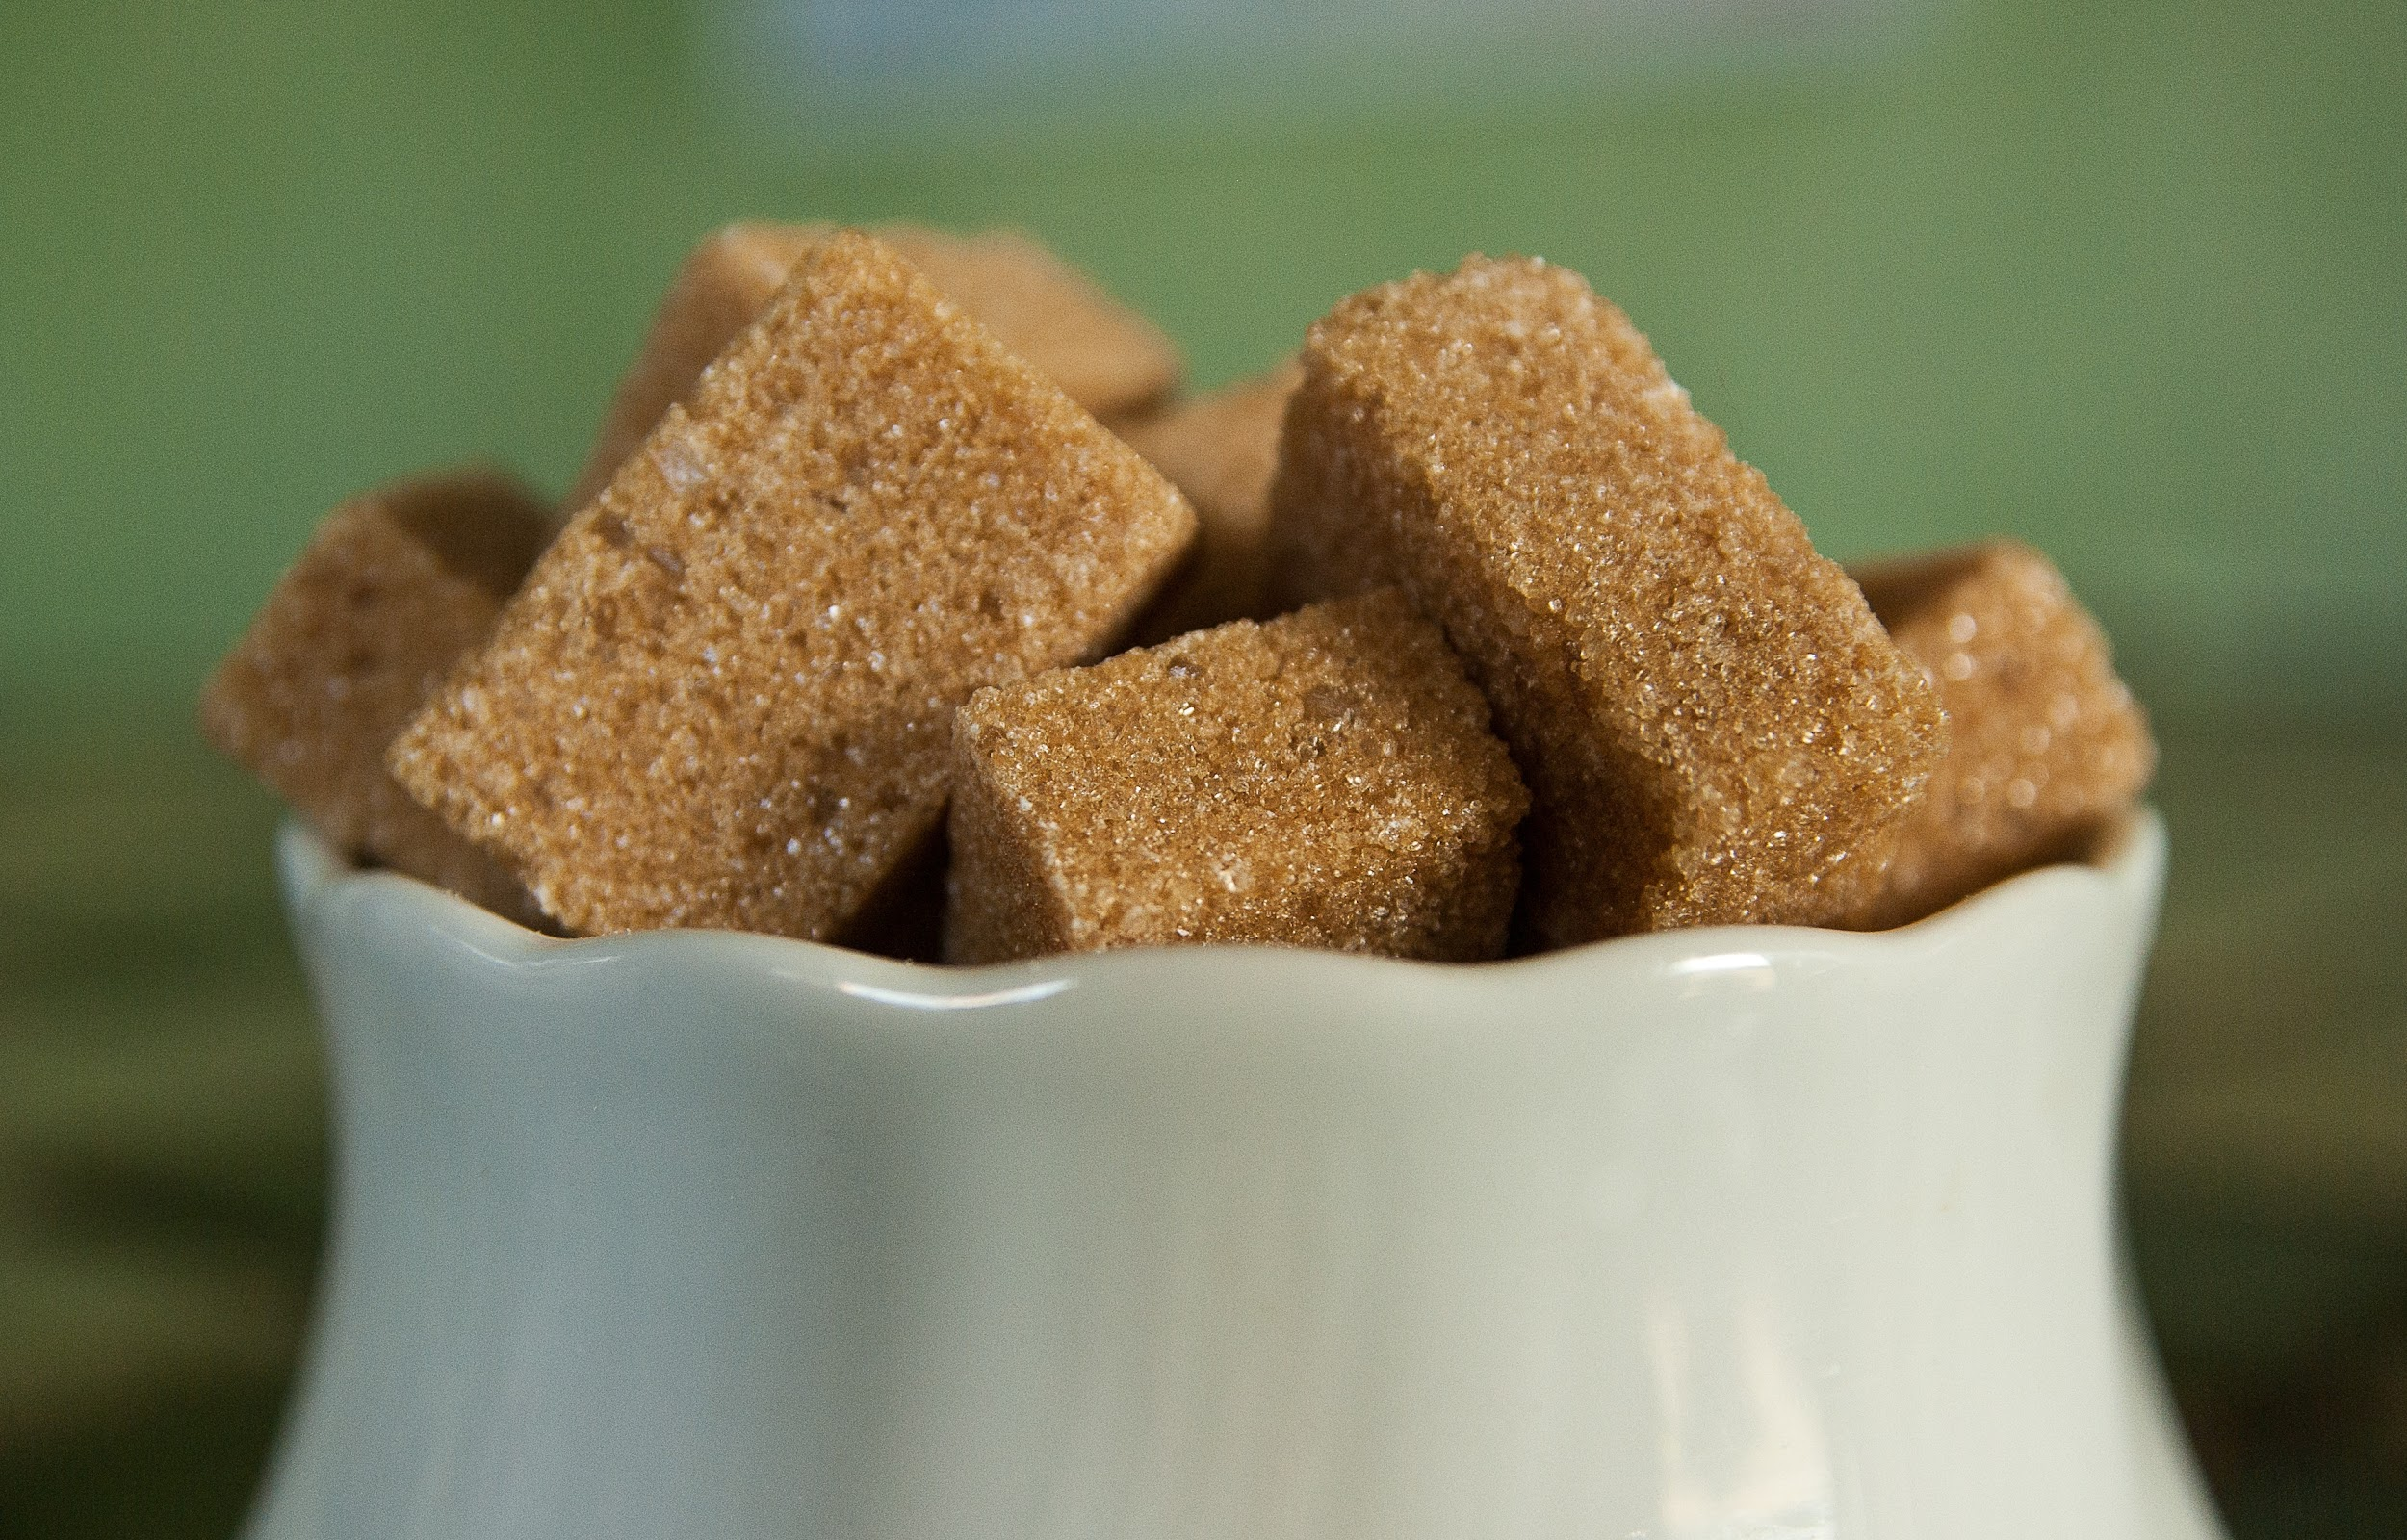
any σε ερωτήσεις και αρνήσεις για αριθμήσιμα και μη αριθμήσιμα
no σε καταφάσεις
Countable
Are there any strawberries in the fridge?
No, there aren’t any.
(There are no strawberries )
Uncountable
Is there any sugar in the cupboard?
No, there isn’t any.
(There is no sugar)

Slide 5
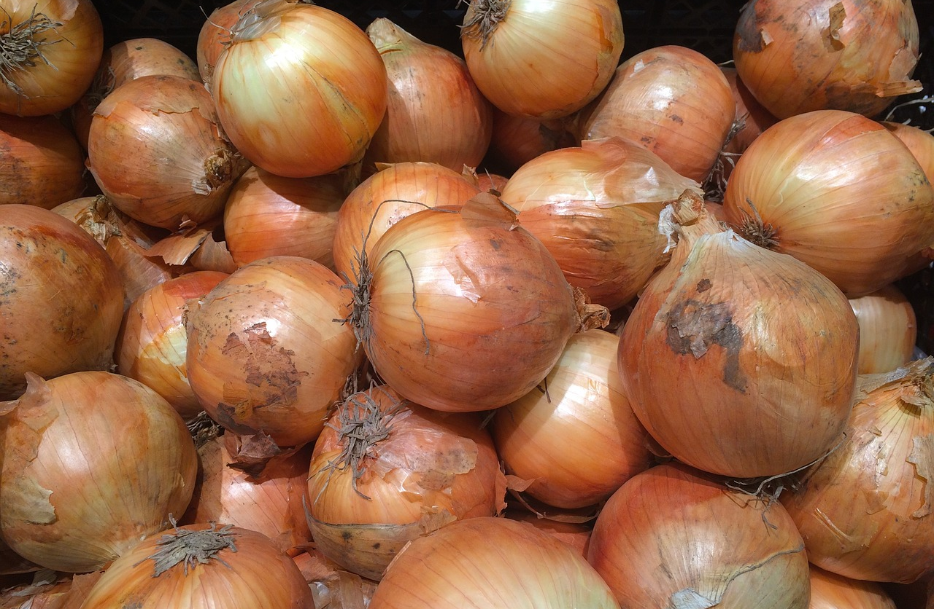
many
much
Countable
There are many onions in the bag .
Uncountable
There’s much orange juice left in the jug.

Slide 6
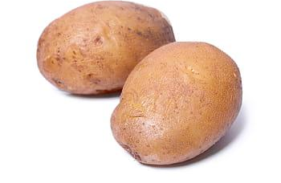
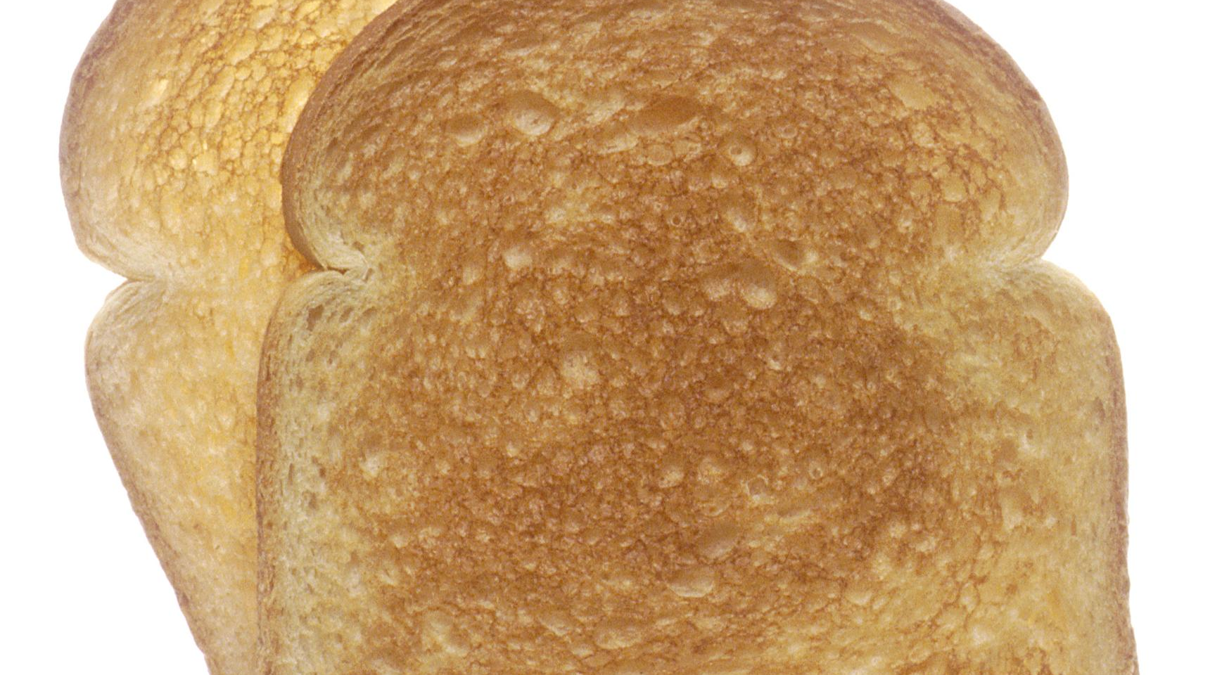
How many?
How much?
Countable
How many potatoes have we got?
Not many.
Uncountable
How much bread is there in the cupboard?
Not much.

Slide 7
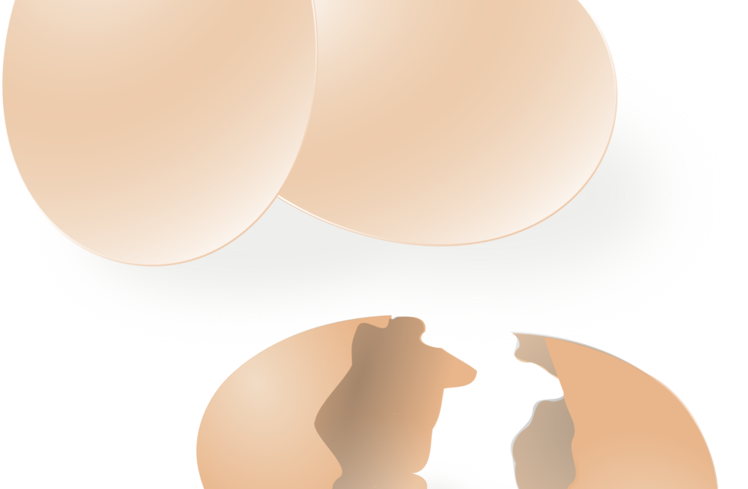
few
little
Countable
There are a few eggs in the fridge,so we can make an omellete.
Uncountable
There is a little coffee left in the cup.

Slide 8
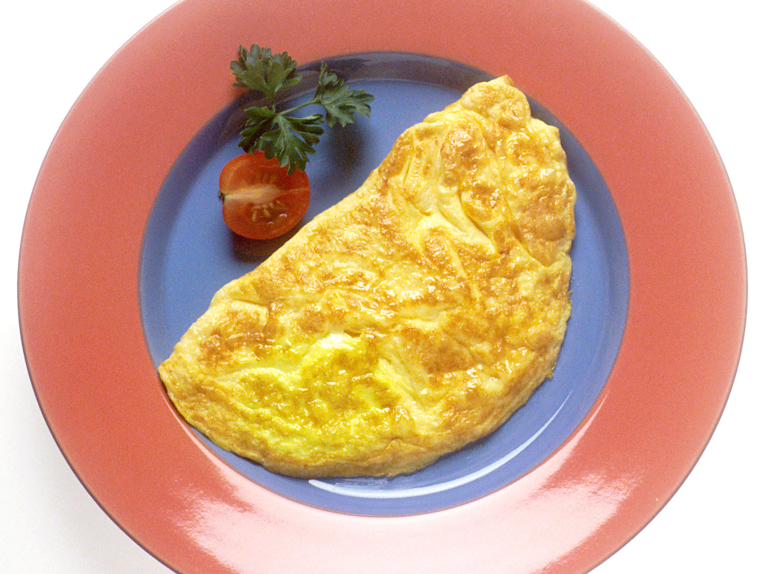
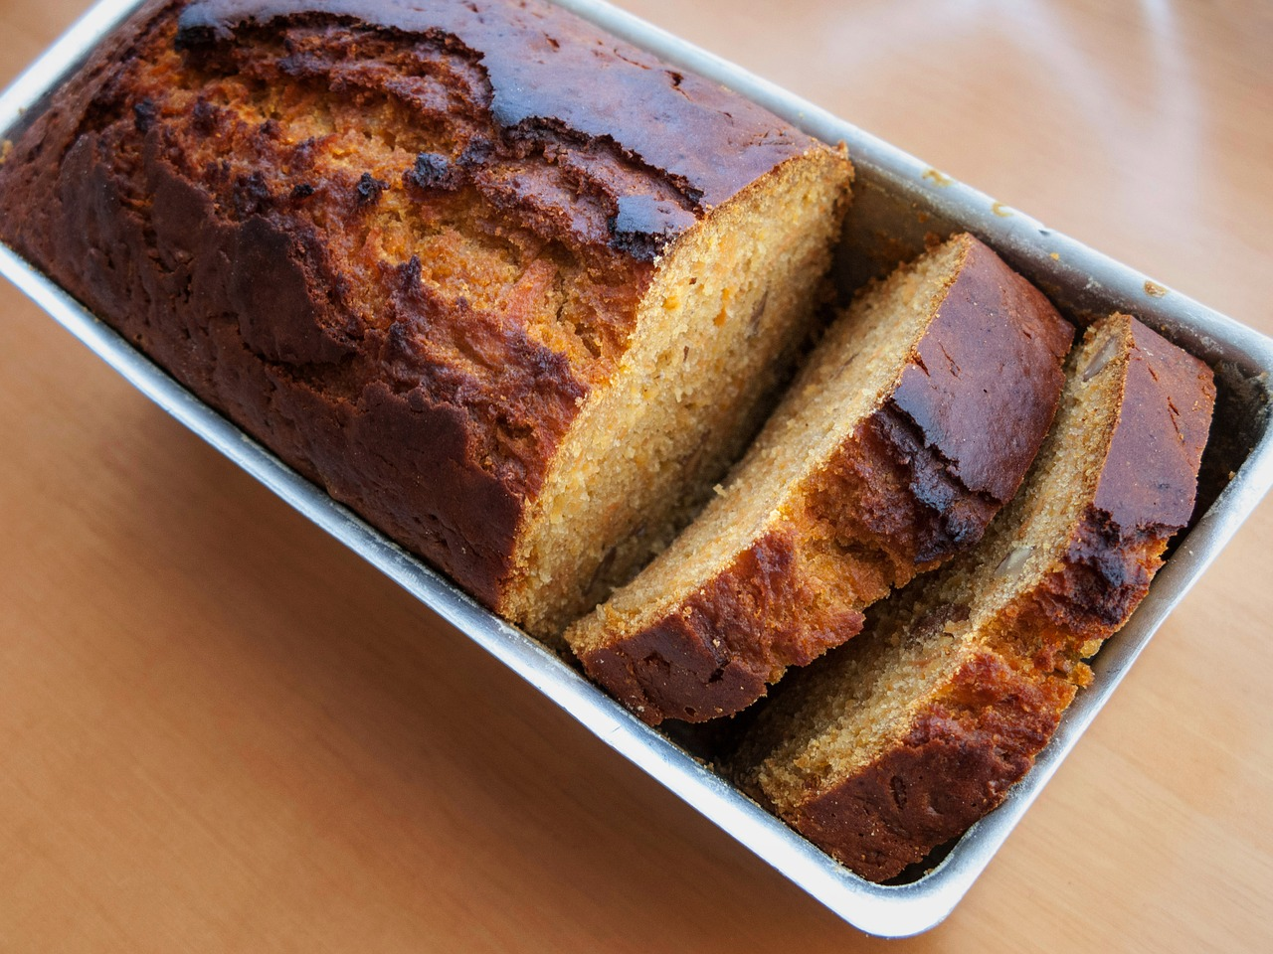
Remember!
a few eggs = λίγα αλλά αρκούν
There are a few eggs. We can make an omellete.
few eggs = λίγα αλλά δεν αρκούν
There are few eggs . We can’t make a cake.

Slide 9
Remember!
a little sugar = λίγη αλλά αρκεί
There is a little sugar. You can add it in your coffee.
little sugar = λίγη , δεν αρκεί
There is little sugar left . We must buy some if we want to make a cake.

