Slide 1
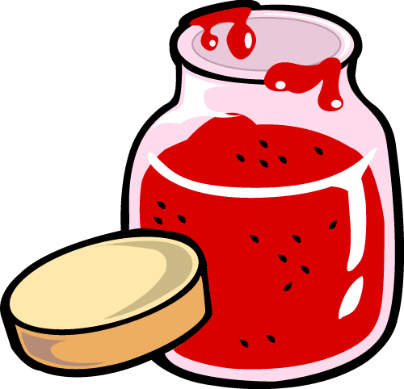
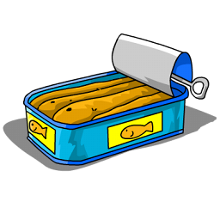
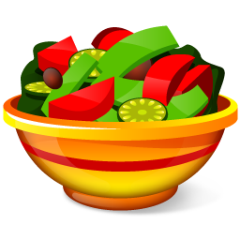
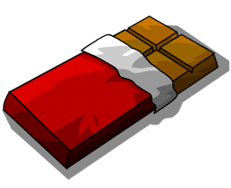
FOOD
partitives

Slide 2
● To count or quantify an uncountable noun we need to use a unit of measurement. For example, if we want to specify a quantity of milk, we need to use words like “carton", "bottle”, “glass”… The structure “a carton of milk” is called partitive structure.
● The word "partitive" indicates that only "part" of a whole is being referred to.
● This structure can also be used with countable nouns, for example: a packet of biscuits.

Slide 3
examples
partitive structure | quantity | measure word | of | Uncountable noun
 | a | cup | of | coffee
 | two | pieces | of | cheese
 | a lot of | jars | of | honey
Let’s practise other partitives.

Slide 4
a bag
What is this?
Click the right WORD.
a bowl
a jug
a cup
a can
a loaf
a bottle
a packet
a slice
a jar
a carton
a glass
a tin
a jug
a bar
___________of water
a box
a piece

Slide 5
a bag
What is this?
Click the right WORD.
a bowl
a jug
a cup
a can
a loaf
a bottle
a packet
a slice
a jar
a carton
a glass
a tin
a glass
a bar
____________of milk
a box
a piece

Slide 6
a bag
What is this?
Click the right WORD.
a bowl
a jug
a cup
a can
a loaf
a bottle
a packet
a slice
a jar
a carton
a glass
a tin
a slice
a bar
____________of pizza
a box
a piece

Slide 7
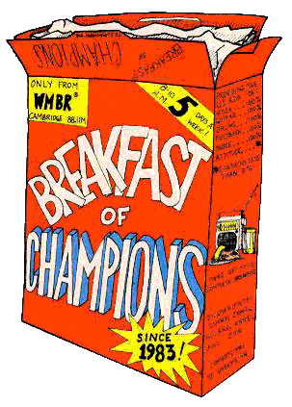
a bag
What is this?
Click the right WORD.
a bowl
a jug
a cup
a can
a loaf
a bottle
a packet
a slice
a jar
a carton
a glass
a tin
a box
a bar
____________of cereal
a box
a piece

Slide 8
a bag
What is this?
Click the right WORD.
a bowl
a jug
a cup
a can
a loaf
a bottle
a packet
a slice
a jar
a carton
a glass
a tin
a cup
a bar
_____________of tea
a box
a piece

Slide 9
a bag
What is this?
Click the right WORD.
a bowl
a jug
a cup
a can
a loaf
a bottle
a packet
a slice
a jar
a carton
a glass
a tin
a piece
a bar
_____________of cake
a box
a piece

Slide 10
a bag
What is this?
Click the right WORD.
a bowl
a jug
a cup
a can
a loaf
a bottle
a packet
a slice
a jar
a carton
a glass
a tin
a bag
a bar
_____________of flour
a box
a piece

Slide 11
a bag
What is this?
Click the right WORD.
a bowl
a jug
a cup
a can
a loaf
a bottle
a packet
a slice
a jar
a carton
a glass
a tin
a bar
a bar
____________ of chocolate
a box
a piece

Slide 12
a bag
What is this?
Click the right WORD.
a bowl
a jug
a cup
a can
a loaf
a bottle
a packet
a slice
a jar
a carton
a glass
a tin
a bowl
a bar
____________ of fruit
a box
a piece

Slide 13
a bag
What is this?
Click the right WORD.
a bowl
a jug
a cup
a can
a loaf
a bottle
a packet
a slice
a jar
a carton
a glass
a tin
a bottle
a bar
____________ of wine
a box
a piece

Slide 14
a bag
What is this?
Click the right WORD.
a bowl
a jug
a cup
a can
a loaf
a bottle
a packet
a slice
a jar
a carton
a glass
a tin
a packet
a bar
____________ of gum
a box
a piece

Slide 15
a bag
What is this?
Click the right WORD.
a bowl
a jug
a cup
a can
a loaf
a bottle
a packet
a slice
a jar
a carton
a glass
a tin
a jar
a bar
____________ of jam
a box
a piece

Slide 16
a bag
What is this?
Click the right WORD.
a bowl
a jug
a cup
a can
a loaf
a bottle
a packet
a slice
a jar
a carton
a glass
a tin
a can
a bar
____________ of soda
a box
a piece

Slide 17
a bag
What is this?
Click the right WORD.
a bowl
a jug
a cup
a can
a loaf
a bottle
a packet
a slice
a jar
a carton
a glass
a tin
a tin
a bar
____________ of sardines
a box
a piece

Slide 18
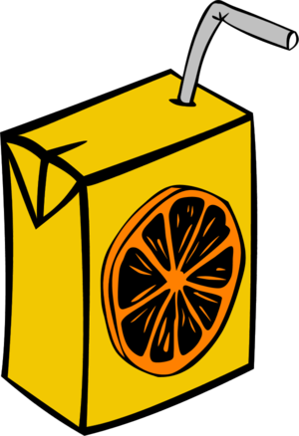
a bag
What is this?
Click the right WORD.
a bowl
a jug
a cup
a can
a loaf
a bottle
a packet
a slice
a jar
a carton
a glass
a tin
a carton
a bar
____________ of juice
a box
a piece

Slide 19
a bag
What is this?
Click the right WORD.
a bowl
a jug
a cup
a can
a loaf
a bottle
a packet
a slice
a jar
a carton
a glass
a tin
a loaf
a bar
____________ of bread
a box
a piece

Slide 20
HOW MUCH DO YOU REMEMBER?
Say what you see and click the pictures to check your answer.
a bowl of fruit
a cup of tea
a jug of water
a tin of sardines
a jar of jam
a bag of flour
a slice of pizza
a piece of cake

Slide 21
HOW MUCH DO YOU REMEMBER?
Say what you see and click the pictures to check your answer.
a bar of chocolate
a bottle of wine
a can of soda
a loaf of bread
a glass of milk
a carton of juice
a box of cereal
a packet of gum

Slide 22
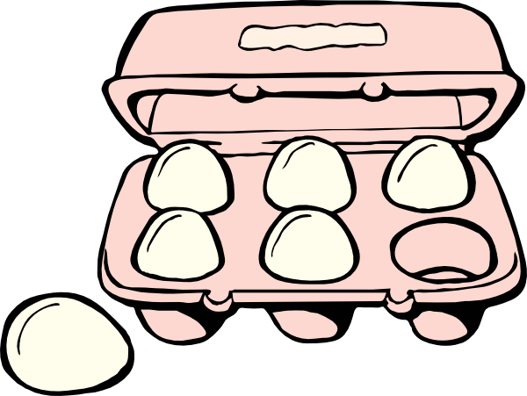
WHAT CAN YOU SEE NOW?
Click the pictures to check your answer.
a bag/packet of chips/crisps
a jar of cookies
a box of chocolates
a slice of orange
a bottle of ketchup
a bowl of ice cream
a tin of tuna
a box / carton of eggs

