Slide 1
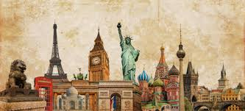
COUNTRIES
NATIONALITIES
LANDMARKS

Slide 2

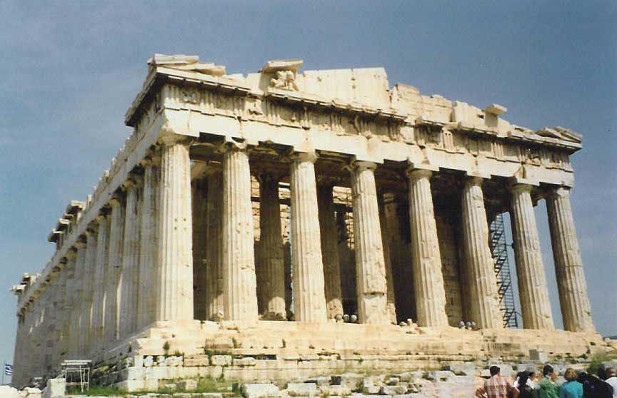
GREECE- Greek
The Parthenon (in Athens)

Slide 3

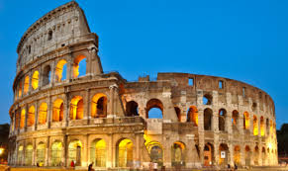
ITALY-Italian
The Colosseum (in Rome)

Slide 4

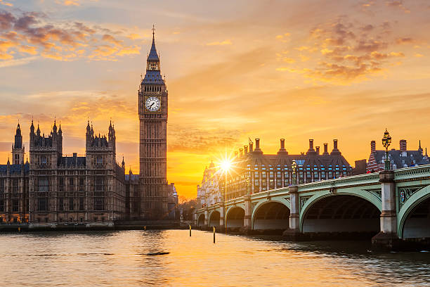
THE UNITED KINGDOM-British/English
The Big Ben (in London)

Slide 5

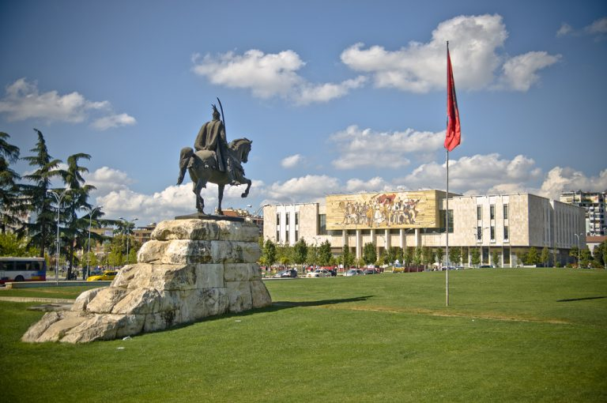
ALBANIA-Albanian
The National History Museum (in Tirana)

Slide 6

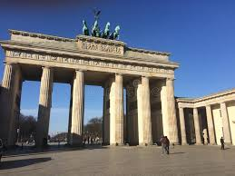
GERMANY-German
The Brandenburg gate (in Berlin)

Slide 7

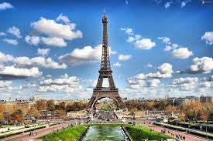
FRANCE-French
The Eiffel Tower (in Paris)

Slide 8

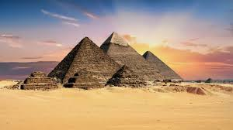
EGYPT-Egyptian
The Pyramids

Slide 9

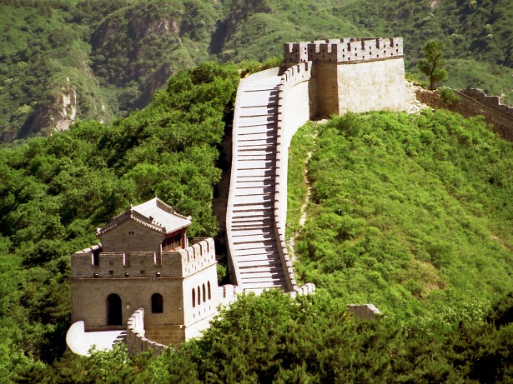
CHINA- Chinese
The Great Wall of China

Slide 10

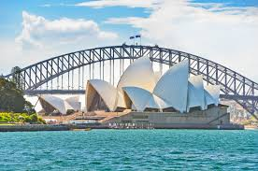
AUSTRALIA- Australian
The Opera House (in Sydney)

Slide 11

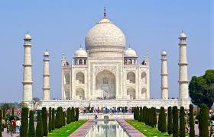
INDIA-Indian
The Taj Mahal

Slide 12

Σημαίες: countryflags.com

