Slide 1

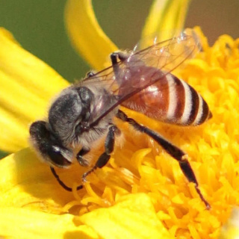
THE BEES ARE IN DANGER
How We Can Help These Amazing Pollinators

Slide 2

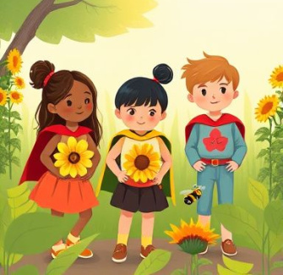
WHAT YOU WILL LEARN
By the end of this lesson, you will be able to:
Explain what bees do that helps plants and food grow
Describe three big problems bees are facing
Use words like pollinator, habitat, and pesticide correctly
Share simple actions you can take to help bees every day
Let’s find out why bees need our help – and how we can be their heroes!

Slide 3
KEY VOCABULARY
Pollinator
An animal that carries pollen from one flower to another, helping plants make fruits and seeds.
Habitat
A place where a living thing lives – like a home for animals. For bees, it’s meadows, gardens, or hollow trees.
Pesticide
A chemical used to kill crop-damaging bugs, but can harm bees too.
Ecosystem
All living and non-living things in an area that depend on each other.
Climate Change
Long-term weather shifts—like hotter summers or early blooms—that disrupt bee behavior.

Slide 4
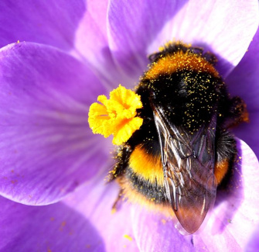
WHY BEES MATTER
Bees Are Super Helpers!
Bees are tiny but vital. Without them, we’d lose apples, strawberries, almonds, and chocolate!
How Do They Help?
As bees move between flowers for nectar, pollen sticks to them and spreads—this pollination helps food grow.
Did You Know?
One bee can visit 100 flowers per trip, working hard to power our food supply!

Slide 5
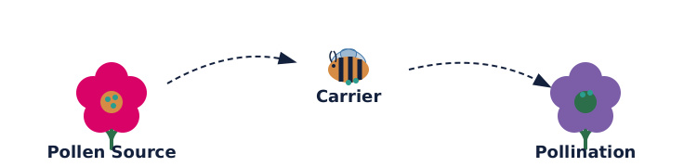
THE JOURNEY OF POLLEN
A bee is like a tiny mail carrier, delivering pollen so plants can make fruits and seeds.
This process helps plants reproduce. Without bees, many plants couldn't make the fruits and vegetables we eat every day.

Slide 6
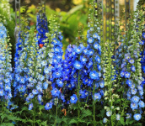
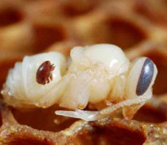
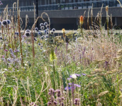
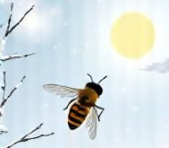
PROBLEMS BEES FACE
Harmful Chemicals
Pesticides can poison bees or impair their ability to fly and forage.
Sick Bees
Bees get sick and mites weaken them.
Lost Homes
Fields to buildings: bees lose homes.
Weather Confusion
Bees miss flowers due to climate-driven timing shifts.

Slide 7
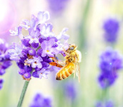
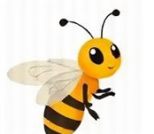
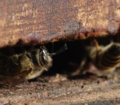
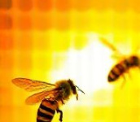
HOW BEES MAKE HONEY
Find Flowers
Worker bees fly up to 5 km to find sweet nectar in flowers.
Collect Nectar
They suck up nectar with their tongues and store it in a special stomach.
Back to Hive
They carry the nectar back to the hive and pass it to other bees.
Turn to Honey
Bees fan nectar with wings to dry it into thick, sweet honey.

Slide 8

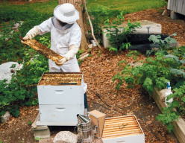
DISCUSS! 🤷‍♀️​ 💁‍♂️​ 💬​
A Bee's Day in Your Town
If you were a bee in your town or village, what would make it hard to find food, shelter, or stay safe? What could people do to help?

Slide 9
DISCUSS! 🤷‍♀️​ 💁‍♂️​ 💬​
✅​
You might have said...
Few flowers due to pavement, pesticides taint nectar, and cars/buildings create hazardous flight conditions.

Slide 10
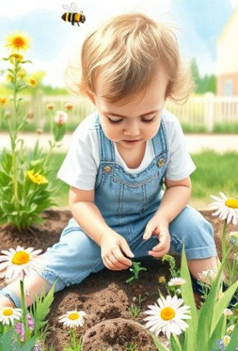
YOU CAN HELP THE BEES!
1
Plant Flowers
Grow bee-friendly plants like lavender, sunflowers, or thyme in pots or gardens.
2
Skip Pesticides
Ask adults to use natural plant protection like mint or water spray.
3
Build a Bee Home
Make a bee hotel with sticks, bamboo, or cardboard tubes.
4
Spread the Word
Tell your friends and family why bees are important and how to help them.

Slide 11
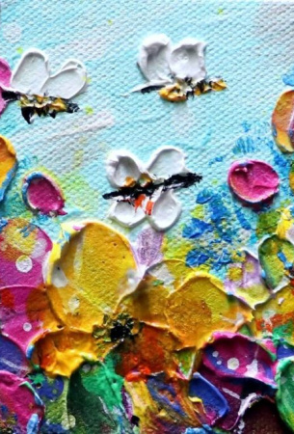
LET’S BE BEE HEROES
Bees are small, but they play a huge role in our world. From the food we eat to the beauty of nature, they make a big difference. Now that you know the dangers they face – and how easy it is to help – you can make a change!
Every flower planted, every kind choice, helps bees survive. Together, we can give bees a safer, sweeter future.

