Slide 1






ETWINNING
PROJECT
BEE BRAVE

Slide 2
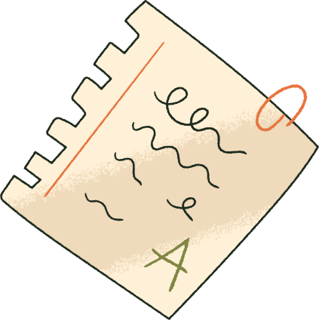
DESCRIPTION
Each school writes a short physical description of the bee on one slide of the shared presentation (on the left side of the slide) and creates an illustration of a partner school’s description (on the right side of the slide, next to the partner’s text).
1
The text should be simple but expressive, giving enough detail for another team to imagine the bee correctly.
For example: colour of the body and stripes, size, expression (happy/sad/brave), type of wings, maybe a special feature (a hat, a flower, a backpack, etc.).
2

Slide 3

A BRAVE, LITTLE BEE

Slide 4
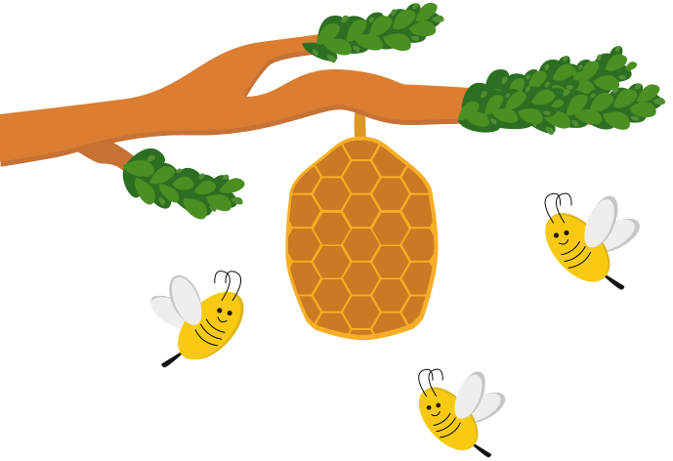
THANK
YOU
2nd Primary School of Skiathos, Greece, 6th grade

