Slide 1
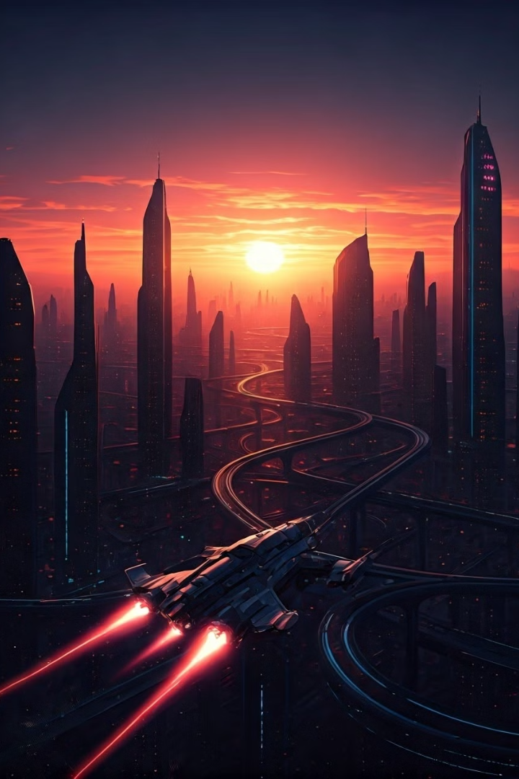
Our Solar System
Our solar system is a fascinating place full of wonders. Let's explore the amazing things in our solar system!
by VASSO LIBERIOU

Slide 2
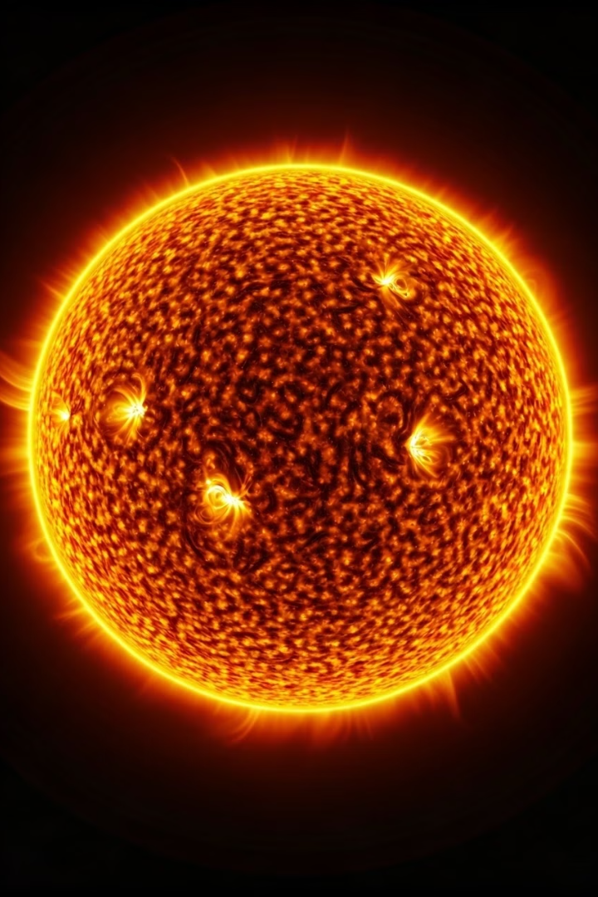
The Sun
The Sun is a giant ball of hot gas. It is the center of our solar system and provides light and heat for all the planets.
Burning Gas
Life Giver
It is mainly composed of hydrogen and helium, which fuse together in its core, releasing a tremendous amount of energy.
Without the Sun, life on Earth wouldn't be possible. It provides the light and warmth necessary for plant growth and sustains all life.
Solar Flares
Sometimes, the Sun releases powerful bursts of energy called solar flares, which can affect Earth's atmosphere.

Slide 3
The Planets
Planets are large celestial bodies that orbit a star. Our solar system has eight planets, which we can classify into two main groups: terrestrial and Jovian.
Terrestrial
Jovian
These planets are rocky and solid. They are smaller and denser than Jovian planets.
These planets are gas giants. They are larger and less dense than terrestrial planets.
Mercury
Jupiter
Venus
Saturn
Earth
Uranus
Mars
Neptune

Slide 4
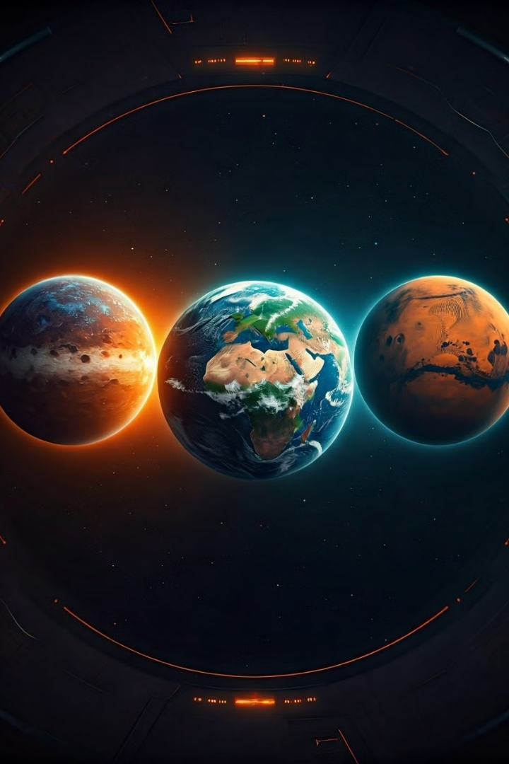
Terrestrial Planets
These planets are closer to the Sun and have solid surfaces. They are also smaller and denser than the gas giants.
1
Mercury
2
Venus
The smallest planet in our solar system, Mercury is a rocky world with a very thin atmosphere. It is known for its extreme temperatures, with scorching days and freezing nights.
Known as Earth's "sister planet," Venus is a hot and toxic world with a thick atmosphere made mostly of carbon dioxide. Its surface is covered in volcanoes and lava flows.
3
Earth
4
Mars
Our home planet, Earth is a unique world with liquid water, a diverse atmosphere, and a rich ecosystem. It's the only planet known to support life.
The "Red Planet" is a cold and dusty world with a thin atmosphere. It's known for its iconic red color, which comes from iron oxide in the soil.

Slide 5
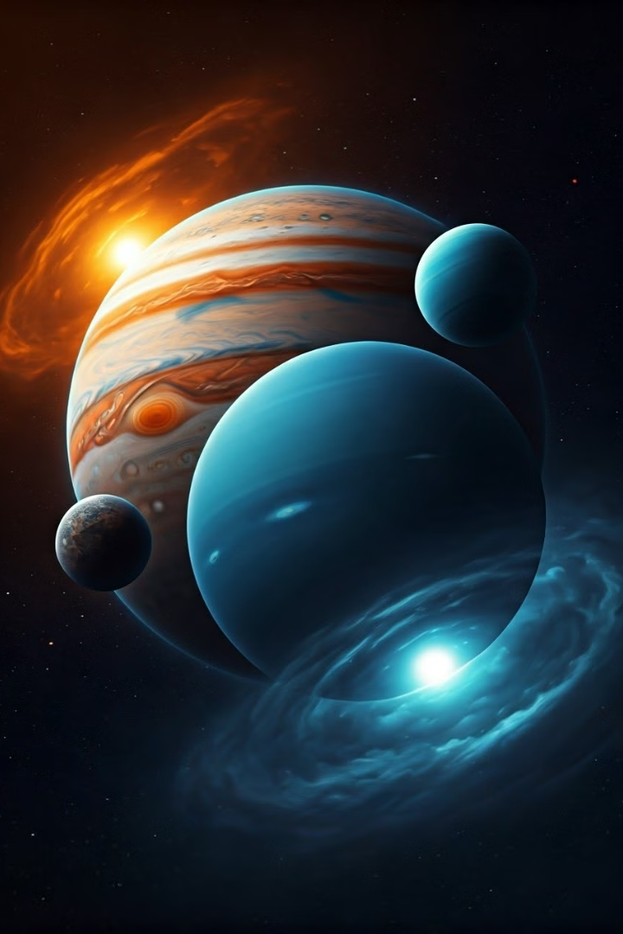
Jovian Planets
These planets are farther from the Sun and are made mostly of gas. They are much larger than the terrestrial planets and have many moons.
1
Jupiter
The largest planet in our solar system, Jupiter is a gas giant with a strong magnetic field and a famous red spot, a giant storm that has been raging for centuries.
2
Saturn
Known for its stunning ring system, Saturn is another gas giant with a swirling atmosphere and numerous moons. Its rings are made of ice and rock particles.
3
Uranus
This ice giant is tilted on its side, making it appear to spin on its side. It also has a faint ring system and numerous moons, some of which are thought to have subsurface oceans.
4
Neptune
The farthest planet from the Sun, Neptune is a cold and windy world with a blue-colored atmosphere. It also has a faint ring system and numerous moons.

Slide 6
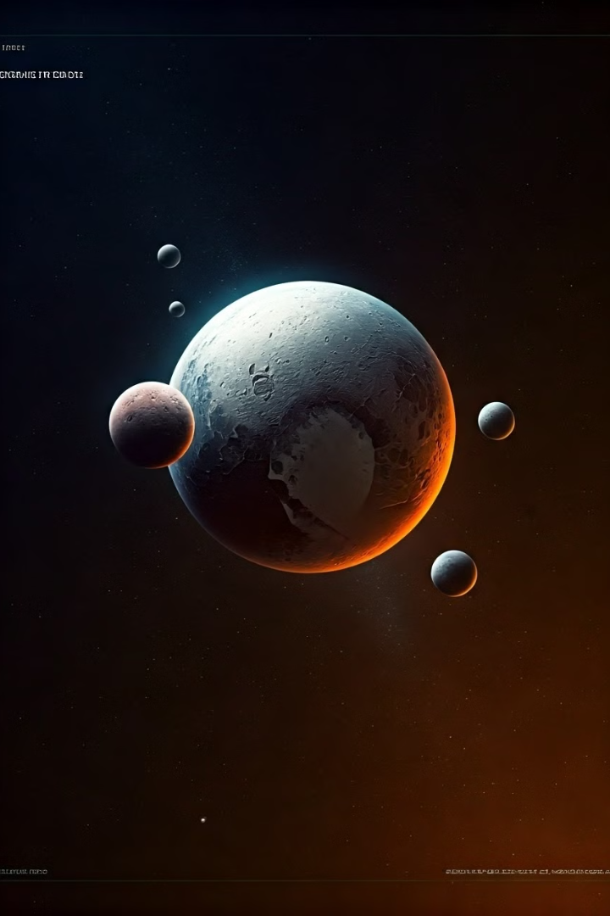
Dwarf Planets
Dwarf planets are celestial bodies that orbit the Sun and are large enough for their gravity to pull them into a nearly round shape, but they haven't cleared their neighborhood of other objects.
Pluto
Eris
Pluto was once considered the ninth planet but was reclassified as a dwarf planet in 2006. It's a cold and icy world with a thin atmosphere and numerous moons.
Eris is a dwarf planet in the Kuiper Belt, a region of icy bodies beyond Neptune. It is slightly larger than Pluto and is known for its extremely elliptical orbit.
Ceres
Makemake
Ceres is the largest object in the asteroid belt between Mars and Jupiter. It is a dwarf planet with evidence of water ice and possibly even liquid water beneath its surface.
Makemake is a dwarf planet in the Kuiper Belt. It's known for its elongated shape and has a faint ring system.

Slide 7
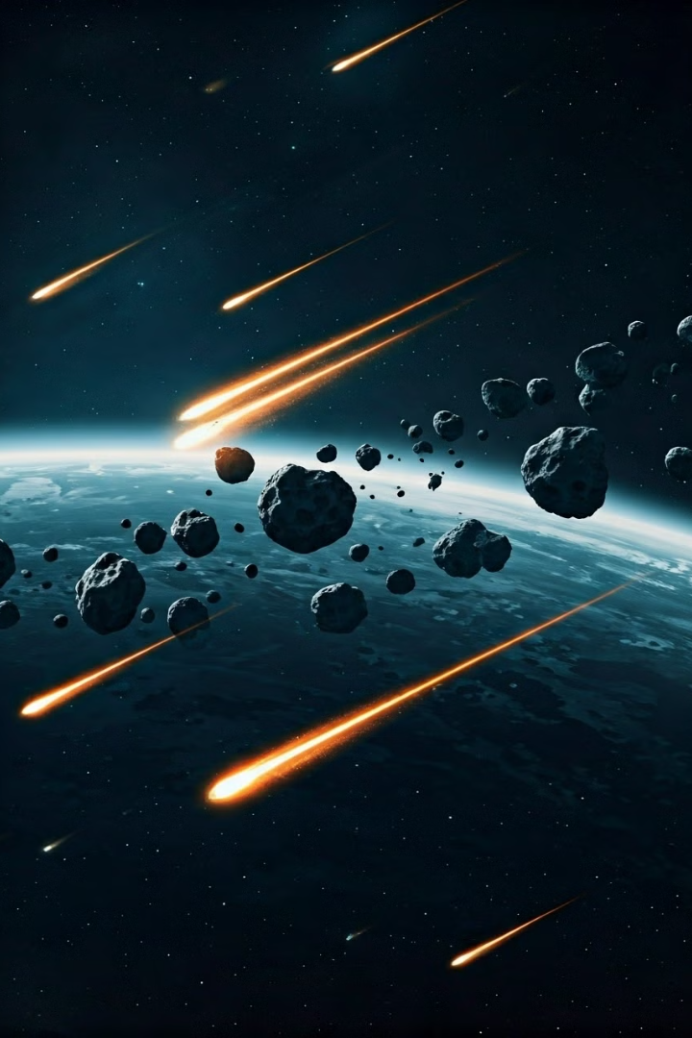
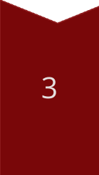
Asteroids, Comets, and Meteors
Besides planets and dwarf planets, our solar system is also home to smaller objects like asteroids, comets and meteors.
Asteroids
These are rocky bodies that orbit the Sun, mostly found in the asteroid belt between Mars and Jupiter.
Comets
Comets are icy bodies that orbit the Sun. When they get close to the Sun, they heat up and release gas and dust, forming a visible tail.
Meteors
Meteors are small pieces of space debris that enter Earth's atmosphere and burn up, creating a streak of light known as a shooting star.

Slide 8
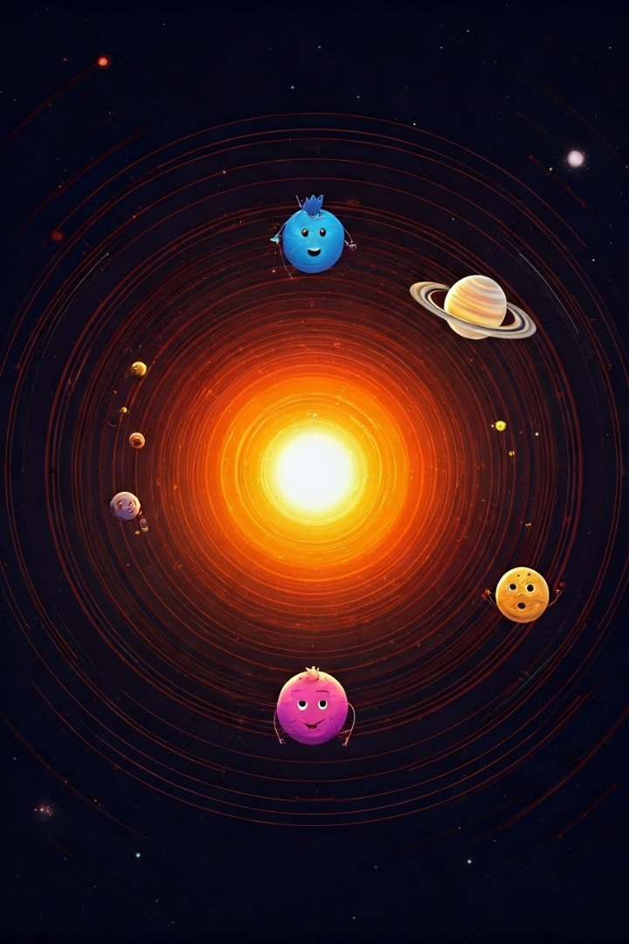
Fun Facts about the Solar System
Our solar system is full of amazing things! Did you know that Jupiter has a storm that has been raging for hundreds of years? Or that Saturn's rings are made of ice and rock?
The largest volcano in the solar system is on Mars, Olympus Mons.
The Sun is so big that over 1 million Earths could fit inside it.
Venus is the hottest planet in the solar system, even though Mercury is closer to the Sun.
Uranus is the only planet that rotates on its side.

