Slide 1
Our English Class
Ms Vasso Liberiou
2nd Primary School of Skiathos
English Language -

Slide 2
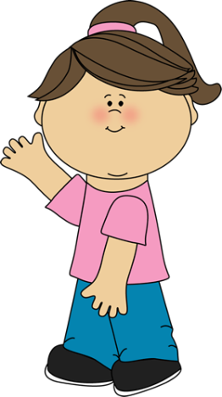
HELLO!!!!!
This is your English class
HI!!!!!!
I’ m your English teacher

Slide 3
My name is _________________
What’s your name?
Good morning!!!!
Nice to meet you
My name is __________

Slide 4
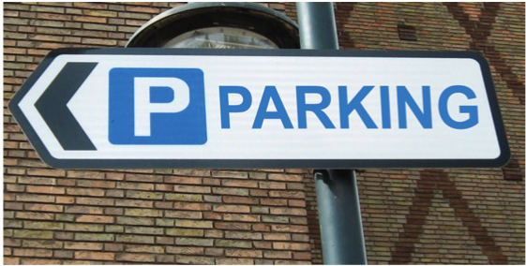
English is everywhere!!!!!

Slide 5
English is everywhere!!!!!

Slide 6
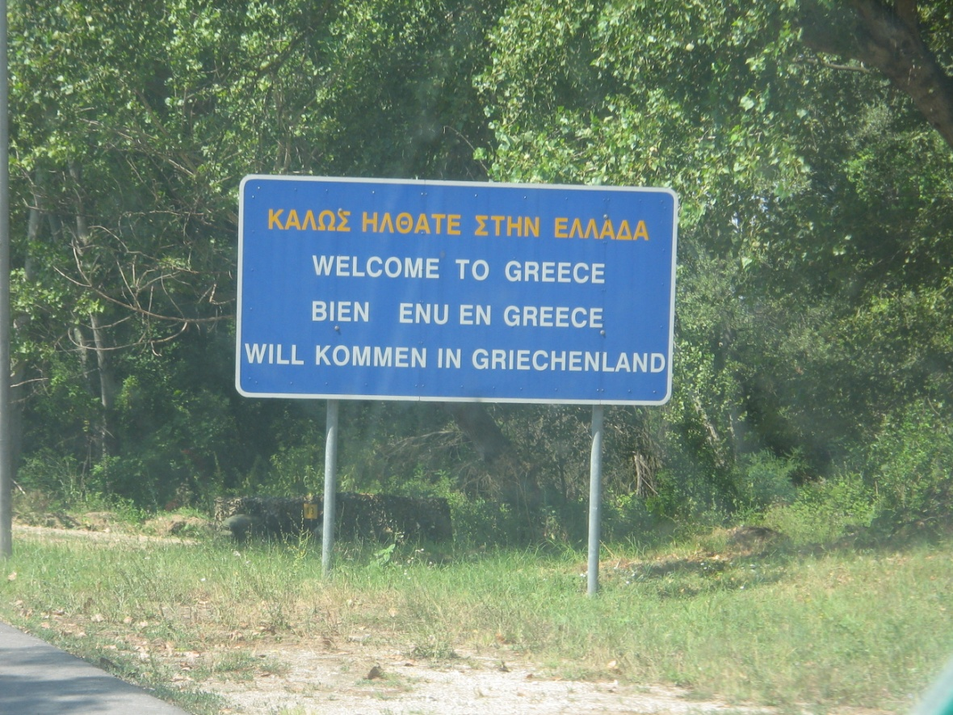
English is everywhere!!!!!

Slide 7
What’s your name?
https://www.youtube.com/watch?v=yqlbn_nI2w8

