Slide 1
Feelings

Slide 2

happy

Slide 3

hungry

Slide 4

bored

Slide 5
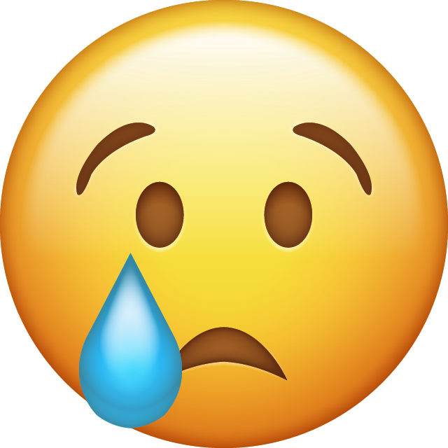
sad

Slide 6

scared

Slide 7

angry

Slide 8
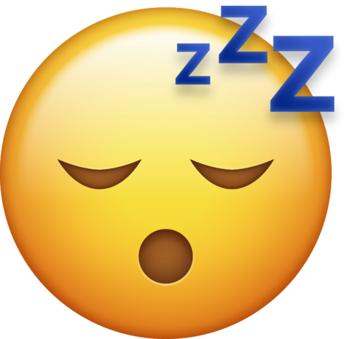
sleepy

Slide 9
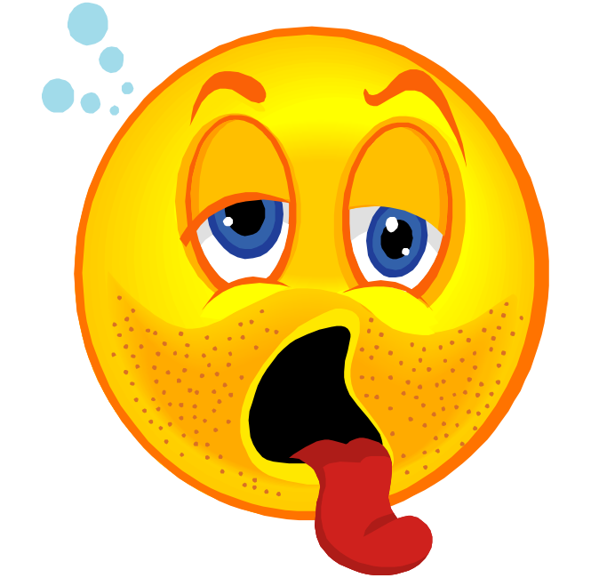
thirsty

