Slide 1
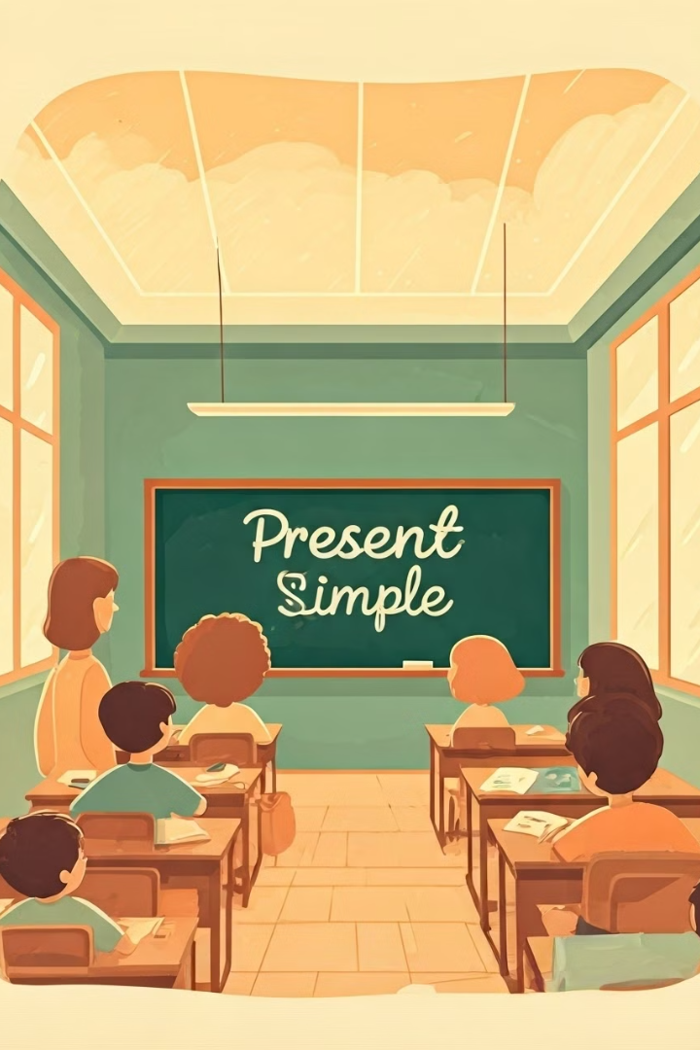
Introduction to Present Simple Tense
Welcome to the world of the Present Simple tense! This tense is used to talk about things that happen regularly, facts, and routines.
by VASSO LIBERIOU

Slide 2
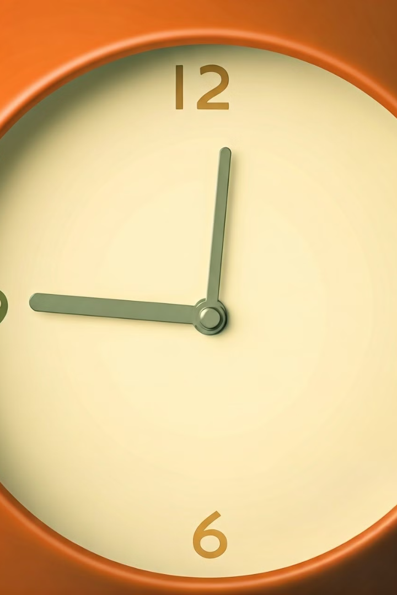
What is the Present Simple Tense?
The Present Simple tense describes actions or states that happen regularly, habitually, or are always true.
Routine
Facts
What you do every day.
Things that are always true.
Habits
Things you do often.

Slide 3
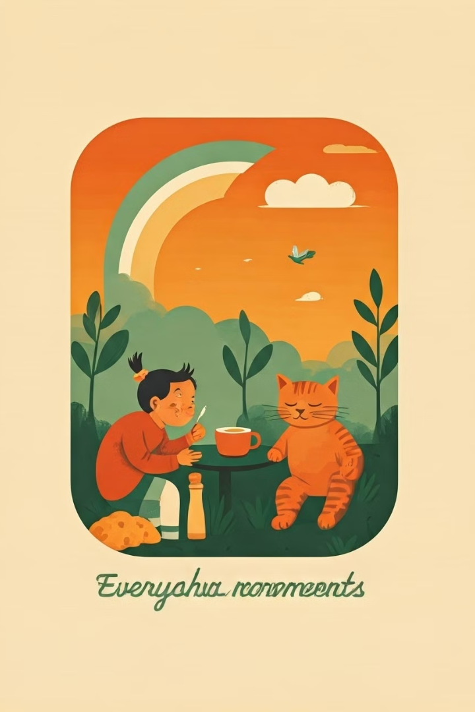
When to use the Present Simple Tense
The Present Simple tense is used for many things, such as describing daily routines, expressing facts, and talking about habits.
1
Daily Routine
2
Facts
I wake up at 7:00 am every day.
The sun rises in the east.
3
Habits
I play soccer every Saturday.

Slide 4
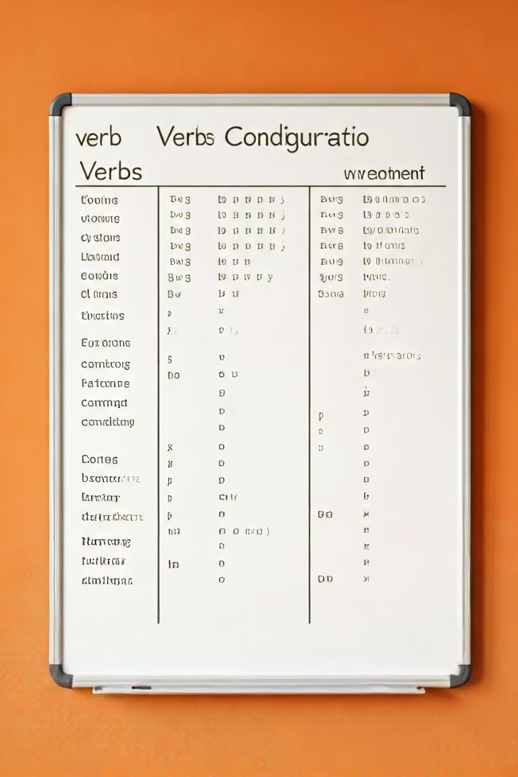
Forming the Present Simple Tense
The Present Simple tense is formed with the base form of the verb, but there are some changes to make for different pronouns.
I
play
You
play
He/She/It
plays
We
play
You
play
They
play

Slide 5
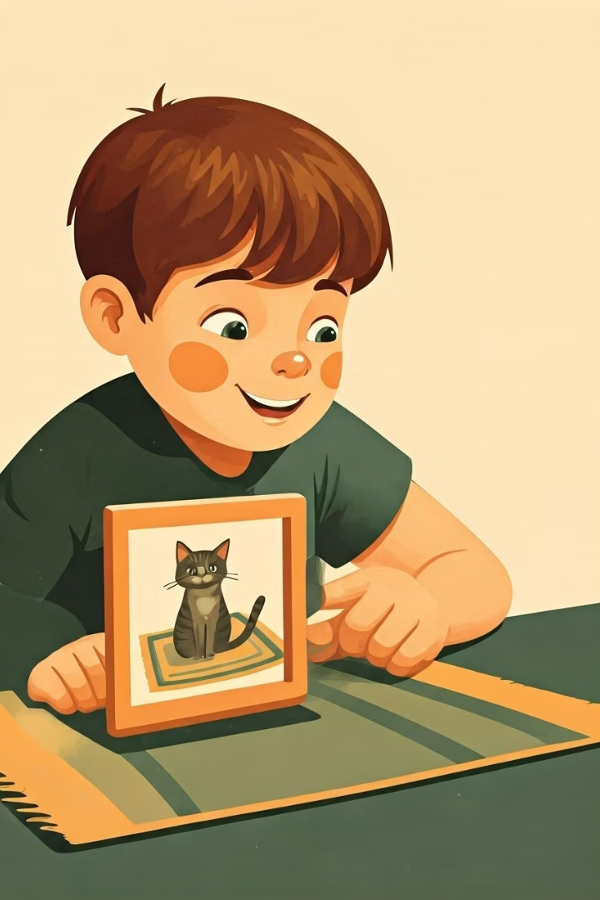
Positive Statements in the Present Simple Tense
Positive statements in the Present Simple tense are used to describe actions or states that happen regularly, habitually, or are always true.
1
Example 1
2
Example 2
He eats breakfast every morning.
The dog barks at the mailman.
3
Example 3
She plays the piano.

Slide 6
Negative Statements in the Present Simple Tense
Negative statements in the Present Simple tense are used to say that something does not happen or is not true.
1
Example 1
2
Example 2
3
Example 3
She doesn't drink coffee.
They don't go to school on weekends.
The cat doesn't eat fish.

Slide 7
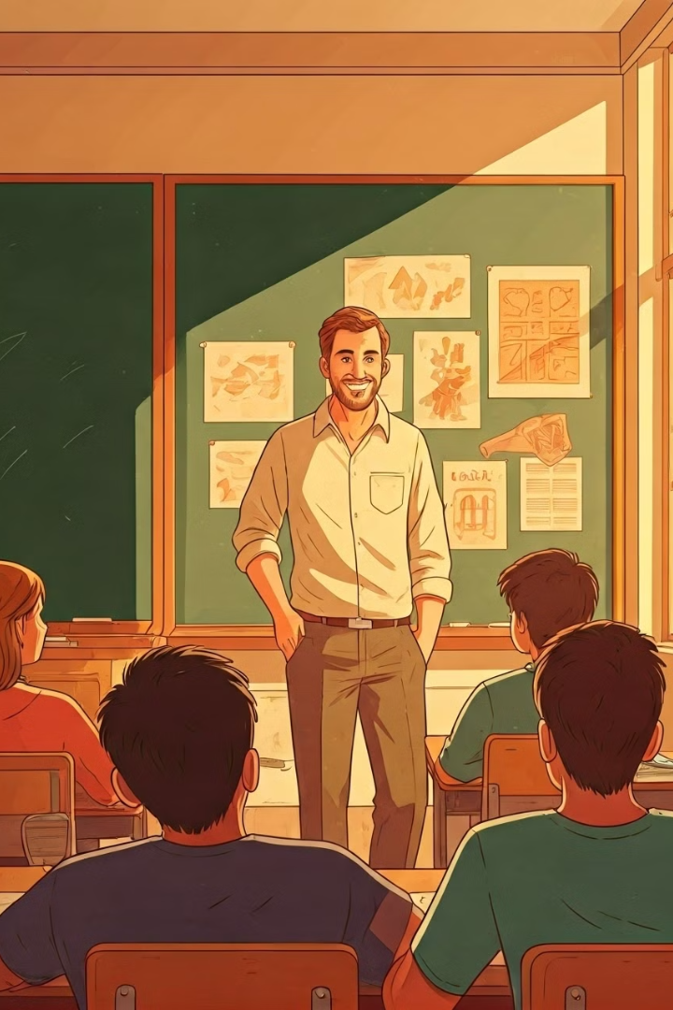
Questions in the Present Simple Tense
Questions in the Present Simple tense are used to ask about actions or states that happen regularly, habitually, or are always true.
1
Example 1
2
Example 2
Do you like pizza?
Does she play the guitar?
3
Example 3
What time does the bus arrive?

Slide 8
Examples of the Present Simple Tense
The Present Simple tense is a versatile tense used to describe actions and states that happen regularly, habitually, or are always true.
Routine
Facts
Habits
I get up at 7:00 am every morning.
The Earth is round.
I play tennis on Sundays.
I eat breakfast at 8:00 am.
Water boils at 100 degrees Celsius.
I read books in my free time.

