Slide 1
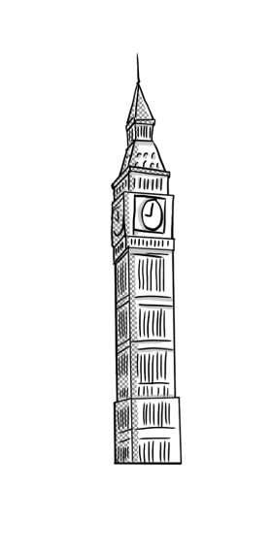
PRESENT CONTINUOUS
Vasso Liberiou
2nd Primary School of Skiathos, Greece
English Language -

Slide 2
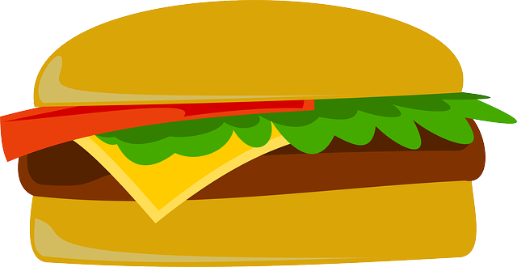
FORM
am-is-are
verb
- ing

Slide 3
Verb be +ing
Affirmative | Interrogative | Negative | Negative
I am working | Am I working ? | I’m not working | …
You are working | Are you working ? | You’re not working | You aren’t working
He is working | Is he working ? | He’s not working | He isn’t working
She is working | Is she working ? | She’s not working | She isn’t working
It is working | Is it working ? | It’s not working | It isn’t working
We are working | Are we working ? | We’re not working | We aren’t working
You are working | Are you working ? | You’re not working | You aren’t working
They are working | Are they working ? | They’re not working | They aren’t working

Slide 4
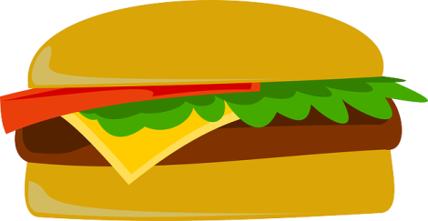
Spelling rules
If the verb ends in –e , we say goodbye to e and we put –ing. Eg. Write→ writing
If the verb ends in consonant/vowel/consonant, we double (x2) the last consonant. Eg. Put →putting
But! Fix→ fixing
If the verb ends in –y, don’t worry! Y loves ing=L.F.E Eg. Study → studying
If the verb ends in –ie like tie, die →tying, dying

Slide 5
USE
NOW!
We use present continuous:
To talk about something that it is happening right now (I’m brushing my teeth right now, I cannot talk on the phone)
For a temporary situation (I’m staying at this hotel for a couple of days)
For future plans and arrangements (I’m visiting my grandparents this weekend)
Near future (this weekend, tonight)
Changing situation (More and more tourists are coming to Greece lately)
Annoying habit +always /constantly (My brother is always leaving his clothes on the floor)

Slide 6
Key words
Right now
Now
At the moment
At present
Tonight
Today
Currently
These days, this week, this month, this year
Listen!

Slide 7
Remember!!!
The present continuous tense is not used with the stative verbs!
BUT
You can see stative vebs in –ing
with a different meaning.
I’m having a bath/ a lunch/ fun
I’m seeing the doctor today (=I have an appointment)
I’m tasting the soup (= the act of trying) VS
The soup tastes great (=it has a flavour)
Know, understand, hate, love, fancy, own, believe

