Slide 1
Summer Olympic Sports for Young English Learners

Slide 2
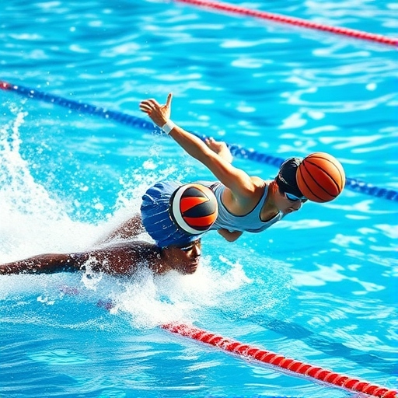
Swimming
Swimming is a sport in water
Athletes race in a big pool
They use different styles:
Freestyle
Backstroke
Breaststroke
Butterfly
Swimmers try to be the fastest

Slide 3
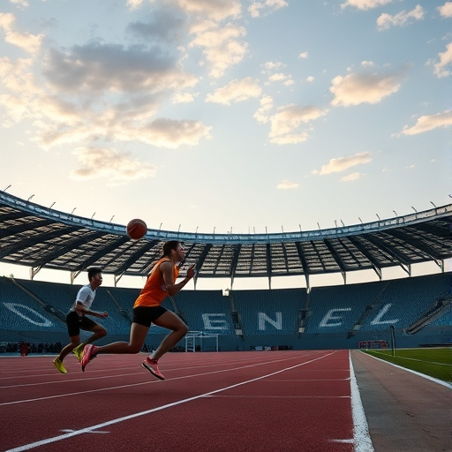
Athletics (Track and Field)
Athletics has many events
Running:
Short races (100m, 200m),
Long races (marathon)
Jumping: Long jump
High jump
Throwing:
Javelin
Discus

Slide 4
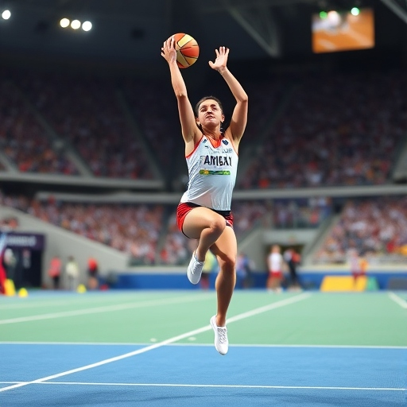
Gymnastics
Gymnasts do amazing moves
They use special equipment:
Balance beam
Rings
Parallel bars
Gymnasts need to be strong and flexible
They get points for their performance

Slide 5
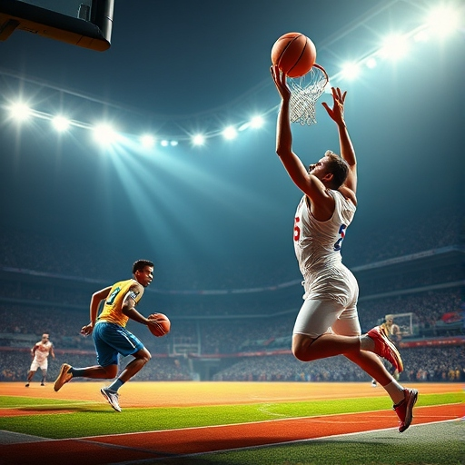
Team Sports
Basketball:
Two teams try to score points
Players throw a ball through a hoop
Football (Soccer):
Two teams kick a ball
Try to score goals
Volleyball:
Teams hit a ball over a net
Don't let the ball touch the ground

Slide 6
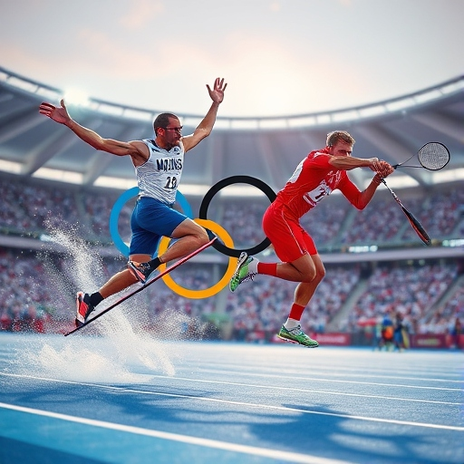
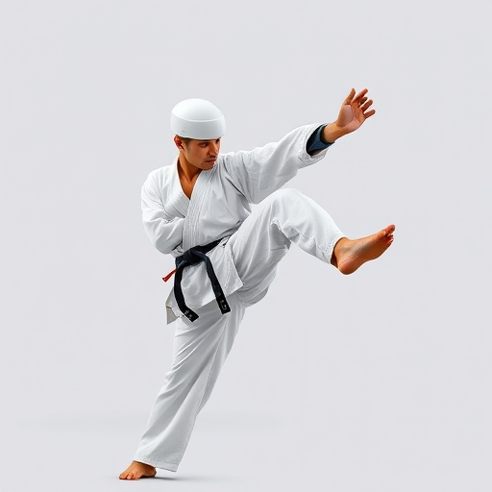
Other Olympic Sports
Skateboarding
Surfing
Sport Climbing
These sports are fun and exciting!

