Slide 1
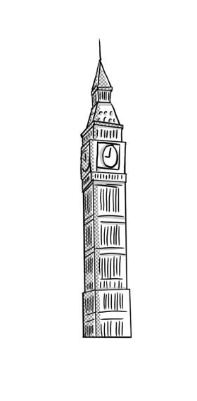
PRESENT SIMPLE
Vassiliki Liberiou
2nd Primary School of Skiathos
English Language -

Slide 2

-s –es -ies
FORM
We put -s –es –ies after he/ she/ it

Slide 3
HE/ SHE /IT
Verbs ending in a consonant (b,c,d,f,g...) + Y
change y to ies
Verbs ending in ch, s, sh, o, x
add – es
study – studies
carry – carries
Fly - flies
watch – watches
guess – guesses
finish – finishes
go – goes
fix - fixes

Slide 4
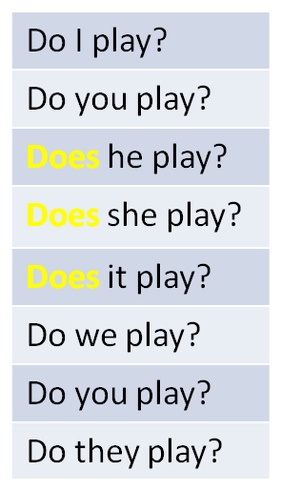
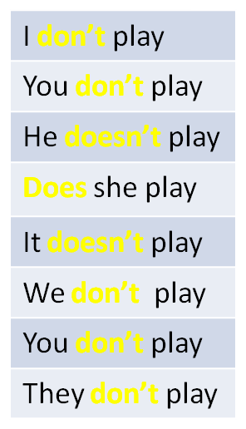
DO +DOES ?/ DON’T +DOESN’T x
QUESTIONS
DO → I, YOU, WE, THEY
DOES → HE, SHE, IT
NEGATIVE
DON’T → I, YOU, WE, THEY
DOESN’T → HE, SHE, IT

Slide 5
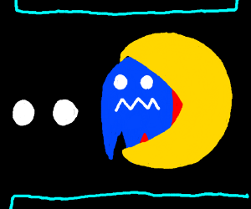
Remember!!
Every time you use does or doesn’t remember to remove the –s –es -ies. The verb should be in its base form. Imagine does or doesn’t as a huge pacman which eats –s –es –ies!

Slide 6
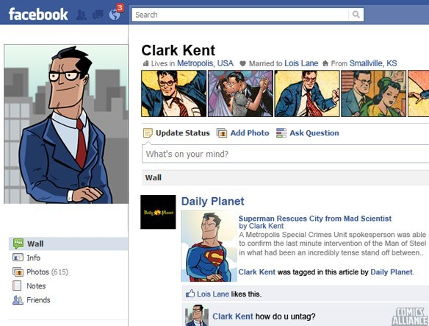
WHEN DO WE USE PRESENT SIMPLE?
Daily routines
Habits
General truth

Slide 7
What do you do every day?
What do you do every year?
What do you do every week?
Remember to use the key words...
Always 100%, usually 80%, sometimes 50%, seldom 20%, rarely 20%, never 0%

