Slide 1
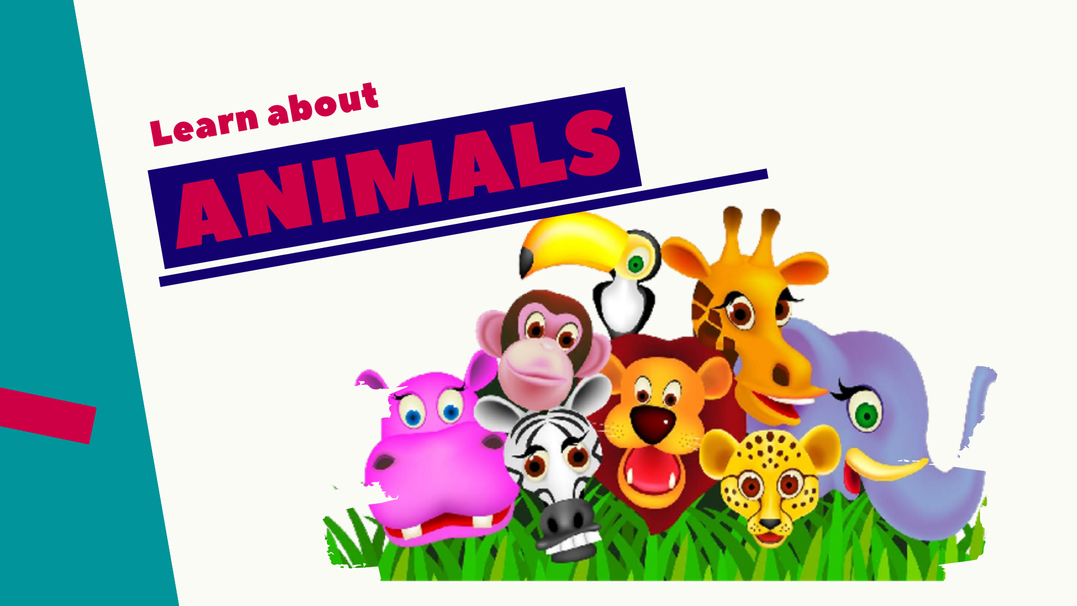

Slide 2
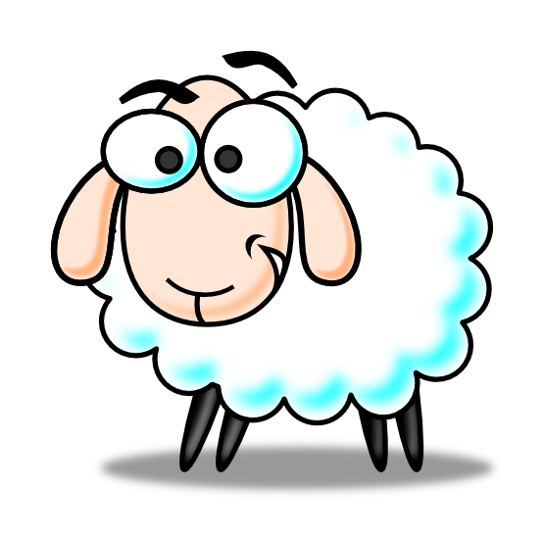
sheep

Slide 3
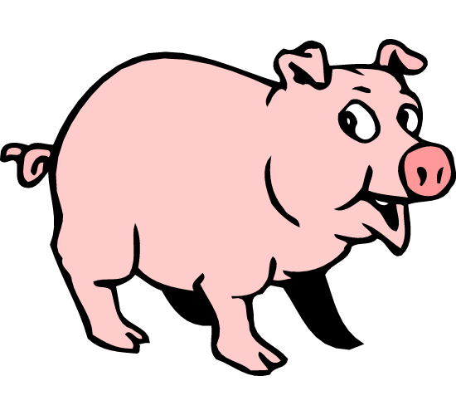
pig

Slide 4
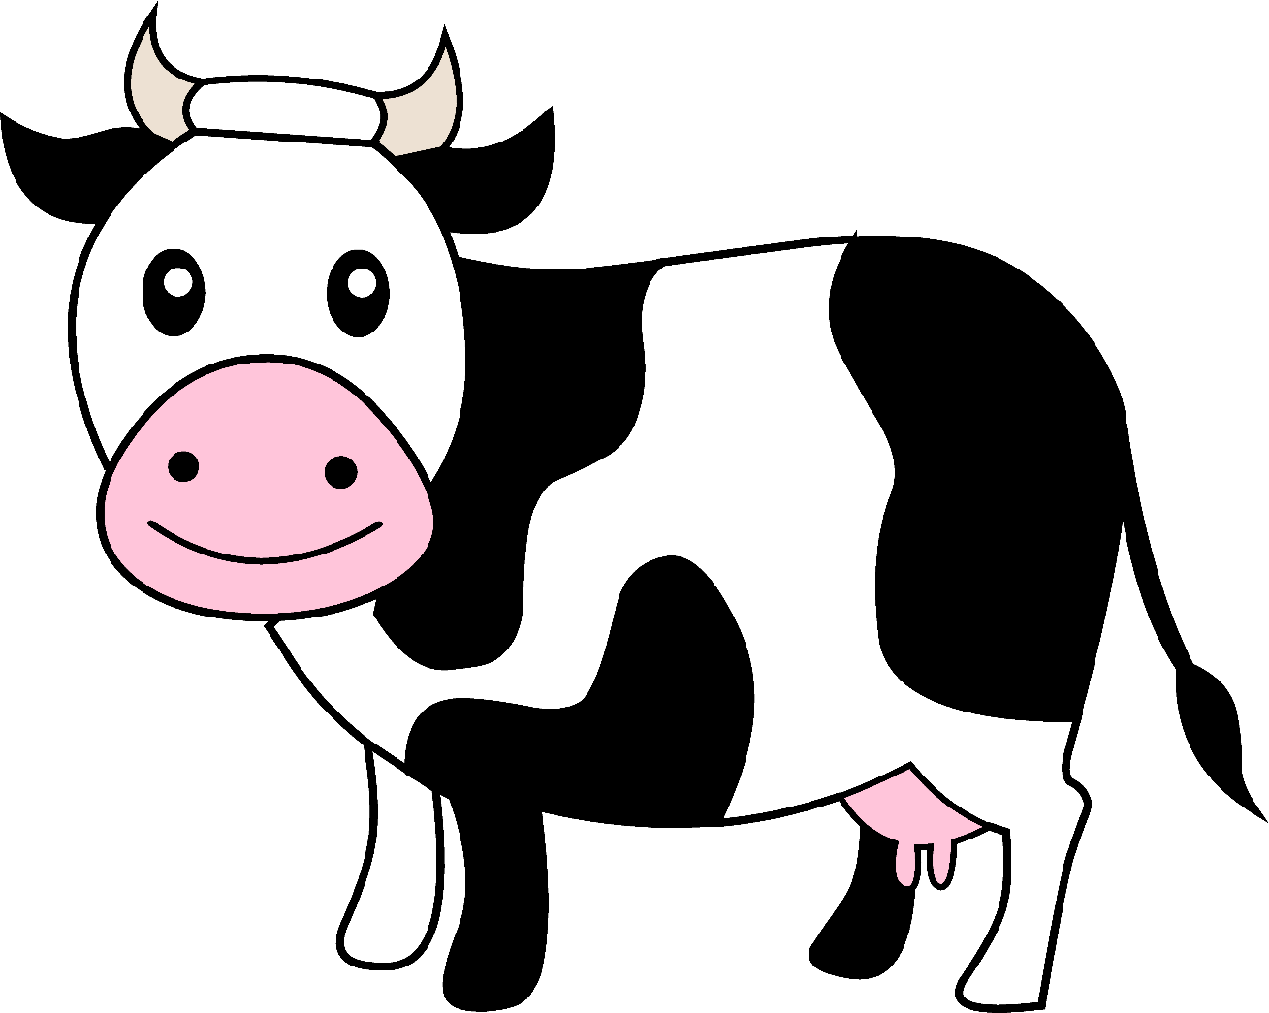
cow

Slide 5
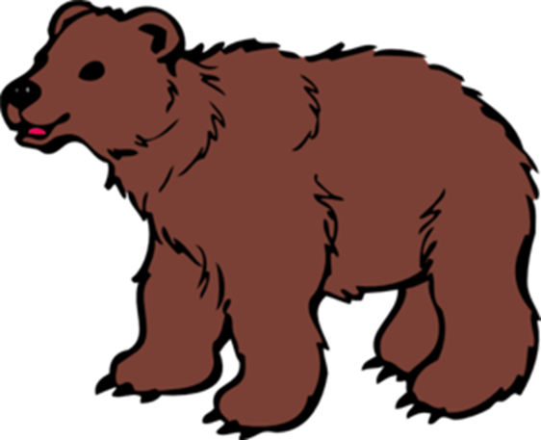
bear

Slide 6
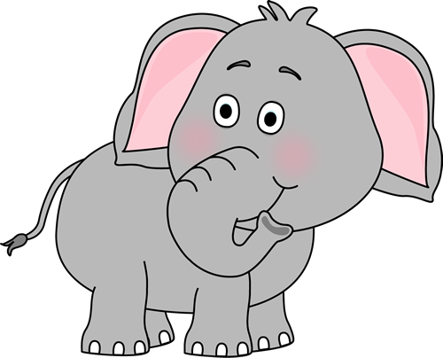
elephant

Slide 7
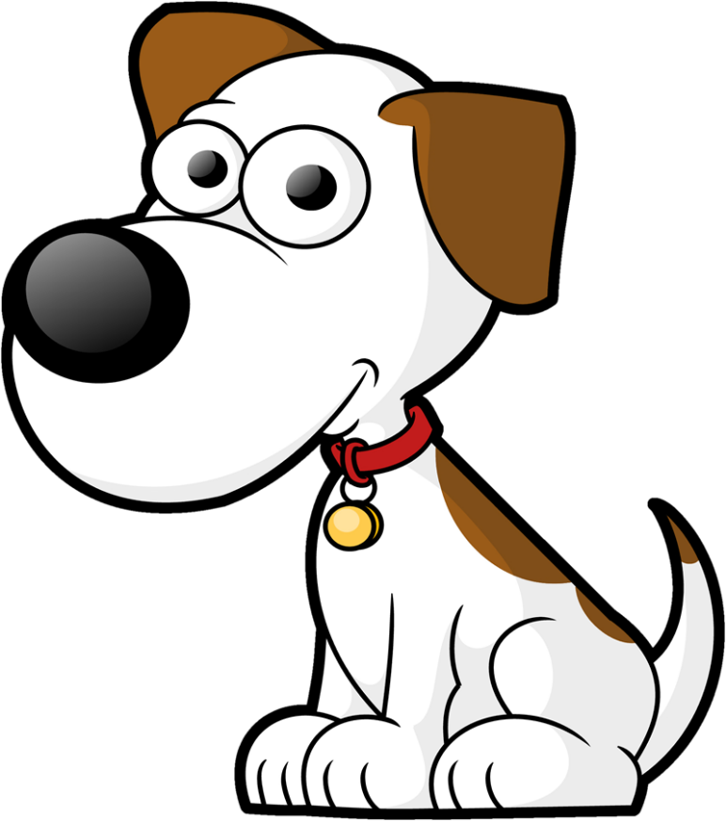
dog

Slide 8
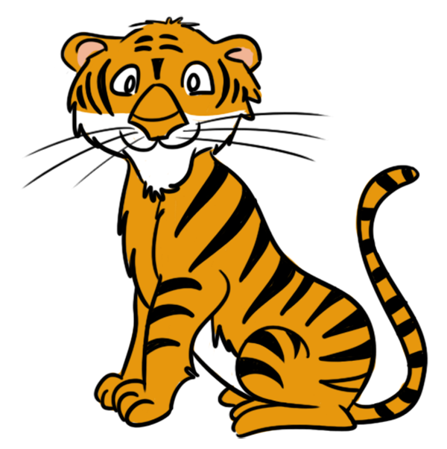
tiger

Slide 9
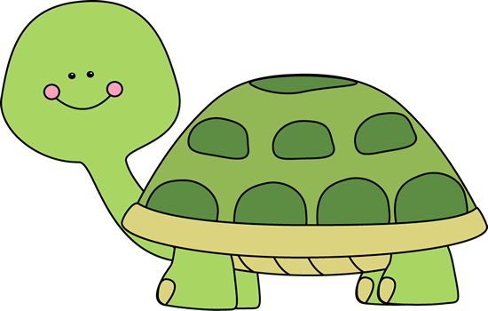
turtle

Slide 10
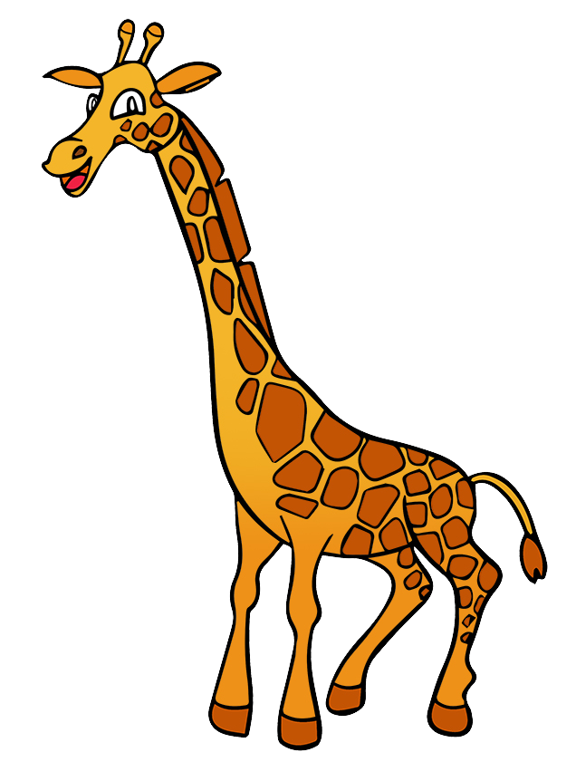
giraffe

Slide 11
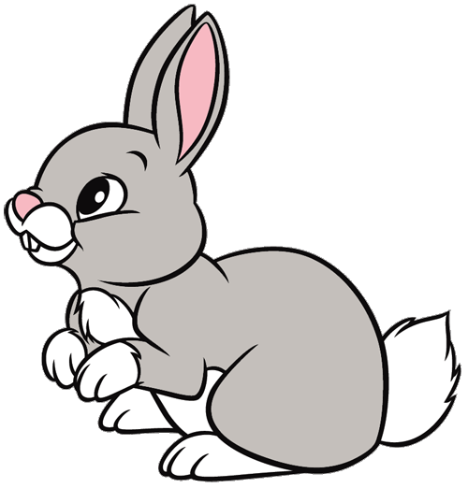
rabbit

Slide 12

monkey

Slide 13
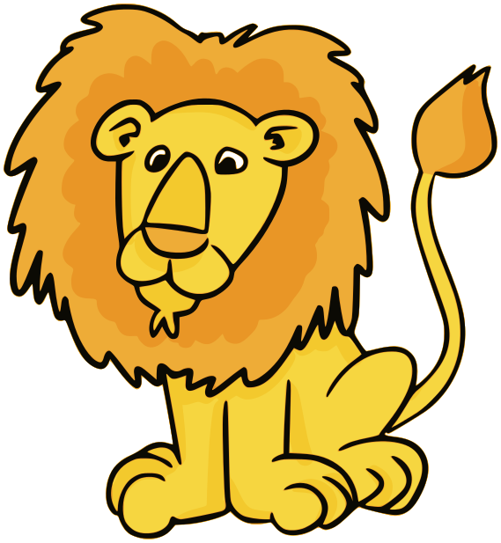
lion

Slide 14
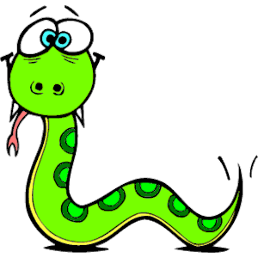
snake

Slide 15
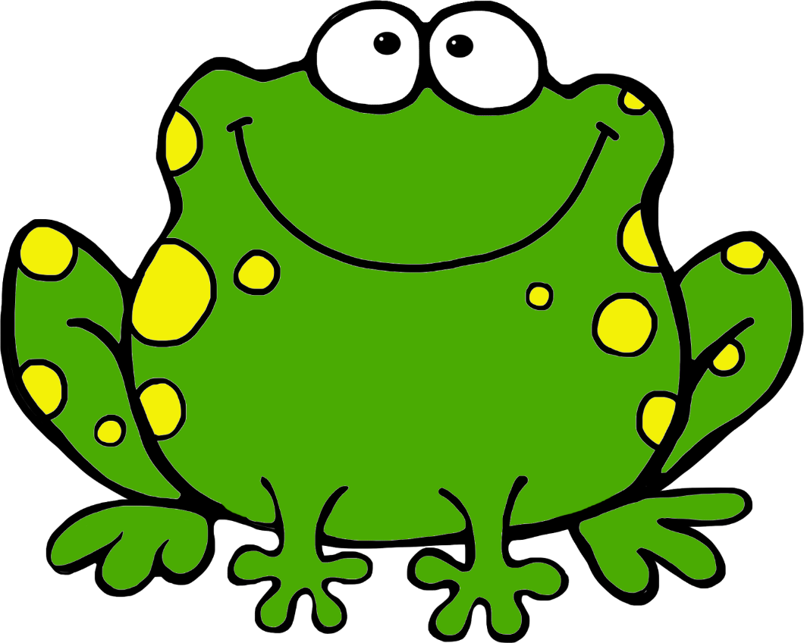
frog

Slide 16

shark

Slide 17
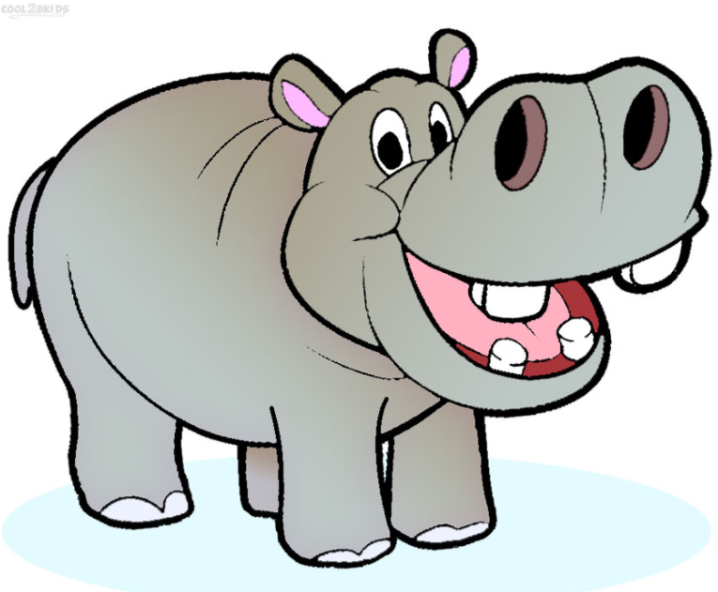
hippo

Slide 18
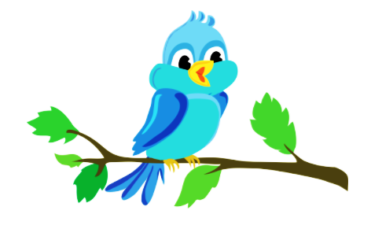
bird

Slide 19
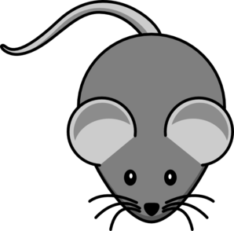
mouse

Slide 20
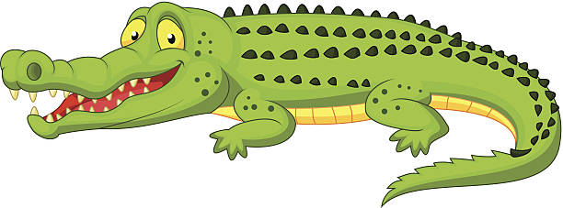
crocodile

Slide 21
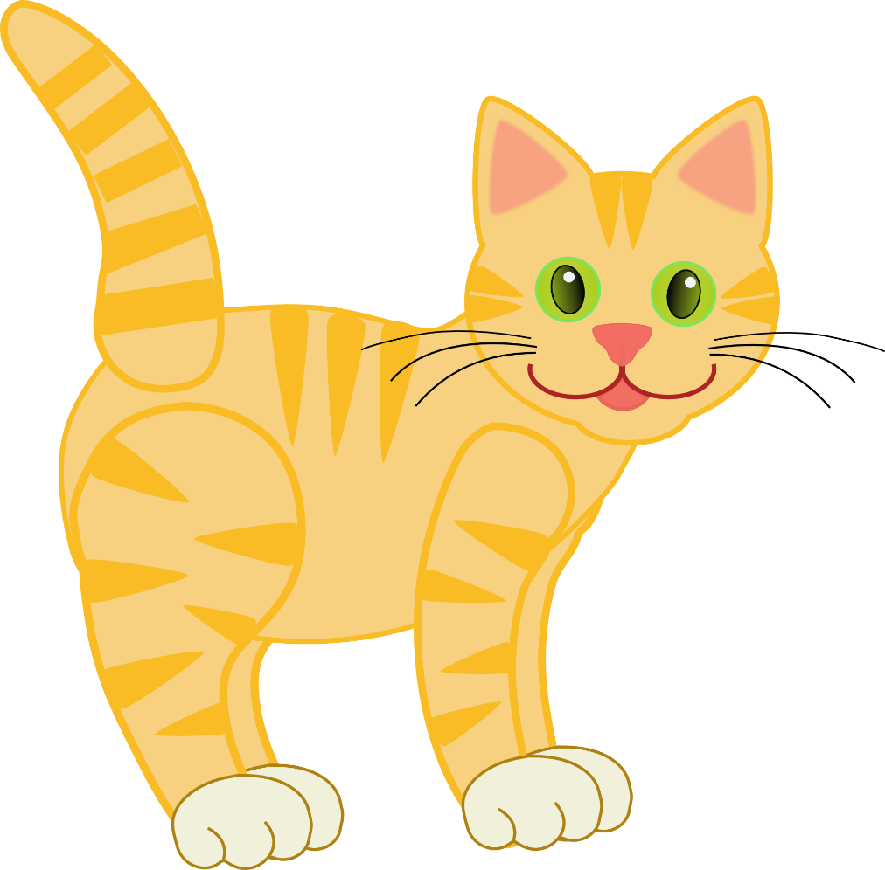
cat

Slide 22
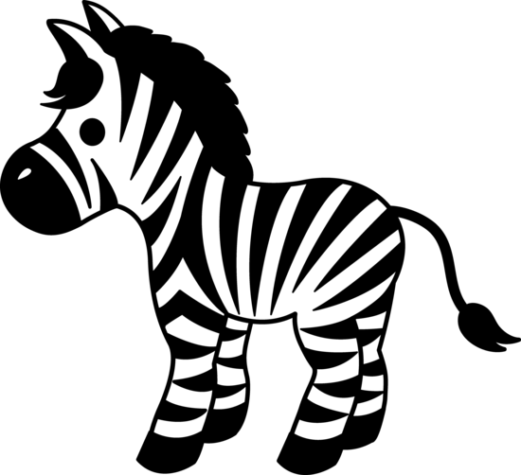
zebra

Slide 23
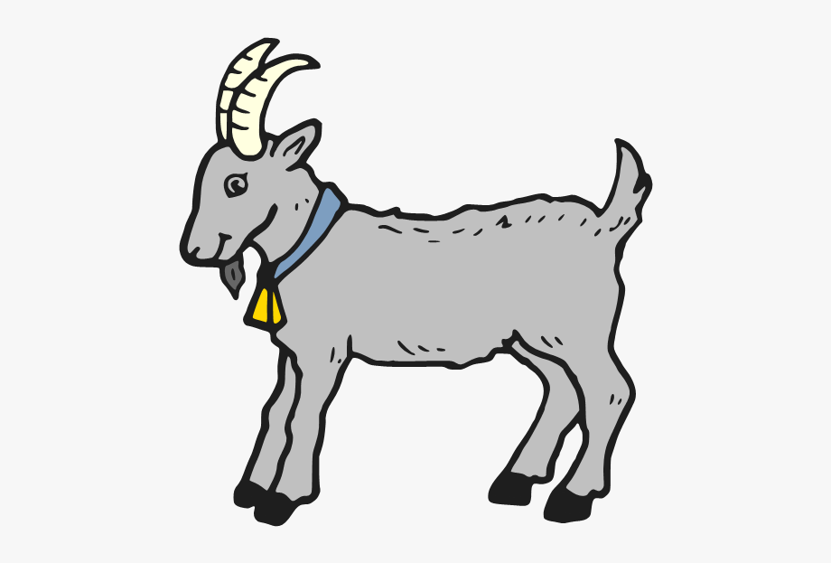
goat

Slide 24
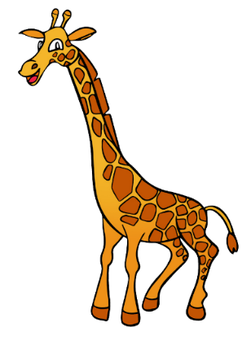




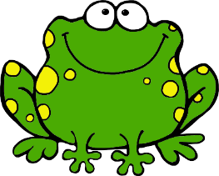

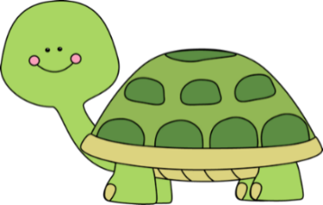

giraffe
zebra
bear
cow
hippo
rabbit
crocodile
frog
bird
shark
turtle

Slide 25
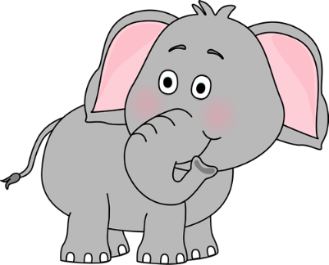




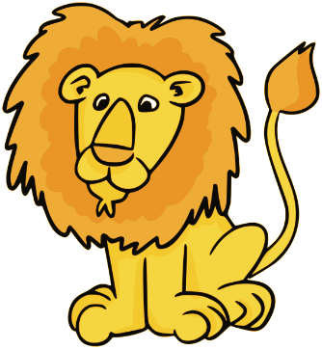
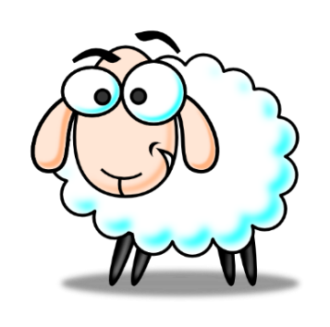
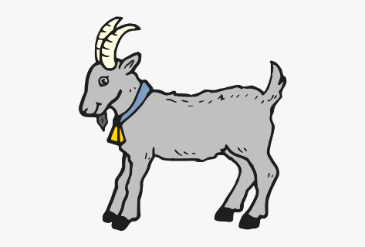
pig
elephant
dog
monkey
cat
tiger
lion
mouse
sheep
snake
goat

Slide 26

Which word matches the picture?

Slide 27
zebra
lion

Slide 28
monkey
frog

Slide 29
dog
cow

Slide 30
rabbit
snake

Slide 31
tiger
bear

Slide 32
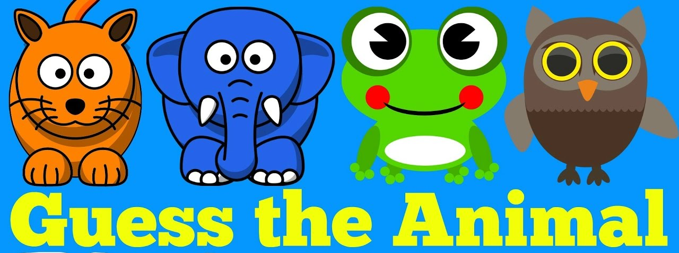

Slide 33


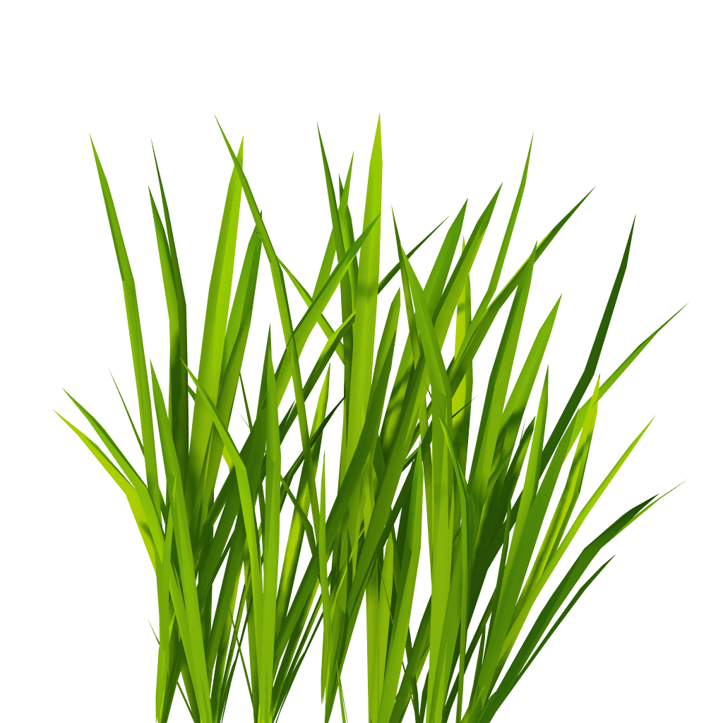

What is it?
z
zebra
It’s a…

Slide 34

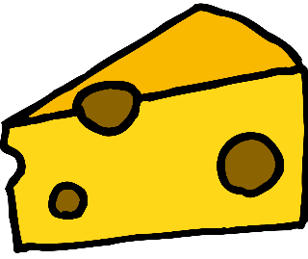

What is it?
m
It’s a…
mouse

Slide 35


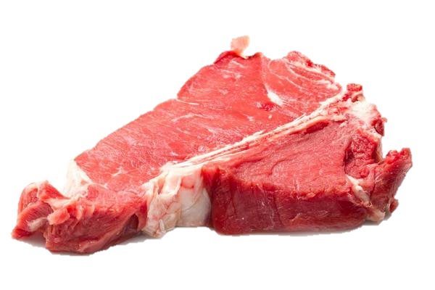

What is it?
t
It’s a…
tiger

Slide 36



What is it?
g
It’s a…
giraffe

Slide 37





What is it?
sh
It’s a…
shark

Slide 38
