Slide 2
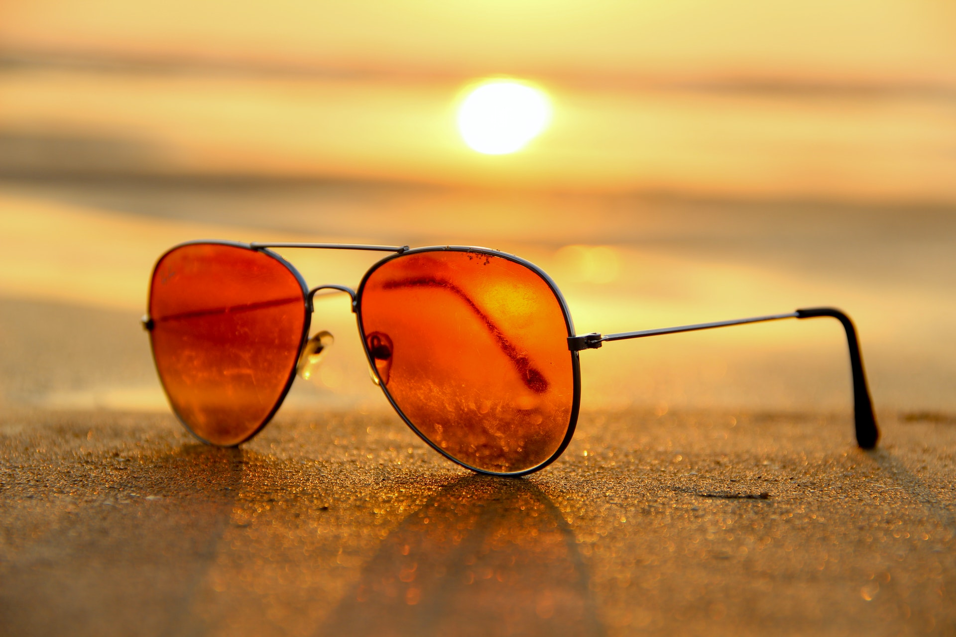
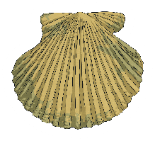
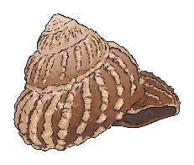
15
11
20
6
13
7
3
18
9
8
2
17
14
1
19
12
10
5
16
4
Sunglasses
Answer

Slide 3
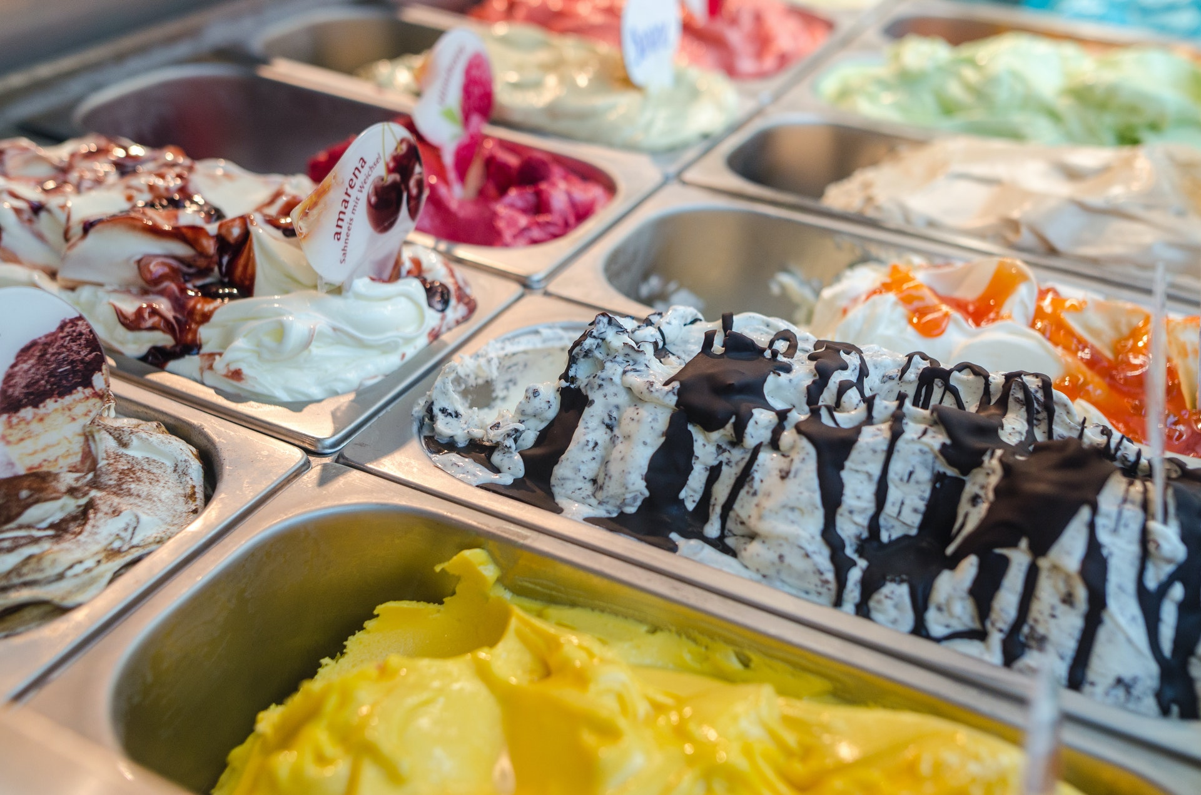
4
10
9
18
7
14
1
15
2
12
13
5
11
19
6
20
16
3
8
17
Ice-cream
Answer

Slide 4
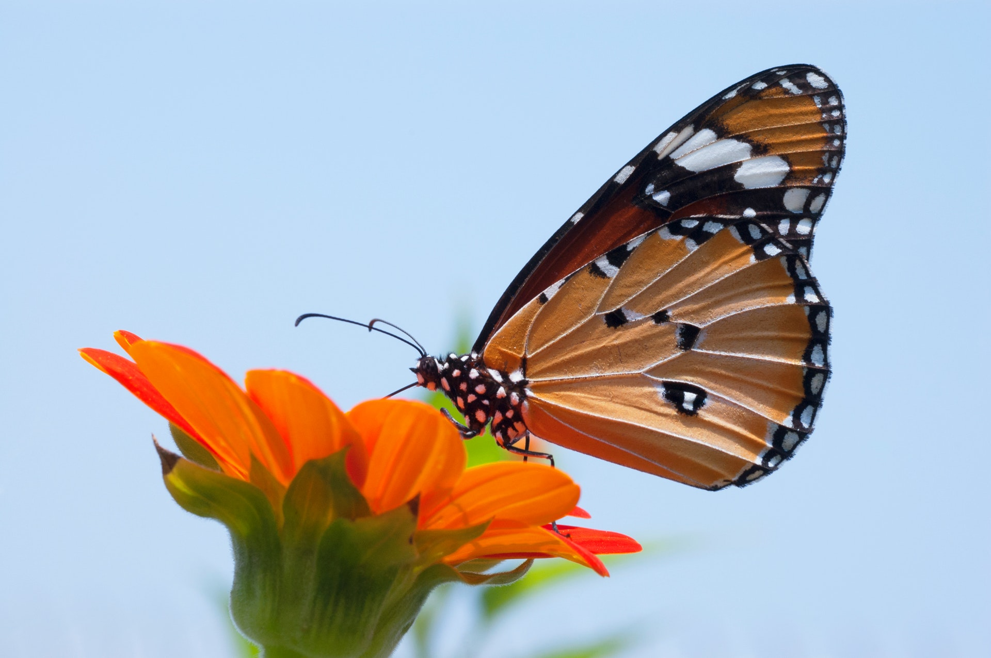
15
11
20
6
13
7
3
18
9
8
2
17
14
1
19
12
10
5
16
4
A butterfly
Answer

Slide 5
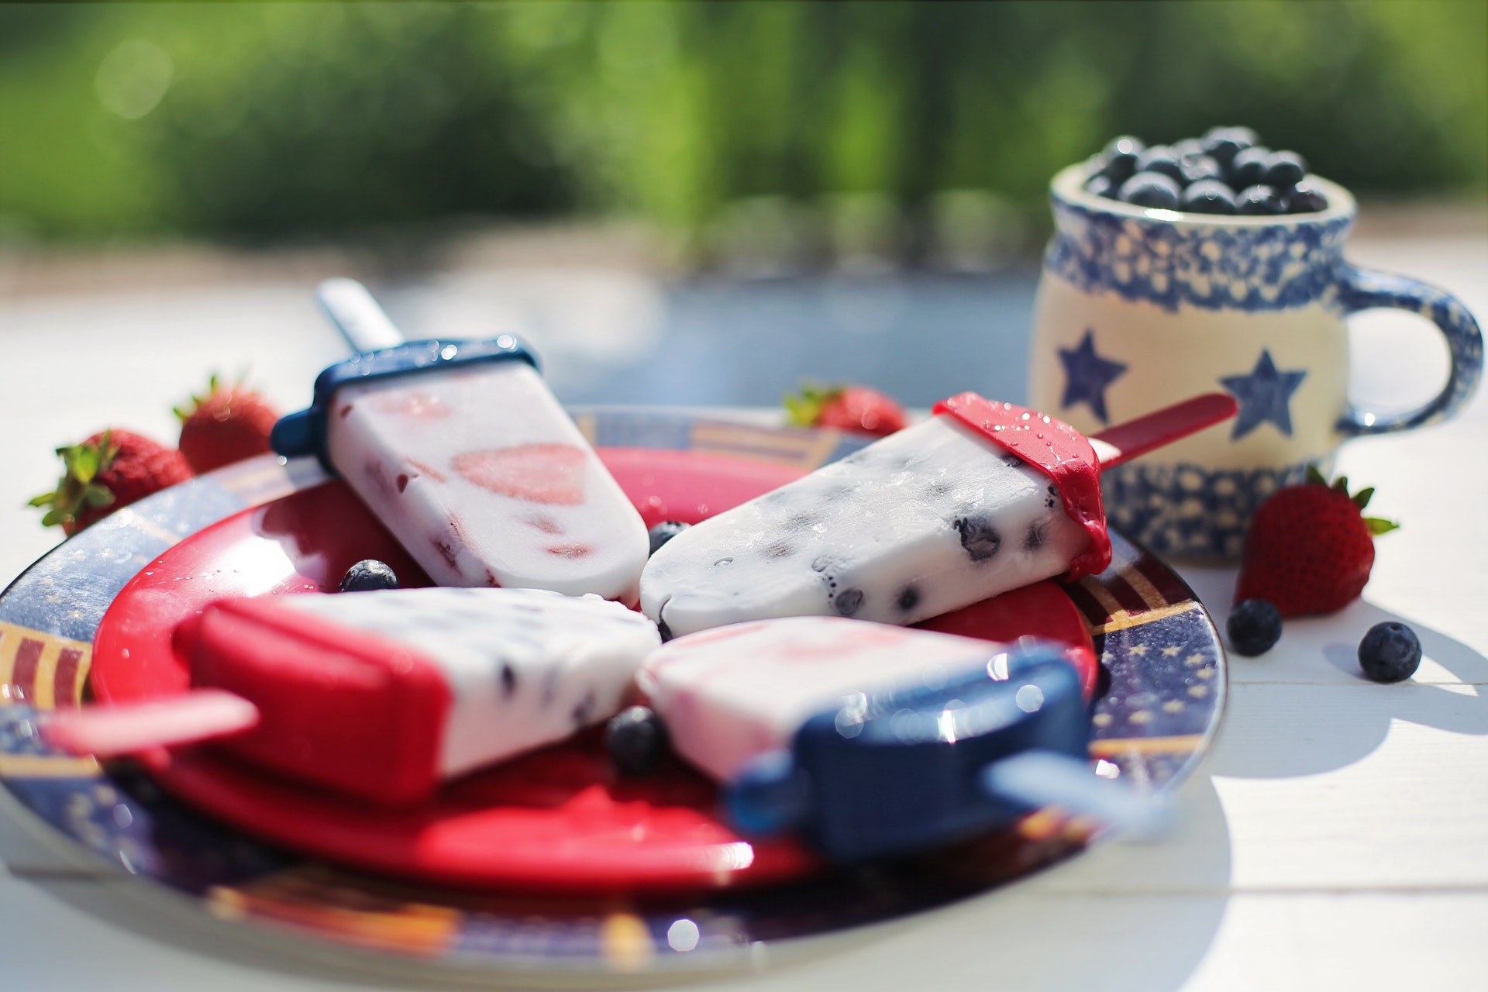
4
10
9
18
7
14
1
15
2
12
13
5
11
19
6
20
16
3
8
17
Ice lollies
Answer

Slide 6
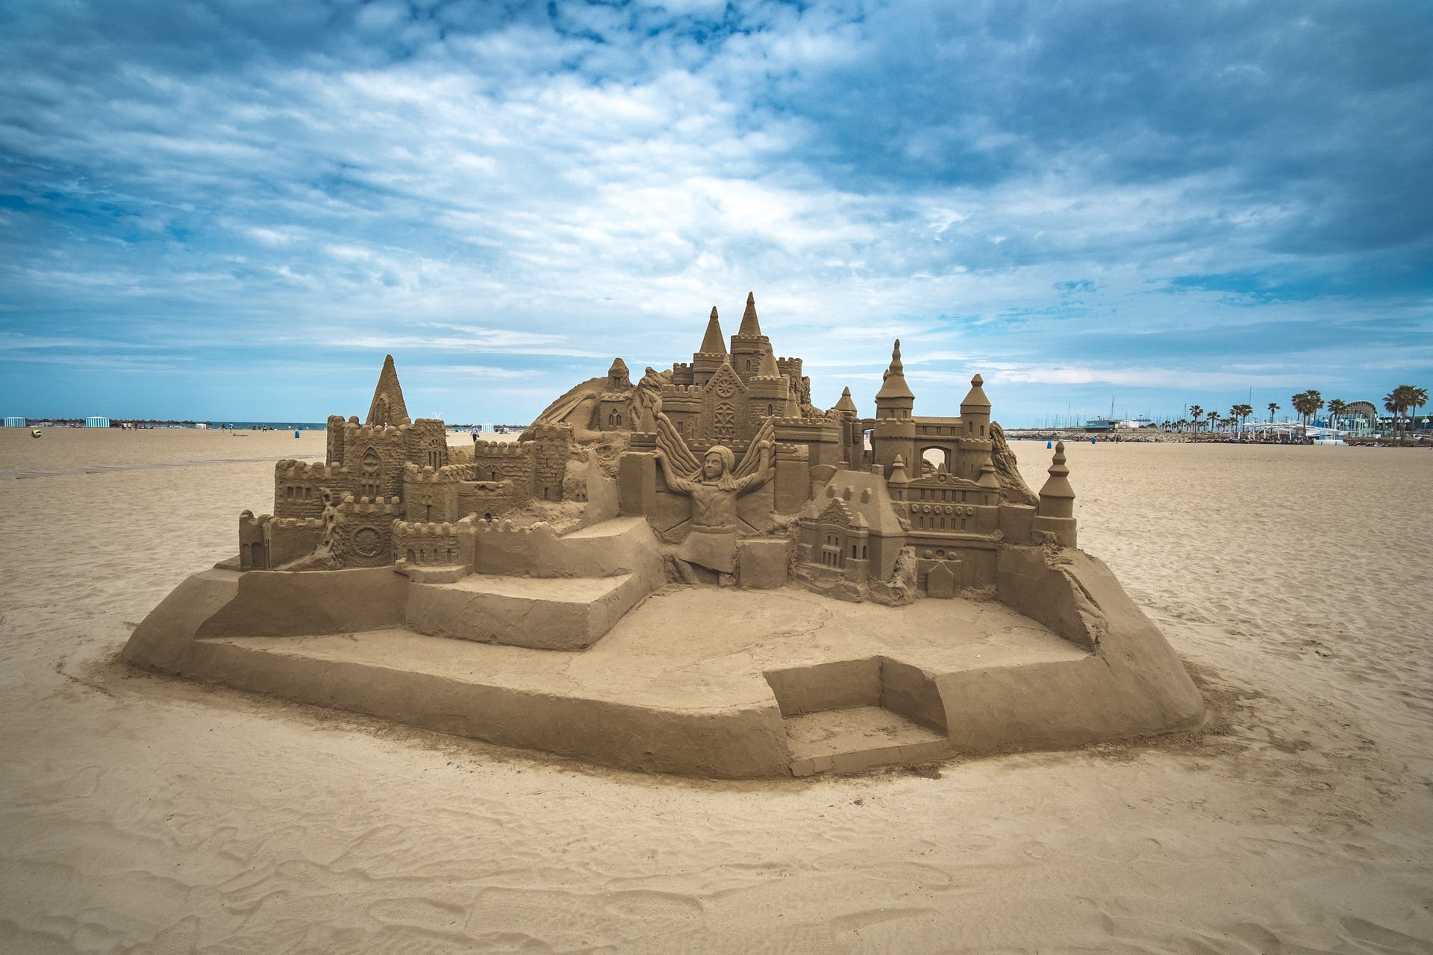
15
11
20
6
13
7
3
18
9
8
2
17
14
1
19
12
10
5
16
4
Sandcastle
Answer

Slide 7
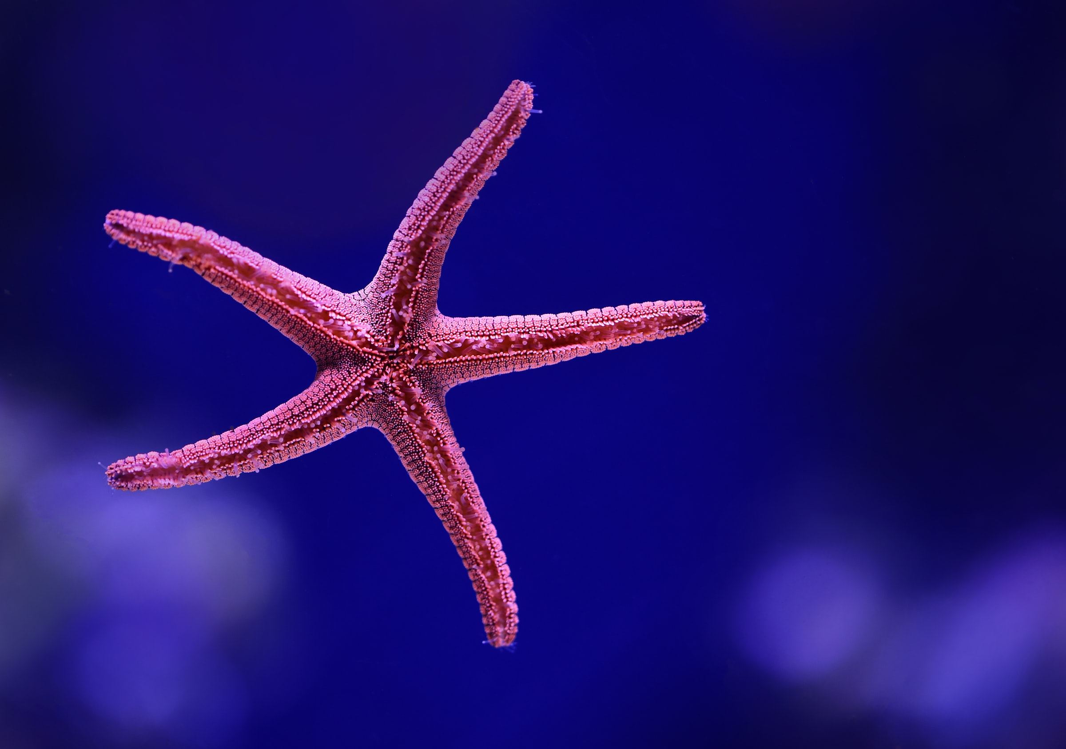
4
10
9
18
7
14
1
15
2
12
13
5
11
19
6
20
16
3
8
17
A starfish
Answer

Slide 8
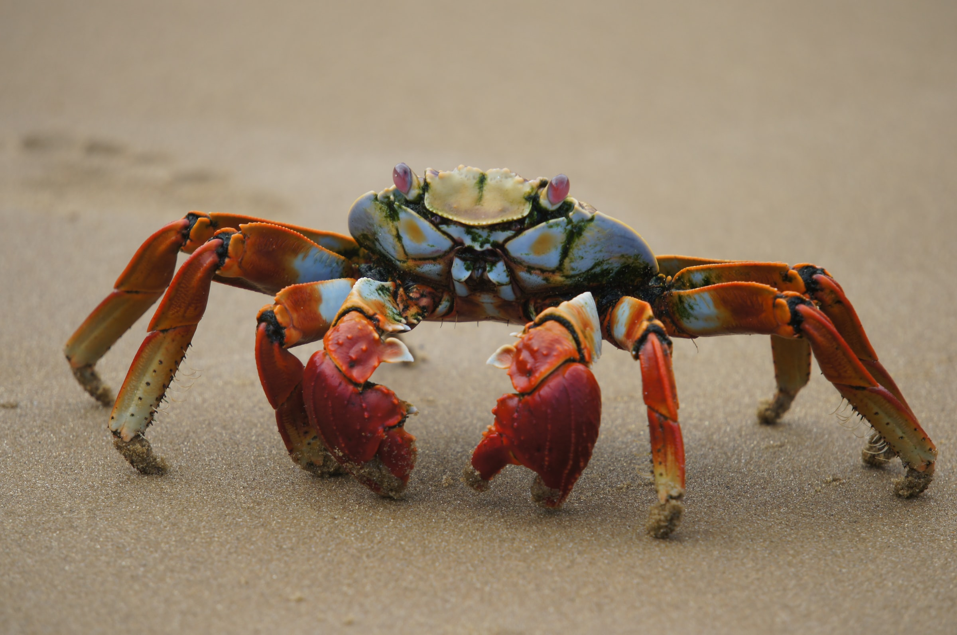
15
11
20
6
13
7
3
18
9
8
2
17
14
1
19
12
10
5
16
4
A crab
Answer

Slide 9
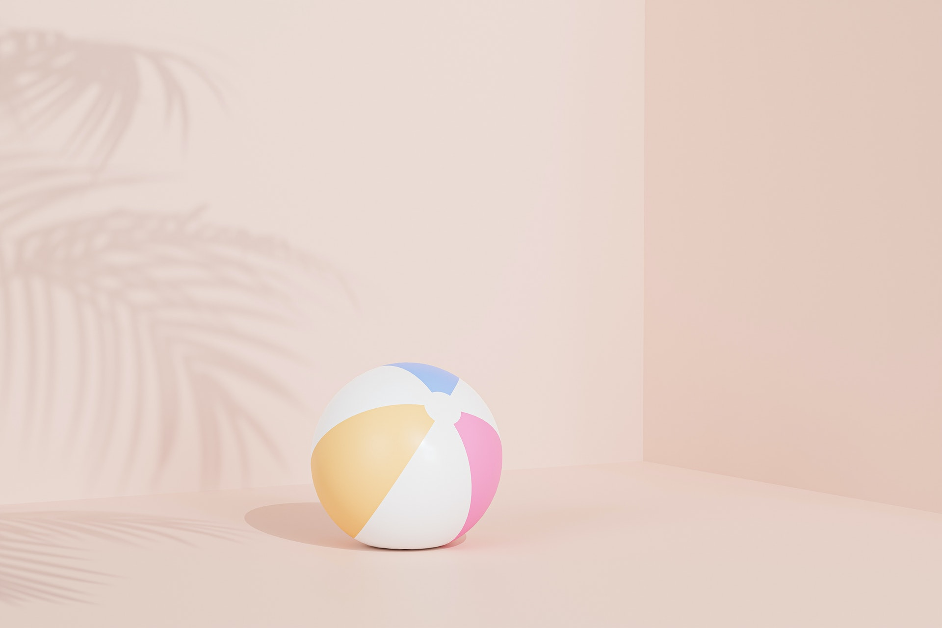
4
10
9
18
7
14
1
15
2
12
13
5
11
19
6
20
16
3
8
17
Beachball
Answer

Slide 10
15
11
20
6
13
7
3
18
9
8
2
17
14
1
19
12
10
5
16
4
Parasol and deck chairs
Answer

Slide 11
4
10
9
18
7
14
1
15
2
12
13
5
11
19
6
20
16
3
8
17
A bonfire
Answer

Slide 12
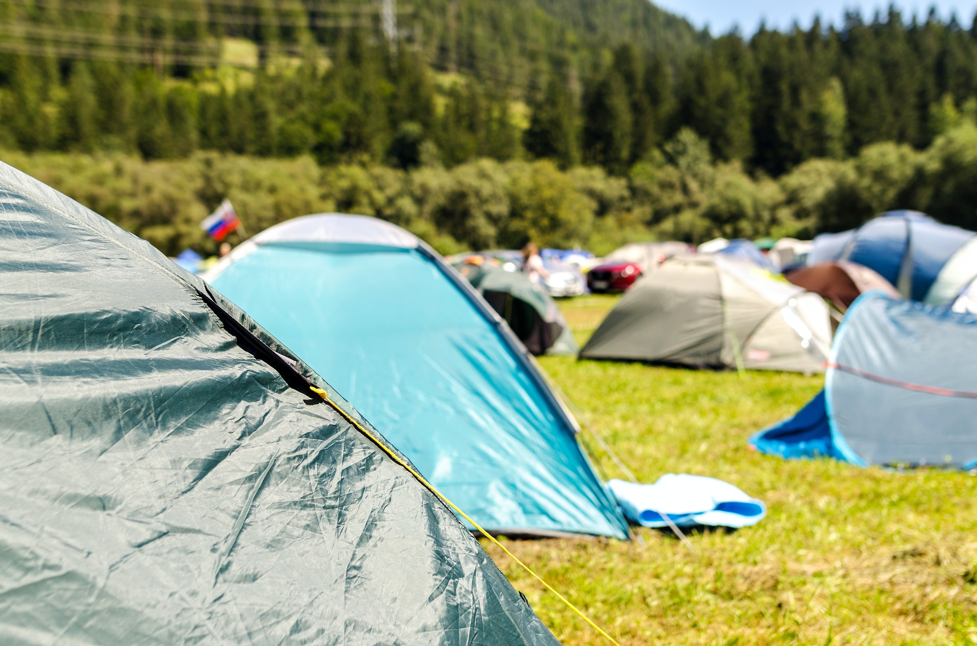
15
11
20
6
13
7
3
18
9
8
2
17
14
1
19
12
10
5
16
4
Tents
Answer

Slide 13
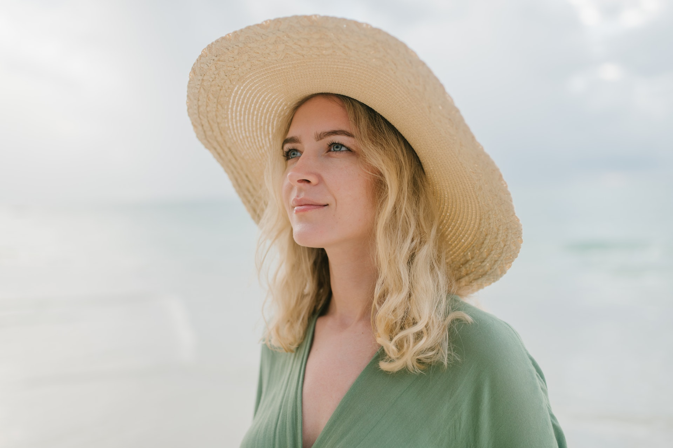
4
10
9
18
7
14
1
15
2
12
13
5
11
19
6
20
16
3
8
17
A sun hat
Answer

