Slide 1
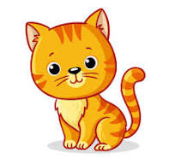
Cc
cat
Computer

Slide 2
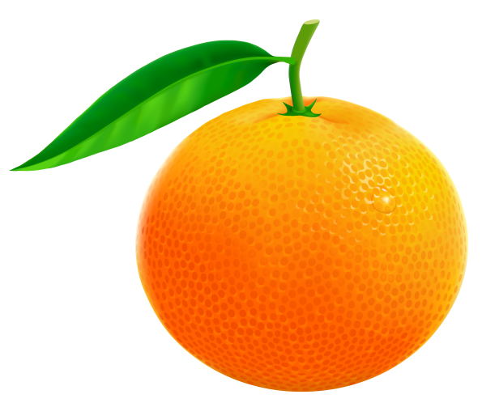
Oo
Orange
Octopus

Slide 3
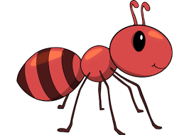
Aa
Apple
Ant

Slide 4
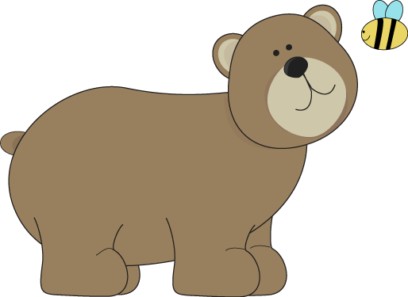
Bb
Ball
bear

