Slide 1

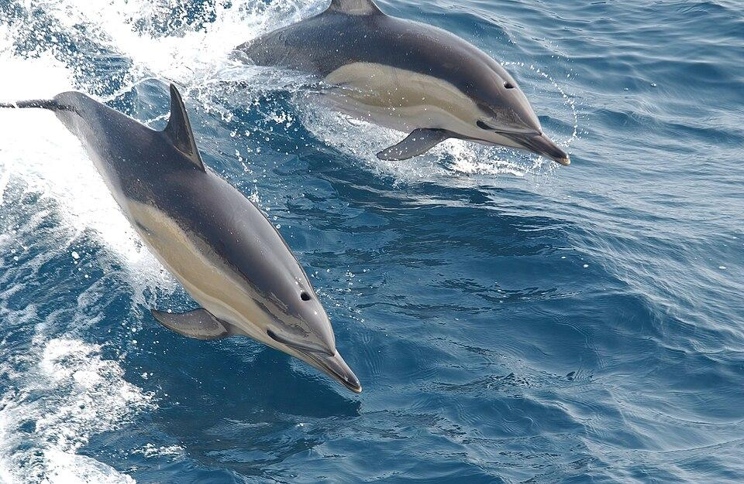
Grammar Contrast: Simple Present and Present Continuous with Dolphin Therapy

Slide 2

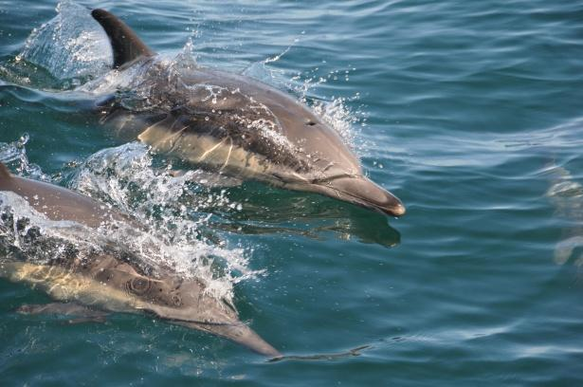
Introduction to Tenses and Special Needs
Today we'll explore two important English grammar tenses
We'll learn about Simple Present and Present Continuous
We'll understand what special needs persons are
Our context: Exciting dolphin therapy experiences!

Slide 3
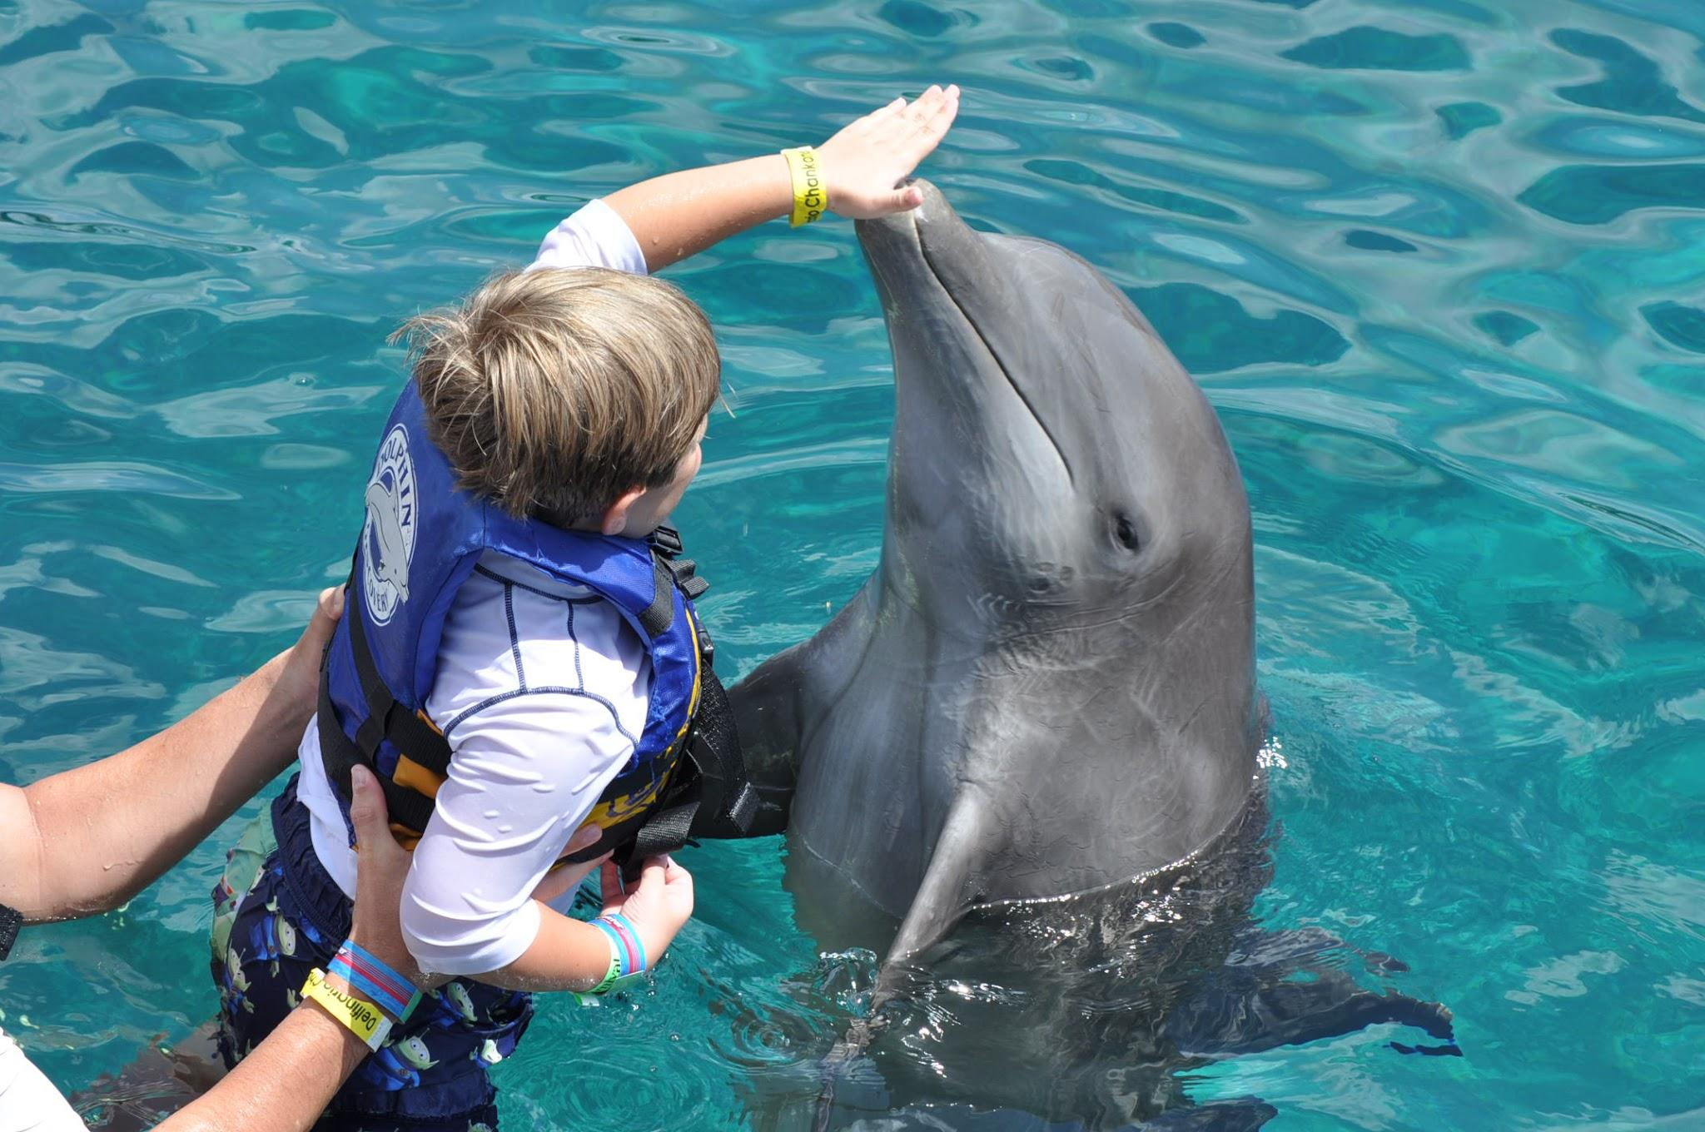
What Are Special Needs Persons?
People who have physical, mental, or learning challenges
May require extra support in daily activities
Have unique strengths and abilities
Deserve respect, understanding, and opportunities

Slide 4
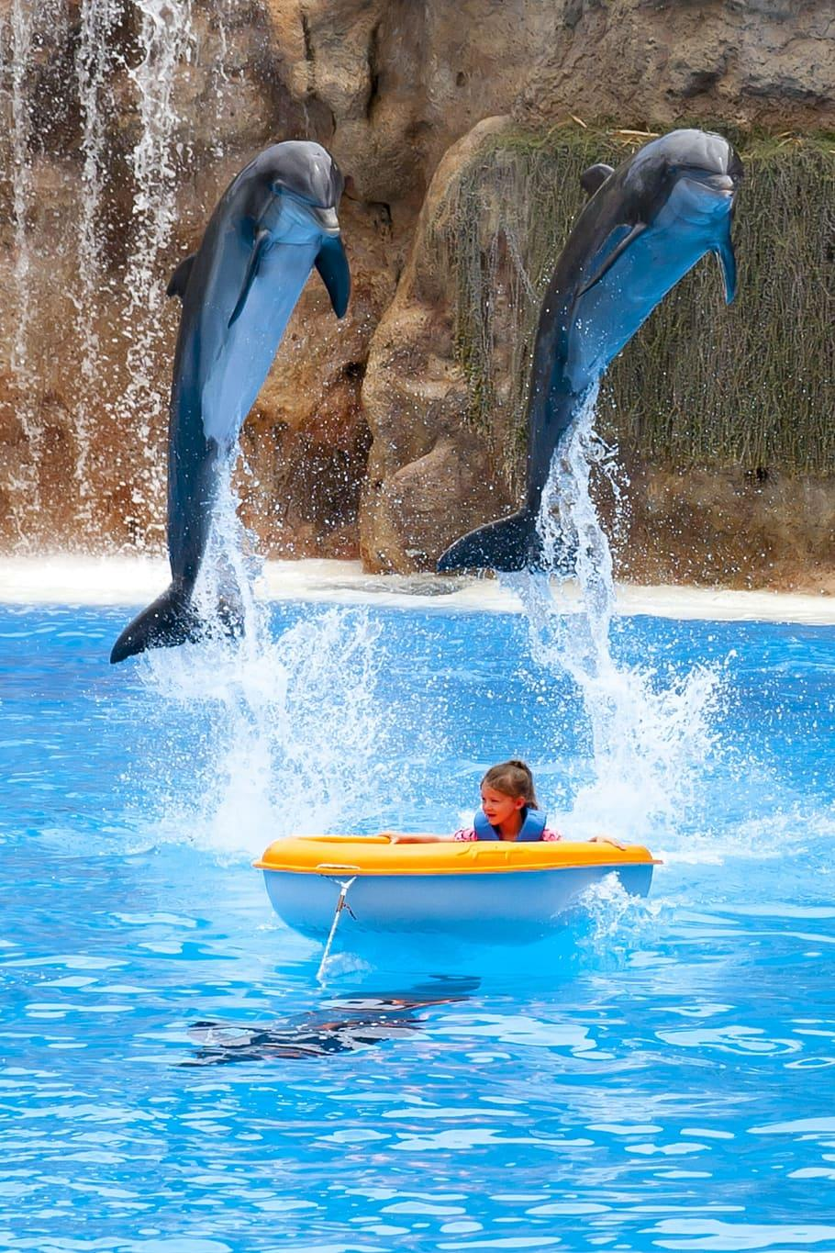
Simple Present Tense: Routine Actions
Describes regular, habitual actions
Example from text: "People with special needs often live routine lives"
Used for general truths and repeated activities
Typically uses base verb form (live, eat, go)

Slide 5
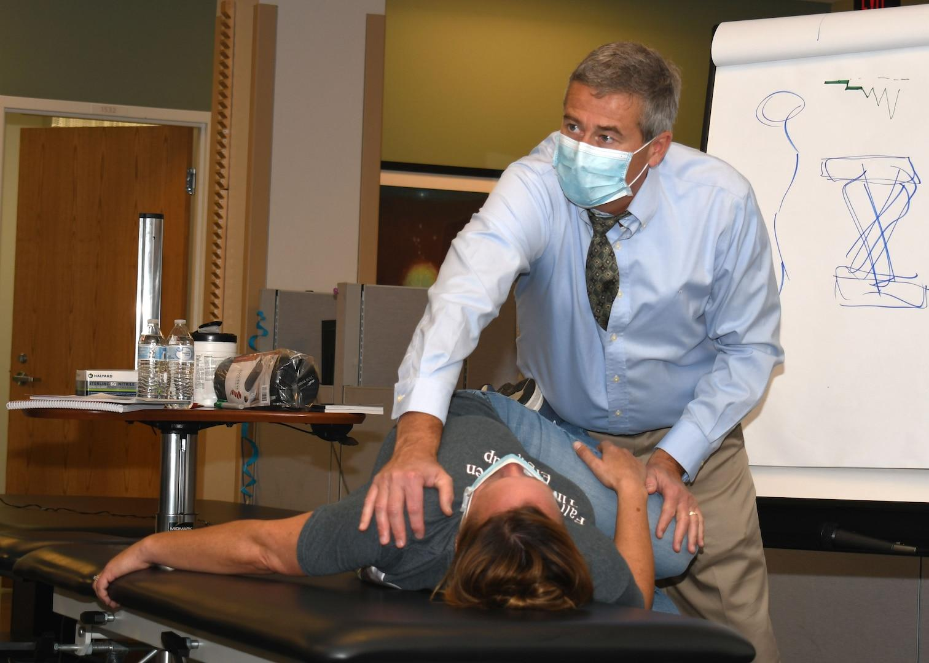
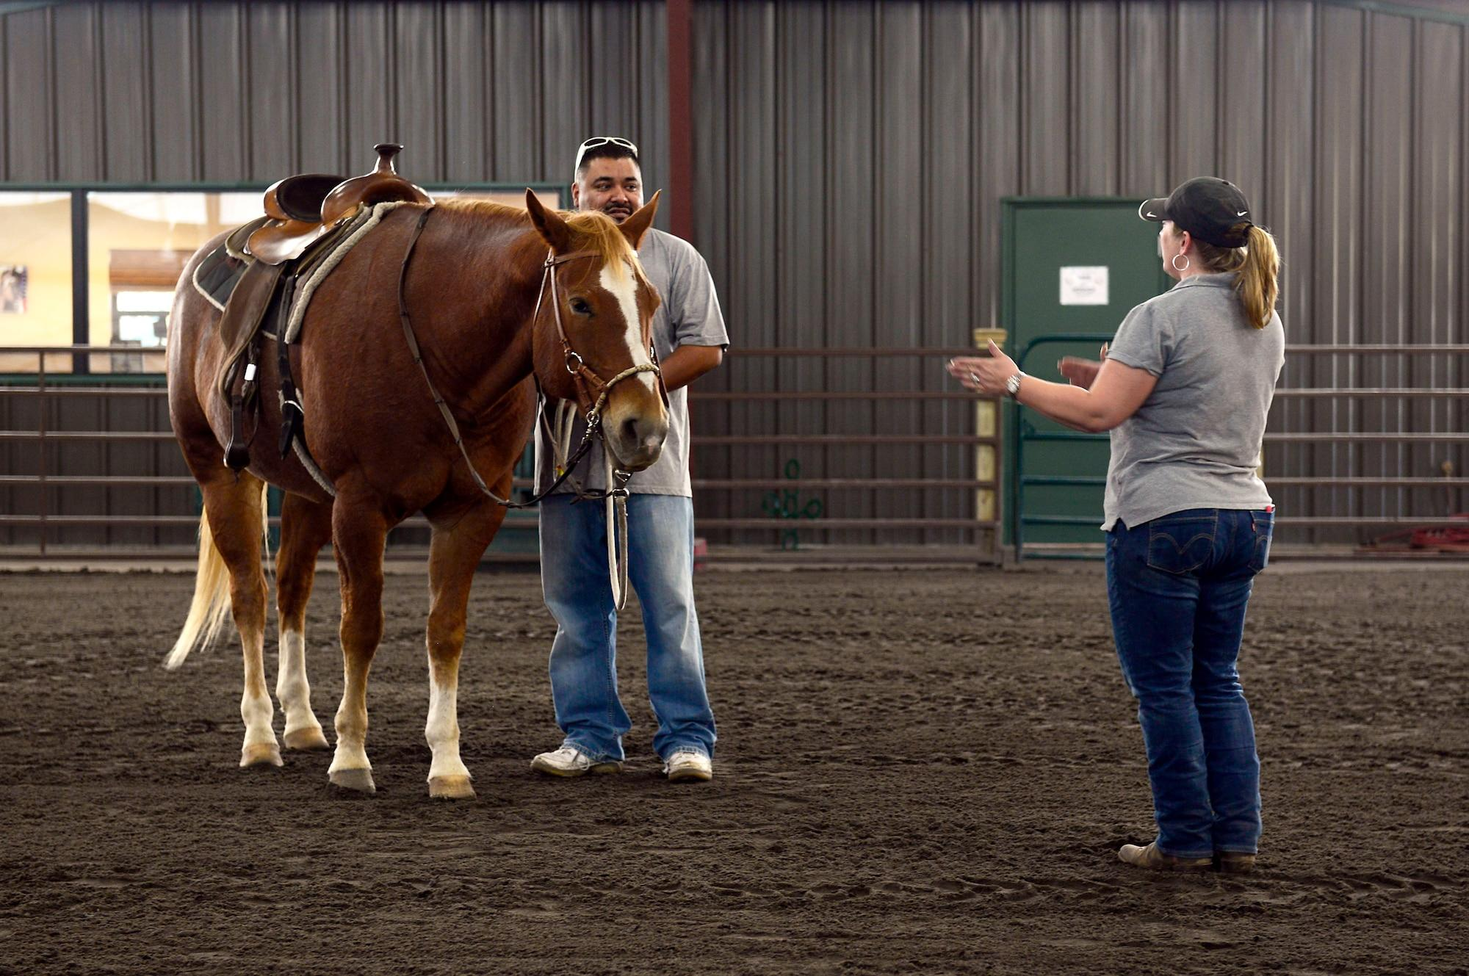
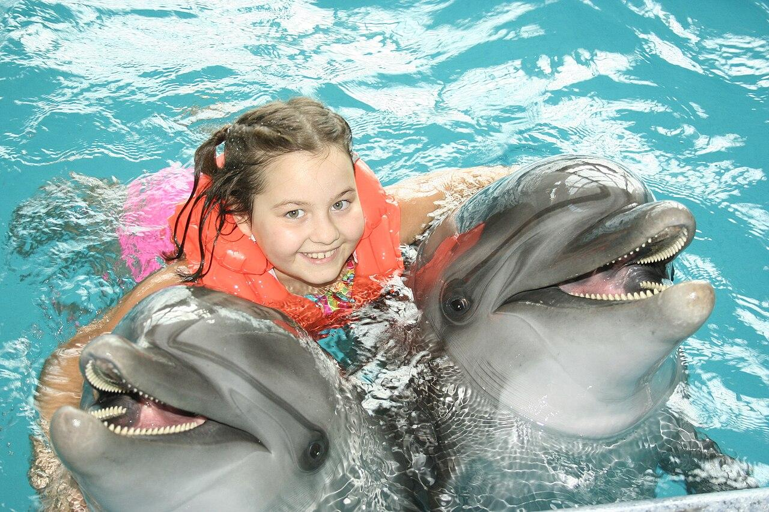
Simple Present Examples
Dolphins help people feel positive
Children attend therapy programmes
People follow set schedules
Dolphins interact with special needs persons

Slide 6
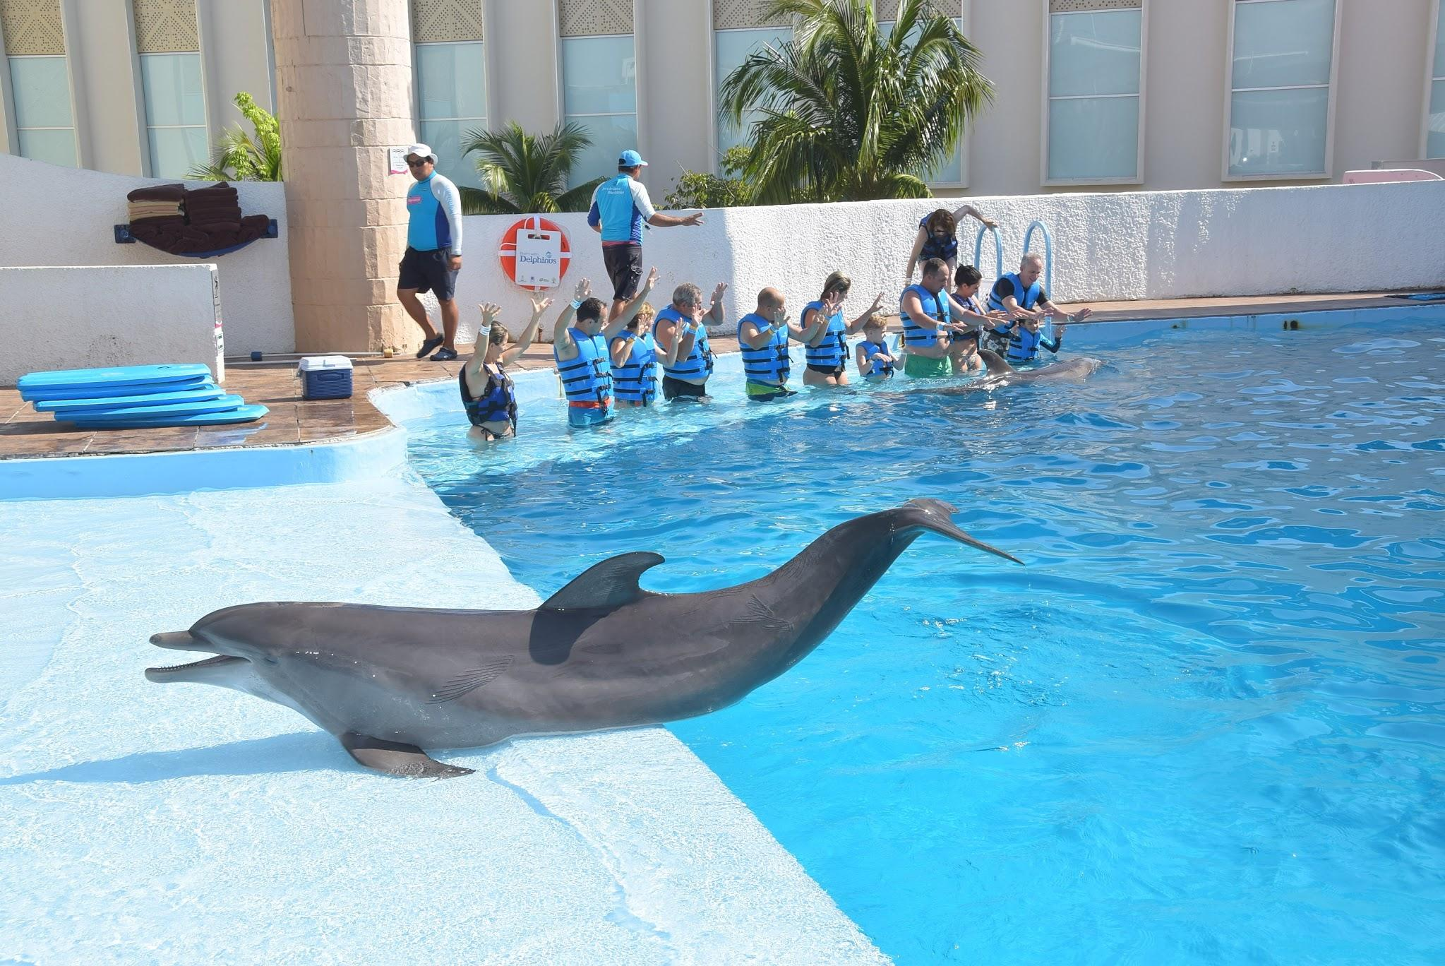
Present Continuous Tense: Happening Now
Describes actions happening right at this moment
Uses "to be" + verb with -ing
Example: "They're playing with dolphins"
Shows current, ongoing activities

Slide 7

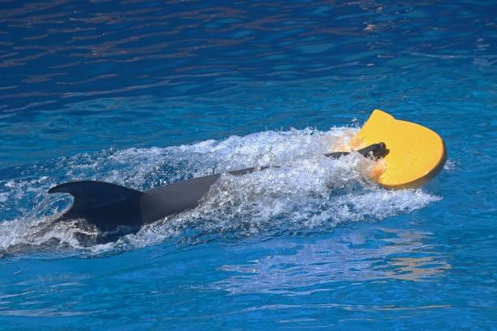
Present Continuous Examples
Children are swimming with dolphins
Dolphins are pulling children
People are enjoying every moment
Participants are having fun

Slide 8
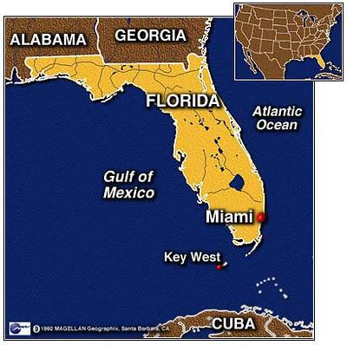
Spotting the Difference
Simple Present: General truths
Present Continuous: Current actions
Think: "Do they always do this?" vs "Are they doing this right now?"

Slide 9
Practice Time: Think-Pair-Share
Write three Simple Present sentences
Write three Present Continuous sentences
Share with a partner
Discuss the differences

Slide 10
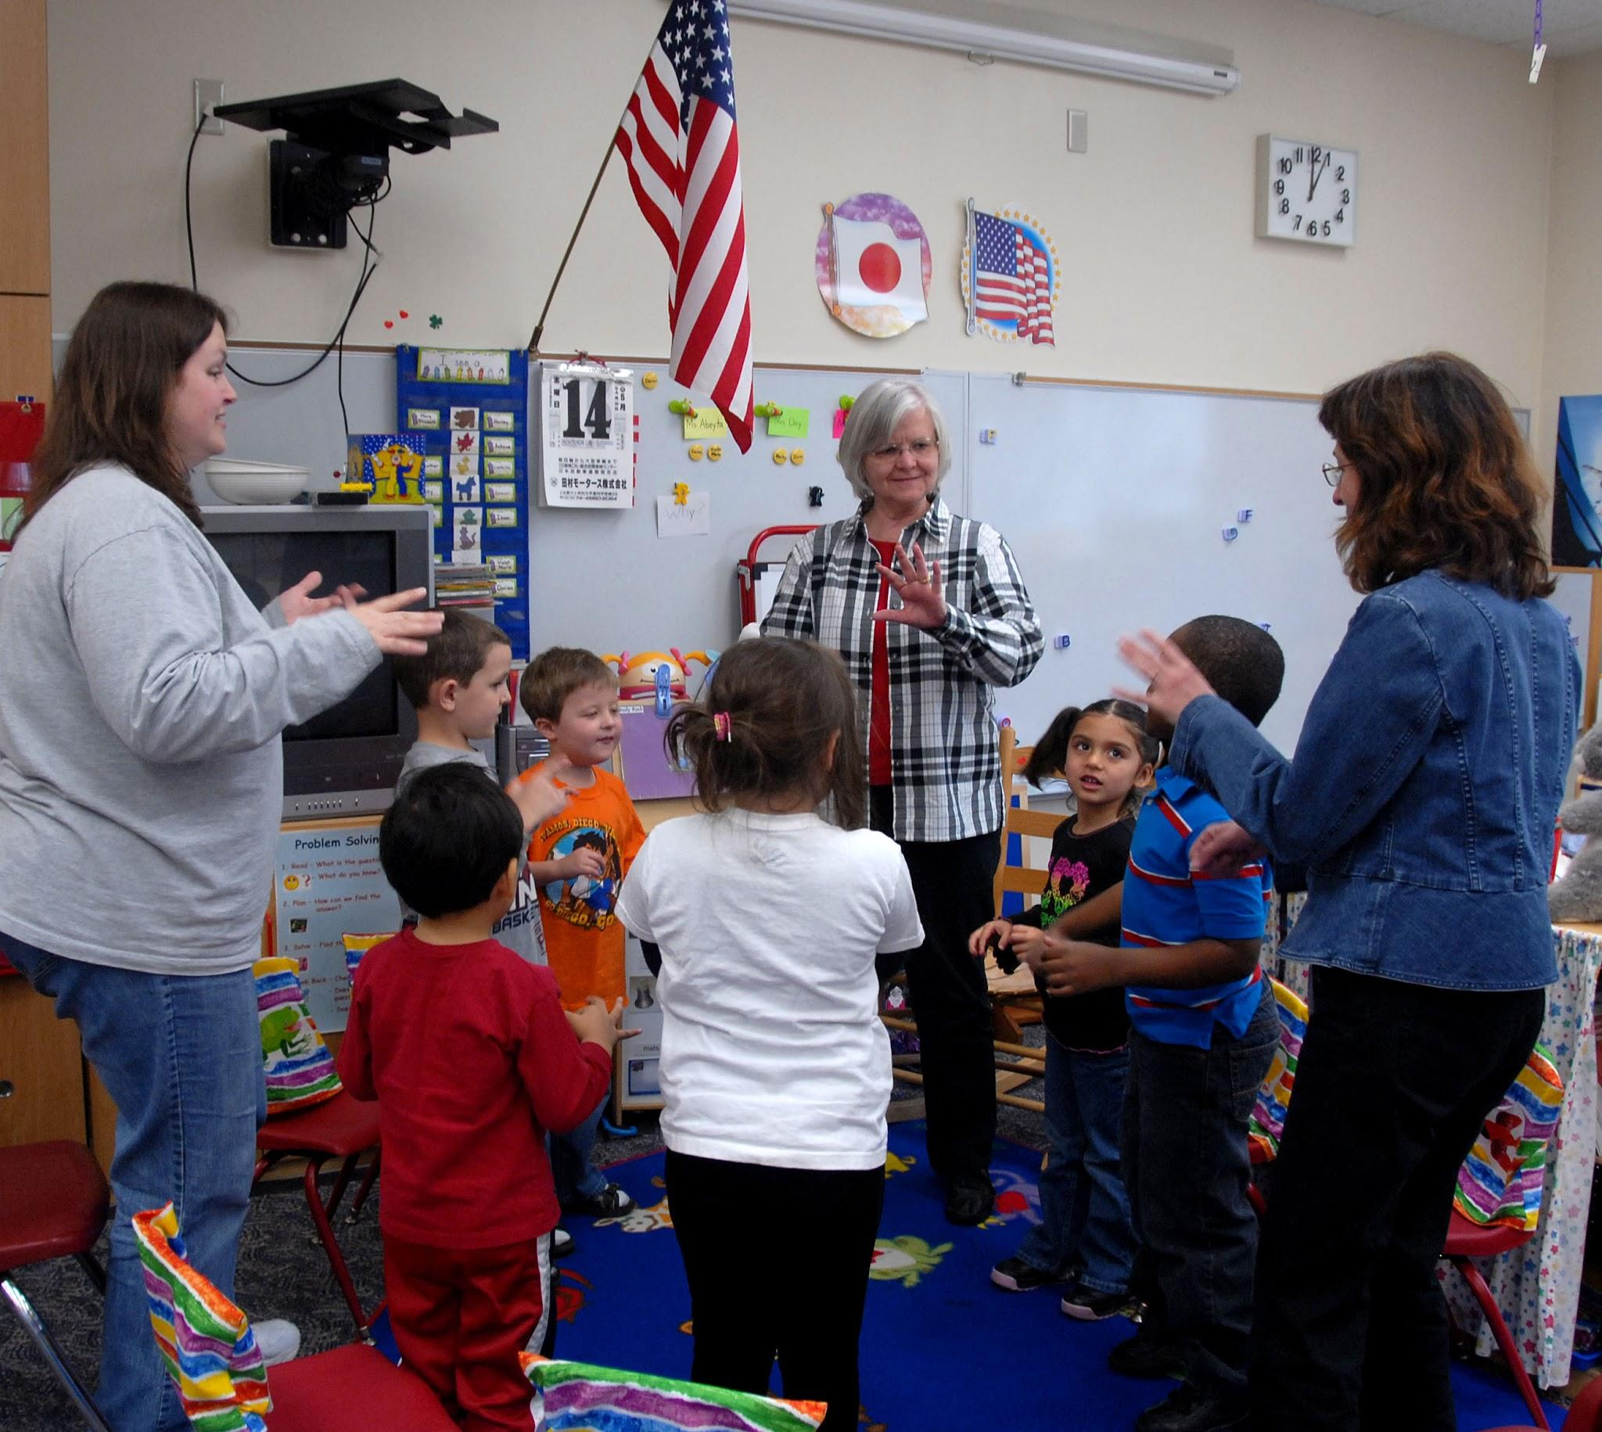
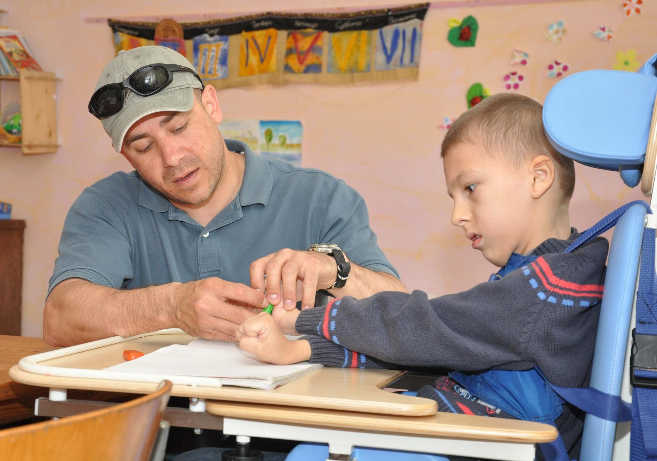
Dolphin Therapy: A Special Experience
Dolphins create magical moments
Special needs persons get unique opportunities
Learning happens through joy and interaction
Celebrate diversity and individual strengths

Slide 11
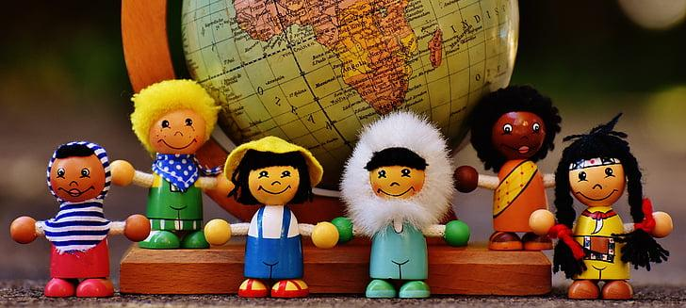
Reflection and Appreciation
What did you learn about grammar?
How do different tenses help us communicate?
Appreciate the unique experiences of all people
Celebrate learning and understanding

