Slide 1
Suit, fit, match, go with

Slide 2
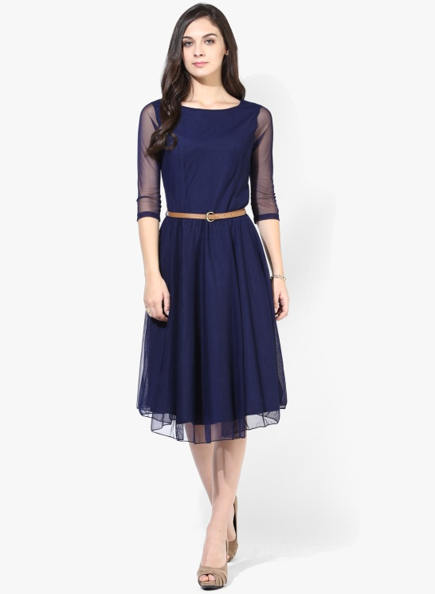
suit
It makes you look attractive
It is convenient for you
It is the best thing for you in the circumstances suit is used for style, colour
The city lifestyle seems to suit her.

Slide 3
fit
It is the right size and shape for your body Fit is used for size.
The pieces of the puzzle didn’t fit together.

Slide 4
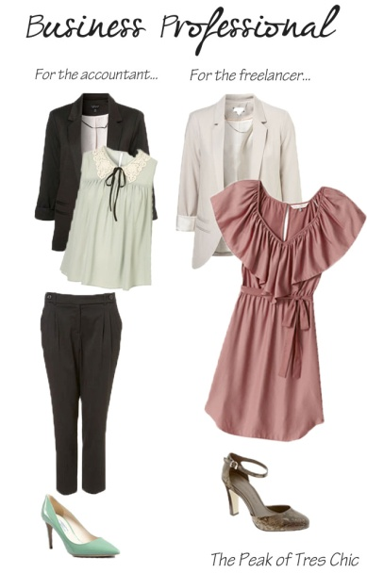
match
If one thing matches another, they have the same pattern, colour or style and therefore look attractive together Match is used for an attractive combination
Do you think these two colours match?

Slide 5
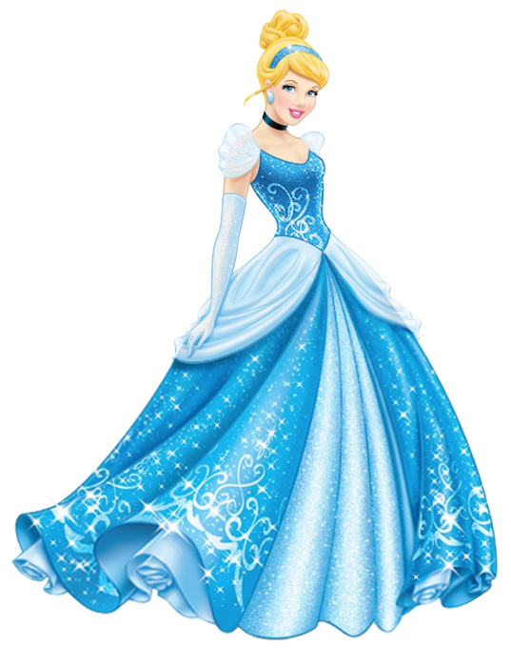
Go with
To combine well, to look good with another item of clothes
Go with = match
The blue headband goes with her dress

