Slide 1
D’ class UNIT 3
Lesson 1-3

Slide 2
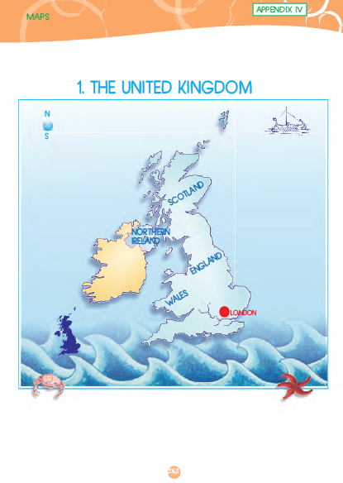

Slide 3
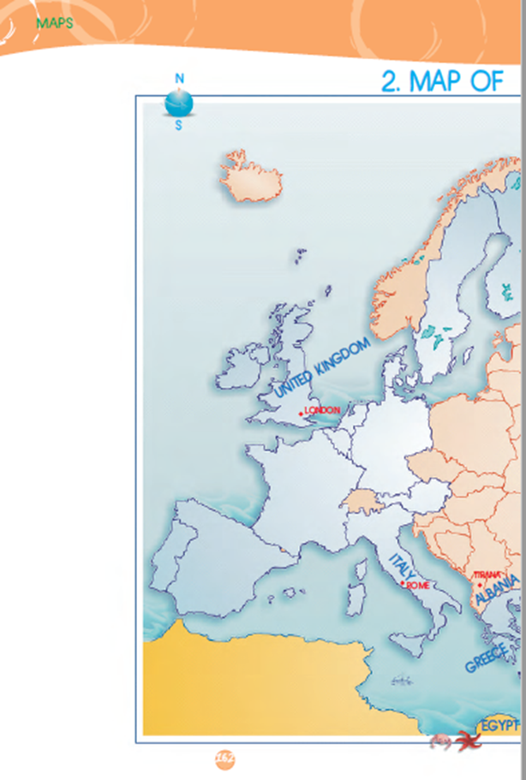
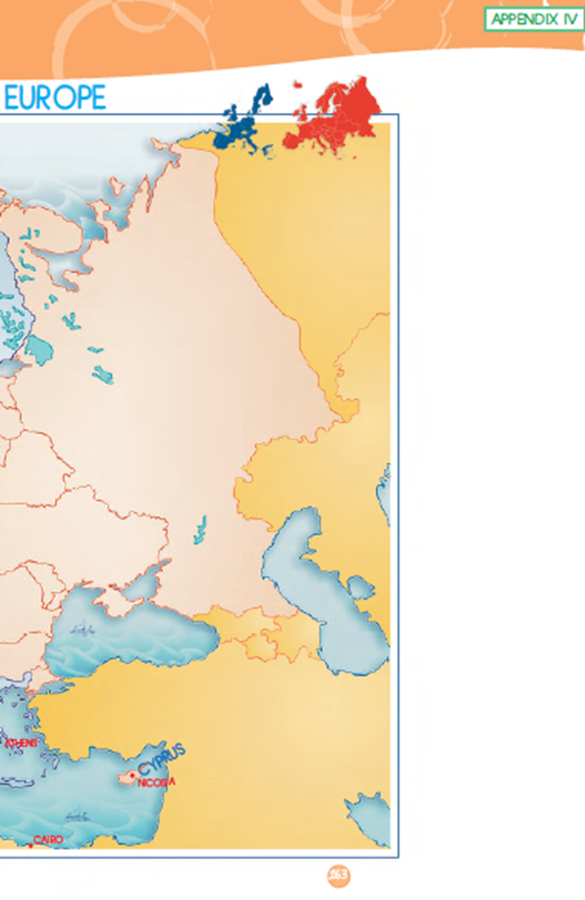
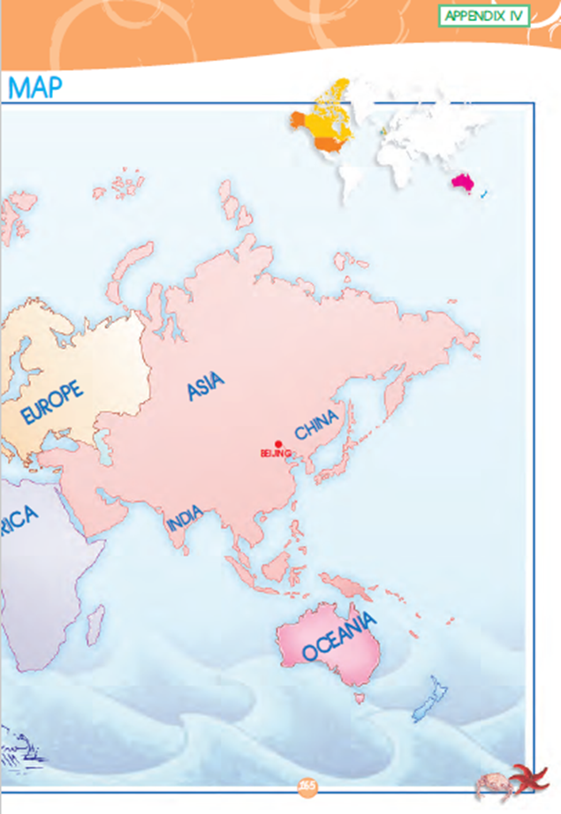

Slide 4
Let’s learn some countries and nationalities!
COUNTRY [Χώρα] | NATIONALITY [Εθνικότητα]
Greece (Ελλάδα) | Greek (Έλληνας)
the United Kingdom (το Ηνωμένο Βασίλειο) | British (Βρετανός)
England (Αγγλία) | English (Άγγλος)
Wales (Ουαλία) | Welsh (Ουαλός)
Scotland (Σκοτία) | Scottish (Σκοτσέζος)
Ireland (Ιρλανδία) | Irish (Ιρλανδός)
Egypt (Αίγυπτος) | Egyptian (Αιγύπτιος)
China (Κίνα) | Chinese (Κινέζος)
Italy (Ιταλία) | Italian (Ιταλός)
Albania (Αλβανία) | Albanian (Αλβανός)
Cyprus (Κύπρος) | Cypriot (Κύπριος)

Slide 6
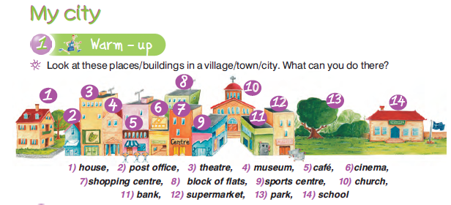
LESSON 2
Let’s learn some places in town.

Slide 8
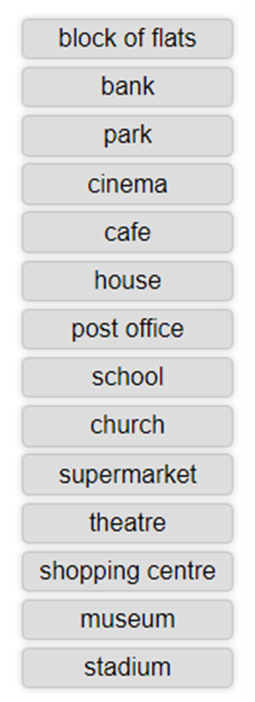

Slide 9
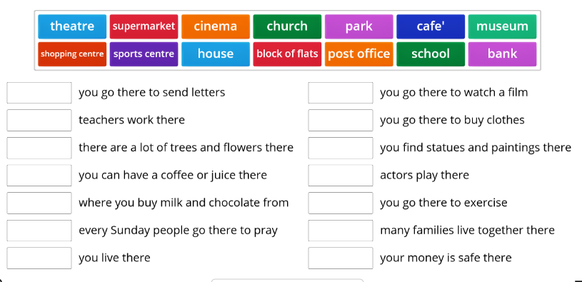
Let’s match the places in town.
https://wordwall.net/resource/7034678/my-town

Slide 10
D’ class – Location/ Prepositions of place Vocabulary
It’s across from/ opposite (the)…= είναι απέναντι από
It’s between ……… and ………= είναι ανάμεσα στο…και στο……
It’s next to/ beside the…= είναι δίπλα στο…
It’s near the …= είναι κοντά στο…
It’s in front of / behind the…= είναι μπροστά από/ πίσω από το…
It’s on the corner of …… and … = είναι στη γωνία της οδού… και …

Slide 11
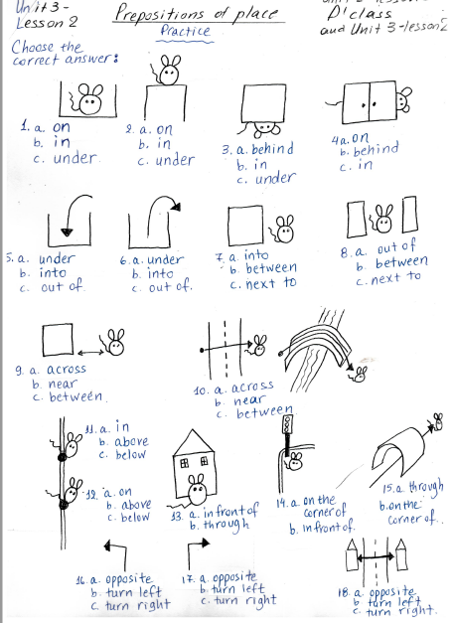
Let’s practise
prepositions of place.

Slide 12
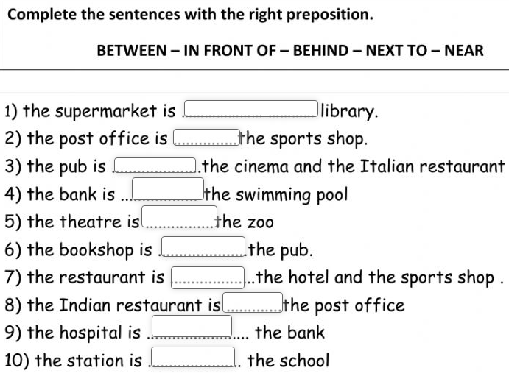
Can you find the correct preposition?
cafe
cafe

Slide 13
Where is the…….?

Slide 14
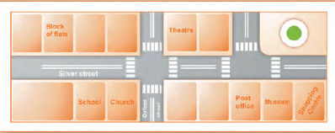
Find the missing places in town. [Resident A]
The park is next to the school opposite the block of flats.
The cinema is on the corner of Silver Street and Oxford Street across from the theatre.
The supermarket is opposite the church and across from the theatre.
The café is between the supermarket and the post office.
The bank is next to the theatre opposite the café.
Maria’s house is next to the block of flats across from the park.

Slide 16
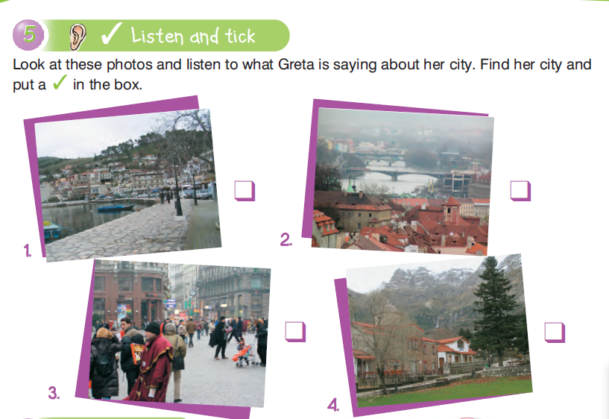

Slide 18
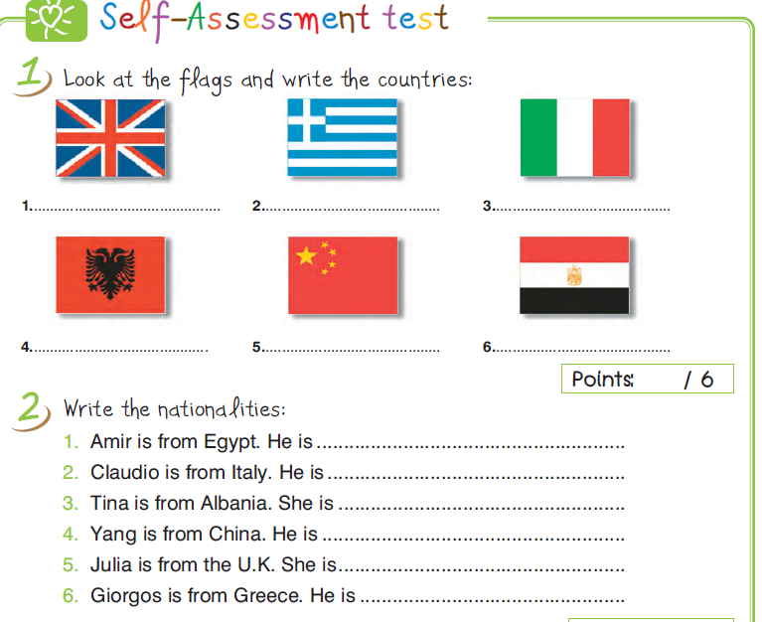
Let’s revise!

Slide 22
Goodbye everyone! See you next time!

