Slide 1

Christmas

Slide 2

Christmas is Britain’s most popular holiday!

Slide 3
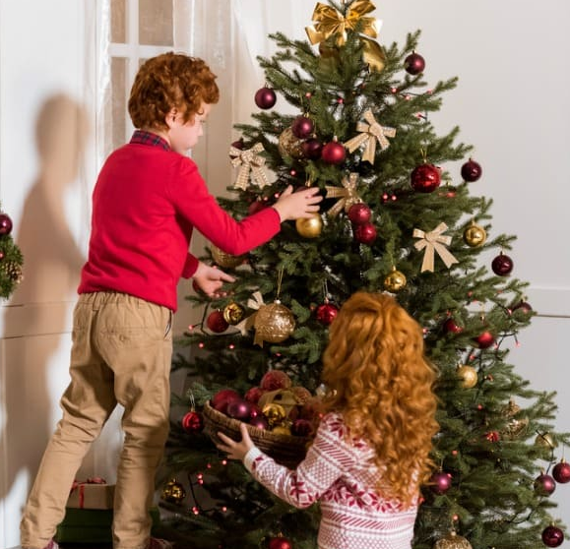
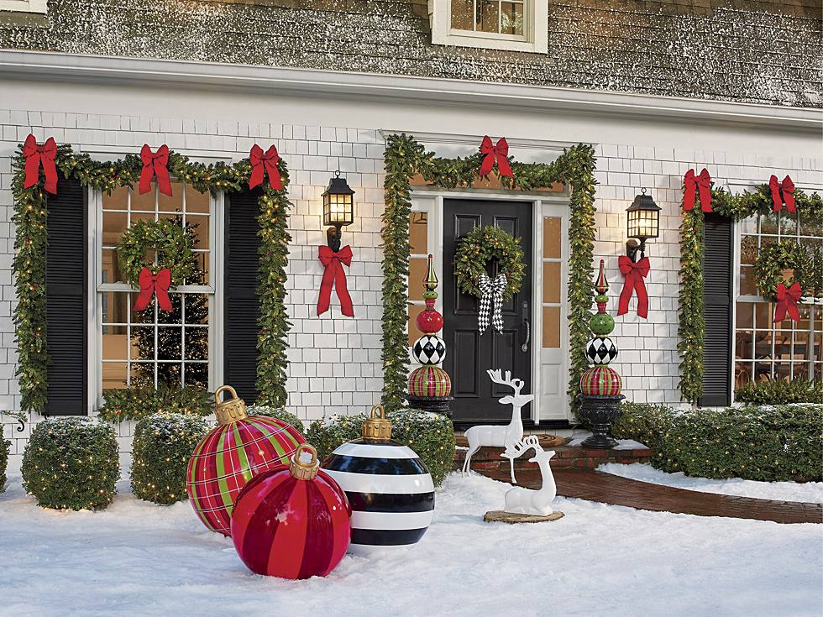
At Christmas, people decorate the Christmas tree and their houses

Slide 4
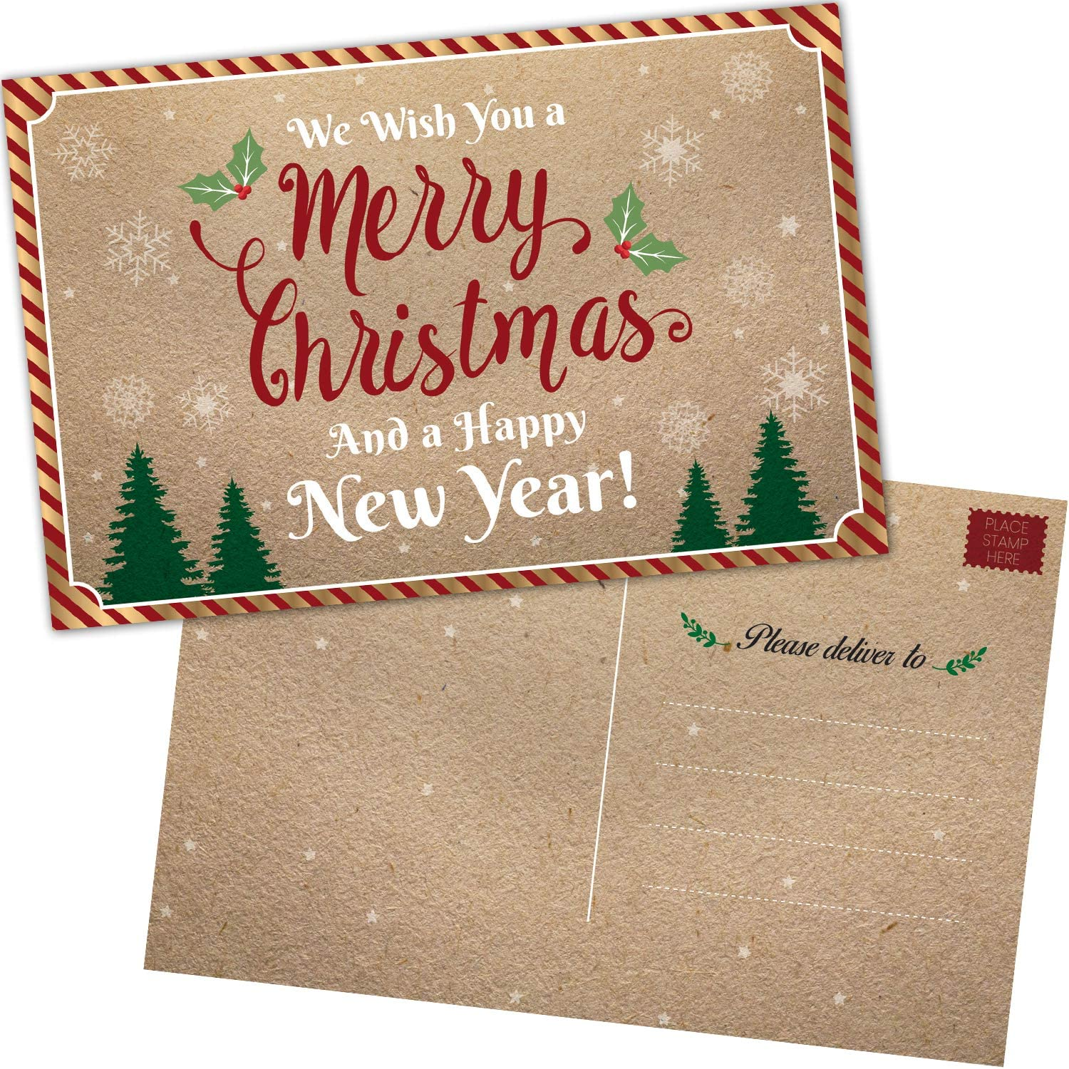
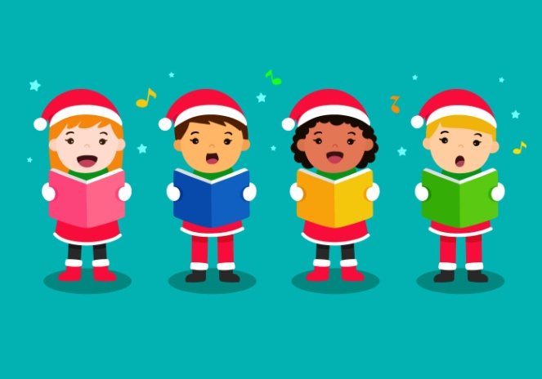
They often send cards to each other and children sing carols in the street

Slide 5
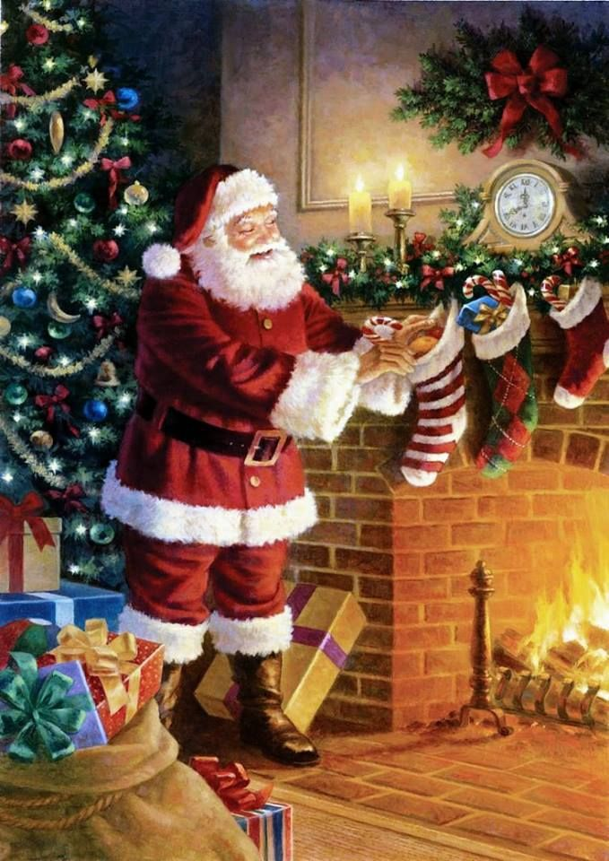
At home, children have a
STOCKING
and
FATHER CHRISTMAS
(Santa Claus)
Puts
PRESENTS
in it.

Slide 6
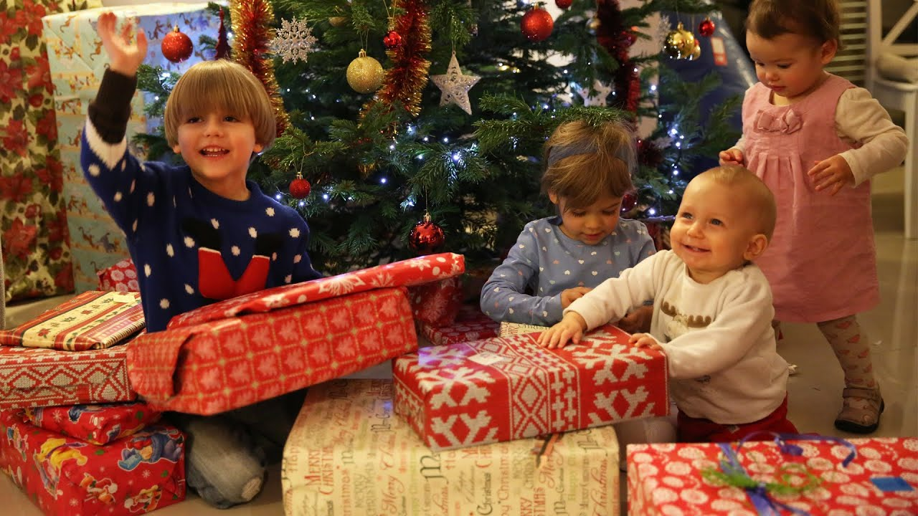
They always open their presents on Christmas Day

Slide 7
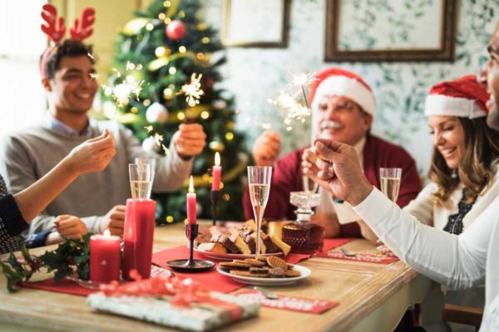
In the evening the family has
Christmas dinner

Slide 8
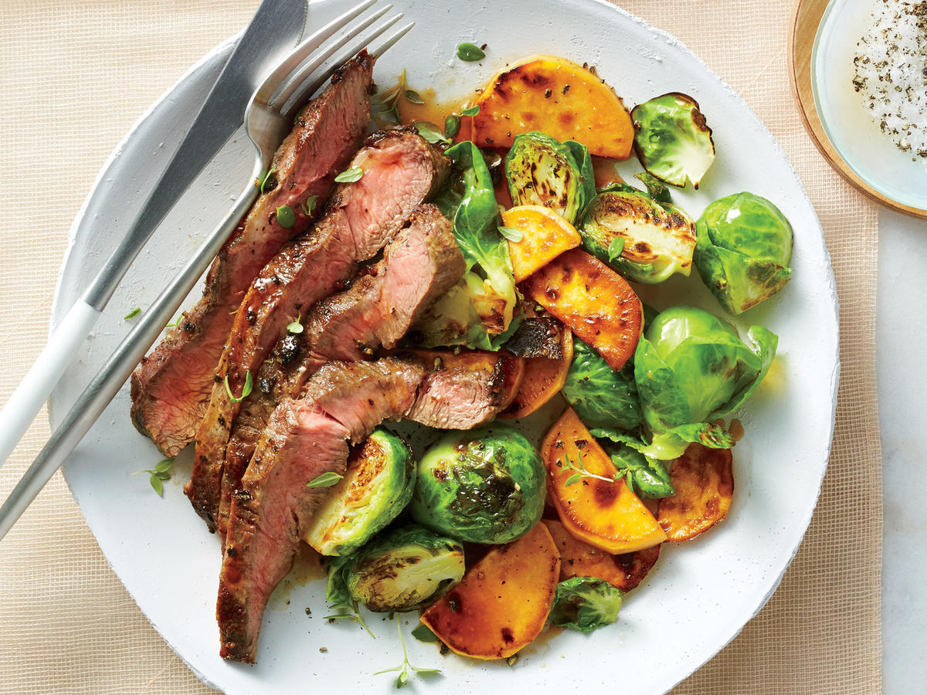
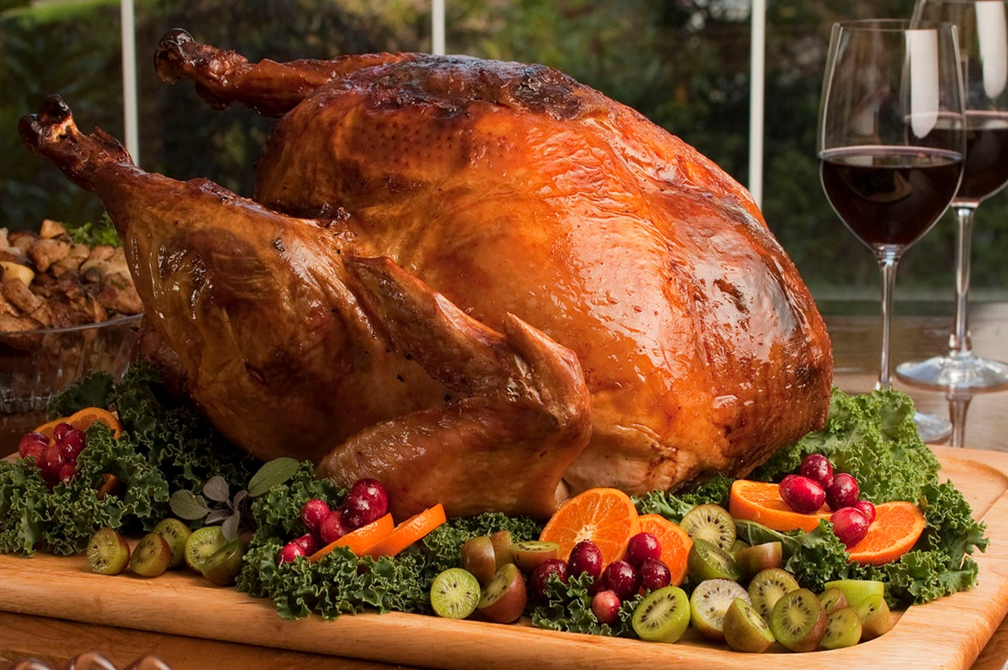
They eat roast turkey or beef with fried potatoes and Brussels sprouts

Slide 9
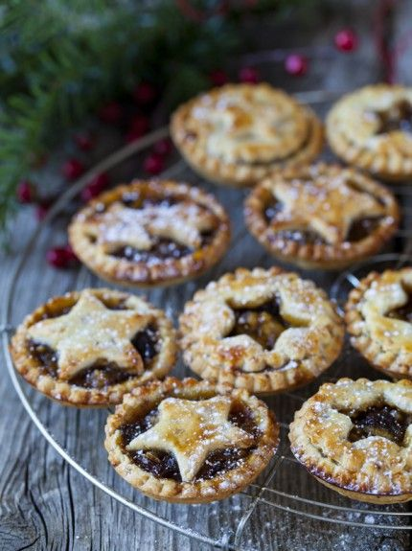
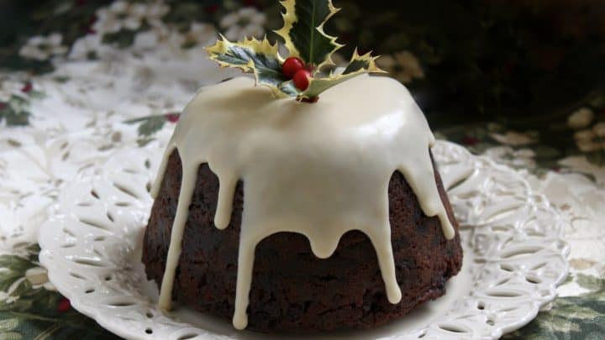
For dessert, they often have sweet mince pies or
Christmas pudding

Slide 10

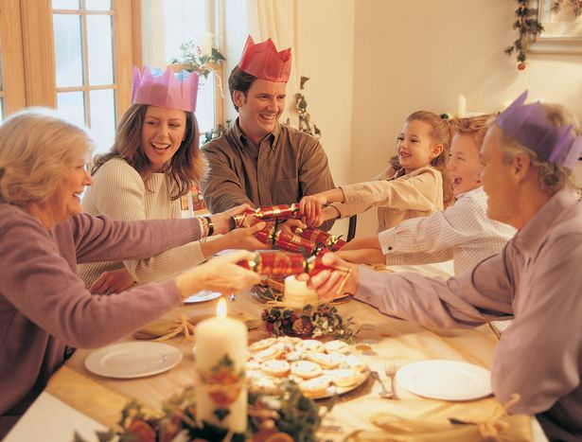
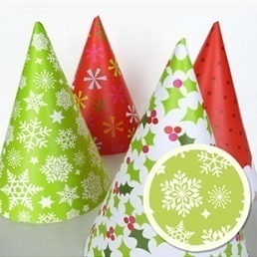
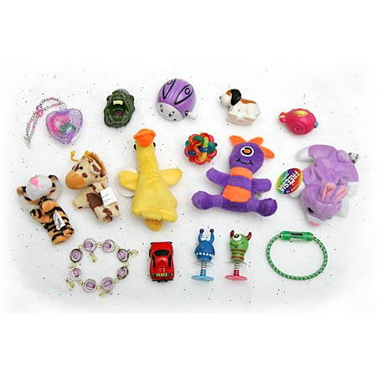
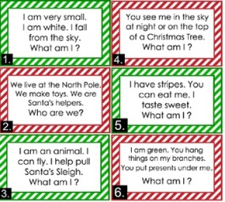
At Christmas dinner, they put Christmas crackers on each plate.
In the crackers, there is usually
a party hat,
a riddle and
a toy

Slide 11
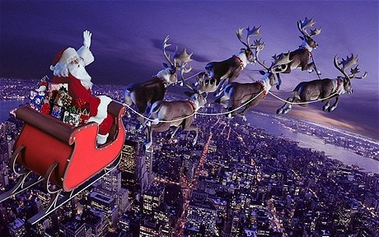
Ho ho ho!
Merry Christmas

