Slide 1
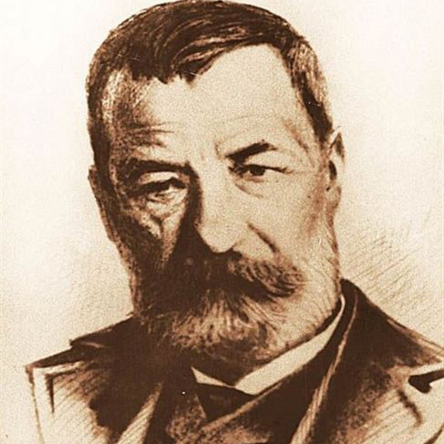
Sport Makes History: Athletes Against Injustice
4th Experimental High School of Trikala " Alexandros Papadiamantis "
ΚΑ1
Notes:
Welcome everyone to our school
Today we will present you our town, Trikala one of the most innovative cities in Greece

Slide 2
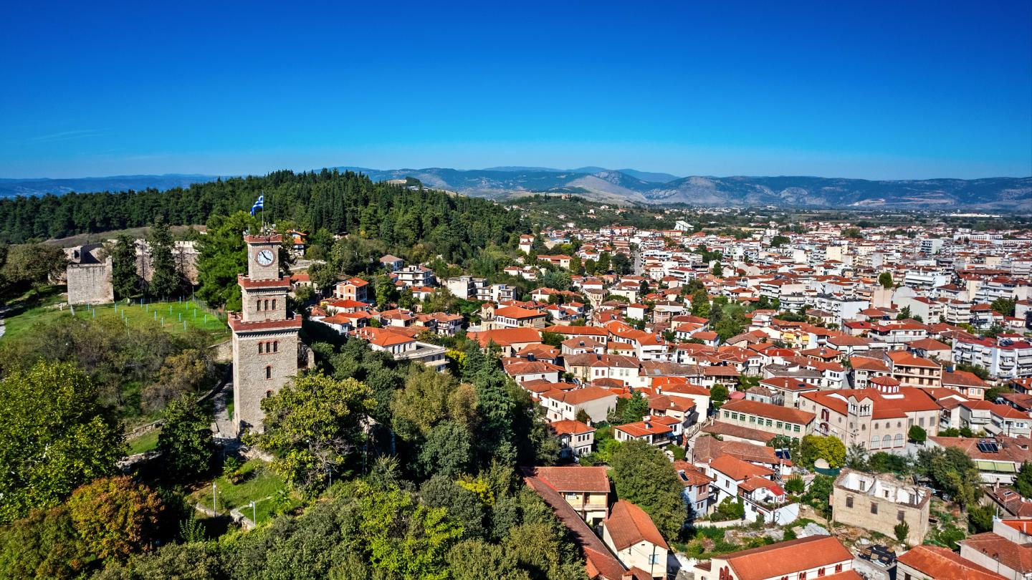

TRIKALA
THE OF GREECE
Notes:
Trikala is located in central Greece, in the region of Thessaly.

Slide 3
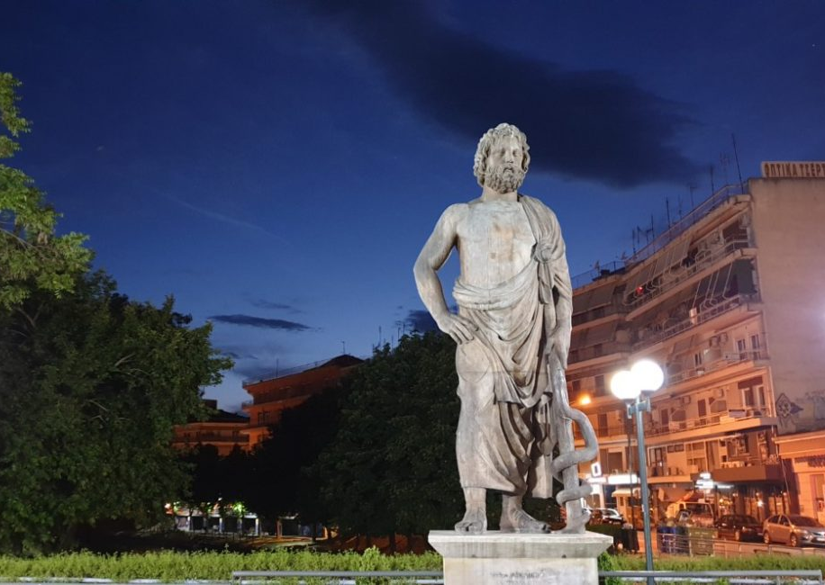
Town History
Back to ancient period: built on ancient town Trikki (3.000 b.C.) named from the nymph Trikki
The town of Asclepius, well known as god therapist
Asclepius’ sons participated in the war of Troia with 30 ships
Archaelogical site in the center of the new town: certifies the long history of the region
Notes:
Trikala traces its origins back to ancient Trikka, around 3000 BC.
It was named after the nymph Trikki.
It’s also known as the birthplace of Asclepius, the ancient Greek god of medicine.
Archaeological findings in the city center show its continuous history through thousands of years.

Slide 4
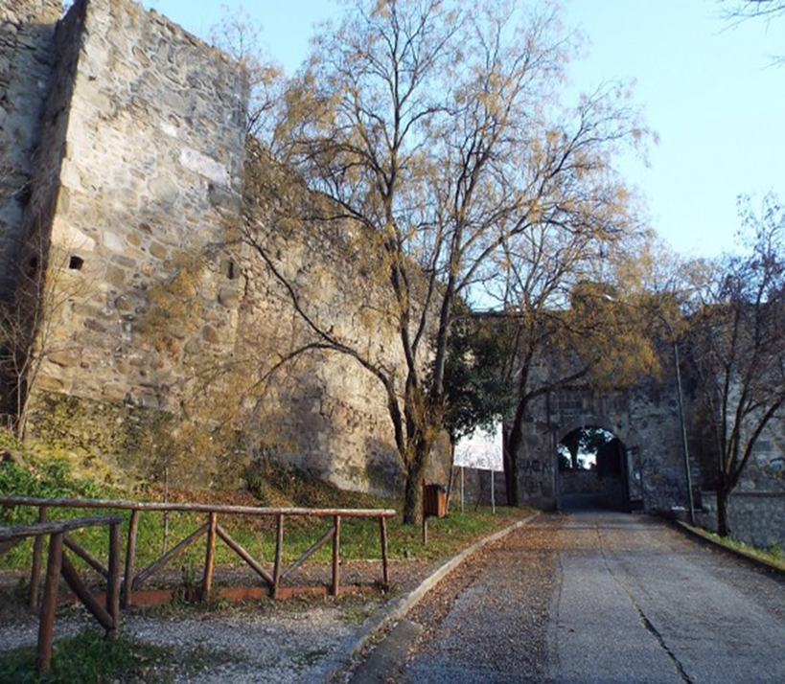
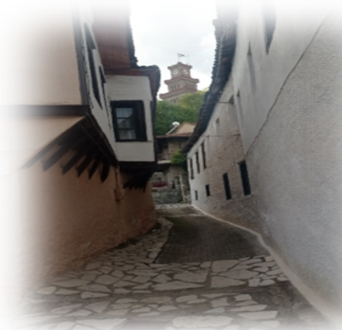
The Fortress: built in byzantine period (Justininian A’, sixth century A.D.) on the ruins of the acropolis of ancient Trikala.
District Varousi: traditional architecture – plethora of byzantine churches
Notes:
The Byzantine Fortress was built in the 6th century by Emperor Justinian.
It was constructed on top of the ancient acropolis.
Next to it is Varousi, the old town, known for its traditional houses and many Byzantine churches.
It’s one of the most picturesque areas in Trikala.

Slide 5
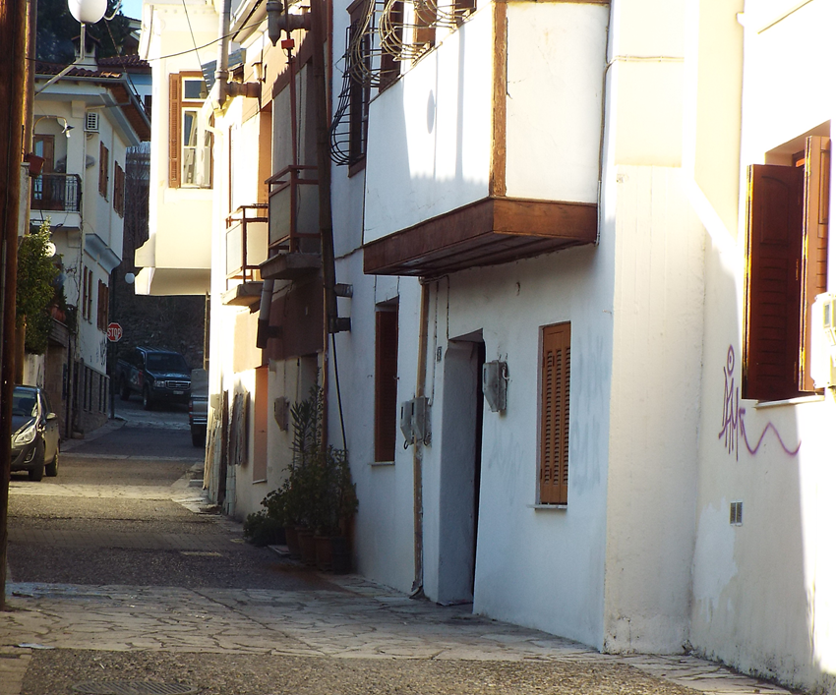
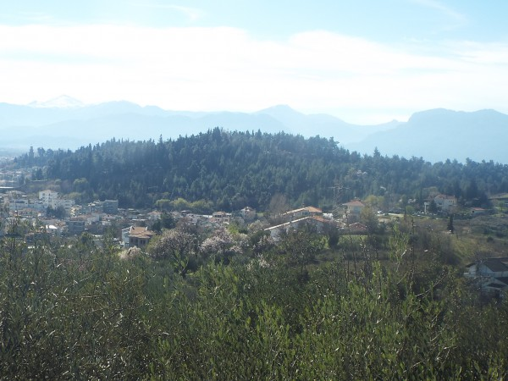
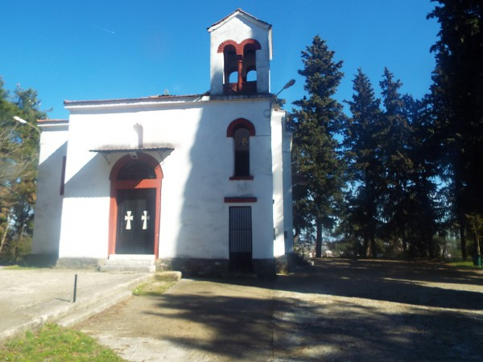
Expands alongside the fortress area
Very short distance from the city center
Accessible through Varousi’ s alleys
THE PROPHET ELIAS HILL
Notes:
This hill is right behind the fortress and offers one of the best views of the city.

Slide 6
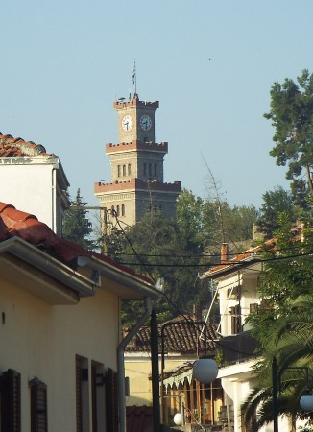
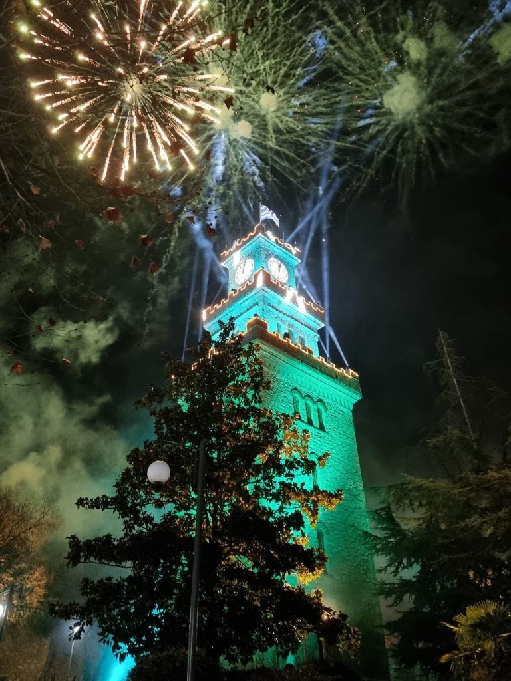
The fortress clock: Trikala’ s trademark
Construction date: 1648
Main building: stonebuilt tower 15 metres high
Knocked down: late 1920’ s
Rebuilt: 1936
Notes:
The clock tower is one of the symbols of Trikala.
The original town constructed at 1648 but it was destroyed in the 1920s and rebuilt in 1936.
It’s visible from many parts of the city.

Slide 7
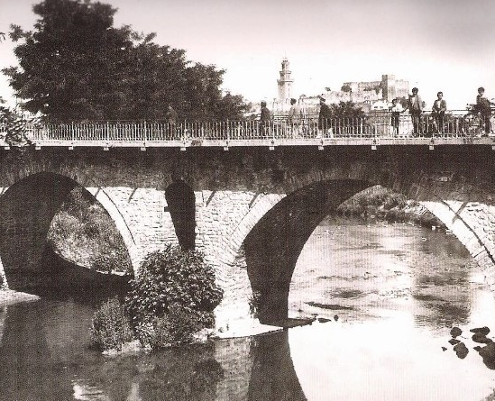
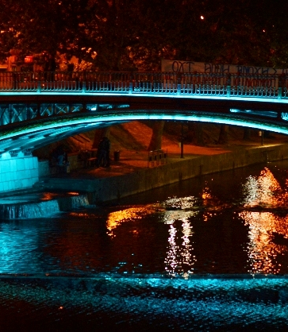
Τhe Historic Central Bridge Of The City
Notes:
there are 13 bridges that link up its watersides
The central bridge is the most famous bridge in Trikala and connects the two sides of the city.
It’s a popular meeting point for both locals and visitors.
It is one of the main landmarks of the city center.

Slide 8
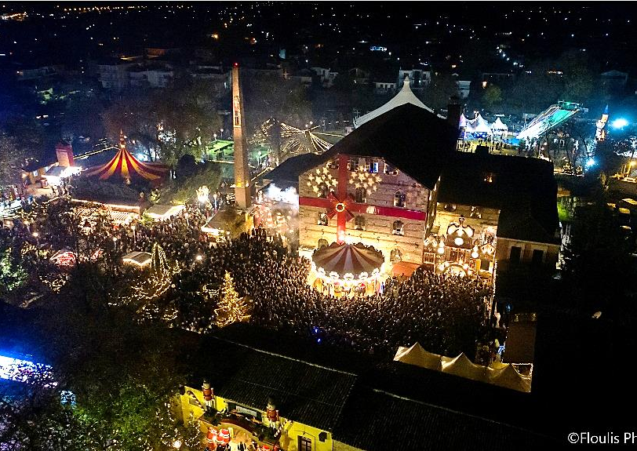
The Elves’ Mill
A large Christmas-themed park with fairy-tale decorations.
Meet Santa Claus and the elves in specially designed holiday areas.
Activities and workshops for children, such as baking and crafts.
Outdoor market and entertainment, including games, an ice rink, music, and food
Location: at the old mill of the town
Notes:
The largest Christmas-themed park in Greece, and very famous nationwide.
Every year it attracts thousands of visitors.
There are activities like workshops, crafts, Santa’s house, an ice rink, and a big Christmas market.
Theatre performances and musical ensembles are presented daily on the central stage
It takes place in the old mill of the city.

Slide 9
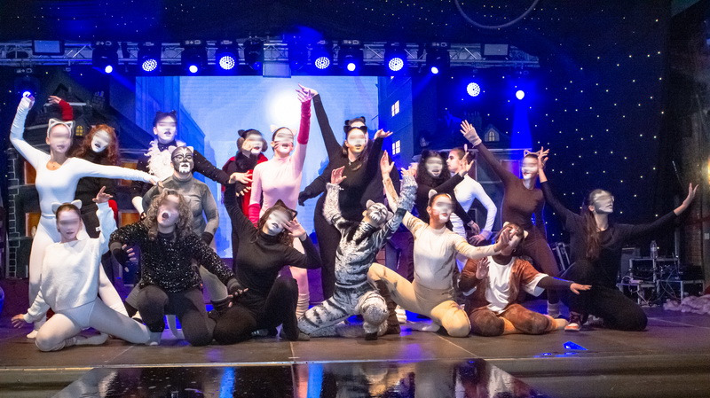
The 13th “Mill of Elves” in Trikala opened on Friday, 29 November 2024, with the music and dance show “Christmas with Cats”, performed by the groups Theatrical Workshop, Cinematheatre, and Performing Arts & Rhetoric of our school..
Notes:
Last year, the 13th Mill of Elves opened with the show “Christmas with Cats.” performed by the Art Clubs of our school

Slide 10
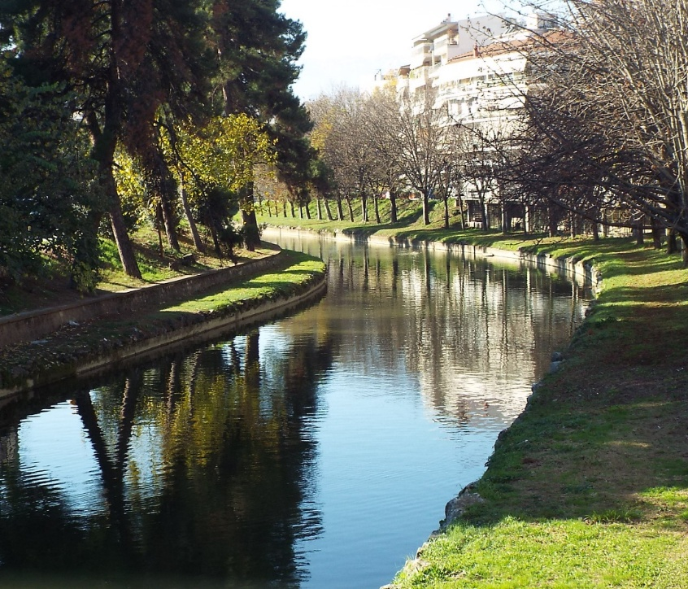
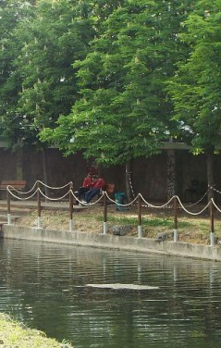
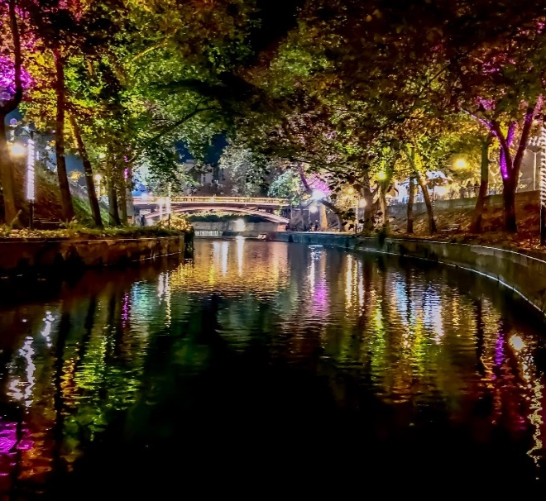
Lithaios river: city’ s landmark
Crosses the city
Promenades
Bicycling alongside
Boat ride
Notes:
The river runs through the center of Trikala.
It’s ideal for walking, cycling
During summer and spring you can take boat ride

Slide 11
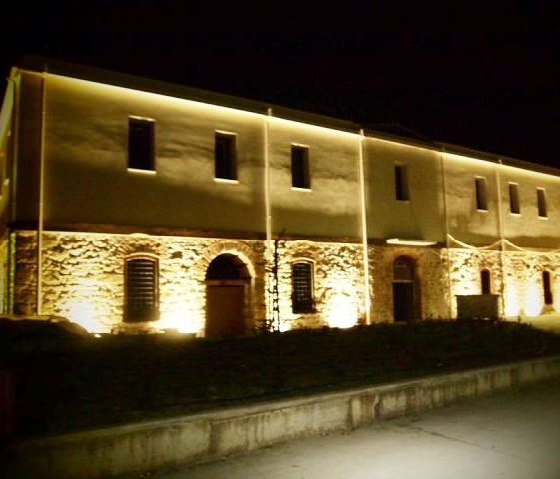
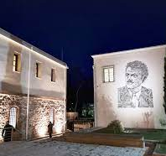
Tsitsanis museum
Song writer and bouzouki player
born and raised in Trikala
one of the founders of modern rebetiko music
multitalented: composed more than 500 songs
There you can find the old Ottoman baths
the Tsitsanis museum provides an interactive approach of his personality enriched with archival material
the museum is rebuilt on the old prison of the city
Notes:
This museum is dedicated to Vasilis Tsitsanis, a famous Greek songwriter born in Trikala.
He was one of the most important figures in rebetiko music.
He composed more
In the same building you can find the old Ottoman baths and the old city prison.

Slide 12
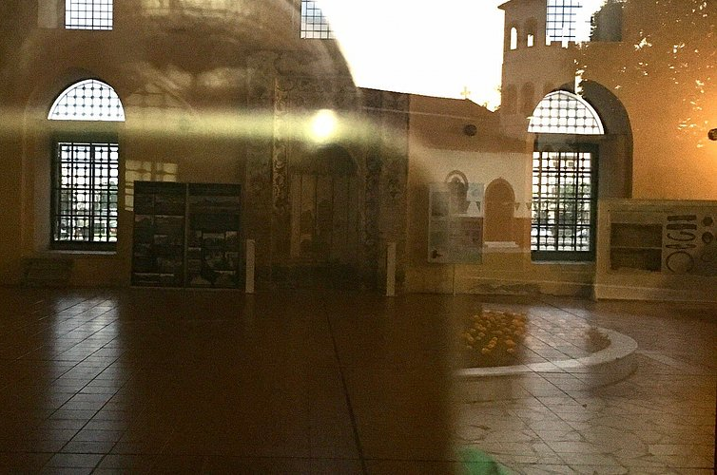
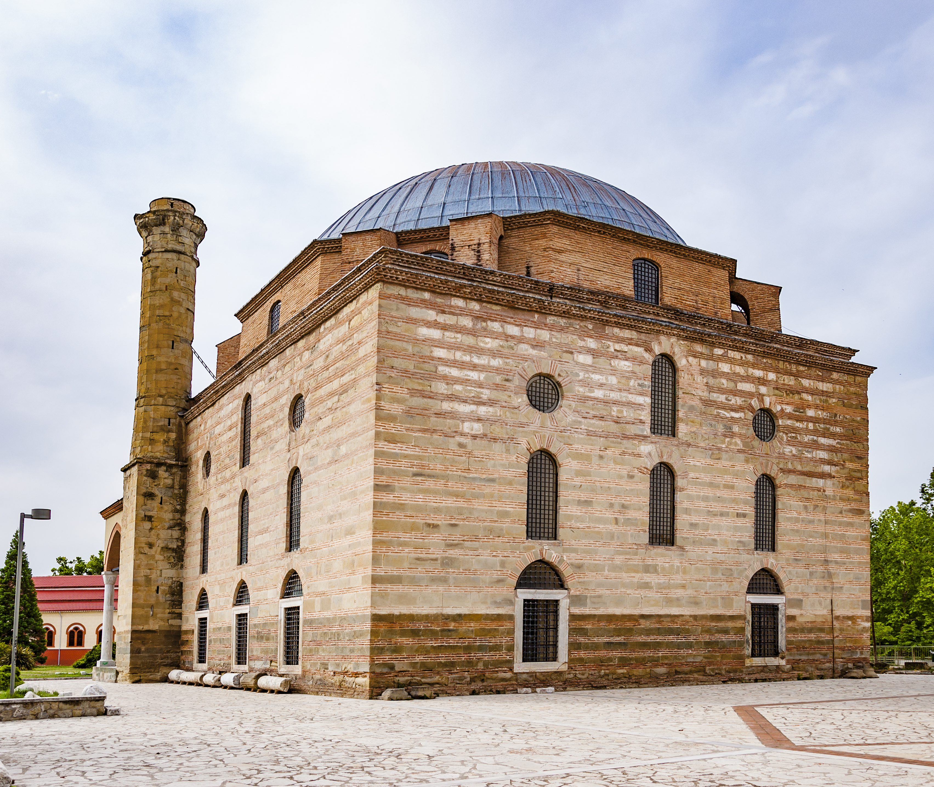
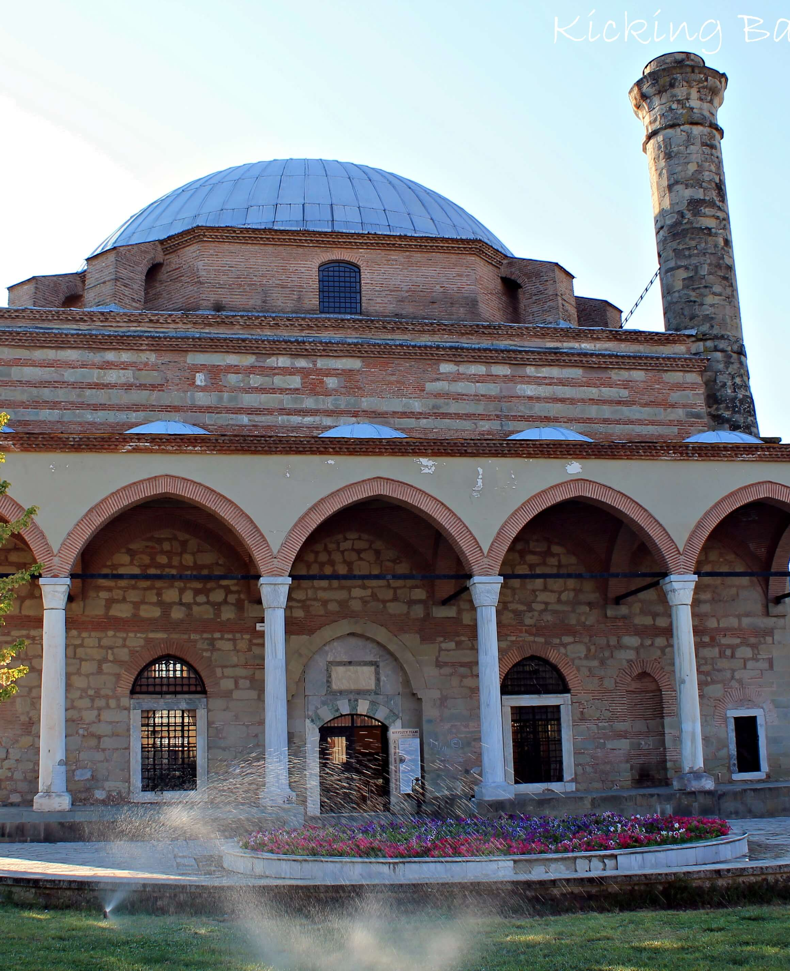
Kursum Mosque (Osman Shah Mosque)
16th-century Ottoman architecture
Lead-covered dom
The only surviving mosque by Mimar Sinan in Greece
Notes:
A 16th-century mosque designed by Mimar Sinan, the most famous Ottoman architect.
It is the only building by Sinan that still survives in Greece.
It has a distinctive lead-covered dome.

Slide 13
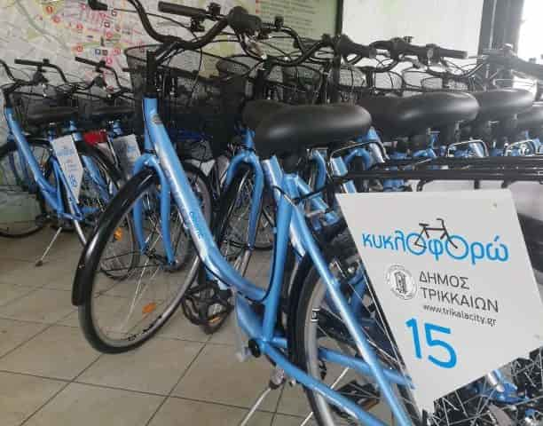


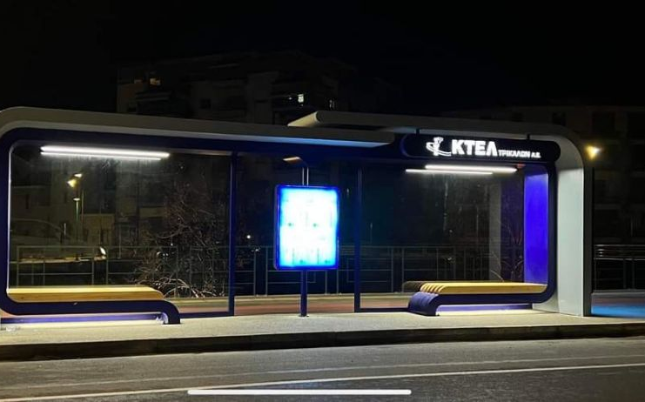
THE SMART CITY
new innovative central square
E-bikes
City ​​bus stops with solar energy chargers
E-Trikala
Free WIFI around the city
Notes:
Trikala is one of the first and most successful smart cities in Greece.
There are e-bikes, smart bus stops with solar power, and free public WiFi.

Slide 14

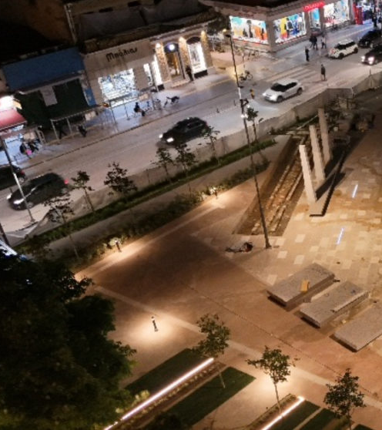
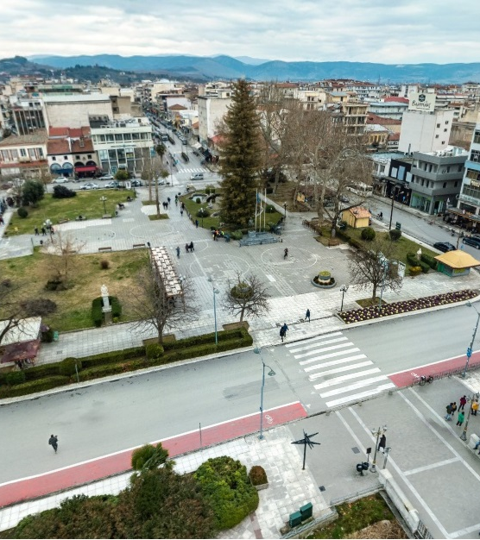
New Innovative Central Square
Notes:
This is the newly renovated main square of the city.
It is designed to be modern, accessible, and eco-friendly.

Slide 15
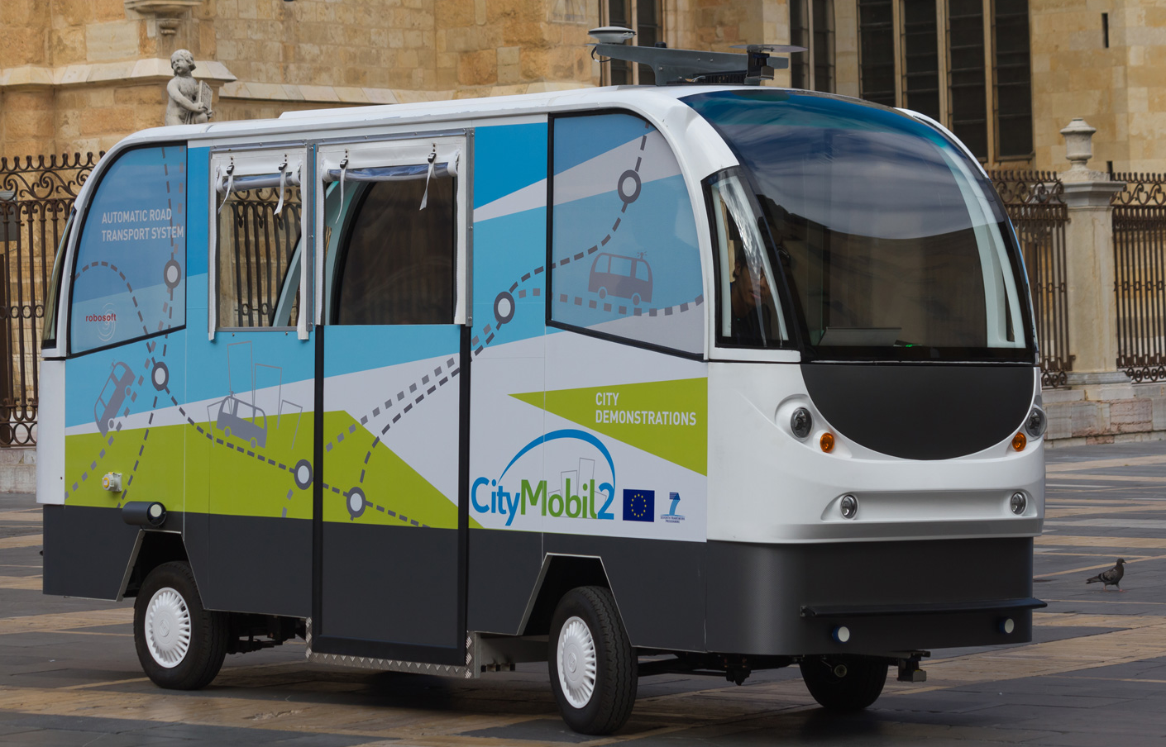
Leading the Future of Autonomous Urban Transport With The CityMobil2 pilot program
September 1, 2015 – February 29, 2016
3 autonomous buses in operation
1,490 trips completed
12,138 passengers transported
Notes:
Trikala was the first city in Greece to test autonomous public transport.
From 2015 to 2016, 3 driverless buses operated in the city.
Over 12,000 passengers were transported.
It was a successful experiment and a big step for smart mobilit

Slide 16
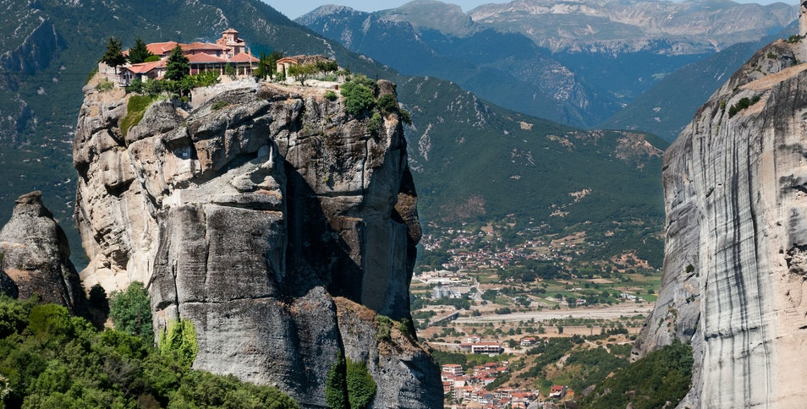
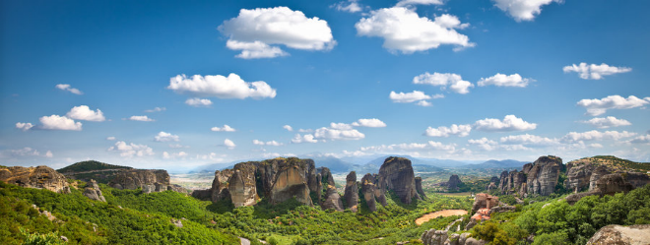
Meteora
Rocks suspended on the air
Unique for the sedimentary rock constituents deposited over million of years
Stunning view – unquestionably a must visit
Included on the UNESCO World Heritage List
Location: Kalambaka, 20 km away from Trikala
The Monasteries of Meteora: ascetic community since 12th century (at least) – 24 monasteries at their peak in 16th century
Today: 6 monasteries still functioning
Notes:
Meteora is one of the most impressive places in the world, located only 20 km from Trikala.
The huge rock formations and monasteries are part of UNESCO World Heritage.
Monastic life began there in the 12th century.
Today, 6 monasteries remain active.

Slide 17
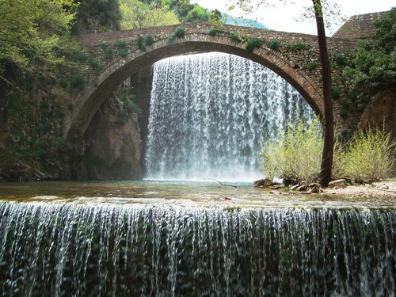
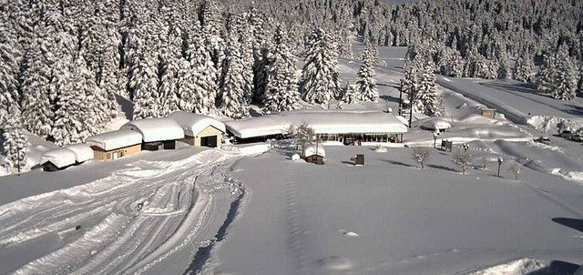
Mountain trips
All season attraction
The flatlands of Trikala embraced by the Pindos mountain range
Pertouli - Ski Center
Elati - Mountain village.
The scenic Pertouli meadows
The stunning Palaiokaria Waterfall
Numerous mountain trails
Traditional stone bridges
Notes:
The region around Trikala is surrounded by the Pindos mountains, making it perfect for year-round nature activities.
Pertouli Ski Center is a popular winter destination
The Pertouli meadows are ideal for nature lovers
The area offers many mountain trails, perfect for hiking, exploring, and enjoying the natural landscape.
There are also traditional stone bridges that showcase the region’s rich cultural heritage.
One of the most famous sights is the Palaiokaria Waterfall, a landmark of natural beauty and a great place for photos.

Slide 18
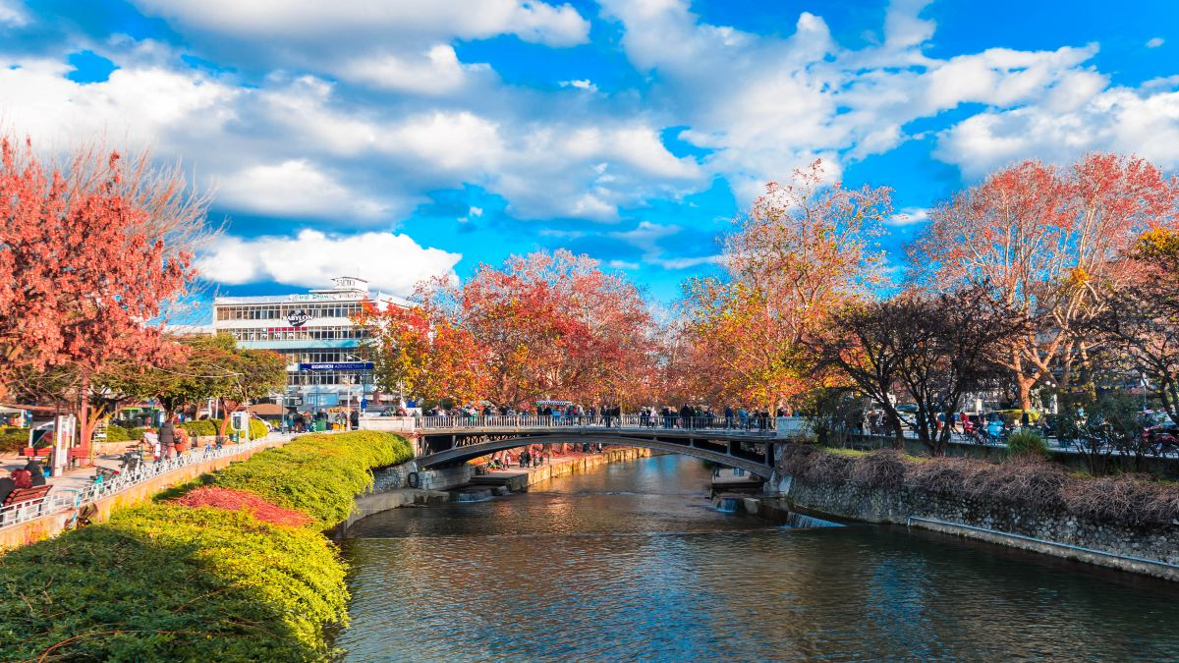
Thank you for watching to our presentation!
We hope you enjoy our city and everything it has to offer.
Notes:
Thank you for listening carefully to our presentation!
We hope you enjoy our city and everything it has to offer.

