Slide 1
Practising common illnesses

Slide 2
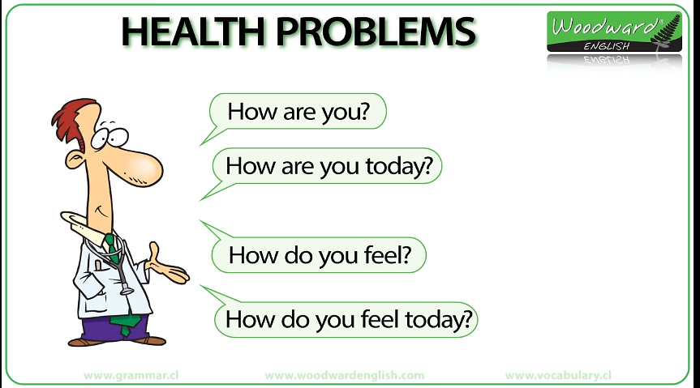

Slide 40
Watch the video here:
https://www.youtube.com/watch?v=Zm1KKcgQ7DM

Slide 41
Watch more videos here:
https://www.youtube.com/watch?v=pLRBLsdei2Q
https://www.youtube.com/watch?v=WMojbSbAQgM
https://www.youtube.com/watch?v=RaB5Bydz8rE
https://www.youtube.com/watch?v=ORAePdF9szs
https://www.youtube.com/watch?v=2mQ-weZKJRE
https://www.youtube.com/watch?v=fuNmvM5BvDM
https://www.youtube.com/watch?v=GMKRBzAnwRA

