Slide 1
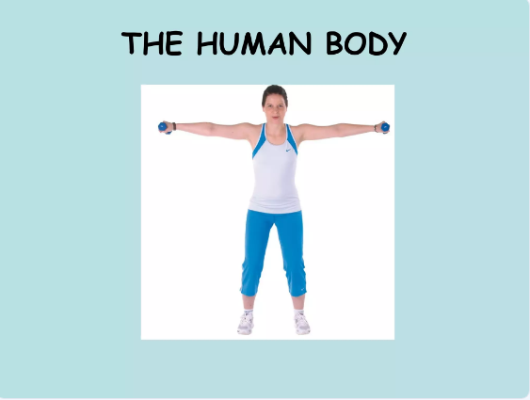

Slide 2
The human body is a complex network of cells, tissues and organs that together make life possible.
https://www.youtube.com/watch?v=Ae4MadKPJC0

Slide 3
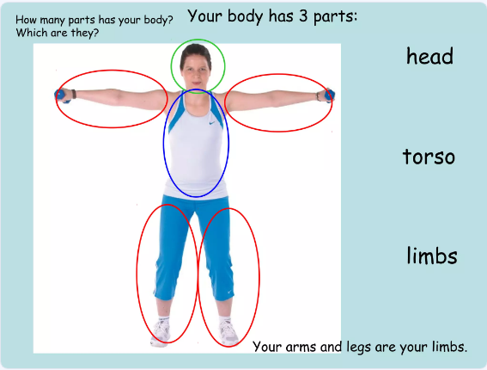
How many parts does your body have?
Which are they?
There are three parts in the human body:

Slide 4
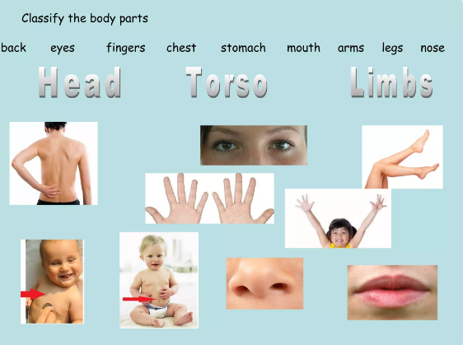

Slide 7
There are over 200 bones in our body.

Slide 9
hard
rigid
hard

Slide 18
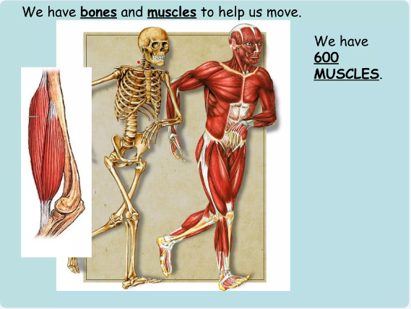

Slide 21
There are 10 basic systems in our body

Slide 22
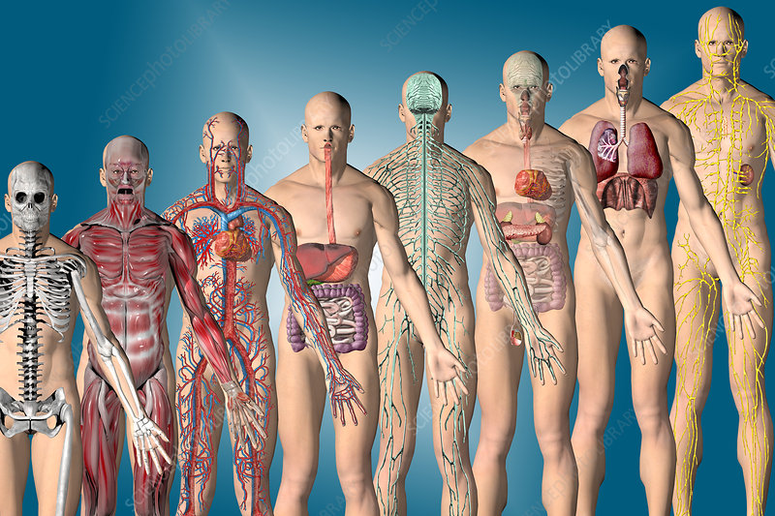
the Lymphatic
System
the Digestive
System
the Muscular
System
the Circulatory
System
the Skeletal
System
the Respiratory
System
the Nervous
System
the Endocrine
System

Slide 23
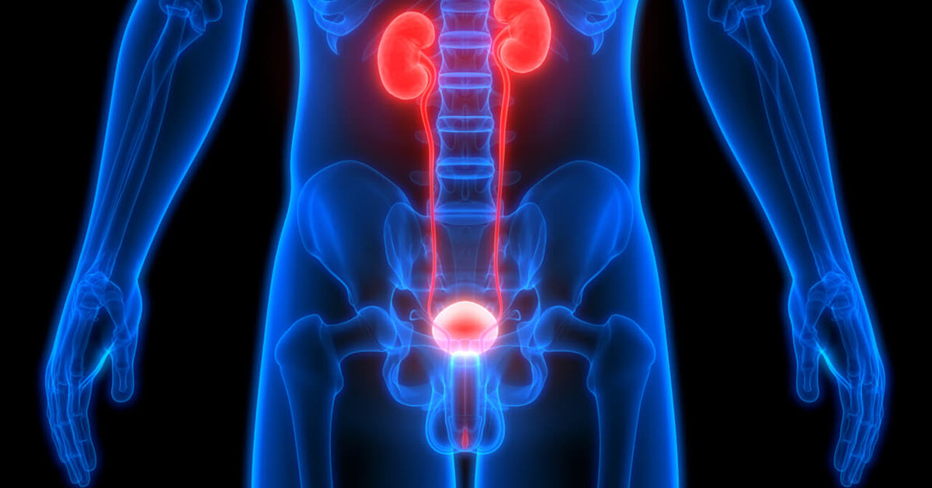
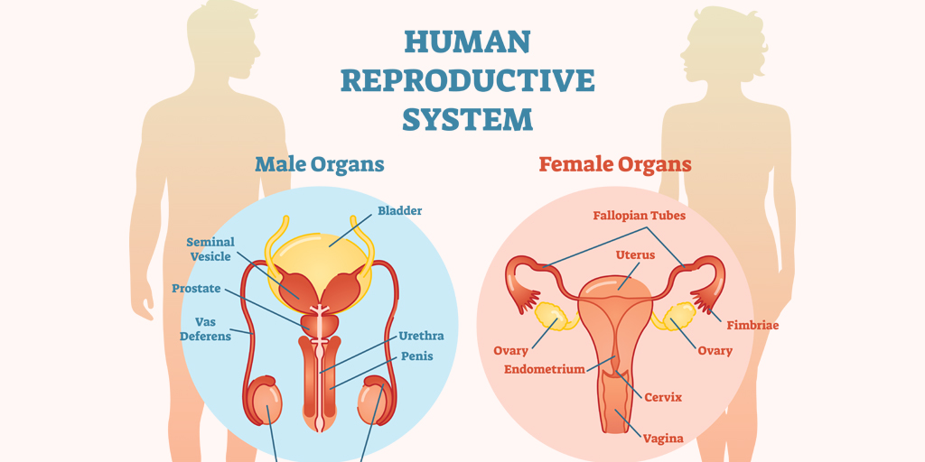
and the
the Urinary
System

Slide 24
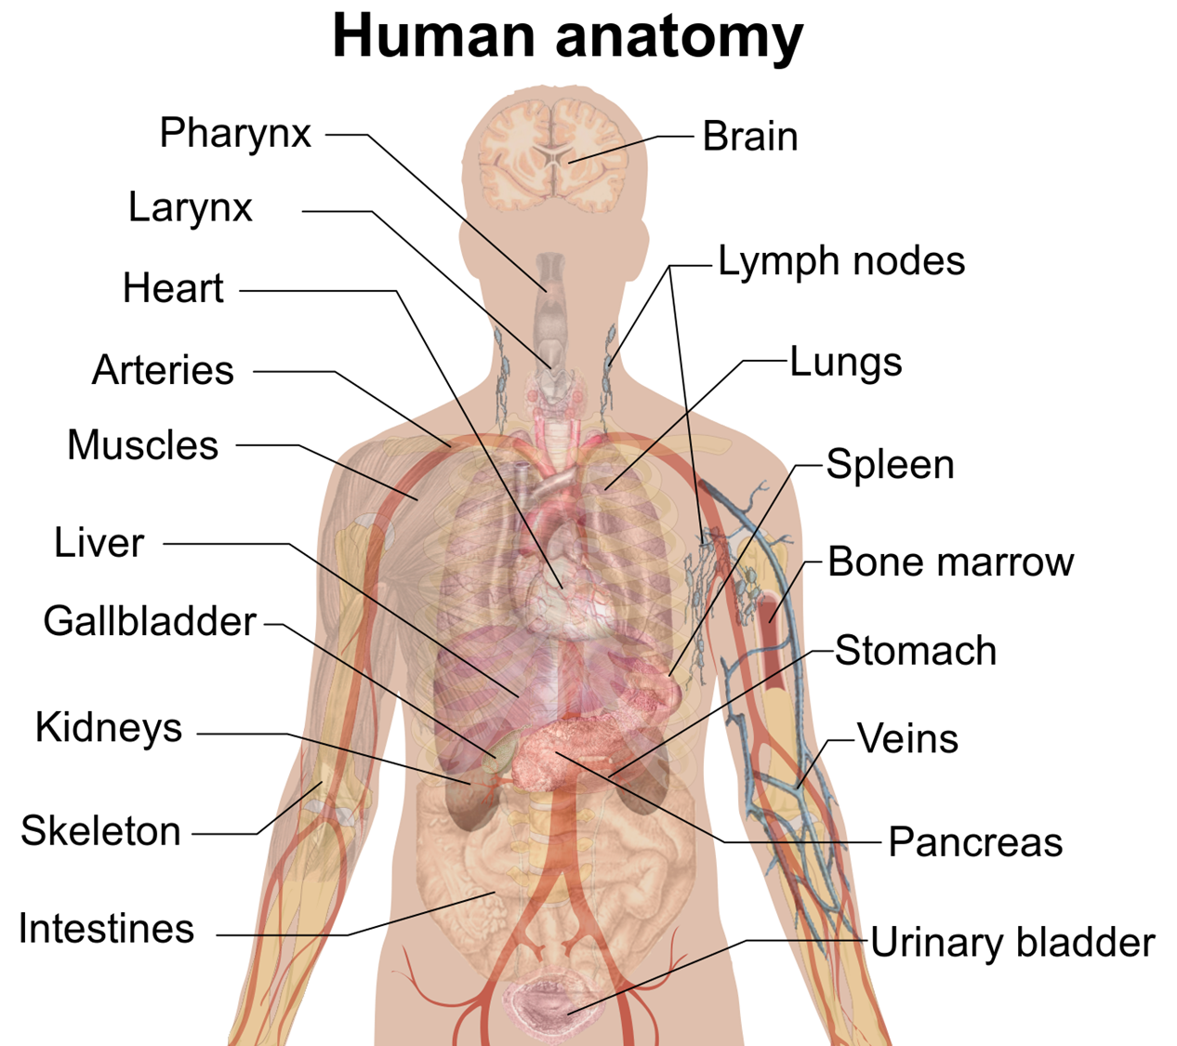

Slide 28
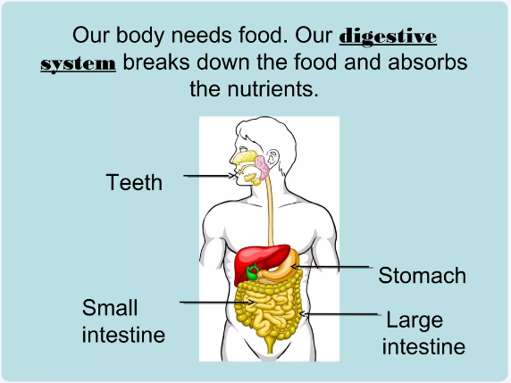

Slide 30
More body parts…

Slide 31
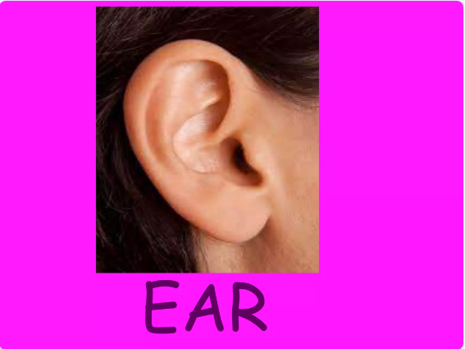

Slide 32
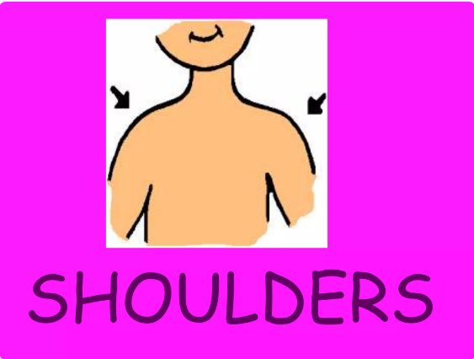
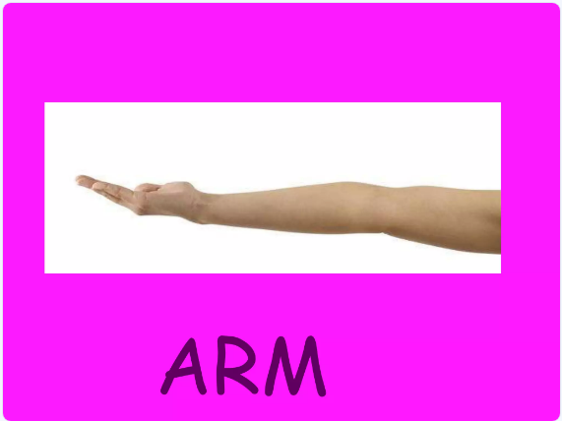

Slide 33
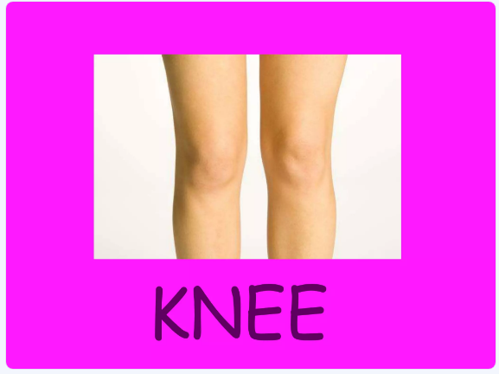
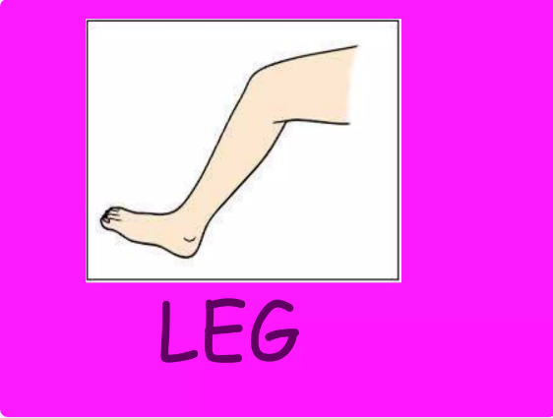
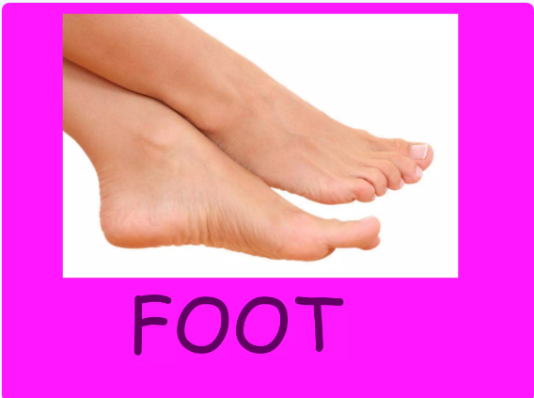
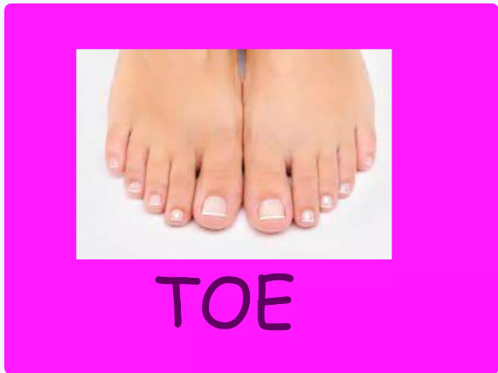

Slide 35
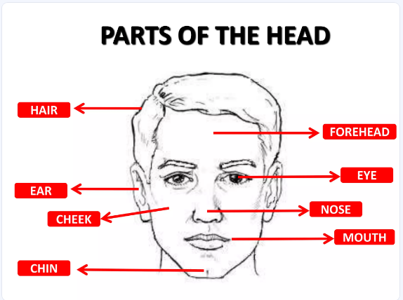

Slide 38
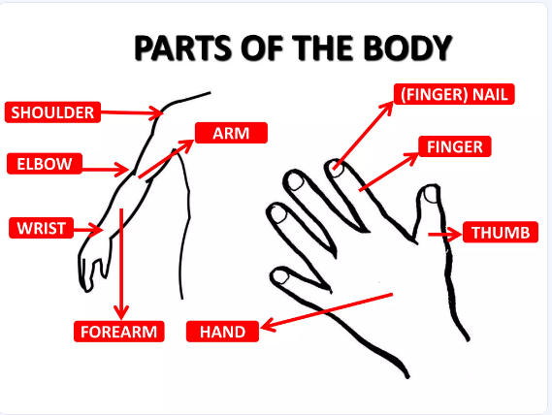

Slide 40
