Slide 1
HEALTHCARE, WELFARE AND WELLNESS SERVICES
1st EVENING VOCATIONAL HIGH SCHOOL OF TRIKALA

Slide 2
Healthcare refers to the organized efforts, services, and systems designed to maintain, improve, and restore the health of individuals and communities. It encompasses a wide range of activities aimed at diagnosing, treating, preventing, and managing diseases, illnesses, injuries, and other physical or mental health conditions.

Slide 3
USEFUL VOCABULARY
healthcare | ιατροφαρμακευτική περίθαλψη
to maintain | συντηρώ, διατηρώ
to improve | βελτιώνω
to restore | αποκαθιστώ
individual | άτομο, ατομικός
community | κοινότητα, κοινωνία, κοινωνικό σύνολο
to encompass | περιλαμβάνω
to aim at + V-ing | σκοπεύω, στοχεύω, σημαδεύω
to diagnose diagnosis | διαγιγνώσκω διάγνωση
to treat treatment | περιποιούμαι, φροντίζω, θεραπεύω θεραπεία, φροντίδα
to prevent prevention preventive medicine | προλαμβάνω, εμποδίζω πρόληψη προληπτική ιατρική
to manage | διαχειρίζομαι
USEFUL VOCABULARY
disease | νόσος
illness | αρρώστια, ασθένεια
injury | τραυματισμός
physical | φυσικός
mental | νοητικός, πνευματικός
condition | κατάσταση

Slide 4
The word “health” and its derivatives
health = υγεία
healthiness = υγεία, καλή υγεία
healthy = υγιεινός
unhealthy = ανθυγιεινός
healthily = υγιεινά (επιρρ.)
unhealthily = ανθυγιεινά (επιρρ.)

Slide 5
Key Components of Healthcare:
Preventive Care:
Services that focus on preventing diseases before they occur, such as vaccinations, health screenings, lifestyle counseling, and public health initiatives.
efforts, programs, or actions aimed at improving the health and well-being of the public.
preventive health checks

Slide 6
USEFUL VOCABULARY
focus on | εστιάζω, επικεντρώνομαι, συγκεντρώνομαι
occur | προκύπτω, υπάρχω, εμφανίζομαι
vaccinations | εμβολιασμοί
health screenings | εξετάσεις υγείας
lifestyle | τρόπος ζωής
counselling | ψυχοθεραπεία, συμβουλευτική υπηρεσία
public health | δημόσια υγεία
initiatives | πρωτοβουλίες

Slide 7
2. Primary Care:
(Πρωτοβάθμια Φροντίδα Υγείας)
The first point of contact for individuals seeking medical attention, typically provided by general practitioners or family doctors. It includes routine checkups, diagnosis, and treatment of common illnesses.

Slide 8
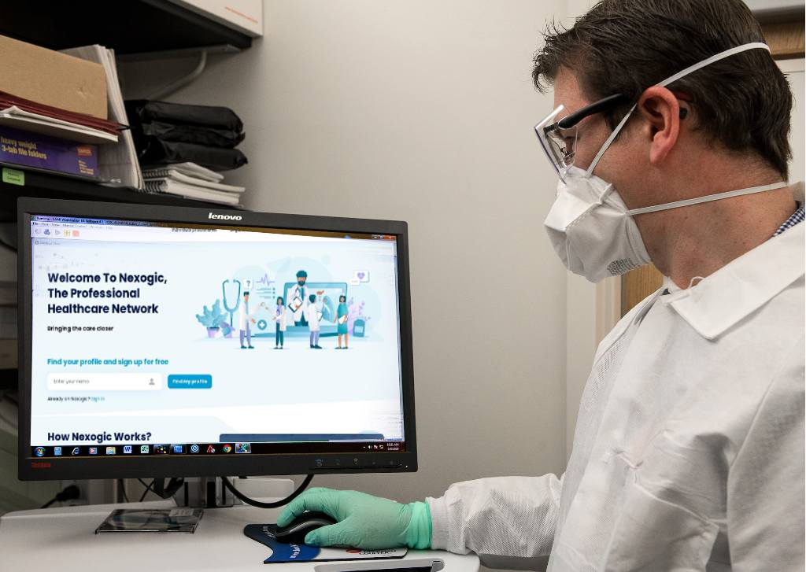
3. Specialized Care:
(Εξειδικευμένη φροντίδα)
Care provided by medical specialists in specific fields, such as cardiologists, oncologists, and neurologists. This is typically for more complex health issues that require advanced expertise.

Slide 9
USEFUL VOCABULARY
specialist | ειδικός, ειδικός γιατρός
specific field | συγκεκριμένος τομέας/πεδίο
complex health issues | περίπλοκα θέματα υγείας
to require | απαιτώ, έχω ως προϋπόθεση
advanced | προηγμένος, αναπτυγμένος, προχωρημένος
expertise | ειδικές γνώσεις

Slide 10
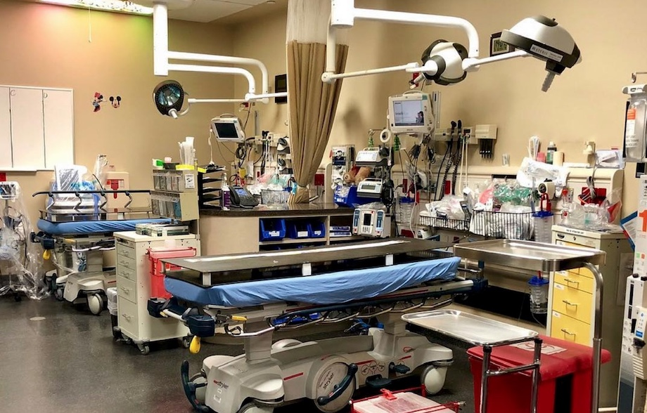
4. Emergency Care:
(Επείγοντα)
Immediate care provided in life-threatening situations, such as accidents, heart attacks, or severe injuries, often in emergency rooms or trauma centers.

Slide 11
USEFUL VOCABULARY
life- threatening | απειλητικός για τη ζωή
situations | καταστάσεις
accidents | ατυχήματα
heart attack | καρδιακή προσβολή
severe injury | βαρύς τραυματισμός
emergency room | τμήμα επειγόντων περιστατικών

Slide 12
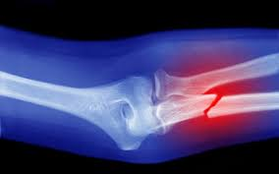
5. Surgical Care:
(Χειρουργική φροντίδα)
Involves operations performed by surgeons to treat or manage conditions like broken bones, cancers, or internal organ issues.

Slide 13
USEFUL VOCABULARY
surgeon | χειρουργός
surgery | χειρουργείο
surgical | χειρουργικός
broken bones | σπασμένα οστά
internal organs | εσωτερικά όργανα
issues | θέματα, ζητήματα

Slide 14
6. Rehabilitation and Palliative Care:
(Αποκατάσταση και Παρηγορητική/Ανακουφιστική Αγωγή/Φροντίδα)
Services that help people recover from surgeries or illnesses (rehabilitation), or provide comfort and quality of life to those with serious, chronic, or terminal conditions (palliative care).

Slide 15
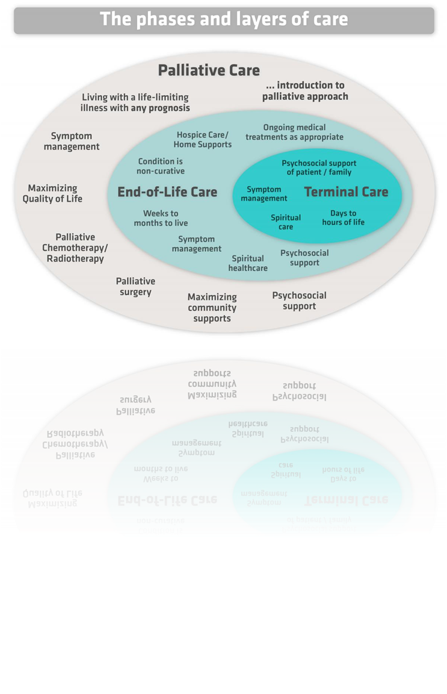
USEFUL VOCABULARY
rehabilitation rehab (centre) | αποκατάσταση, επανένταξη κέντρο αποκατάστασης
to recover | αναρρώνω
to provide | παρέχω
comfort | παρηγοριά, άνεση
quality of life | ποιότητα ζωής
chronic issues | χρόνια θέματα, ζητήματα, προβλήματα
terminal issues | θέματα, ζητήματα τελικού σταδίου

Slide 16
7. Mental Health Care:
(Φροντίδα Νοητικής Υγείας)
Services aimed at diagnosing and treating mental health conditions like anxiety, depression, and schizophrenia. It includes therapy, counseling, and psychiatric care.

Slide 17
USEFUL VOCABULARY
depression | κατάθλιψη
anxiety anxiety disorder | άγχος αγχώδης διαταραχή
schizophrenia | σχιζοφρένεια

Slide 18
8. Pharmaceuticals:
(Φάρμακα, φαρμακευτική βιομηχανία)
The use of medications to treat or manage various health conditions.

Slide 19
Healthcare services are typically provided by a range of professionals, including doctors, nurses, pharmacists, therapists, and social workers. They can be accessed through various settings, such as hospitals, clinics, community health centers, and home care.
In most countries, healthcare systems are funded either through public/government funding (like universal healthcare), private insurance, or a combination of both.

Slide 20
USEFUL VOCABULARY
professionals | επαγγελματίες
doctor | γιατρός
nurse | νοσηλευτής /-τρια
therapist | θεραπευτής
pharmacist | φαρμακοποιός
social worker | κοινωνικός λειτουργός
setting | χώρος, περιβάλλον
hospital | νοσοκομείο
clinic | κλινική
health centre | κέντρο υγείας
home care | φροντίδα στο σπίτι

Slide 21
Welfare = πρόνοια
Welfare refers to the well-being or quality of life of individuals or communities, often focusing on providing basic needs and support for those who are vulnerable or disadvantaged. It can include financial assistance, healthcare, housing, education, and social services aimed at ensuring people's physical, emotional, and social well-being.
In a government context, welfare usually refers to programs designed to help those in need, such as unemployment benefits, food assistance, or housing support.

Slide 22
USEFUL VOCABULARY
welfare | πρόνοια
well-being | ευημερία, καλή ψυχοσωματική κατάσταση
vulnerable | ευάλωτος, ευπαθής, ευαίσθητος
disadvantaged | μη προνομιούχος, μειονεκτών
financial | οικονομικός
assistance | βοήθεια, αρωγή, επικουρία
housing | στέγαση
education | εκπαίδευση
social services | κοινωνικές υπηρεσίες
to ensure | εξασφαλίζω, βεβαιώνομαι
emotional | συναισθηματικός
government | κυβέρνηση
in need | σε ανάγκη
unemployment benefits | επιδόματα ανεργίας

Slide 23
Wellness refers to a holistic state of health that encompasses physical, mental, emotional, and social well-being. It goes beyond the absence of illness and involves actively making choices that promote a balanced and fulfilling life. Wellness includes aspects like:
Physical wellness: Maintaining a healthy body through regular exercise, proper nutrition, and adequate sleep.
Mental and emotional wellness: Managing stress, fostering positive relationships, and cultivating a positive mindset.
Social wellness: Building strong, supportive connections with others and engaging in meaningful interactions.
Spiritual wellness: Finding purpose, meaning, and inner peace, often through personal beliefs or practices.
Wellness is about proactive self-care and striving for balance in all aspects of life.

Slide 24
USEFUL VOCABULARY
wellness | ευεξία
holistic | ολιστικός
state | κατάσταση
to go beyond | πηγαίνω πέρα από
absence | απουσία
to involve | περιλαμβάνω
actively | δραστήρια, ενεργά
to make choices | κάνω επιλογές
to promote | προωθώ
fulfilling | ικανοποιητικός
regular exercise | τακτική άσκηση
proper | κατάλληλος
nutrition | τροφή, θρεπτική αξία, διατροφή
adequate | επαρκής
to foster | ενθαρρύνω, ευνοώ, προάγω
relationship | σχέση
USEFUL VOCABULARY
to cultivate | καλλιεργώ
positive | θετικός
mindset | νοοτροπία
to build | χτίζω
supportive | υποστηρικτικός
connection | σύνδεση
to engage in | εμπλέκω/-ομαι σε κάτι
meaningful | που έχει νόημα
interactions | αλληλεπιδράσεις
spiritual | πνευματικός
to find purpose | βρίσκω σκοπό/κίνητρο
inner space | εσωτερικός χώρος
beliefs | τα πιστέυω/ οι πεποιθήσεις κάποιου
pro-active | προληπτικός, ενεργητικός, δραστήριος
to strive for | πασχίζω, αγωνίζομαι, προσπαθώ για..
self-care | αυτοφροντίδα
in all aspects of life | σε όλες τις πτυχές της ζωής

