Slide 1
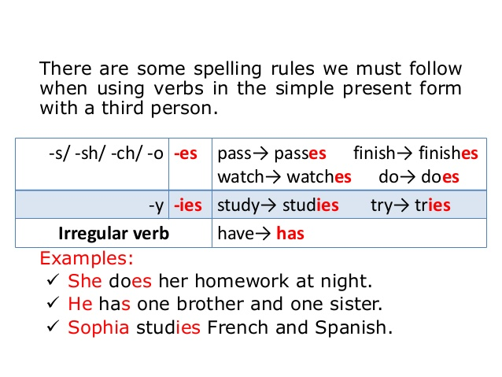
Introducing the Simple Present
Positive form
I | drink | coffee
You | drink | milk
He | drinks | beer
She | drinks | coke
It | drinks | water
We | drink | tea
You | drink | juice
They | drink | wine
-x

Slide 2
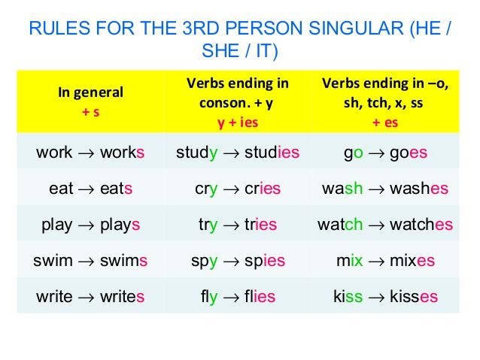
What is the 3rd person of the following:
drive
clean
fix
miss
stretch
carry
say
make
mix
finish
tell
do
connect
dress
drives
cleans
fixes
misses
stretches
carries
says
makes
mixes
finishes
tells
does
connects
dresses

Slide 3
Negative form do not = don’t
does not = doesn’t
I | don’t | drink | coffee
You | don’t | drink | milk
He | doesn’t | drink | beer
She | doesn’t | drink | coke
It | doesn’t | drink | water
We | don’t | drink | tea
You | don’t | drink | juice
They | don’t | drink | wine

Slide 4
Questions
Do | I | drink | coffee?
Do | you | drink | milk?
Does | he | drink | beer?
Does | she | drink | coke?
Does | it | drink | water?
Do | we | drink | tea?
Do | you | drink | juice?
Do | they | drink | wine?

Slide 5
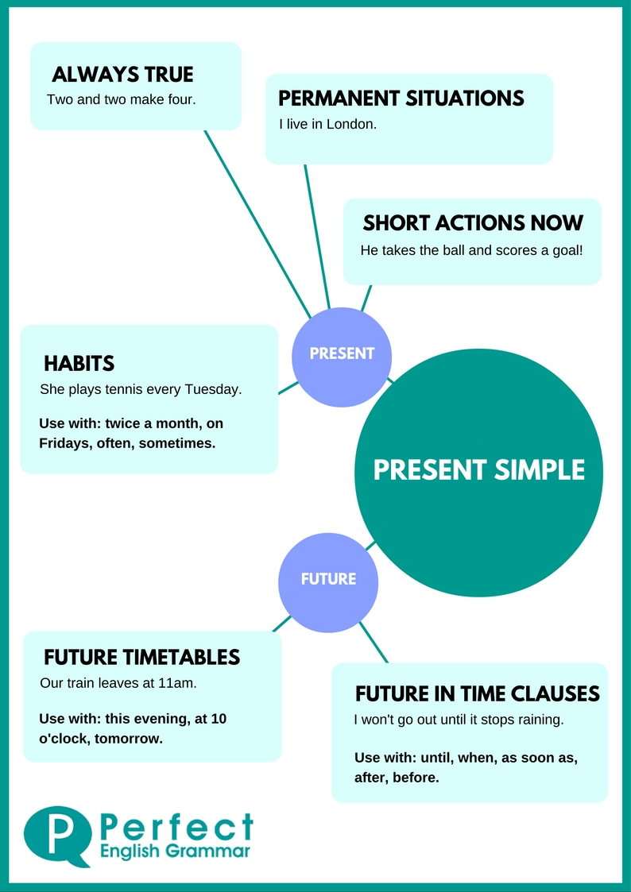
USES
Κάτι πραγματικό
Μόνιμες καταστάσεις
Σύντομες πράξεις που συμβαίνουν τώρα (πχ. Περιγραφή ποδοσφαιρικού αγώνα)
Συνήθειες
Ωρολόγιο πρόγραμμα με μελλοντική σημασία
Χρήση μέλλοντα στις δευτερεύουσες χρονικές προτάσεις

Slide 7
What about your daily routine?
How do you spend your day?
What do you do in the morning, afternoon or evening?

