Slide 1
Practising dimensions
COURCEBOOK FOR MECHANICAL ENGINEERING TECHNICIANS
Unit 2
Exercise – pages 44-45

Slide 2
Read out the dimensions of the following objects as in the example
1._______________________________________________________ ________________________________________________________2. ______________________________________________________
________________________________________________________

Slide 3
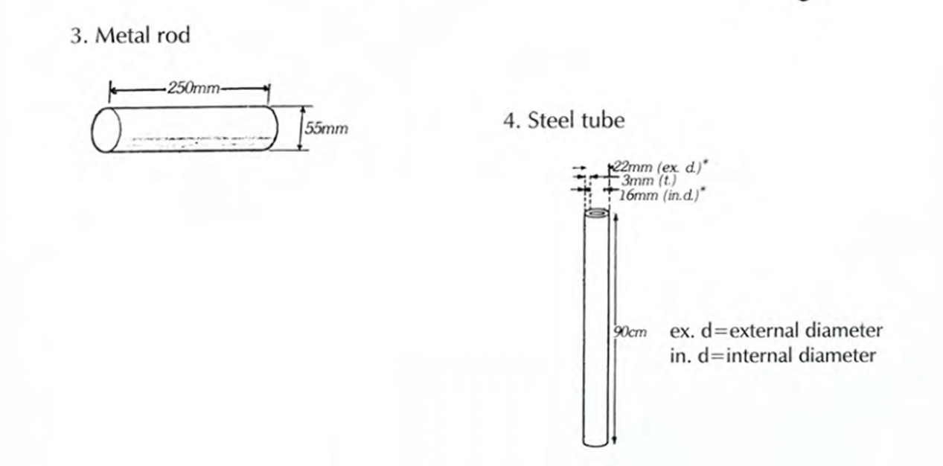
3._______________________________________________________ ________________________________________________________4. ______________________________________________________
________________________________________________________

Slide 4
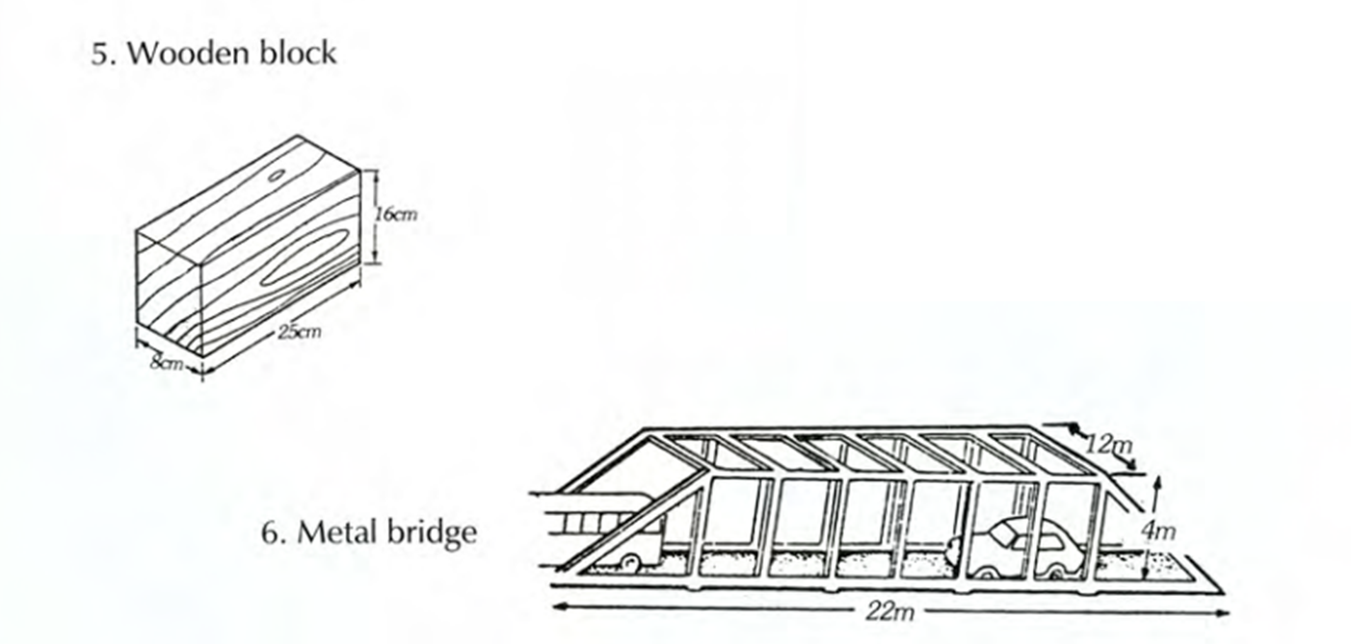
5._______________________________________________________ ________________________________________________________6. ______________________________________________________
________________________________________________________

Slide 5
7._______________________________________________________ ________________________________________________________8. ______________________________________________________
________________________________________________________

Slide 6
9._______________________________________________________ ________________________________________________________10. ______________________________________________________
________________________________________________________

Slide 7
11.______________________________________________________________________________________________________________
12. ______________________________________________________
________________________________________________________

Slide 8
13.______________________________________________________________________________________________________________14. ______________________________________________________
________________________________________________________

