Slide 1
WHAT’S INSIDE YOUR COMPUTER?
Have you ever wondered what’s under your PC case?
Instead of taking it apart we could watch the following video and find out:
https://edu.gcfglobal.org/en/computerbasics/inside-a-computer/1/

Slide 2
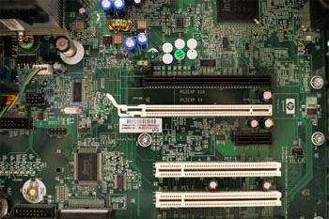
Motherboard
The motherboard is the computer's main circuit board. It's a thin plate that holds the CPU, memory, connectors for the hard drive and optical drives, expansion cards to control the video and audio, and connections to your computer's ports (such as USB ports). The motherboard connects directly or indirectly to every part of the computer.

Slide 3
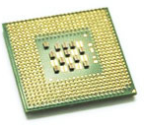
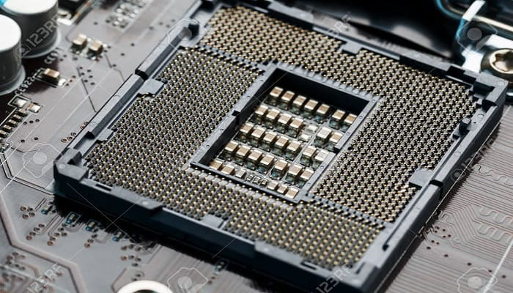
CPU/processor
The central processing unit (CPU), also called a processor, is located inside the computer case on the motherboard. It is sometimes called the brain of the computer, and its job is to carry out commands. Whenever you press a key, click the mouse, or start an application, you're sending instructions to the CPU.
The CPU is usually a two-inch ceramic square with a silicon chip located inside. The chip is usually about the size of a thumbnail. The CPU fits into the motherboard's CPU socket, which is covered by the heat sink, an object that absorbs heat from the CPU.

Slide 4
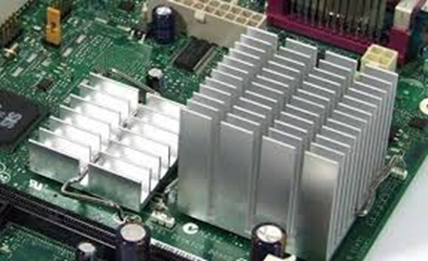
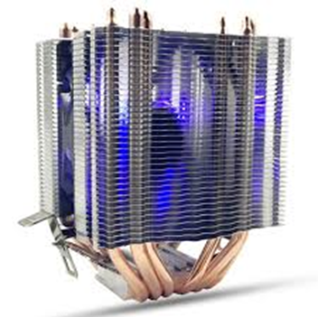
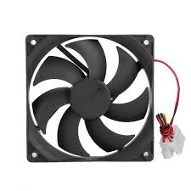
Heat sinks
Motherboards generate a lot of heat. To prevent heat damage heat sinks and fans are installed.

Slide 5
A processor's speed is measured in megahertz (MHz), or millions of instructions per second; and gigahertz (GHz), or billions of instructions per second.
A faster processor can execute instructions more quickly. However, the actual speed of the computer depends on the speed of many different components—not just the processor.
1 Mhz = 1 million Hz

Slide 6
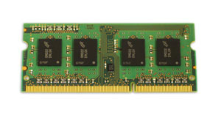
RAM (random access memory)
RAM is your system's short-term memory. Whenever your computer performs calculations, it temporarily stores the data in the RAM until it is needed.
This short-term memory disappears when the computer is turned off. If you're working on a document, spreadsheet, or other type of file, you'll need to save it to avoid losing it. When you save a file, the data is written to the hard drive, which acts as long-term storage.
RAM is measured in megabytes (MB) or gigabytes (GB). The more RAM you have, the more things your computer can do at the same time. If you don't have enough RAM, you may notice that your computer is sluggish when you have several programs open. Because of this, many people add extra RAM to their computers to improve performance.

Slide 7
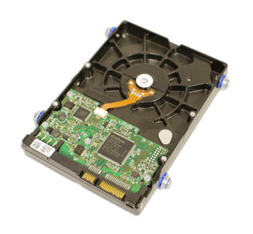
Hard drive
The hard drive is where your software, documents, and other files are stored. The hard drive is long-term storage, which means the data is still saved even if you turn the computer off or unplug it.
When you run a program or open a file, the computer copies some of the data from the hard drive onto the RAM. When you save a file, the data is copied back to the hard drive. The faster the hard drive, the faster your computer can start up and load programs.

Slide 8
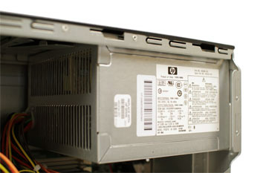
Power supply unit
The power supply unit in a computer converts the power from the wall outlet to the type of power needed by the computer. It sends power through cables to the motherboard and other components.

Slide 9
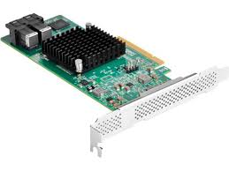
Expansion cards
Most computers have expansion slots on the motherboard that allow you to add various types of expansion cards. These are sometimes called PCI (peripheral component interconnect) cards. You may never need to add any PCI cards because most motherboards have built-in video, sound, network, and other capabilities.
However, if you want to boost the performance of your computer or update the capabilities of an older computer, you can always add one or more cards.

Slide 10
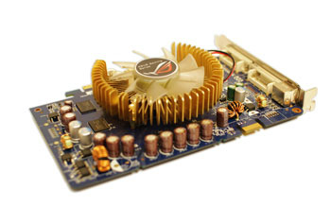
Video card
The video card is responsible for what you see on the monitor. Most computers have a GPU (graphics processing unit) built into the motherboard instead of having a separate video card. If you like playing graphics-intensive games, you can add a faster video to get better performance.

Slide 11
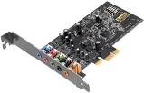
Sound card
The sound card — also called an audio card — is responsible for what you hear in the speakers or headphones. Most motherboards have integrated sound, but you can upgrade to a dedicated sound card for higher-quality sound.

Slide 12
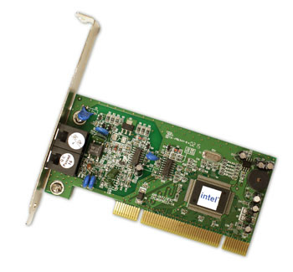
Network card
The network card allows your computer to communicate over a network and access the Internet. It can either connect with an Ethernet cable or through a wireless connection (often called Wi-Fi). Many motherboards have built-in network connections, and a network card can also be added to an expansion slot

Slide 13
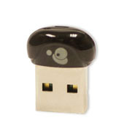
Bluetooth card (or adapter)
Bluetooth is a technology for wireless communication over short distances. It's often used in computers to communicate with wireless keyboards, mice, and printers. It's commonly built into the motherboard or included in a wireless network card. For computers that don't have Bluetooth, you can purchase a USB adapter, often called a dongle.

